Slide 1
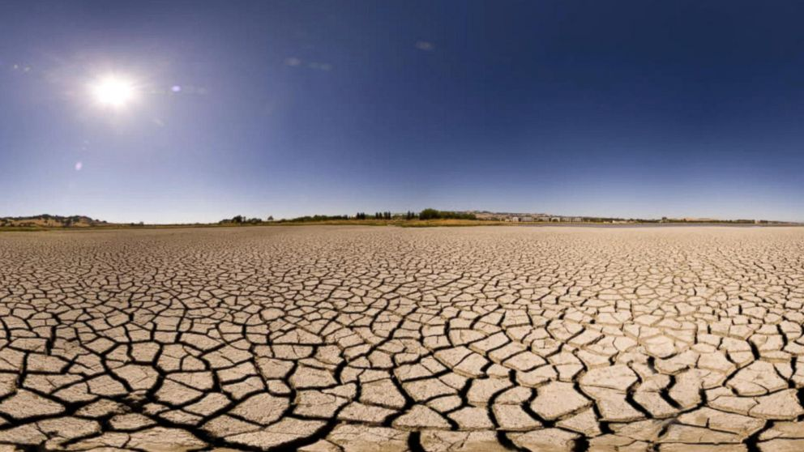
Earth Analytics Applications: Final Project Kendall M. Rosenberg Imtiaz Rangwala Gabriel Senay
https://abcnews.go.com/US/californias-wet-weather-believing-drought/story?id=45628808

Slide 2
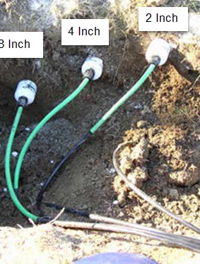
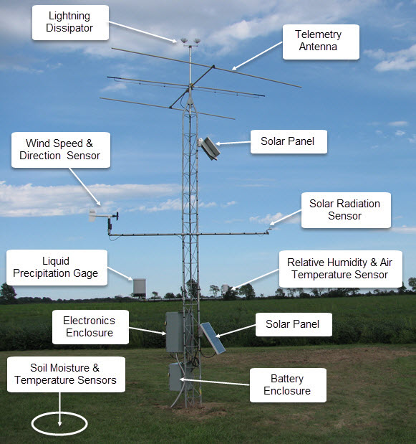
Soil Moisture: What is it and why should we care?
Soil Moisture: the volumetric amount of water contained in a layer of soil. AKA the % of space in-between soil particles filled with water.
Very important!
Not much historical data – therefore not widely incorporated

Slide 3
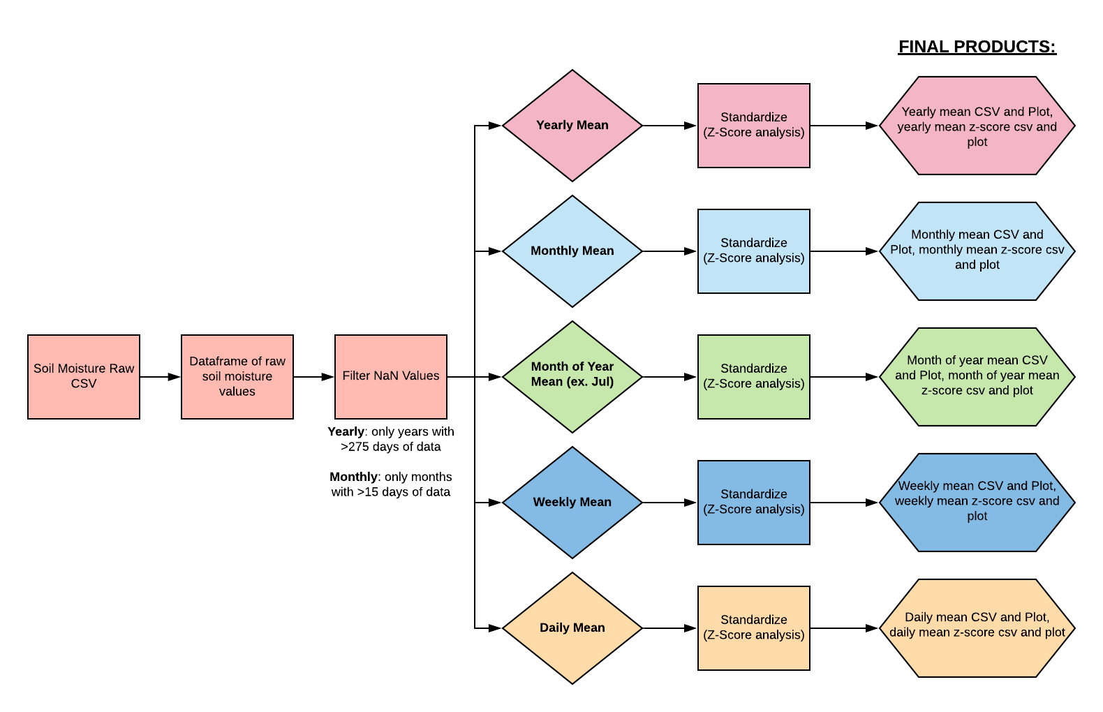
Goal of Project? Automated tool to examine soil moisture!

Slide 4
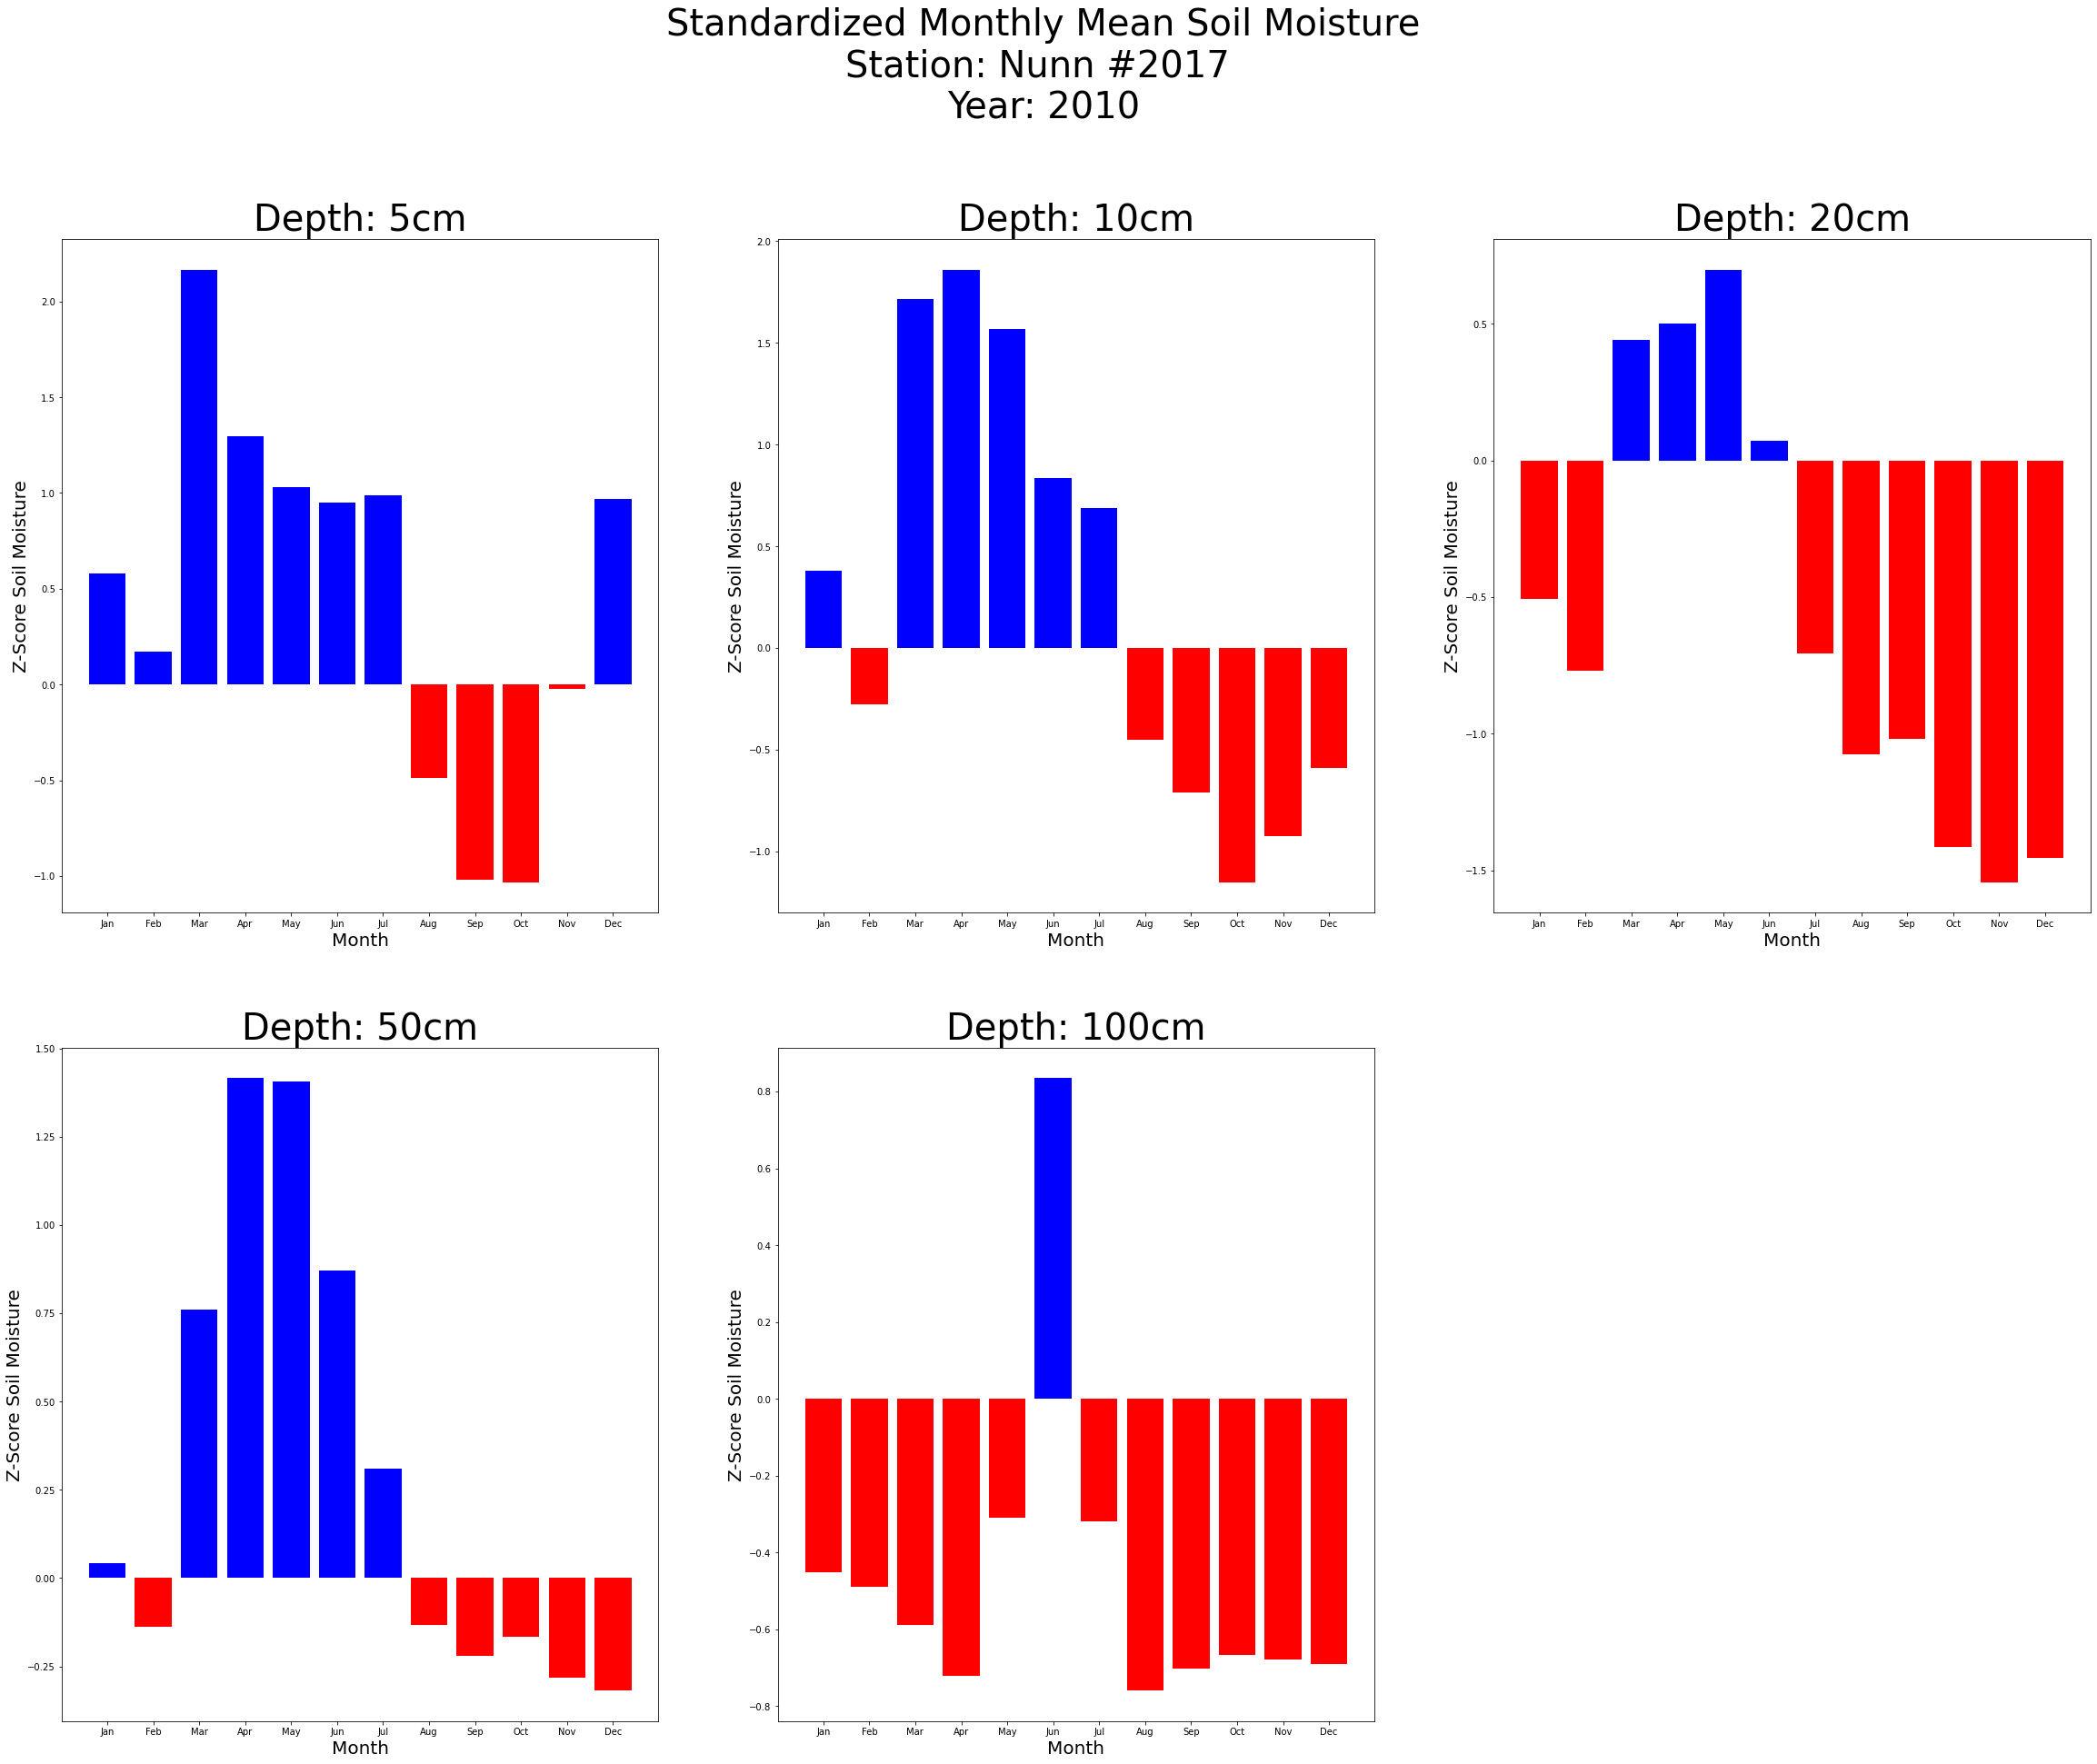
Outputs of the tool: How the months of a year deviated from the mean

Slide 5
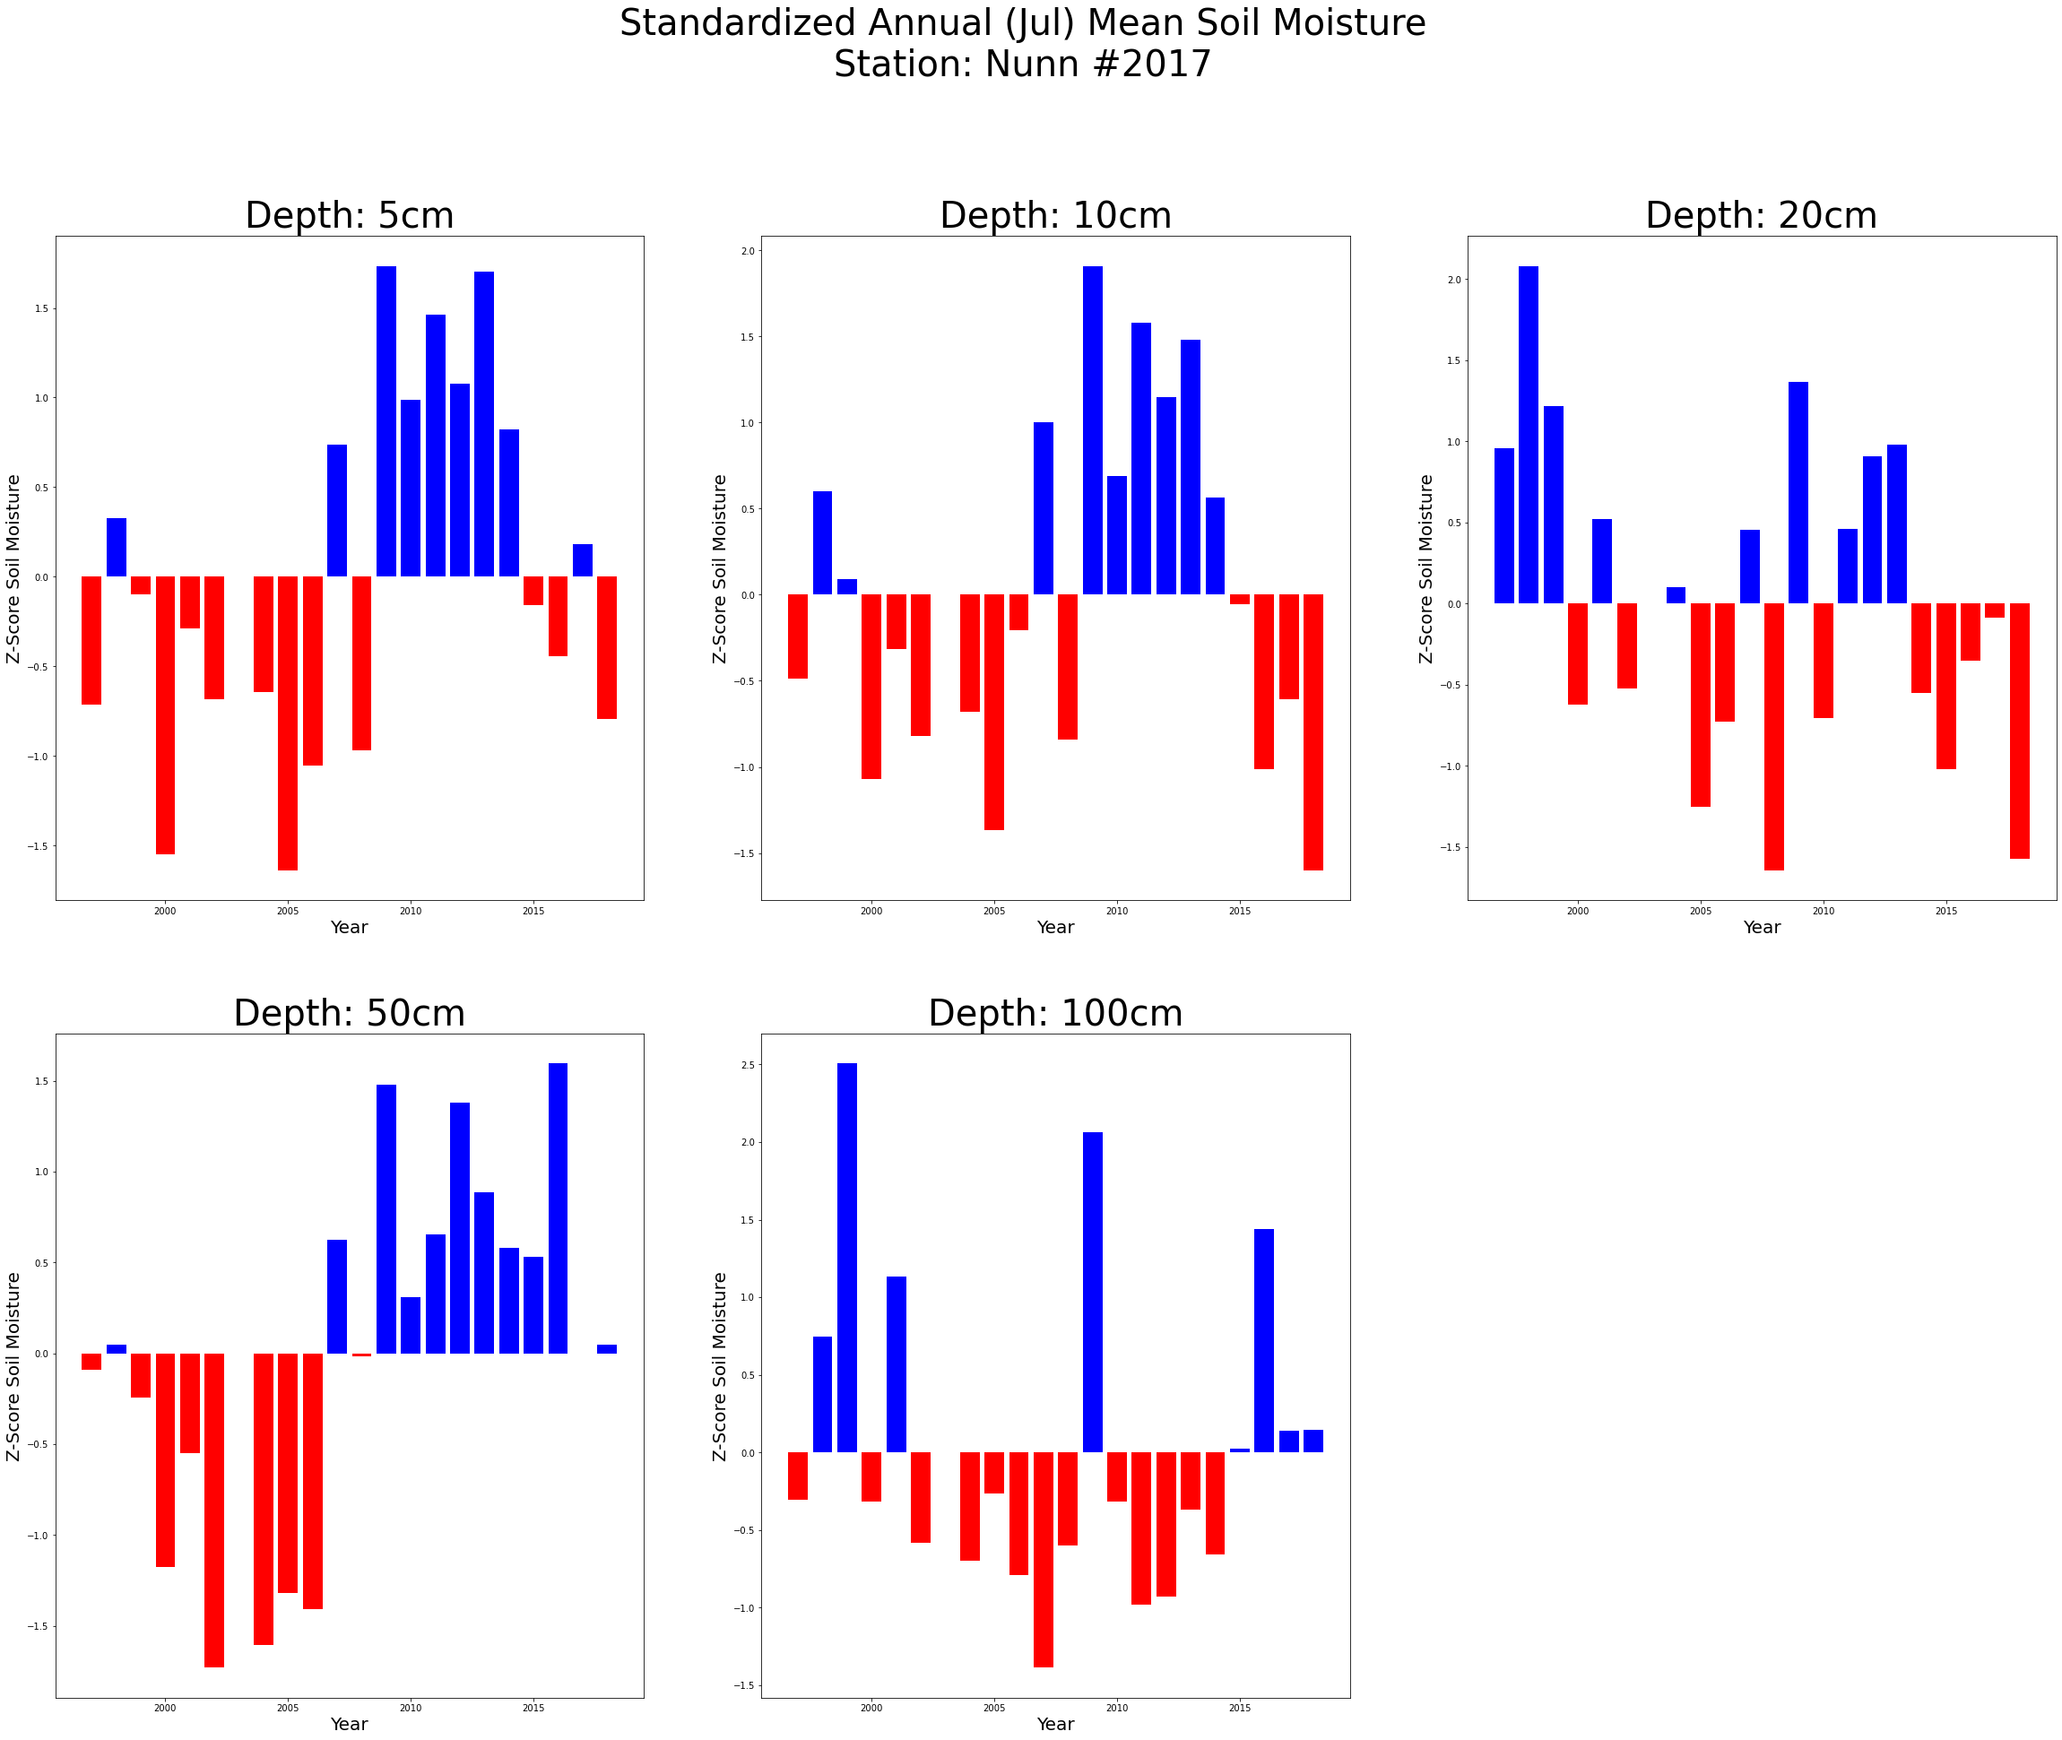
Outputs of the tool: How a certain month deviated from the mean throughout the historical record

Slide 6
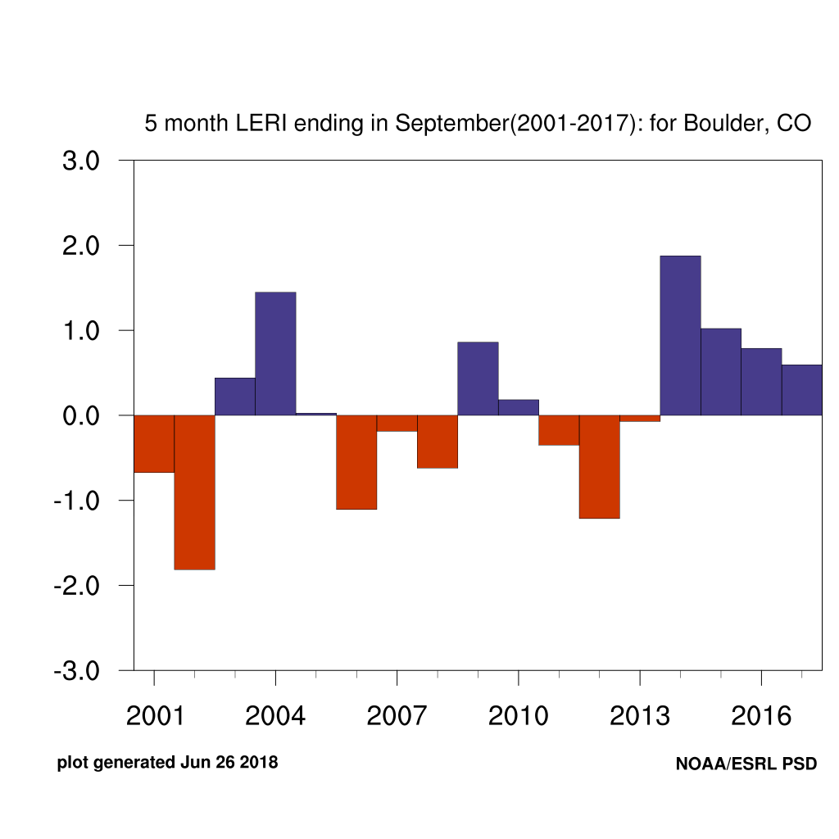
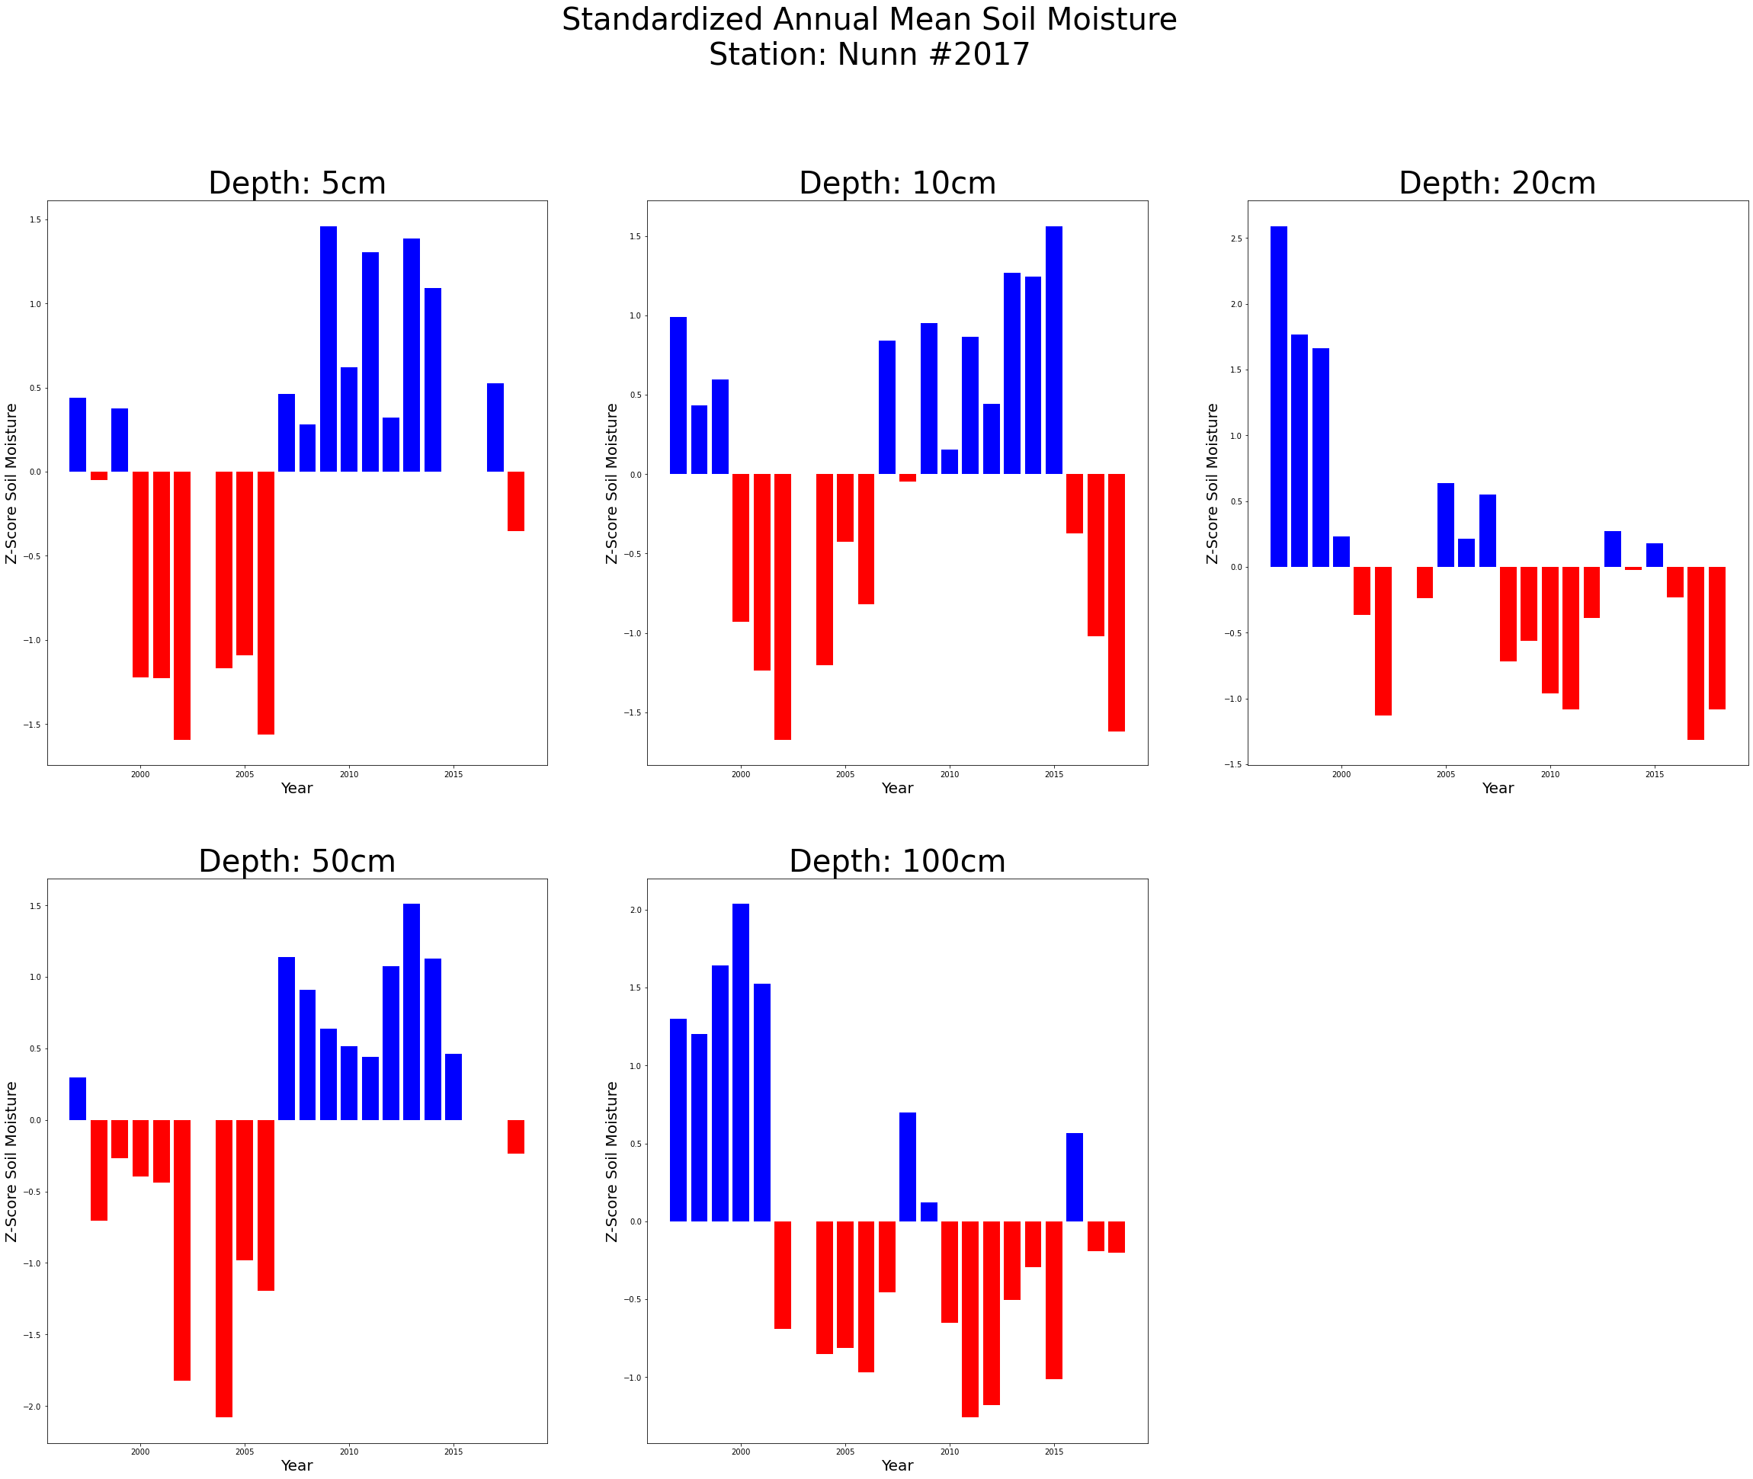
Standardize & Compare?
Temporally & Vertically by Depth

Slide 7
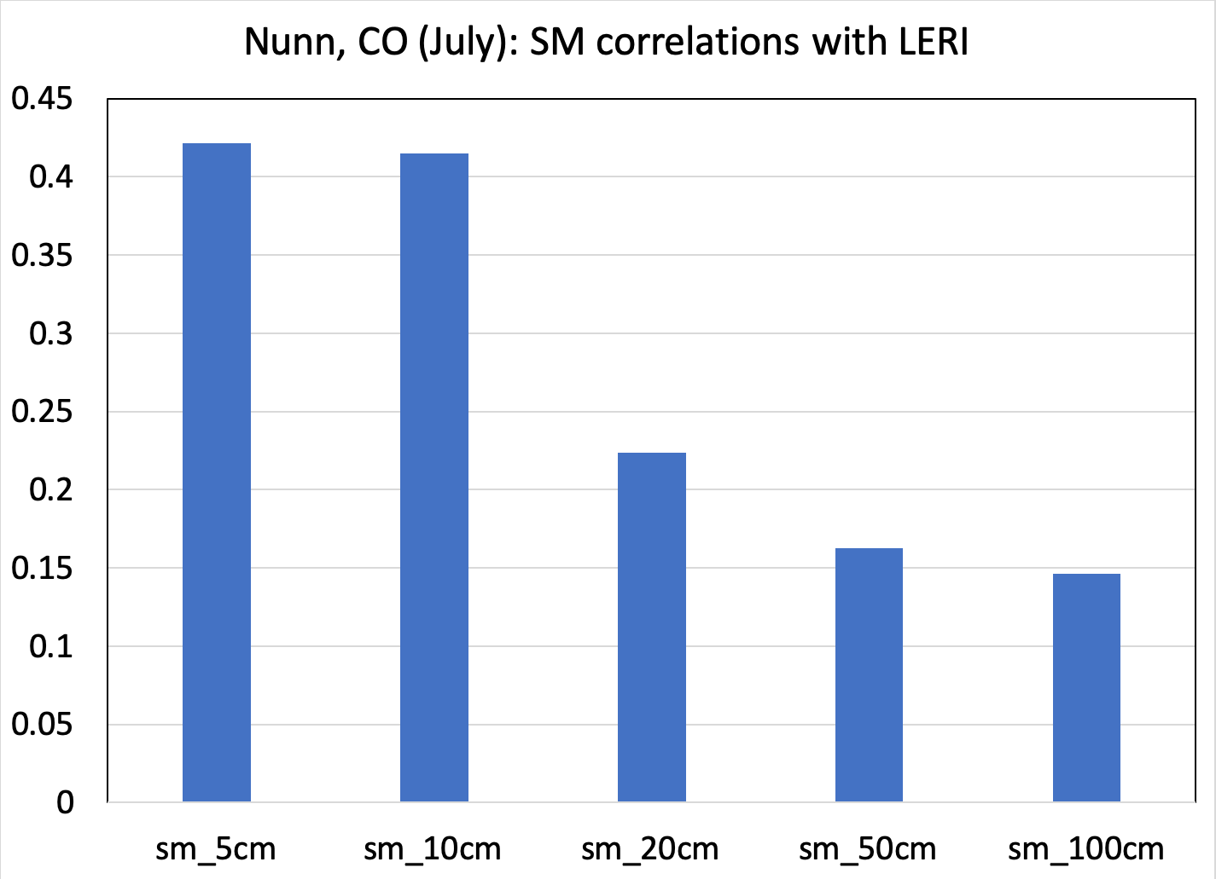
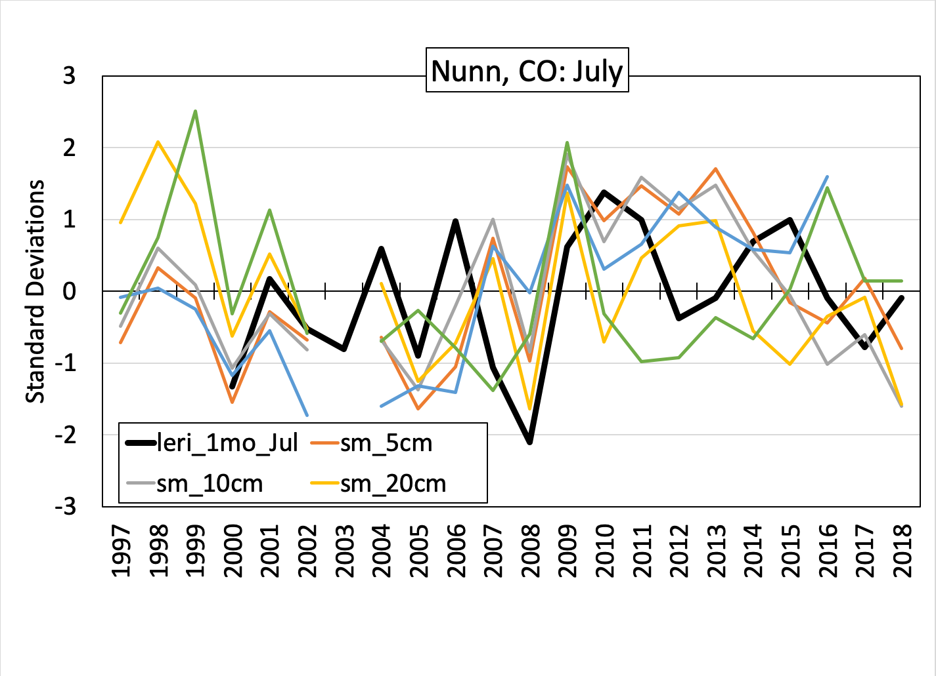
Initial Results:
Images courtesy of Imtiaz Rangwala, Ph.D.

Slide 8
Implications and Next Steps:
Useful as a readily available tool to extract and examine soil moisture!
Create a workflow in Python to examine the relationships of the standardized SM data at different depths with select drought indices such as LERI, PDSI, SPEI, EDDI as a time series analysis.
Drought index portal – University of Colorado, Boulder
Compare soil moisture trends at different depths with other natural factors to examine correlation!
Does soil moisture variation within each depth measured correlate with other natural processes?

Slide 9

Thanks for listening!
If you have any questions, feel free to shoot me a message on canvas!

