Slide 1
Arcball Interface
Flavia R. Cavalcanti

Slide 2
Definition
Goal: implementation of an algorithm for rotating an object, by using the Arcball paradigm
Input: mouse movement
Output: a matrix to rotate, in a natural way, a 3D object

Slide 3




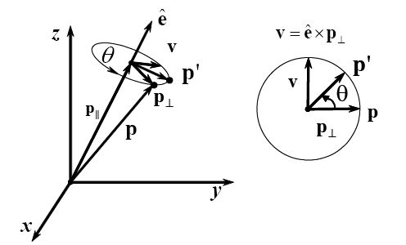




Writing Rotation About
p’ described in orthogonal base

Slide 4

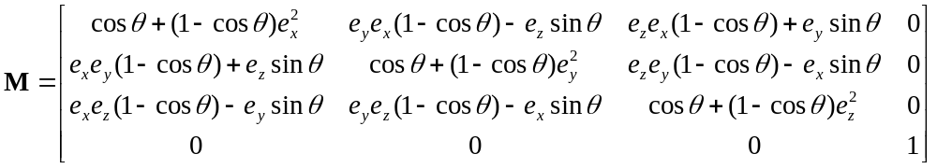
Rotation Matrix
z
Rotation about an axis.
  OpenGL - glRotatef(θ, ex, ey, ez)
Rotation matrix, after changing coordinate system from to x,y,z:
  Columns of M are given by: p’(1,0,0), p’(0,1,0), p’(0,0,1)
ê
θ
ê – axis of rotation
θ – rotation angle
y
x

Slide 5
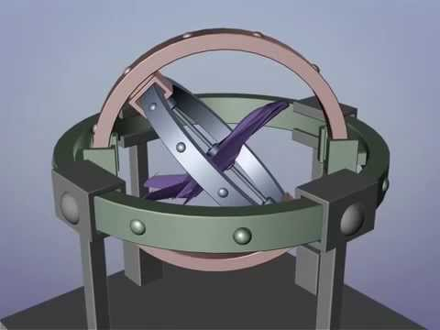
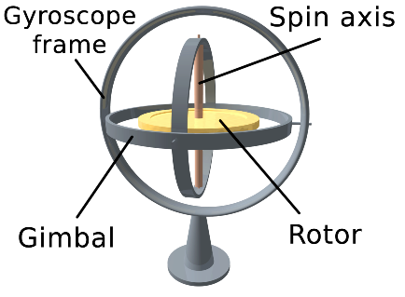
Euler Angles in Animation
Gimbal Lock
Is the loss of one degree of freedom in a 3D, 3-gimbal mechanism, which occurs when the axes of two gimbals are driven into a parallel configuration
  "locking" the system into rotation in a degenerate two-dimensional space.
  https://www.youtube.com/watch?v=zc8b2Jo7mno

Slide 6
Gimbal lock on Apollo 13
“13, Houston. We see you getting close to gimbal lock there. We'd like you to bring up all quad Cs on MAIN A, quad C-1, C-2, C-3, C-4 on MAIN A, and also bring B-3 and B-4 up on MAIN A.”
Apollo used an Inertial Mechanism Unit for navigation, same as airliners do today.
  Three gyroscopes. One points up and down, one right and left, the other fore and back. Accelerometers attached to these record accelerations in each direction.
  Given a starting point, such a system can record where you are in relation to that point at any time. Each of these gyroscopes will have a "null point“, where the gyro lines up perfectly with its gimbals. If all three enter this state at once, the platform instantly loses it knowledge of where it is. It goes into "gimbal lock".
  http://www.universetoday.com/119984/13-more-things-that-saved-apollo-13-part-9-avoiding-gimbal-lock/

Slide 7
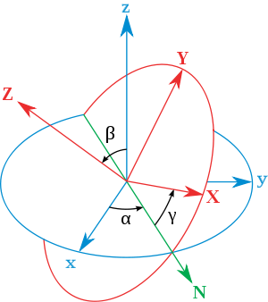
Euler Angles Between Two Reference Frames xyz to XYZ
α represents a rotation around z.
N (line of nodes) is the orientation of X after the first elemental rotation (x’).
  Β represents a rotation around x’.
The third rotation occurs about Z. Hence, Z = z″.
    γ represents a rotation around z″.
z-x’-z″ (intrinsic rotations)
  α and γ in [−π, π] and
  β in [−π/2, π/2].
  Β = 0 and plane XY coincides with plane xy -> gimbal lock.

Slide 8
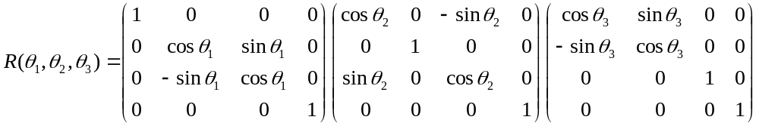
Gimbal Lock in CG
In fact, this is just an analogy (a good one?), and the problem only occurs if Euler angles are used.
  Some systems (Blender, Maya) use just three numbers, R_{x}, R_{y}, R_{z,} instead of a 4 dimensional array (quaternion) to store an orientation.
  A general rotation R is then calculated, by multiplying these three matrices (or, some say, applying three “rolls”):
  The animator uses the parameterization above to set up an arbitrary orientation.
    An x-roll, then a y-roll and finally a z-roll
    https://sundaram.wordpress.com/2013/03/08/mathematical-reason-behind-gimbal-lock-in-euler-angles/

Slide 9
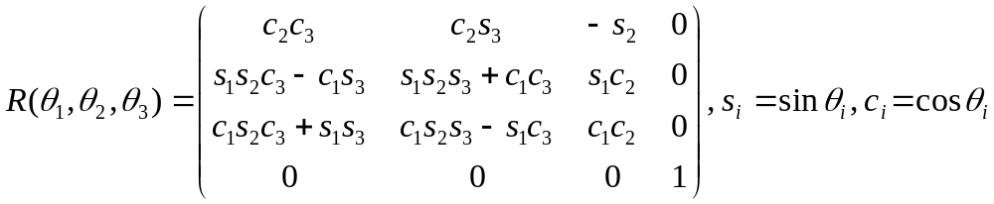
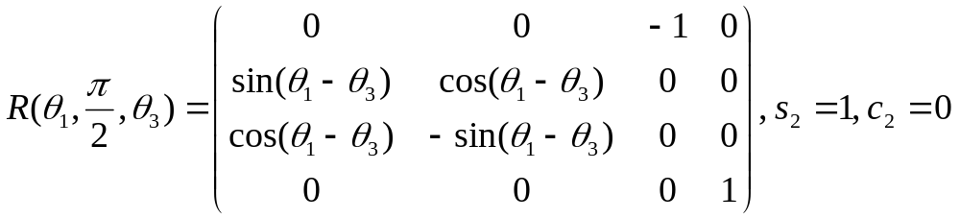


Euler Angles and Gimbal Lock
If the y-roll happens to be 90º, then the “lock” occurs:
The animator has stumbled upon a singularity in the parameterization space ( is gone).
  are associated with the same degree of freedom.
  http://en.wikipedia.org/wiki/Euler_angles

Slide 10
How to Avoid
Lock occurs because Euler angles are being changed, in a fixed order, one at a time, so axes can line up.
If all three angles are changed simultaneously, the lock does not occur
  But interpolation from one key orientation to another is not unique
Another possibility is using a “fourth gimbal”, not allowed to align, which take us to a…
Better paradigm: quaternions.

Slide 11
Sir William Rowan Hamilton
Hamilton, in 1830, tried to generalize complex numbers to R³ (a complex volume, with two imaginary axes)
  a + ib, i² = -1
He realized in 1843 that it was impossible on R³ (triples of numbers are not closed under multiplication), but not on R⁴ or R⁸
  q = a + bi + cj + dk = (a,v), i² = j² = k² = ijk =-1
  ij = k, jk = i, ki = j, kj = -i = ji = -k, ik = -j
The multiplication of two quaternions is a quaternion
  Closed under multiplication => mathematical group.
  Quaternion multiplication is not commutative! q₁.q₂ ≠ q₂.q₁

Slide 12
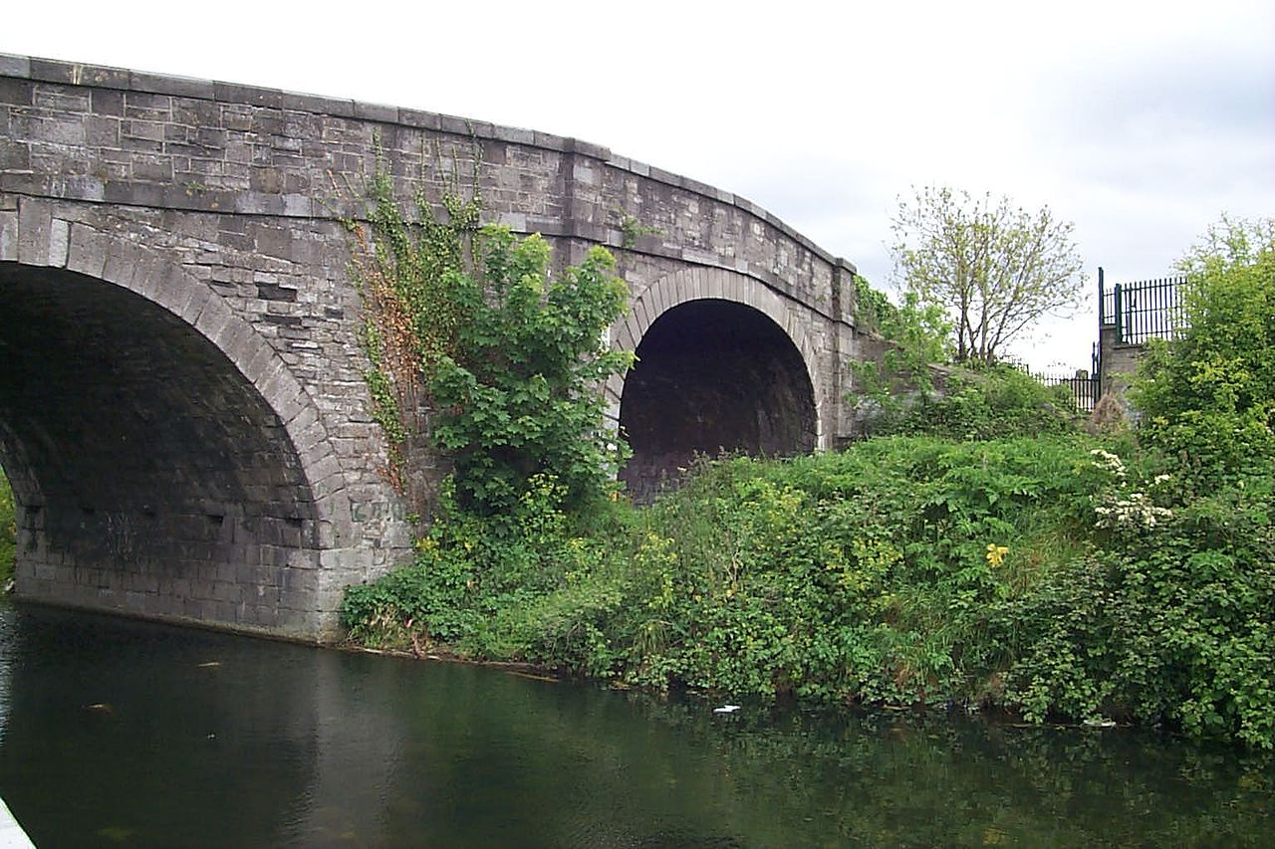
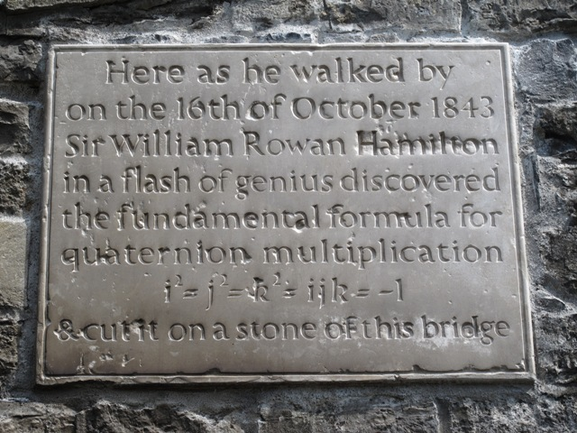
Broome Bridge in Dublin
Greatest Irish mathematician ever (?)
https://www.youtube.com/watch?v=mHVwd8gYLnI&nohtml5=False

Slide 13
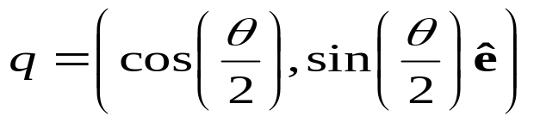
Quaternions
Complex Numbers on R⁴
  q = a + bi + cj + dk
  q = (s, v),
    s – real component and
    v – vector representing the imaginary component
Simplifies the calculation of rotations about an axis
Rotations using product of quaternions
  Rotation of a point p about an axis v
    R(p) = q p q ⁻¹
      p = (0, r ) - point represented as a pure quaternion
      q = (s, v ) - rotation (angle and axis) represented as a quaternion
ê – unit vector (rotation axis)
θ – rotation angle

Slide 14



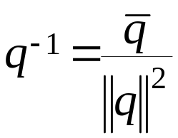

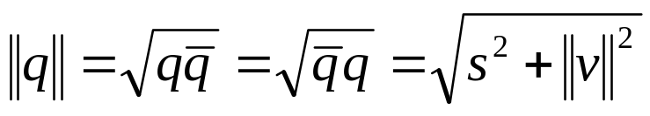

Properties of Quaternions
Multiplication and Addition
Conjugate and reciprocal:
Norm:
Rotation: take a pure quaternion p = (0, r) and a unit quaternion q=(s,v), where , and define:
  R(p) = q p q ⁻¹

Slide 15
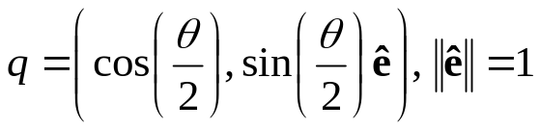
Orientations as Quaternions
This is exactly the same equation in transparency 4
  aside from a factor of 2, and p written as r
Therefore, orientations can be parameterized as:

Slide 16
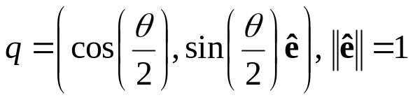
Moving In and Out Quaternion Space
Unit quaternions are closed under multiplication
  Multiplication of two unit quaternions is a unit quaternion
  Pile up rotations really nice, with no gimbal locks!
Go from a general rotation matrix to quaternion and vice versa.
Taking a unit quaternion and
performing q()q ⁻¹ is the same as applying a rotation matrix:
    double quat[4]
    double mat[4][4]
  mat2quat (double* mat, double* q)
  quat2mat (double* q, double* mat)
Code can be found in reference [2]

Slide 17
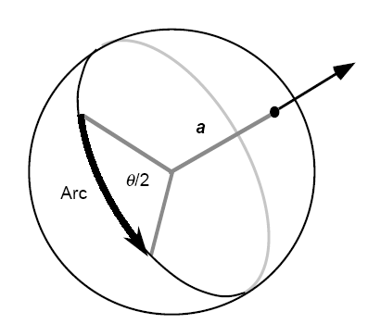
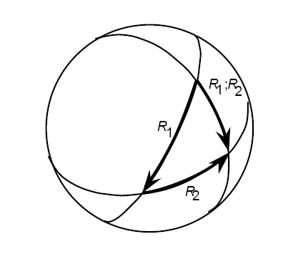
ArcBall
Definition: interface for rotating a 3D object, by using just a mouse
Arc Interpretation
a – rotation axis
θ – rotation angle
Arc Combination

Slide 18
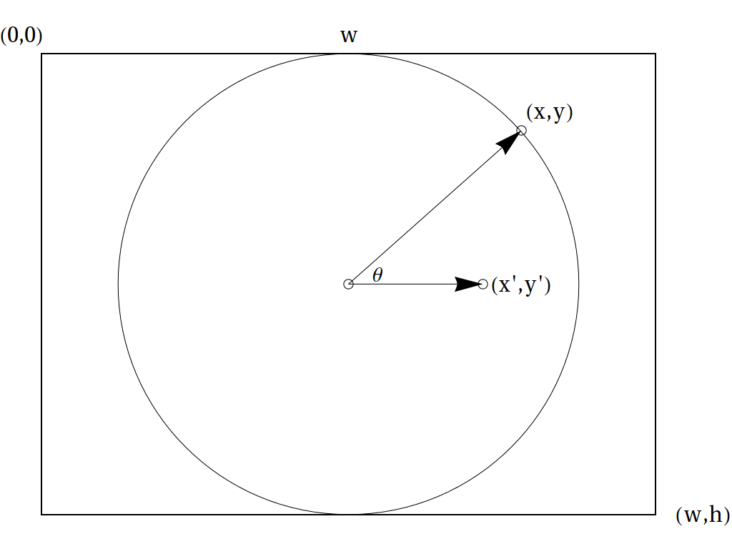
Sphere As a Virtual Trackball
  Consider screen coordinates from (0,0) to (w,h).
  Mouse coordinates (x,y) are used to sample a function, z(x,y):
  Points inside the circle are mapped onto a sphere, while points outside are mapped onto plane z=0.

Slide 19
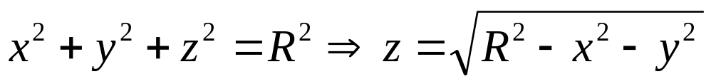
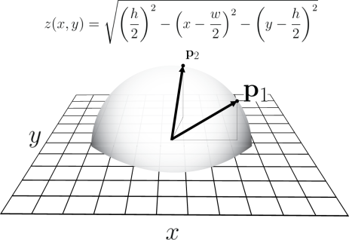
Hemisphere Inscribed in Screen Area
Circle centered at the origin:
Circle centered at (w/2, h/2):

Slide 20
Code [1]
radius = MIN(w/2,h/2)
x = (x1 - w/2)/radius;
y = (h/2 - y1)/radius;
r = x*x + y*y;
if (r > 1.0) {
    s = 1.0/sqrt(r);
  x *= s;
  y *= s;
  z = 0.0;
  } else
  z = sqrt(1.0 – r);

Slide 21




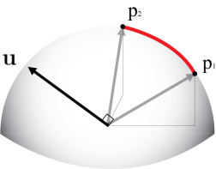
Angle-axis Transformation
Mouse dragged from to
Rotation angle:
Rotation axis:

Slide 22
Rotations as Two Reflections
Practical implementations use two reflections instead of a rotation
  Product of two reflections in intersecting planes is equivalent to a rotation.
  The axis of this rotation is the line of intersection of the planes, while the angle of rotation is twice the angle between the two planes.

Slide 23
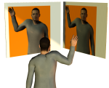
Example
Put two mirrors at 90° to each other and put an object in front of them.
The reflection on the second mirror will appear to have been rotated by 180° relative to the original object.
The rotation angle 180° is twice the angle between mirrors, which is 90° in this example.
https://sureshemre.wordpress.com/2014/07/19/a-rotation-equals-two-reflections/

Slide 24
simple-rotator.js
setView = function( viewDirVec, viewUpVec, viewDistance )
  Create view matrix using (u_{x,} u_{y,} u_{z}) as column vectors
    viewDirectionVector --> u_{z}
    viewUpVector x u_{z} --> u_{x}
    u_{z} x u_{x} --> u_{y}
getViewMatrix = function()
  Return a rotated view matrix (after dragging the mouse)
function toRay(x,y)
  Create a ray from the center of the screen to the point on the sphere, which projects onto (x,y)
  Sphere origin is the center of screen, and radius is the minimum (width, height)

Slide 25
simple-rotator.js
function doMouseDrag(evt)
  Create two rays: ray₁,ray₂
  map them to world coordinates, by using the view matrix inverse (transpose)
  applyTransvection(ray₁,ray₂);
function applyTransvection(e₁, e₂)
  Rotate view matrix (u_{x,} u_{y,} u_{z}) around (e₁ x e₂), by applying two reflections on each vector.
http://math.hws.edu/eck/cs424/notes2013/webgl/skybox-and-reflection/simple-rotator.js

Slide 26
Conclusions
Euler angles make objects move unexpectedly (skew strangely) between key frames
  Gimbal lock can occur in any order of rotation
  Best order for camera in Maya is:
    y (yaw) -> x (pitch) -> z (roll)
    (only locks looking straight up or down)
Quaternions are the appropriate paradigm for rotation interpolation, and they avoid gimbal lock
One can add, multiply and divide two quaternions, but multiplication does not commute (p.q ≠ q.p).
Multiplication of unit quaternions correspond to matrix multiplication (rotation composition)

Slide 27
Conclusions
Arcball does not require quaternions to be implemented
  Very intuitive and only requires a mouse
Replaces all those sliders, for changing angles, for a click and pull.
Qt timer class provides a tick event that can be used to re-apply a quaternion, on and on, to produce an animation.
  Or requestAnimationFrame(render) in html5/javascript.

Slide 28
I Am Done for Today
Thank you all!!

Slide 29
References
[1] ARCBALL: A User Interface for Specifying Three-Dimensional Orientation Using a Mouse - Ken Shoemake
[2] Advanced Animation and Rendering Techniques – Alan Watt
[3] https://braintrekking.wordpress.com/2012/08/21/tutorial-of-arcball-without-quaternions/

