Slide 1

Orientation & Quaternions
CSE169: Computer Animation
Instructor: Steve Rotenberg
UCSD, Winter 2005

Slide 2
Orientation

Slide 3
Orientation
We will define ‘orientation’ to mean an object’s instantaneous rotational configuration
Think of it as the rotational equivalent of position

Slide 4
Representing Positions
Cartesian coordinates (x,y,z) are an easy and natural means of representing a position in 3D space
There are many other alternatives such as polar notation (r,θ,φ) and you can invent others if you want to

Slide 5
Representing Orientations
Is there a simple means of representing a 3D orientation? (analogous to Cartesian coordinates?)
Not really.
There are several popular options though:
  Euler angles
  Rotation vectors (axis/angle)
  3x3 matrices
  Quaternions
  and more…

Slide 6
Euler’s Theorem
Euler’s Theorem: Any two independent orthonormal coordinate frames can be related by a sequence of rotations (not more than three) about coordinate axes, where no two successive rotations may be about the same axis.
Not to be confused with Euler angles, Euler integration, Newton-Euler dynamics, inviscid Euler equations, Euler characteristic…
Leonard Euler (1707-1783)

Slide 7
Euler Angles
This means that we can represent an orientation with 3 numbers
A sequence of rotations around principle axes is called an Euler Angle Sequence
Assuming we limit ourselves to 3 rotations without successive rotations about the same axis, we could use any of the following 12 sequences:
XYZ XZY XYX XZX
YXZ YZX YXY YZY
ZXY ZYX ZXZ ZYZ

Slide 8
Euler Angles
This gives us 12 redundant ways to store an orientation using Euler angles
Different industries use different conventions for handling Euler angles (or no conventions)

Slide 9
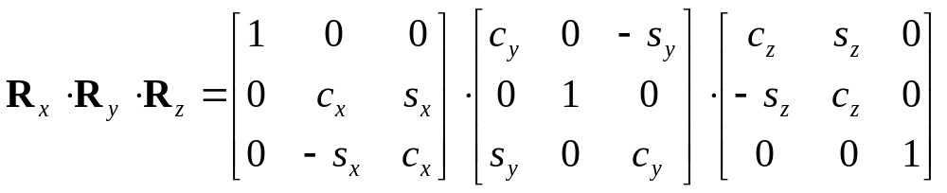
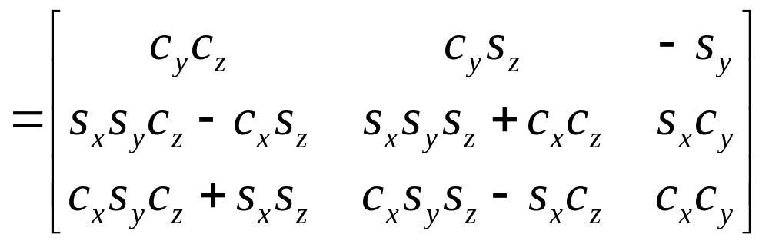
Euler Angles to Matrix Conversion
To build a matrix from a set of Euler angles, we just multiply a sequence of rotation matrices together:

Slide 10
Euler Angle Order
As matrix multiplication is not commutative, the order of operations is important
Rotations are assumed to be relative to fixed world axes, rather than local to the object
One can think of them as being local to the object if the sequence order is reversed

Slide 11
Using Euler Angles
To use Euler angles, one must choose which of the 12 representations they want
There may be some practical differences between them and the best sequence may depend on what exactly you are trying to accomplish

Slide 12
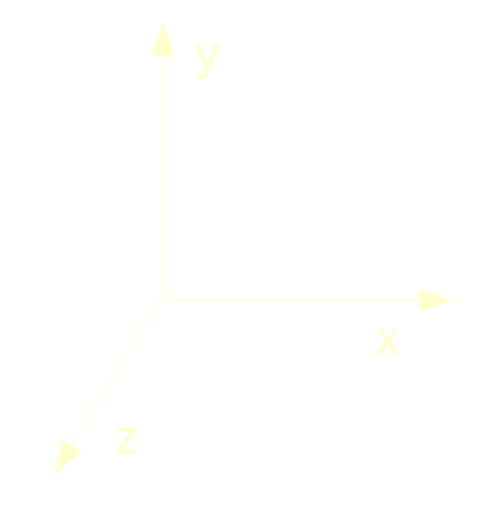
Vehicle Orientation
Generally, for vehicles, it is most convenient to rotate in roll (z), pitch (x), and then yaw (y)
In situations where there
is a definite ground plane,
Euler angles can actually
be an intuitive
representation
front of vehicle

Slide 13
Gimbal Lock
One potential problem that they can suffer from is ‘gimbal lock’
This results when two axes effectively line up, resulting in a temporary loss of a degree of freedom
This is related to the singularities in longitude that you get at the north and south poles

Slide 14
Interpolating Euler Angles
One can simply interpolate between the three values independently
This will result in the interpolation following a different path depending on which of the 12 schemes you choose
This may or may not be a problem, depending on your situation
Interpolating near the ‘poles’ can be problematic
Note: when interpolating angles, remember to check for crossing the +180/-180 degree boundaries

Slide 15
Euler Angles
Euler angles are used in a lot of applications, but they tend to require some rather arbitrary decisions
They also do not interpolate in a consistent way (but this isn’t always bad)
They can suffer from Gimbal lock and related problems
There is no simple way to concatenate rotations
Conversion to/from a matrix requires several trigonometry operations
They are compact (requiring only 3 numbers)

Slide 16
Rotation Vectors and Axis/Angle
Euler’s Theorem also shows that any two orientations can be related by a single rotation about some axis (not necessarily a principle axis)
This means that we can represent an arbitrary orientation as a rotation about some unit axis by some angle (4 numbers) (Axis/Angle form)
Alternately, we can scale the axis by the angle and compact it down to a single 3D vector (Rotation vector)

Slide 17
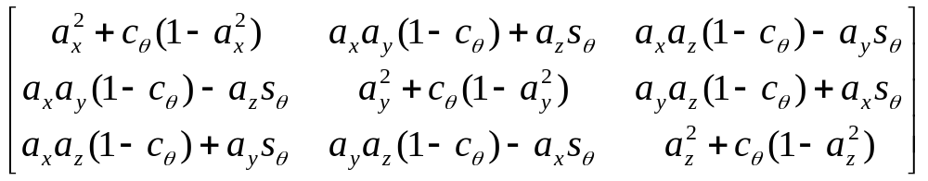
Axis/Angle to Matrix
To generate a matrix as a rotation θ around an arbitrary unit axis a:

Slide 18
Rotation Vectors
To convert a scaled rotation vector to a matrix, one would have to extract the magnitude out of it and then rotate around the normalized axis
Normally, rotation vector format is more useful for representing angular velocities and angular accelerations, rather than angular position (orientation)

Slide 19
Axis/Angle Representation
Storing an orientation as an axis and an angle uses 4 numbers, but Euler’s theorem says that we only need 3 numbers to represent an orientation
Mathematically, this means that we are using 4 degrees of freedom to represent a 3 degrees of freedom value
This implies that there is possibly extra or redundant information in the axis/angle format
The redundancy manifests itself in the magnitude of the axis vector. The magnitude carries no information, and so it is redundant. To remove the redundancy, we choose to normalize the axis, thus constraining the extra degree of freedom

Slide 20
Matrix Representation
We can use a 3x3 matrix to represent an orientation as well
This means we now have 9 numbers instead of 3, and therefore, we have 6 extra degrees of freedom
NOTE: We don’t use 4x4 matrices here, as those are mainly useful because they give us the ability to combine translations. We will not be concerned with translation today, so we will just think of 3x3 matrices.

Slide 21
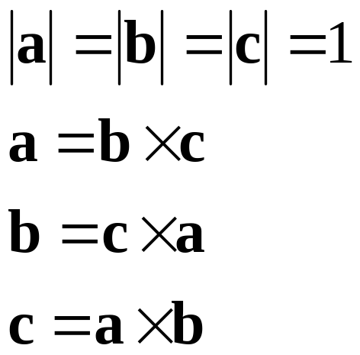
Matrix Representation
Those extra 6 DOFs manifest themselves as 3 scales (x, y, and z) and 3 shears (xy, xz, and yz)
If we assume the matrix represents a rigid transform (orthonormal), then we can constrain the extra 6 DOFs

Slide 22
Matrix Representation
Matrices are usually the most computationally efficient way to apply rotations to geometric data, and so most orientation representations ultimately need to be converted into a matrix in order to do anything useful (transform verts…)
Why then, shouldn’t we just always use matrices?
  Numerical issues
  Storage issues
  User interaction issues
  Interpolation issues

Slide 23
Quaternions

Slide 24
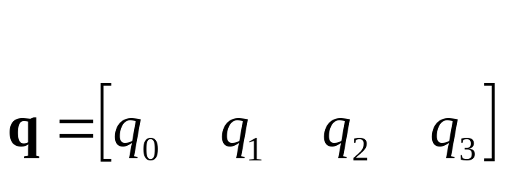
Quaternions
Quaternions are an interesting mathematical concept with a deep relationship with the foundations of algebra and number theory
Invented by W.R.Hamilton in 1843
In practice, they are most useful to us as a means of representing orientations
A quaternion has 4 components

Slide 25
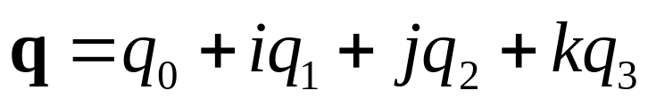
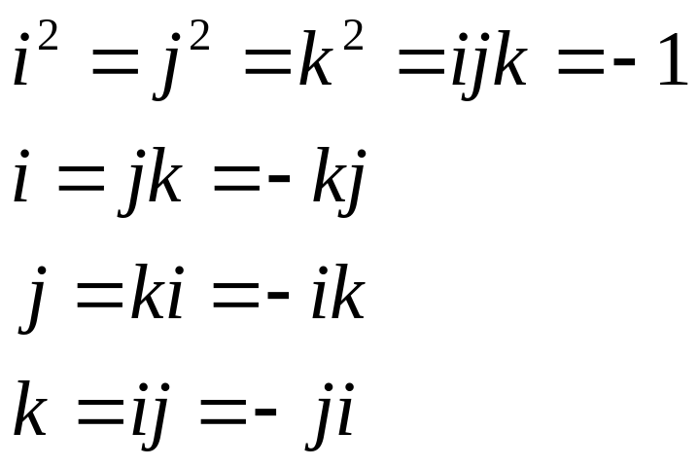
Quaternions (Imaginary Space)
Quaternions are actually an extension to complex numbers
Of the 4 components, one is a ‘real’ scalar number, and the other 3 form a vector in imaginary ijk space!

Slide 26
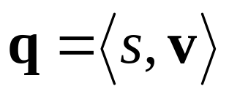
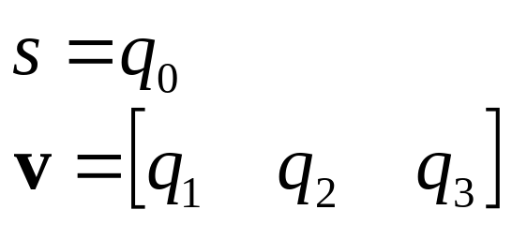
Quaternions (Scalar/Vector)
Sometimes, they are written as the combination of a scalar value s and a vector value v
where

Slide 27
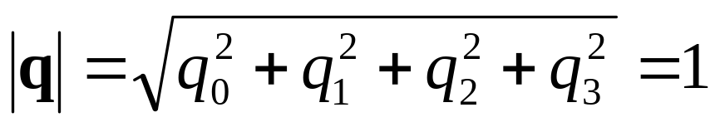
Unit Quaternions
For convenience, we will use only unit length quaternions, as they will be sufficient for our purposes and make things a little easier
These correspond to the set of vectors that form the ‘surface’ of a 4D hypersphere of radius 1
The ‘surface’ is actually a 3D volume in 4D space, but it can sometimes be visualized as an extension to the concept of a 2D surface on a 3D sphere

Slide 28
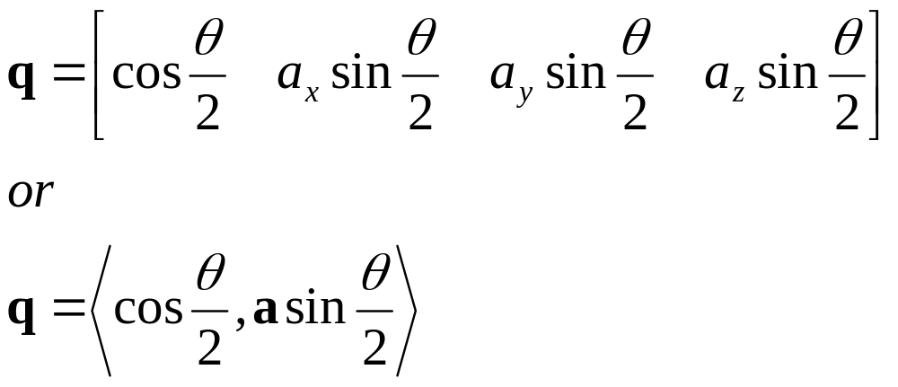
Quaternions as Rotations
A quaternion can represent a rotation by an angle θ around a unit axis a:
If a is unit length, then q will be also

Slide 29
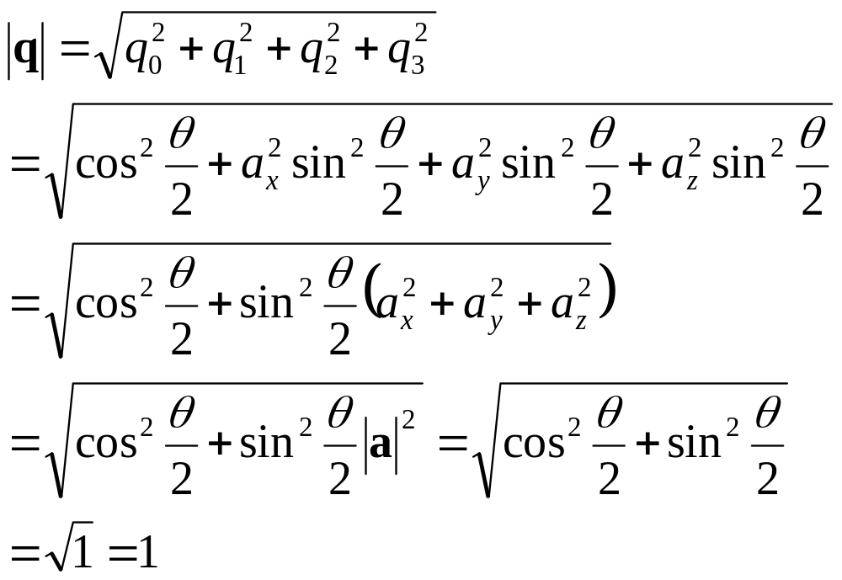
Quaternions as Rotations

Slide 30
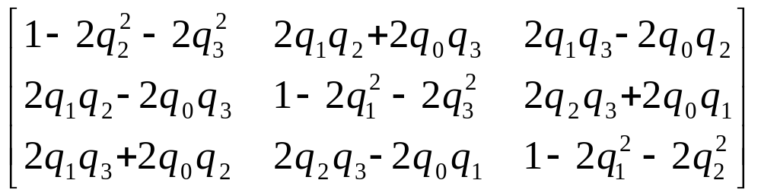
Quaternion to Matrix
To convert a quaternion to a rotation matrix:

Slide 31
Matrix to Quaternion
Matrix to quaternion is not too bad, I just don’t have room for it here
It involves a few ‘if’ statements, a square root, three divisions, and some other stuff
See Sam Buss’s book (p.305) for the algorithm

Slide 32
Spheres
Think of a person standing on the surface of a big sphere (like a planet)
From the person’s point of view, they can move in along two orthogonal axes (front/back) and (left/right)
There is no perception of any fixed poles or longitude/latitude, because no matter which direction they face, they always have two orthogonal ways to go
From their point of view, they might as well be moving on a infinite 2D plane, however if they go too far in one direction, they will come back to where they started!

Slide 33
Hyperspheres
Now extend this concept to moving in the hypersphere of unit quaternions
The person now has three orthogonal directions to go
No matter how they are oriented in this space, they can always go some combination of forward/backward, left/right and up/down
If they go too far in any one direction, they will come back to where they started

Slide 34
Hyperspheres
Now consider that a person’s location on this hypersphere represents an orientation
Any incremental movement along one of the orthogonal axes in curved space corresponds to an incremental rotation along an axis in real space (distances along the hypersphere correspond to angles in 3D space)
Moving in some arbitrary direction corresponds to rotating around some arbitrary axis
If you move too far in one direction, you come back to where you started (corresponding to rotating 360 degrees around any one axis)

Slide 35
Hyperspheres
A distance of x along the surface of the hypersphere corresponds to a rotation of angle 2x radians
This means that moving along a 90 degree arc on the hypersphere corresponds to rotating an object by 180 degrees
Traveling 180 degrees corresponds to a 360 degree rotation, thus getting you back to where you started
This implies that q and -q correspond to the same orientation

Slide 36
Hyperspheres
Consider what would happen if this was not the case, and if 180 degrees along the hypersphere corresponded to a 180 degree rotation
This would mean that there is exactly one orientation that is 180 opposite to a reference orientation
In reality, there is a continuum of possible orientations that are 180 away from a reference
They can be found on the equator relative to any point on the hypersphere

Slide 37
Hyperspheres
Also consider what happens if you rotate a book 180 around x, then 180 around y, and then 180 around z
You end up back where you started
This corresponds to traveling along a triangle on the hypersphere where each edge is a 90 degree arc, orthogonal to each other edge

Slide 38
Quaternion Dot Products
The dot product of two quaternions works in the same way as the dot product of two vectors:
The angle between two quaternions in 4D space is half the angle one would need to rotate from one orientation to the other in 3D space

Slide 39
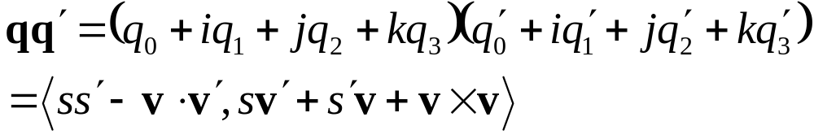
Quaternion Multiplication
We can perform multiplication on quaternions if we expand them into their complex number form
If q represents a rotation and q’ represents a rotation, then qq’ represents q rotated by q’
This follows very similar rules as matrix multiplication (I.e., non-commutative)

Slide 40
Quaternion Multiplication
Note that two unit quaternions multiplied together will result in another unit quaternion
This corresponds to the same property of complex numbers
Remember that multiplication by complex numbers can be thought of as a rotation in the complex plane
Quaternions extend the planar rotations of complex numbers to 3D rotations in space

Slide 41
Quaternion Joints
One can create a skeleton using quaternion joints
One possibility is to simply allow a quaternion joint type and provide a local matrix function that takes a quaternion
Another possibility is to also compute the world matrices as quaternion multiplications. This involves a little less math than matrices, but may not prove to be significantly faster. Also, one would still have to handle the joint offsets with matrix math

Slide 42
Quaternions in the Pose Vector
Using quaternions in the skeleton adds some complications, as they can’t simply be treated as 4 independent DOFs through the rig
The reason is that the 4 numbers are not independent, and so an animation system would have to handle them specifically as a quaternion
To deal with this, one might have to extend the concept of the pose vector as containing an array of scalars and an array of quaternions
When higher level animation code blends and manipulates poses, it will have to treat quaternions specially

Slide 43
Quaternion Interpolation

Slide 44
Linear Interpolation
If we want to do a linear interpolation between two points a and b in normal space
Lerp(t,a,b) = (1-t)a + (t)b
where t ranges from 0 to 1
Note that the Lerp operation can be thought of as a weighted average (convex)
We could also write it in it’s additive blend form:
Lerp(t,a,b) = a + t(b-a)

Slide 45
Spherical Linear Interpolation
If we want to interpolate between two points on a sphere (or hypersphere), we don’t just want to Lerp between them
Instead, we will travel across the surface of the sphere by following a ‘great arc’

Slide 46
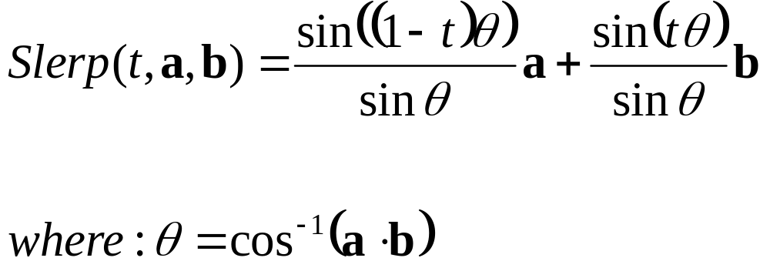
Spherical Linear Interpolation
We define the spherical linear interpolation of two unit vectors in N dimensional space as:

Slide 47
Quaternion Interpolation
Remember that there are two redundant vectors in quaternion space for every unique orientation in 3D space
What is the difference between:
Slerp(t,a,b) and Slerp(t,-a,b) ?
One of these will travel less than 90 degrees while the other will travel more than 90 degrees across the sphere
This corresponds to rotating the ‘short way’ or the ‘long way’
Usually, we want to take the short way, so we negate one of them if their dot product is < 0

Slide 48
Bezier Curves in 2D & 3D Space
Bezier curves can be thought of as a higher order extension of linear interpolation
p₁
p₁
p₂
p₃
p₁
p₀
p₀
p₀
p₂

Slide 49
de Castlejau Algorithm
p₁
Find the point x on the curve as a function of parameter t:
p₀
p₂
p₃

Slide 50
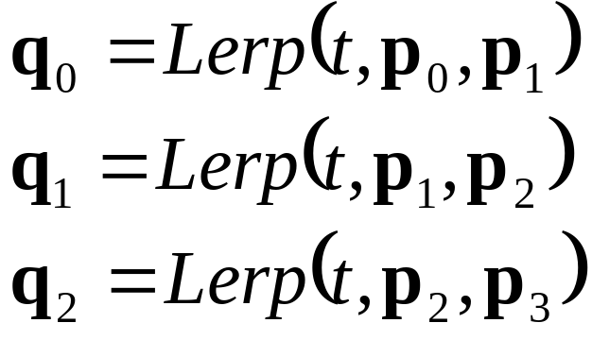
de Castlejau Algorithm
p₁
q₁
q₀
p₀
p₂
q₂
p₃

Slide 51
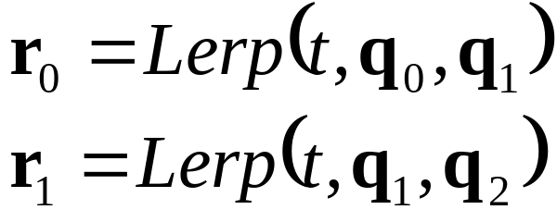
de Castlejau Algorithm
q₁
r₀
q₀
r₁
q₂

Slide 52
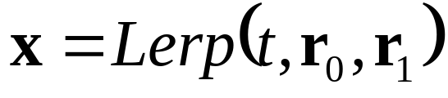
de Castlejau Algorithm
r₀
•
x
r₁

Slide 53
de Castlejau Algorithm
•
x

Slide 54
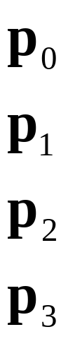
de Castlejau Algorithm

Slide 55
Bezier Curves in Quaternion Space
We can construct Bezier curves on the 4D hypersphere by following the exact same procedure using Slerp instead of Lerp
It’s a good idea to flip (negate) the input quaternions as necessary in order to make it go the ‘short way’
There are other, more sophisticated curve interpolation algorithms that can be applied to a hypersphere
  Interpolate several key poses
  Additional control over angular velocity, angular acceleration, smoothness…

Slide 56
Quaternion Summary
Quaternions are 4D vectors that can represent 3D rigid body orientations
We choose to force them to be unit length
Key animation functions:
  Quaternion-to-matrix / matrix-to-quaternion
  Quaternion multiplication: faster than matrix multiplication
  Slerp: interpolate between arbitrary orientations
  Spherical curves: de Castlejau algorithm for cubic Bezier curves on the hypersphere

Slide 57
Quaternion References
“Animating Rotation with Quaternion Curves”, Ken Shoemake, SIGGRAPH 1985
“Quaternions and Rotation Sequences”, Kuipers

