Slide 1

Advent of Code
Dr. Kristian Rother
©2022 Dr. Kristian Rother
Distributed under the conditions of the
Creative Commons Attribution Share-alike License 4.0

Slide 2

Approach #1: Contest
5:50 wake up
5:55 coffee
5:56 copy skeleton code from your template
5:59 hit refresh button in browser, repeat
6:00 GO!
+X Yay! (X = 10 minutes to 4 days)

Slide 3

Approach #1: Contest
5:50 wake up
5:55 coffee
5:56 copy skeleton code from your template
5:59 hit refresh button in browser, repeat
6:00 GO!
+X Yay! (X = 10 minutes to 4 days)
Doing this for 25 days
is physically & mentally exhausting!

Slide 4
Approach #2: Sustainable
X
1. do not rush
2. test your code
3. identify data structures
4. team up
.. make sure you learn something

Slide 5

Do not rush
Read the requirements very carefully.
https://adventofcode.com/2021/day/14

Slide 6
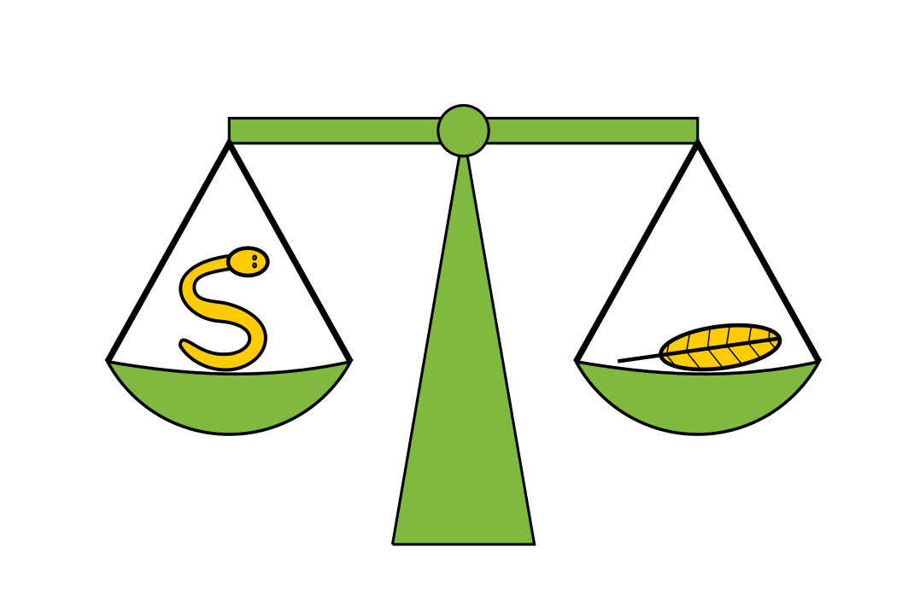
Test your code
Problem description contains data for Unit Tests
add more examples with test parametrization
easy problem: test toplevel function only
difficult problem: test decompositions, too
TDD is a great idea
(also see: Uncle Bob, Clean Code Talks, Youtube)

Slide 7
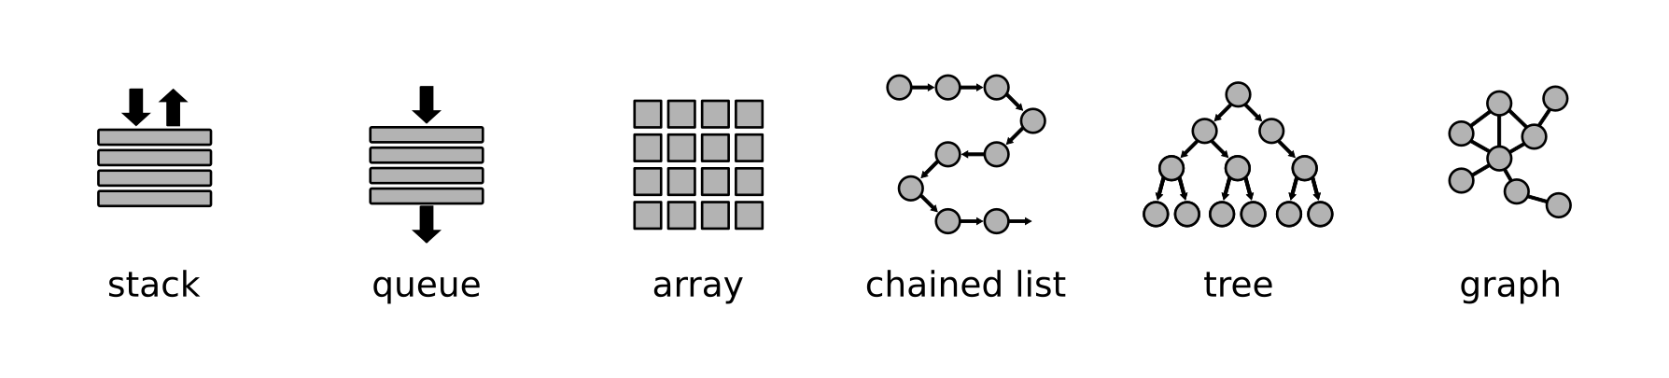
Identify data structures
abstraction of data allows you to estimate complexity,
choose an algorithm and, only after that, decide on the implementation.
(also see: Robert Sedgewick, Algorithms, Coursera)

Slide 8

Team Up!
Things that worked:
Pair programming, daily calls, exchange ideas, review code together, having juniors seniors and web devs around

Slide 9

https://github.com/krother/advent_of_code
www.academis.eu

