Slide 1
Beyond pdb
Delta Debugging in Python
Dr. Kristian Rother
krother@academis.eu
www.academis.eu

Slide 2
Python is not easy to debug
data = ["There are two kinds of people",
"First, those who finish",
"what they start"
SyntaxError: unexpected EOF while parsing

Slide 3
Python is not easy to debug
data = "There are 10 kinds of people",
"those who can read binary",
"and those who don't"]
IndentationError: unexpected indent

Slide 4
Reasons your program is failing:
The code is buggy
The tests are buggy
The data is buggy
You have no idea which of the three applies

Slide 5
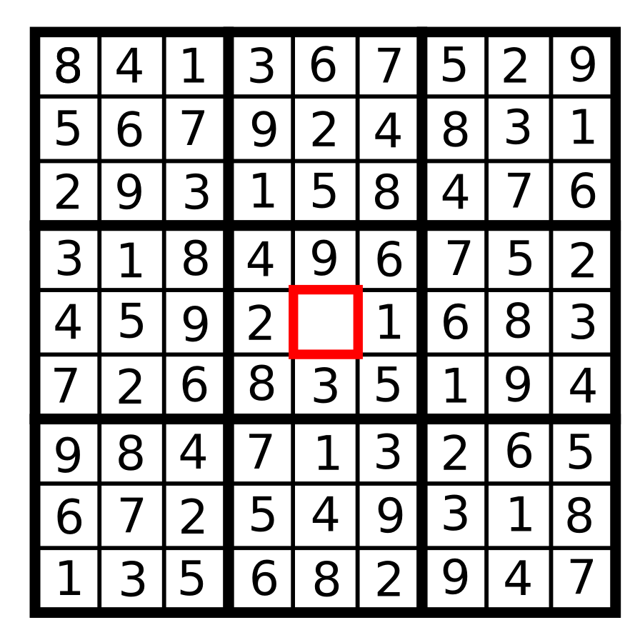

Slide 6
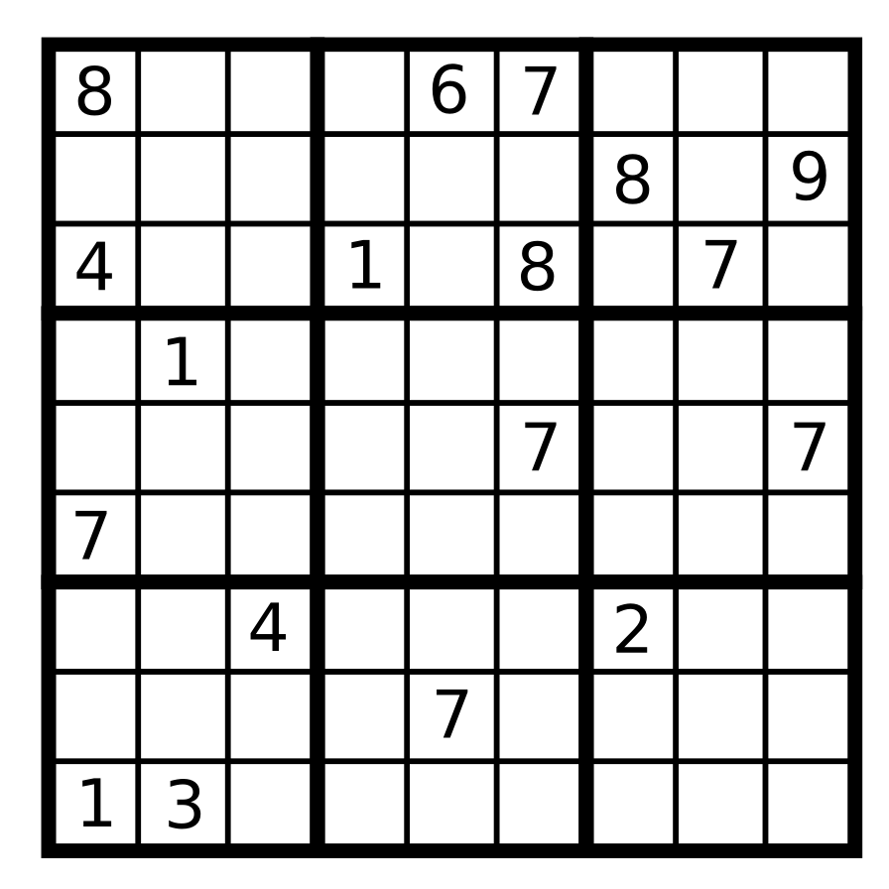

Slide 7
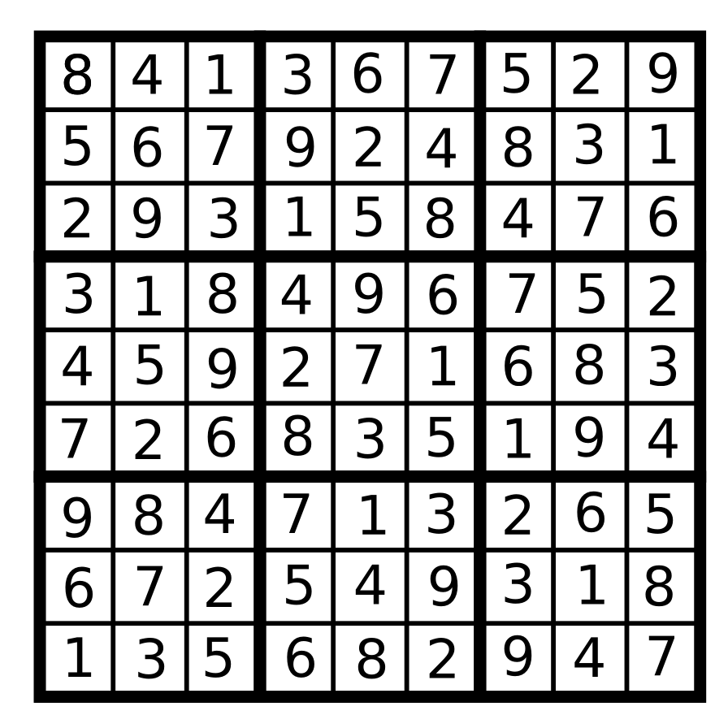
Sudoku Solver
Formulated as linear equations
import pulp
333+ constraints
using an LES is overkill

Slide 8

By Mario Modesto Mata - Own work, CC BY-SA 3.0,
https://commons.wikimedia.org/w/index.php?curid=5263990

Slide 9
Andreas Zeller
Udacity course: “Software Debugging”
Author of the book: “Why Programs Fail”
Published Delta Debugging article in 1999

Slide 10
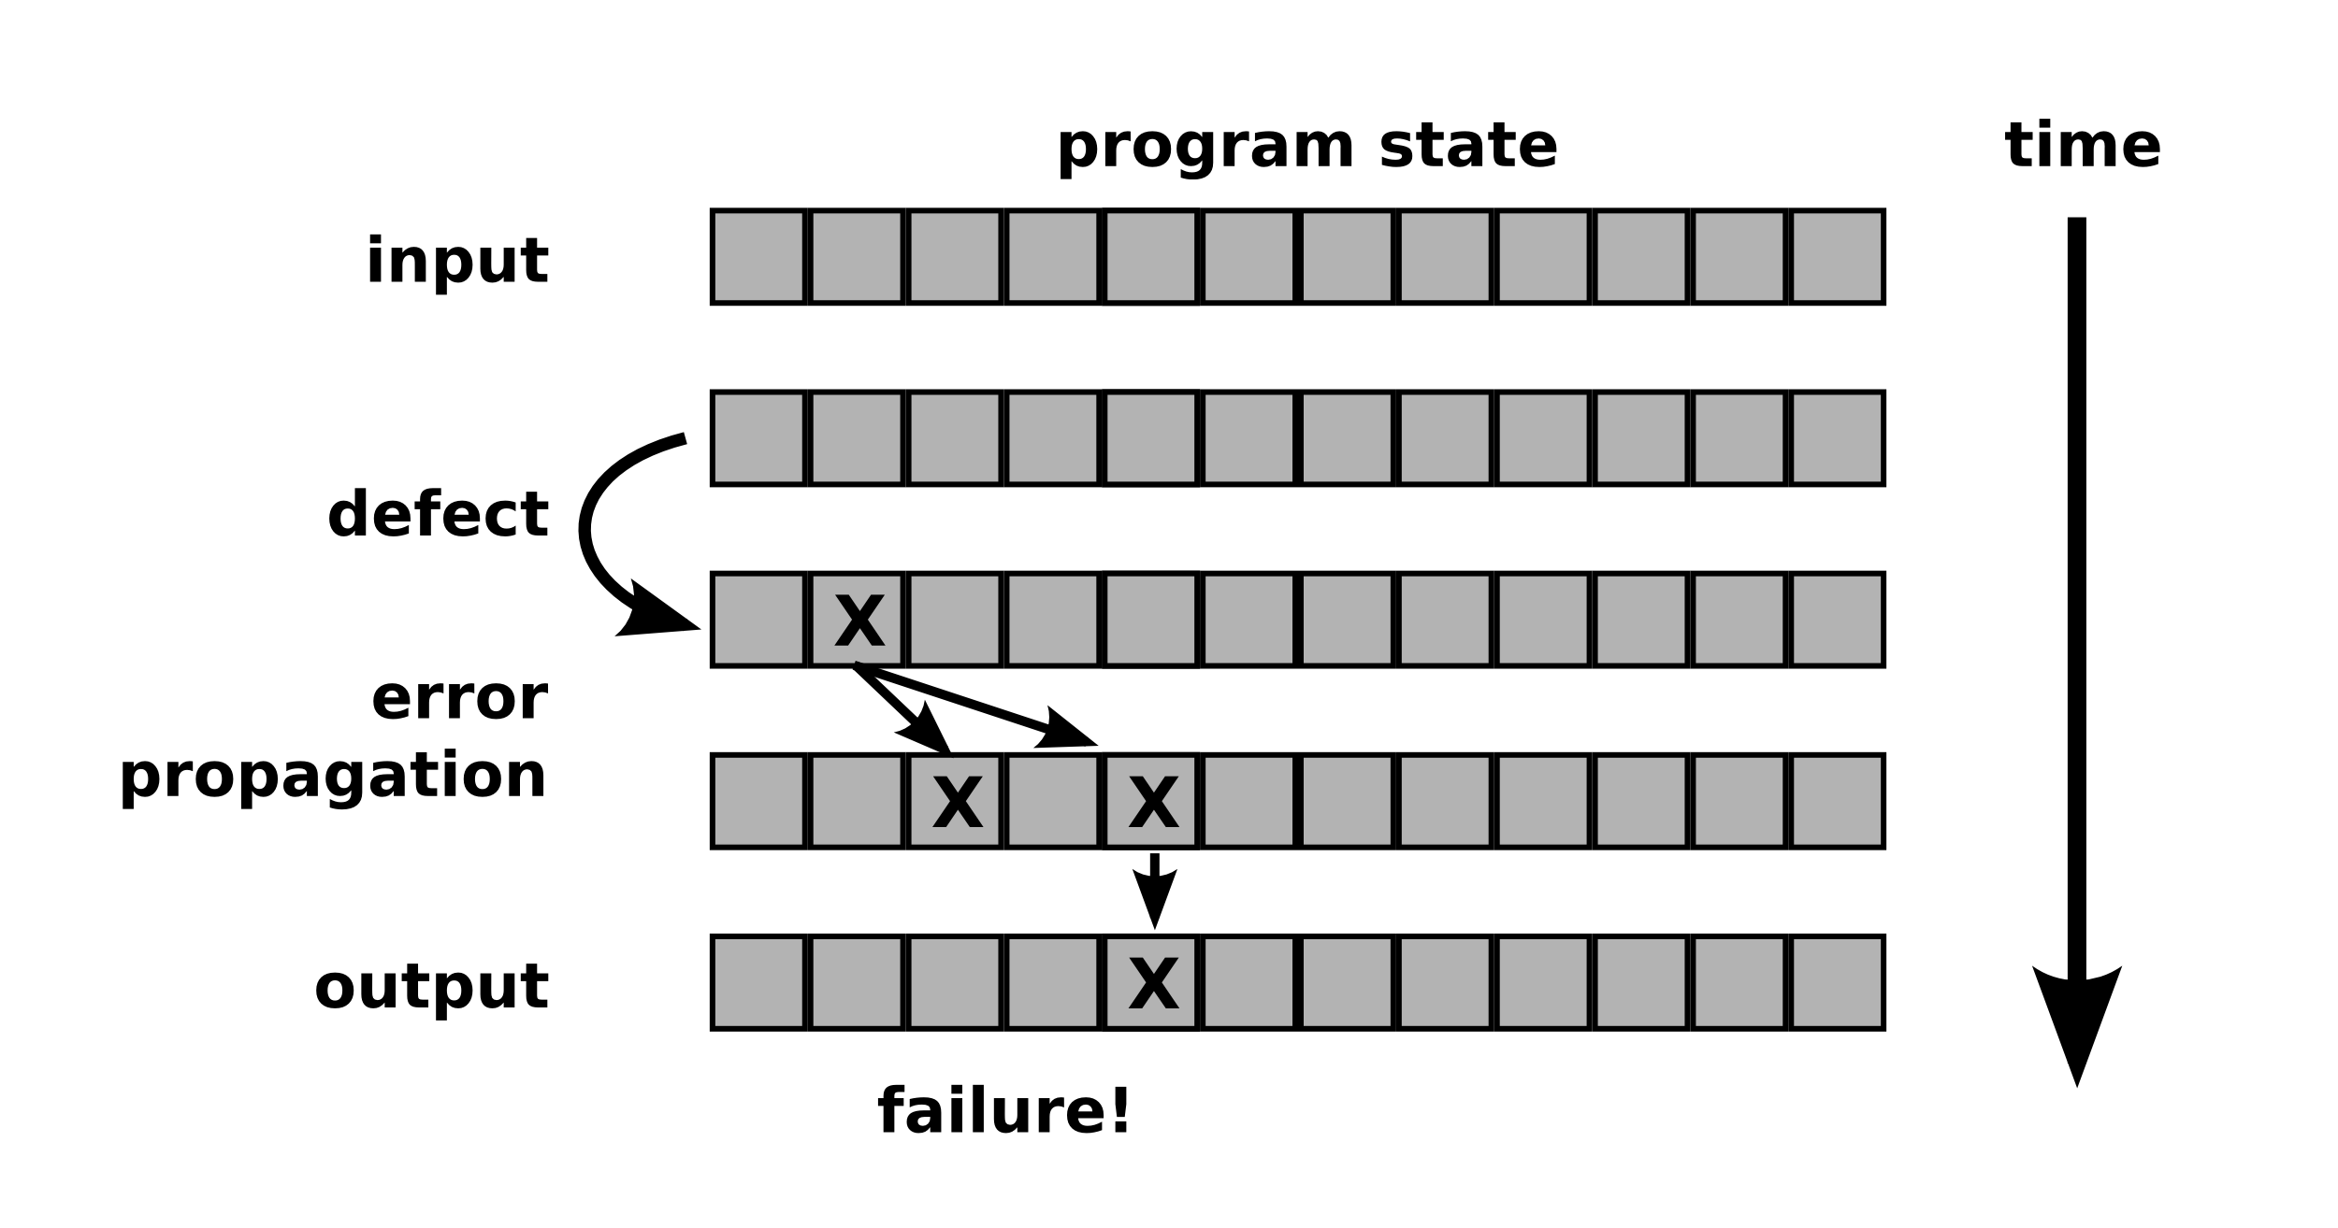
Program failures and defects

Slide 11
Partitioning data
Beyond pdb

Slide 12
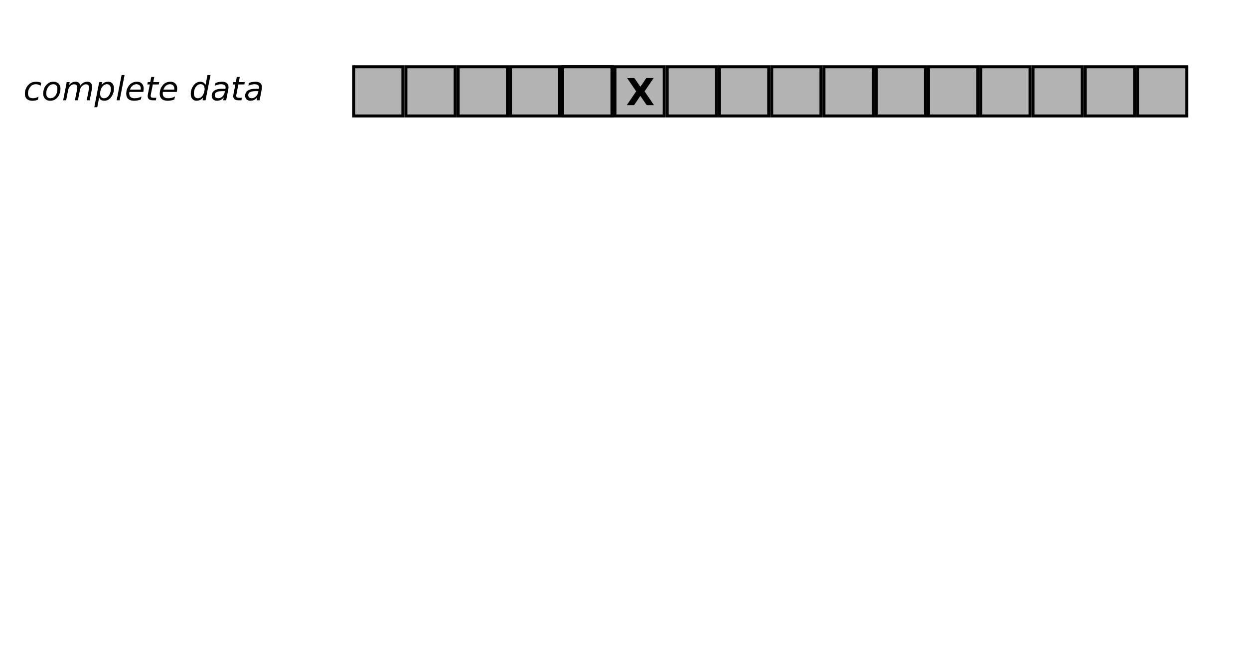
Partitioning data with binary search

Slide 13
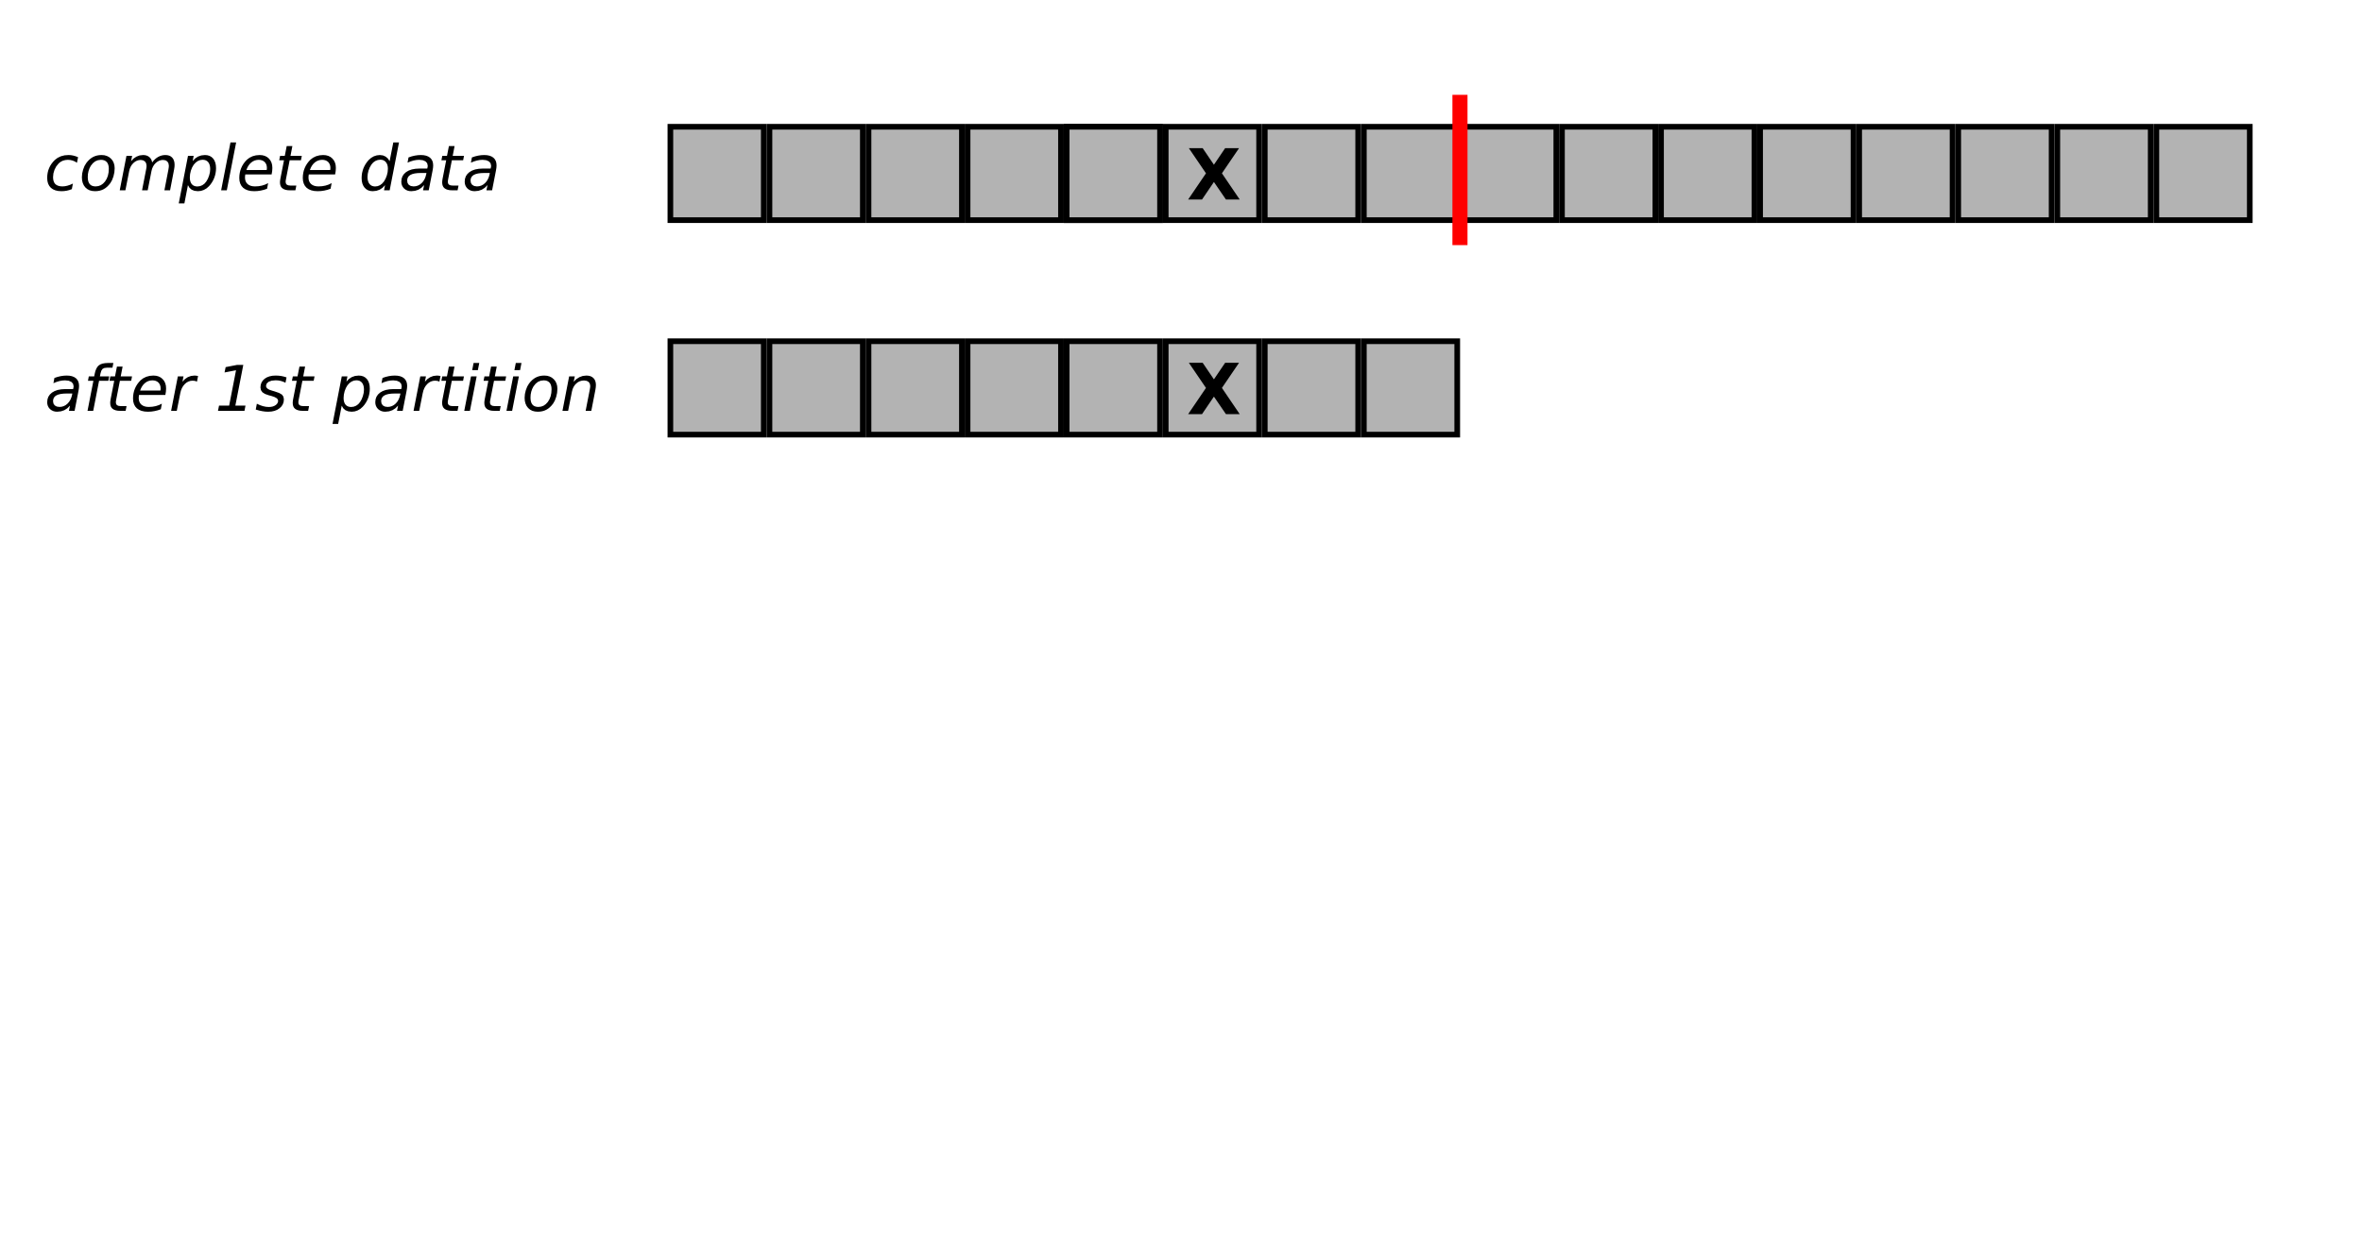
Partitioning data with binary search

Slide 14
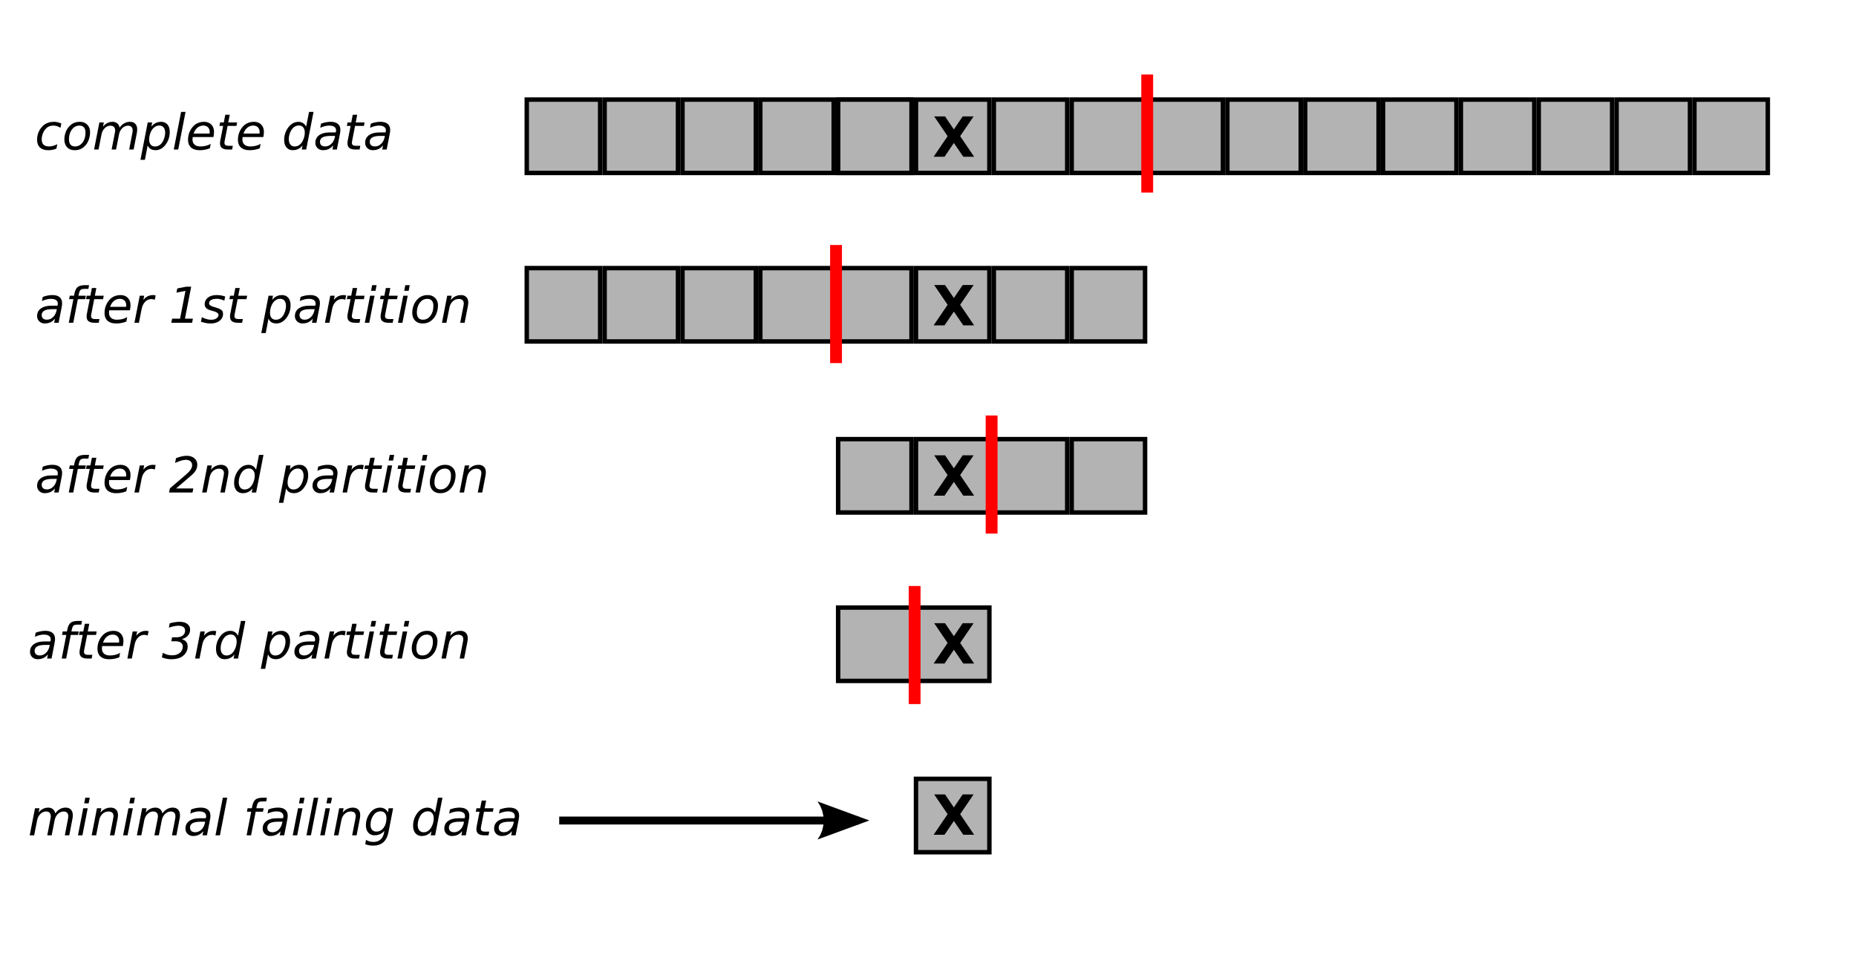
Partitioning data with binary search

Slide 15
Partitioning data with increasing granularity
Beyond pdb

Slide 16
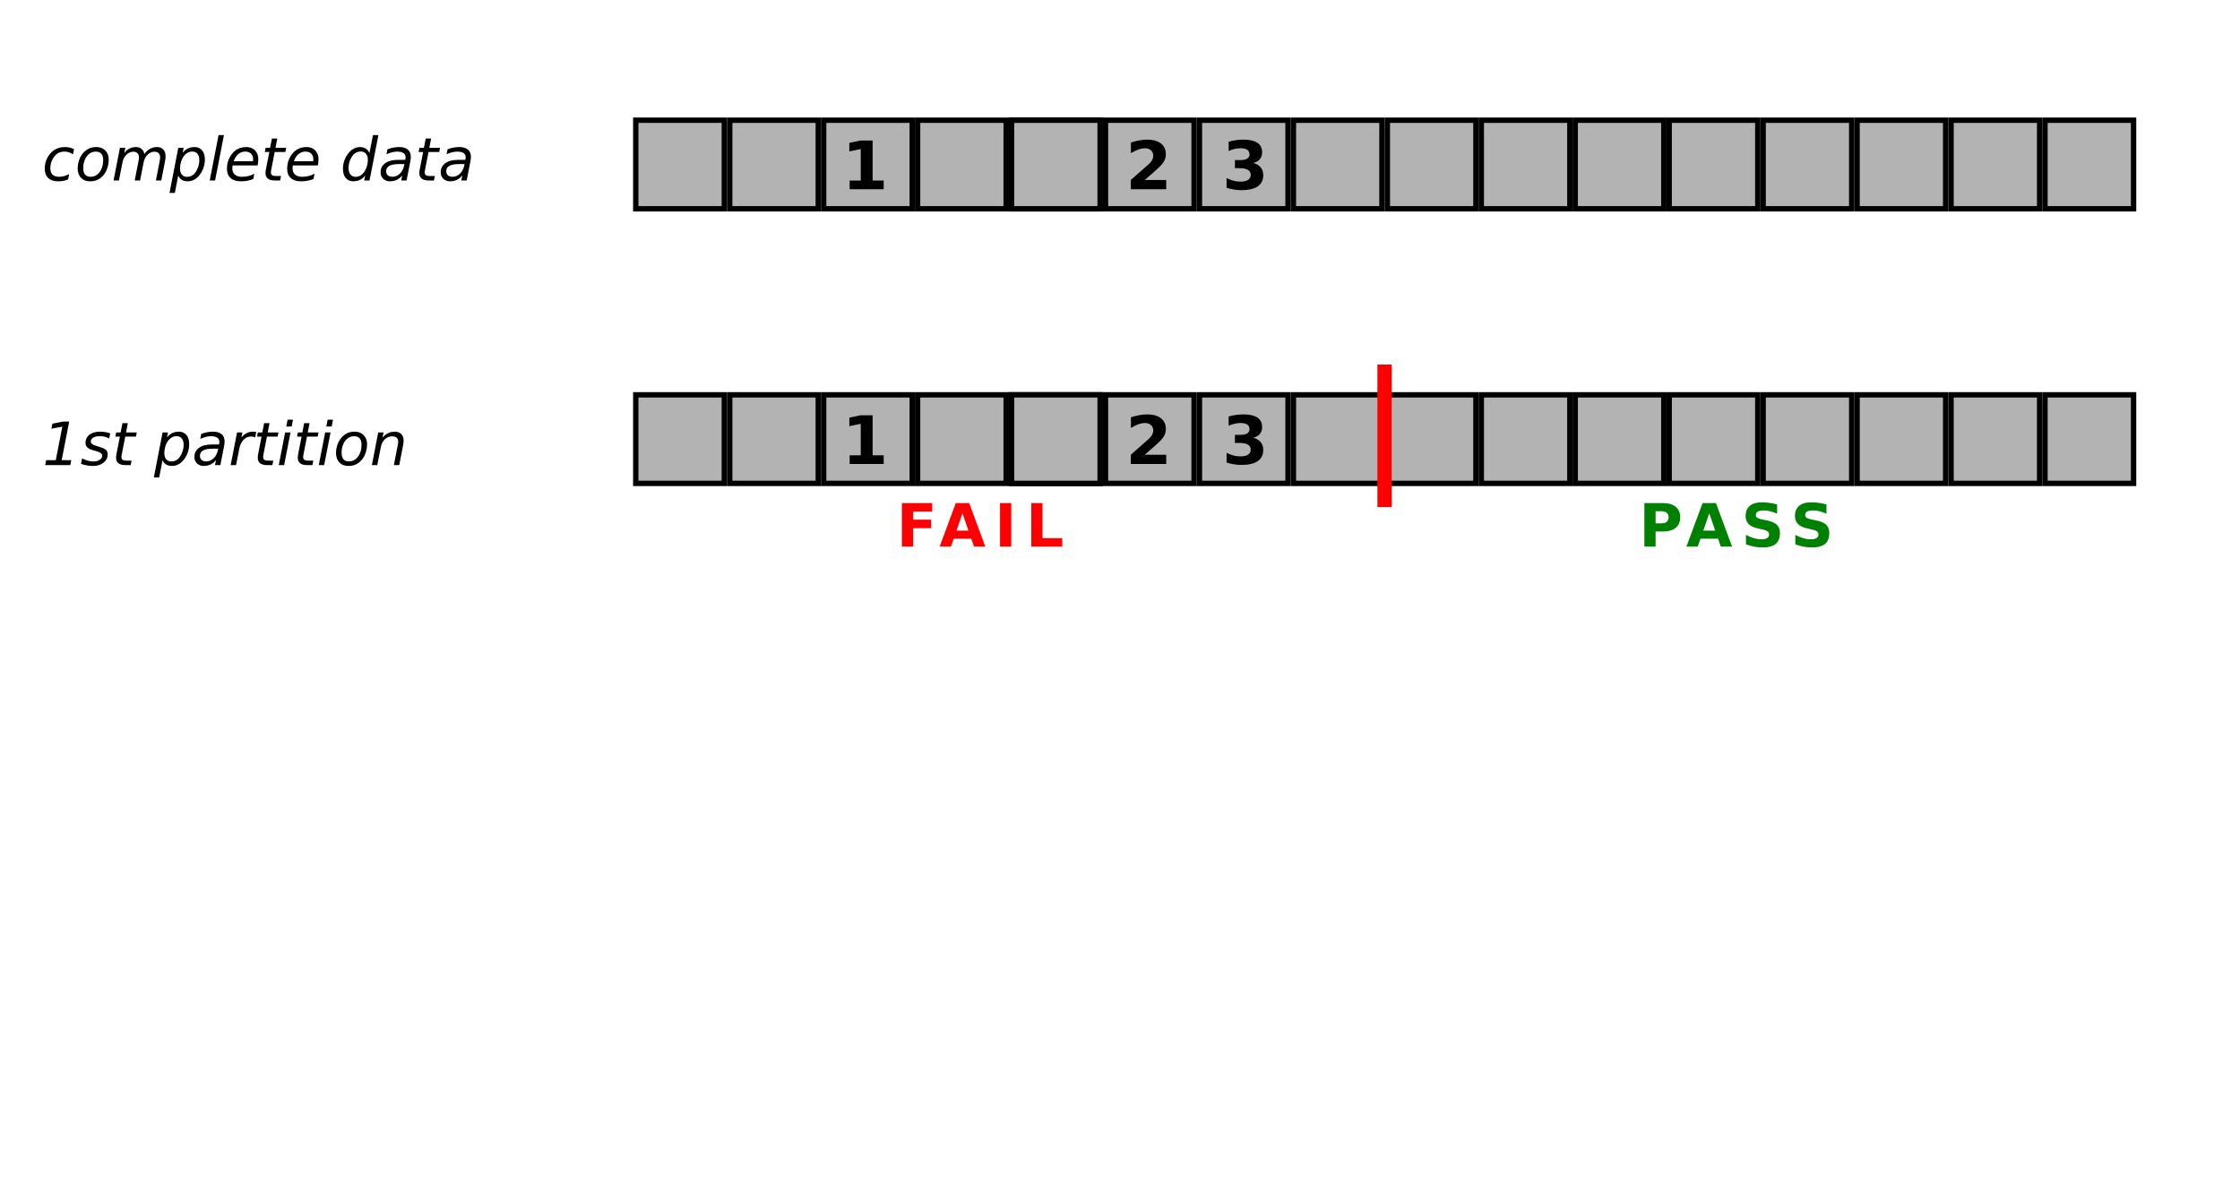
1, 2, 3 only fail together

Slide 17
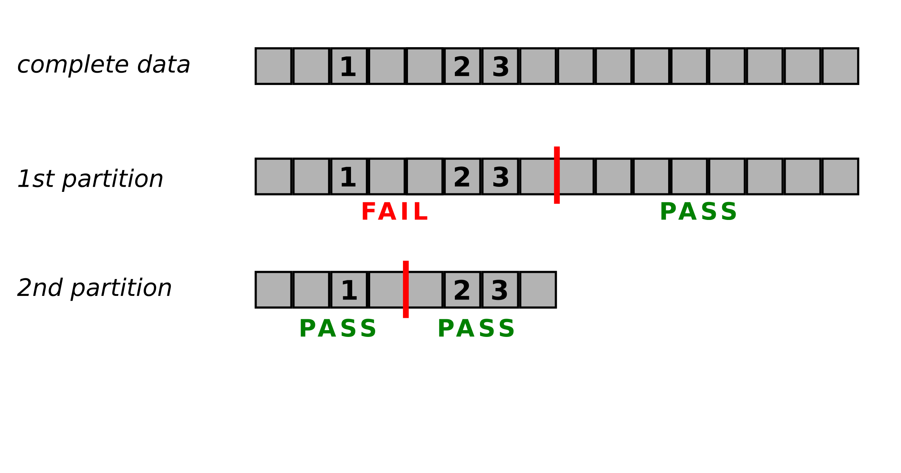
1, 2, 3 only fail together

Slide 18
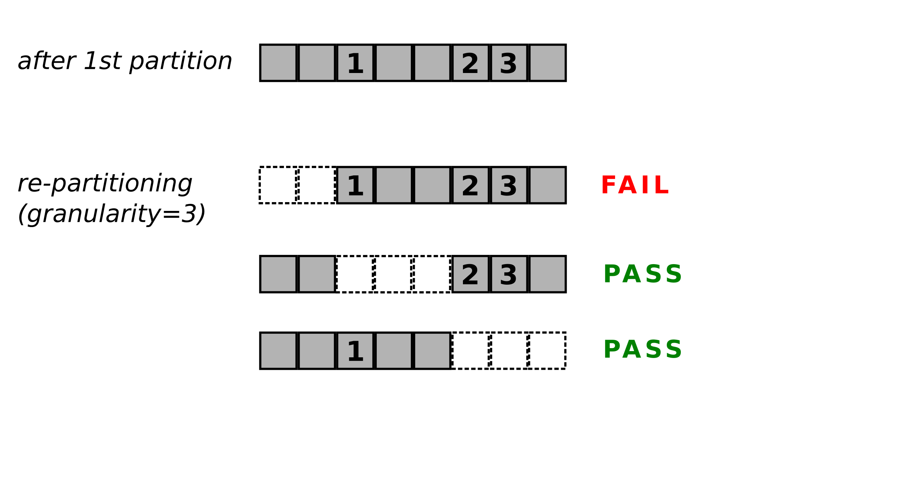
1, 2, 3 only fail together

Slide 19
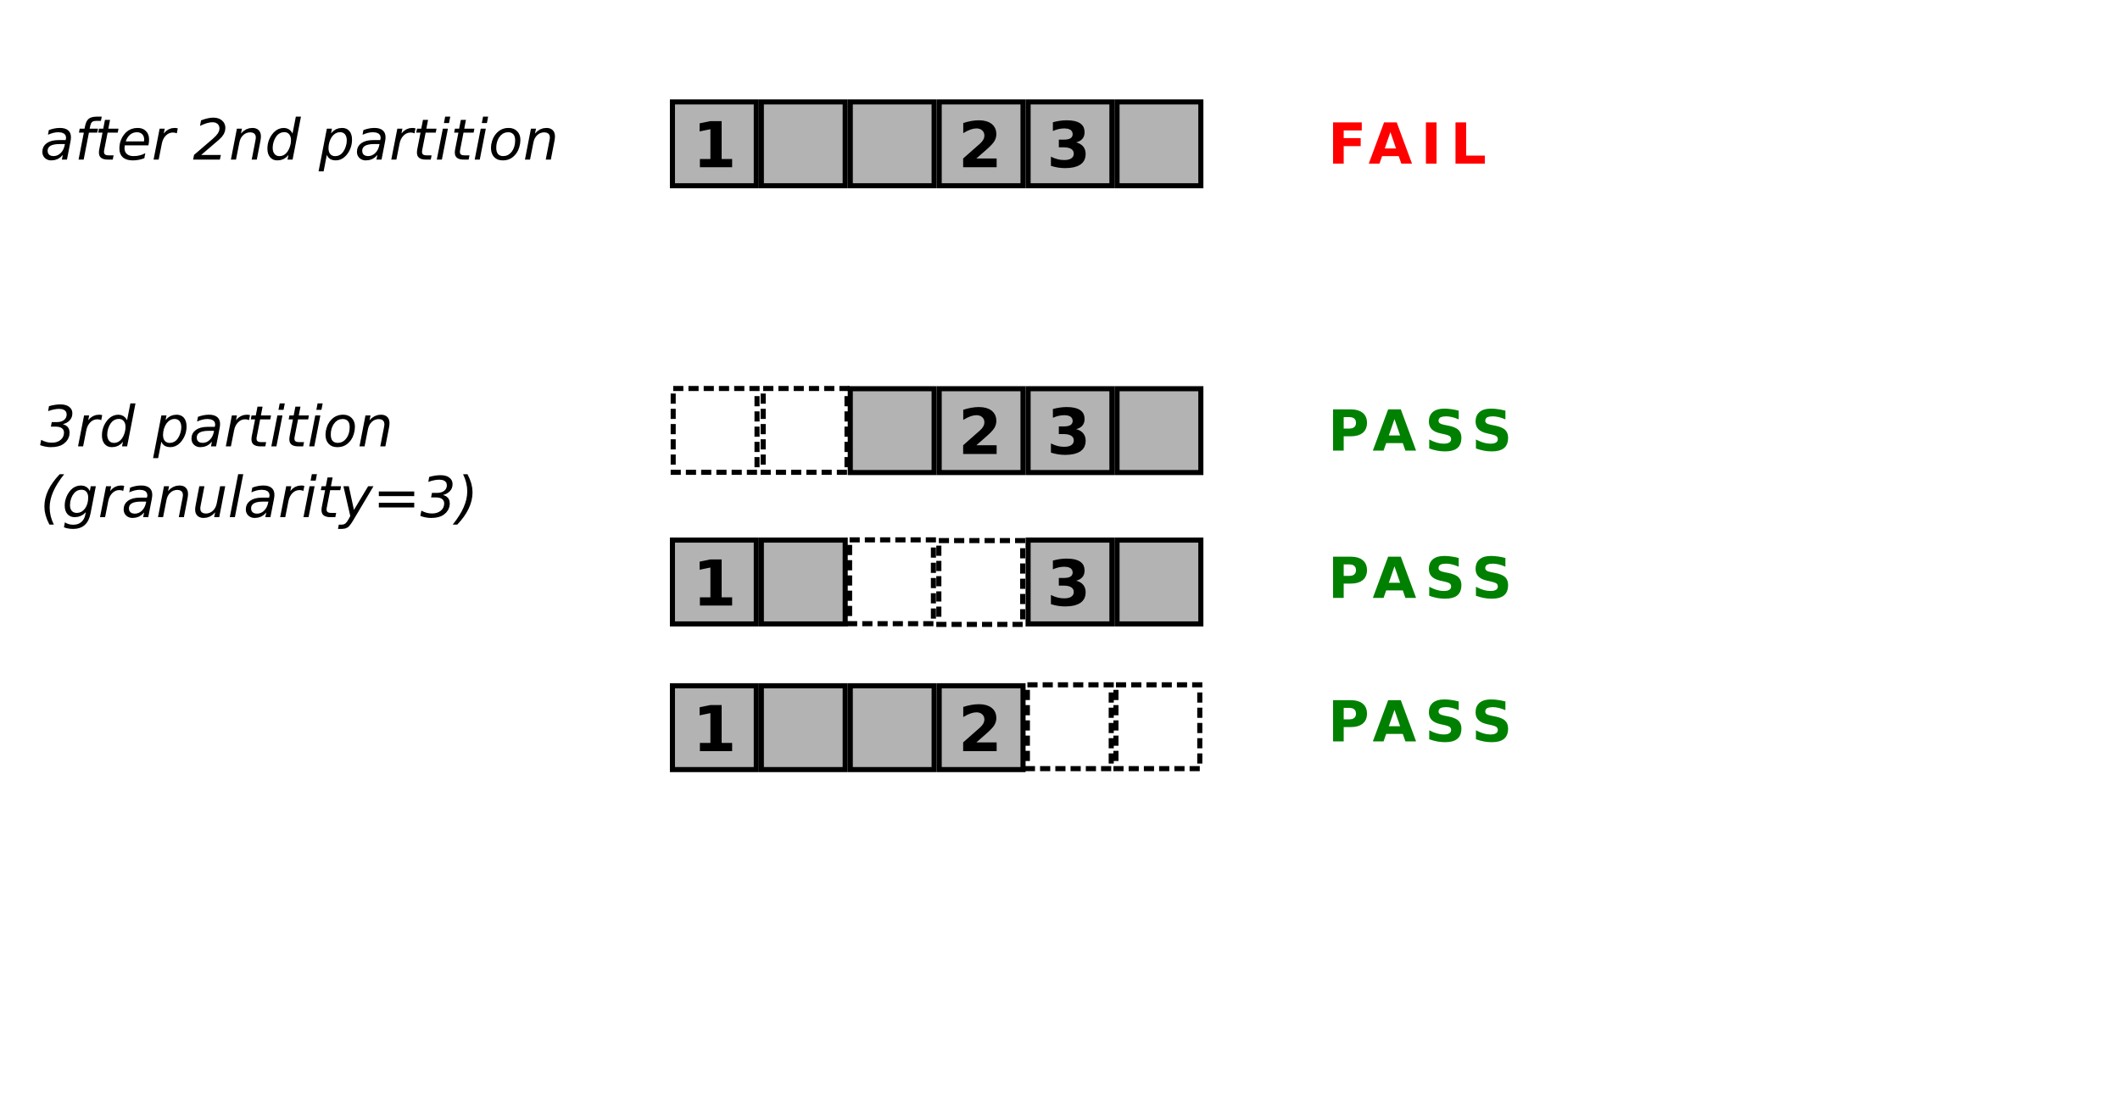
1, 2, 3 only fail together

Slide 20
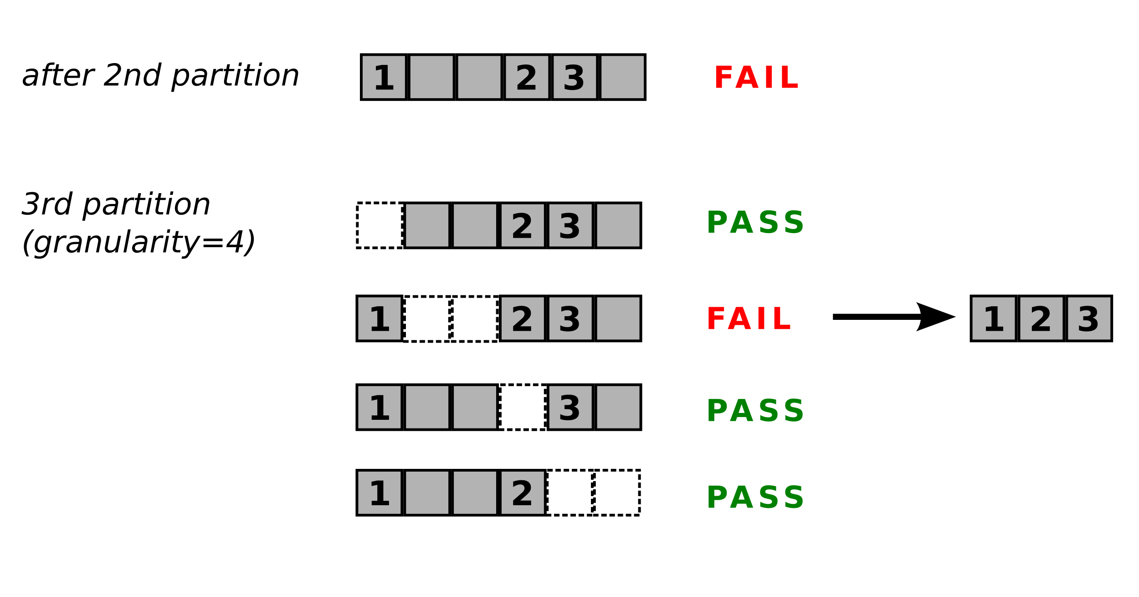
1, 2, 3 only fail together

Slide 21
Partitioning data with increasing granularity is called Delta Debugging.
Delta Debugging results in a minimal failing subset
Beyond pdb

Slide 22
Best case: all fail
O(log n)
Time Complexity
Worst case:
all pass
O(n)

Slide 23
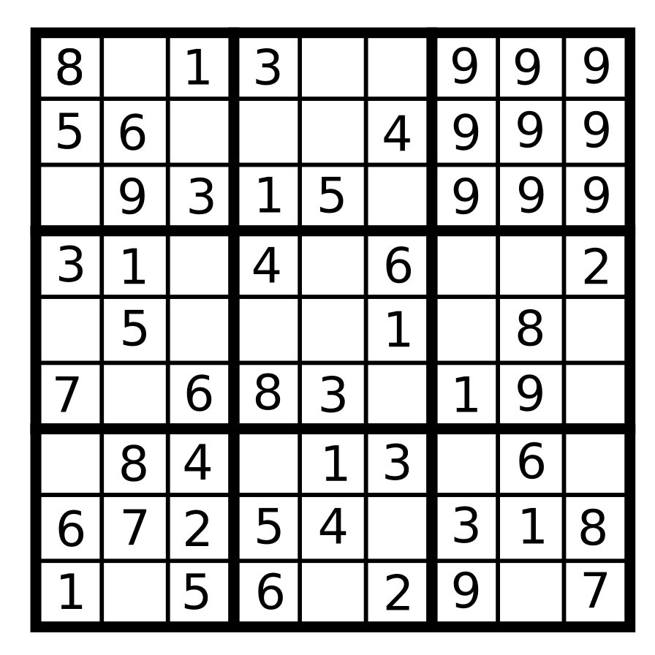

Slide 24
Delta Debugging
Pros
Cons
Does not require knowlede about the nature of the bug
Works on any iterable type
Works well with random tests
Related approach used by
git bisect
You need a test first
Partitions must not have
side effects
Few examples documented since 1999
Does not give the union of
failing subsets

Slide 25
Partitioning data with increasing granularity is called Delta Debugging.
Delta Debugging results in a minimal failing subset for any partitionable type
(HTML, key strokes, git commits, Sudoku)
Beyond pdb

Slide 26
Source code and references
github.com/krother/delta_debug
Dr. Kristian Rother
krother@academis.eu
www.academis.eu

Slide 27
Debugging Techniques
A biased and incomplete enumeration
Debug
Test
Analyze
Fail early
print
introspection
pdb
deduction
git bisect
unittest
py.test
doctest
Jenkins
Selenium
pylint
pyflakes
mypy
reviews
Z-notation
data invariants
contracts
assertions
logging
loop invariants

