Slide 1
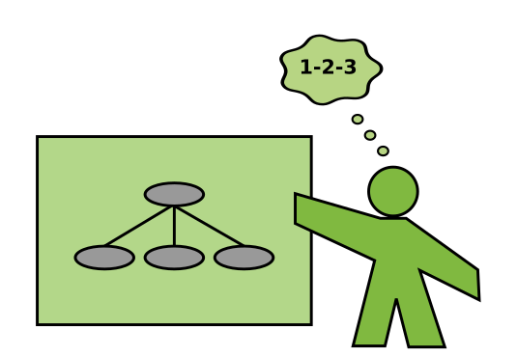
Teaching Programming
6 tips to prepare your next training session
Dr. Kristian Rother
© 2023 Dr. Kristian Rother – CC-BY 4.0

Slide 2

Confucius (孔夫子)
China, 500 BC
“If your plan is for one year, plant rice.
If your plan is for ten years, plant trees.
If your plan is for one hundred years,
educate children.”
Public domain image

Slide 3
Teaching is about helping people grow

Slide 4

Goal: design a 180’ tutorial about 2D arrays in Python

Slide 5

What challenges might we face when teaching 2D arrays?

Slide 6

Writing a Speech without an audience in mind is like starting a love letter with
“to whomever it may concern”
John Zimmer
European Champion of Public Speaking mannerofspeaking.org

Slide 7
Hint #1:
Connect with your participants early
(1-2 weeks is usually sufficient)

Slide 8
Hint #2: Theme your Lessons
to engage your students use exactly one business case or fun theme

Slide 9
What topics should a tutorial on 2D arrays cover?

Slide 10
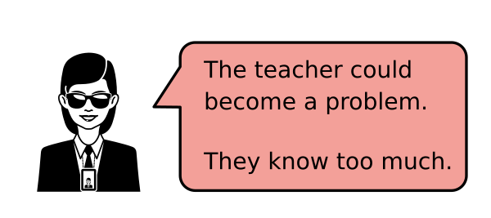
Frequent problem when experts teach:

Slide 11

github.com/krother/training_and_teaching_methods

