Slide 1

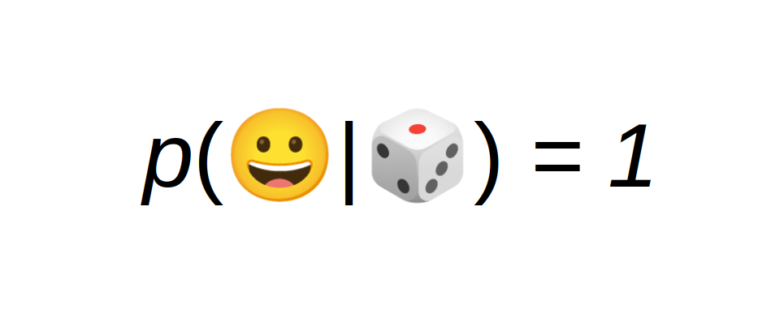
Probably Fun
Games to teach Machine Learning
Dr. Kristian Rother & Shreyaasri Prakash
www.academis.eu/probably_fun

Slide 2
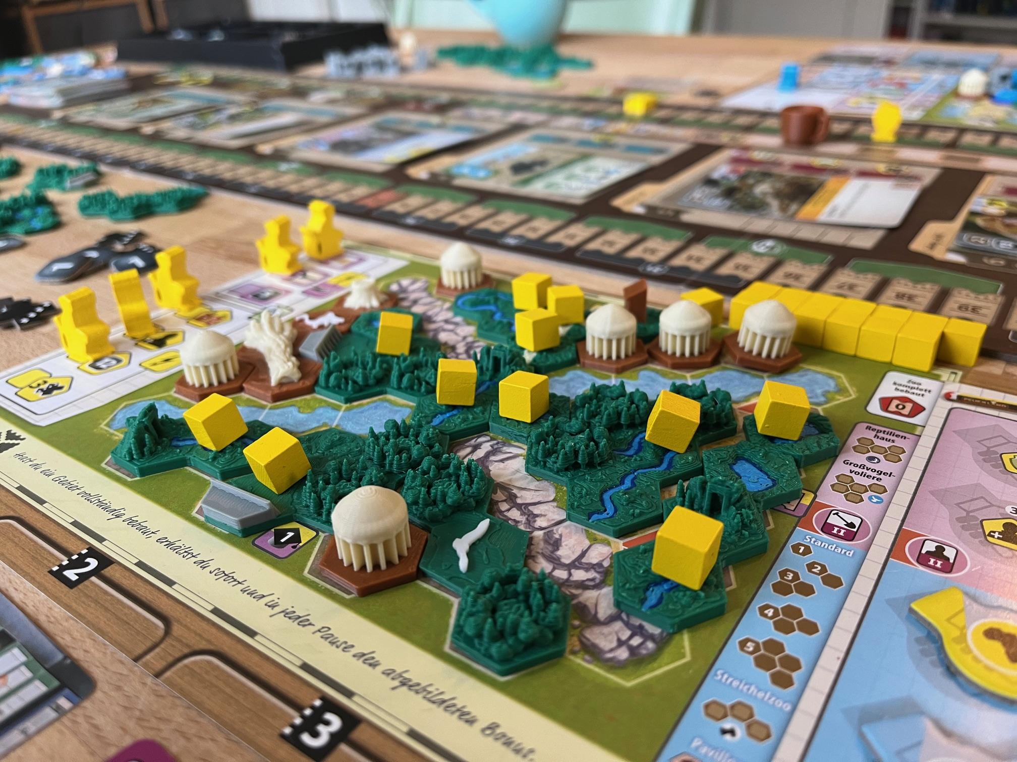
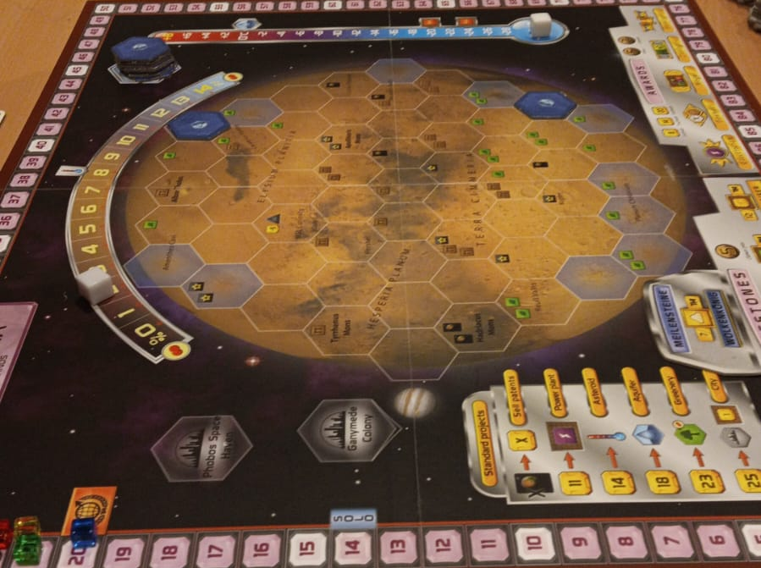
Two great board games
Ark Nova:
build a zoo and protect animal species
(playtime 2+ hours)
Terraforming Mars:
make Mars warm & cozy
(playtime 2+ hours)

Slide 3


Board games are culture
Board gaming in Germany is recognized as immaterial cultural heritage by UNESCO
You can get certified as
”Fachkraft für Gesellschaftsspiele”
www.brettspielakademie.de
www.unesco.de/staette/brettspiele-spielen

Slide 4
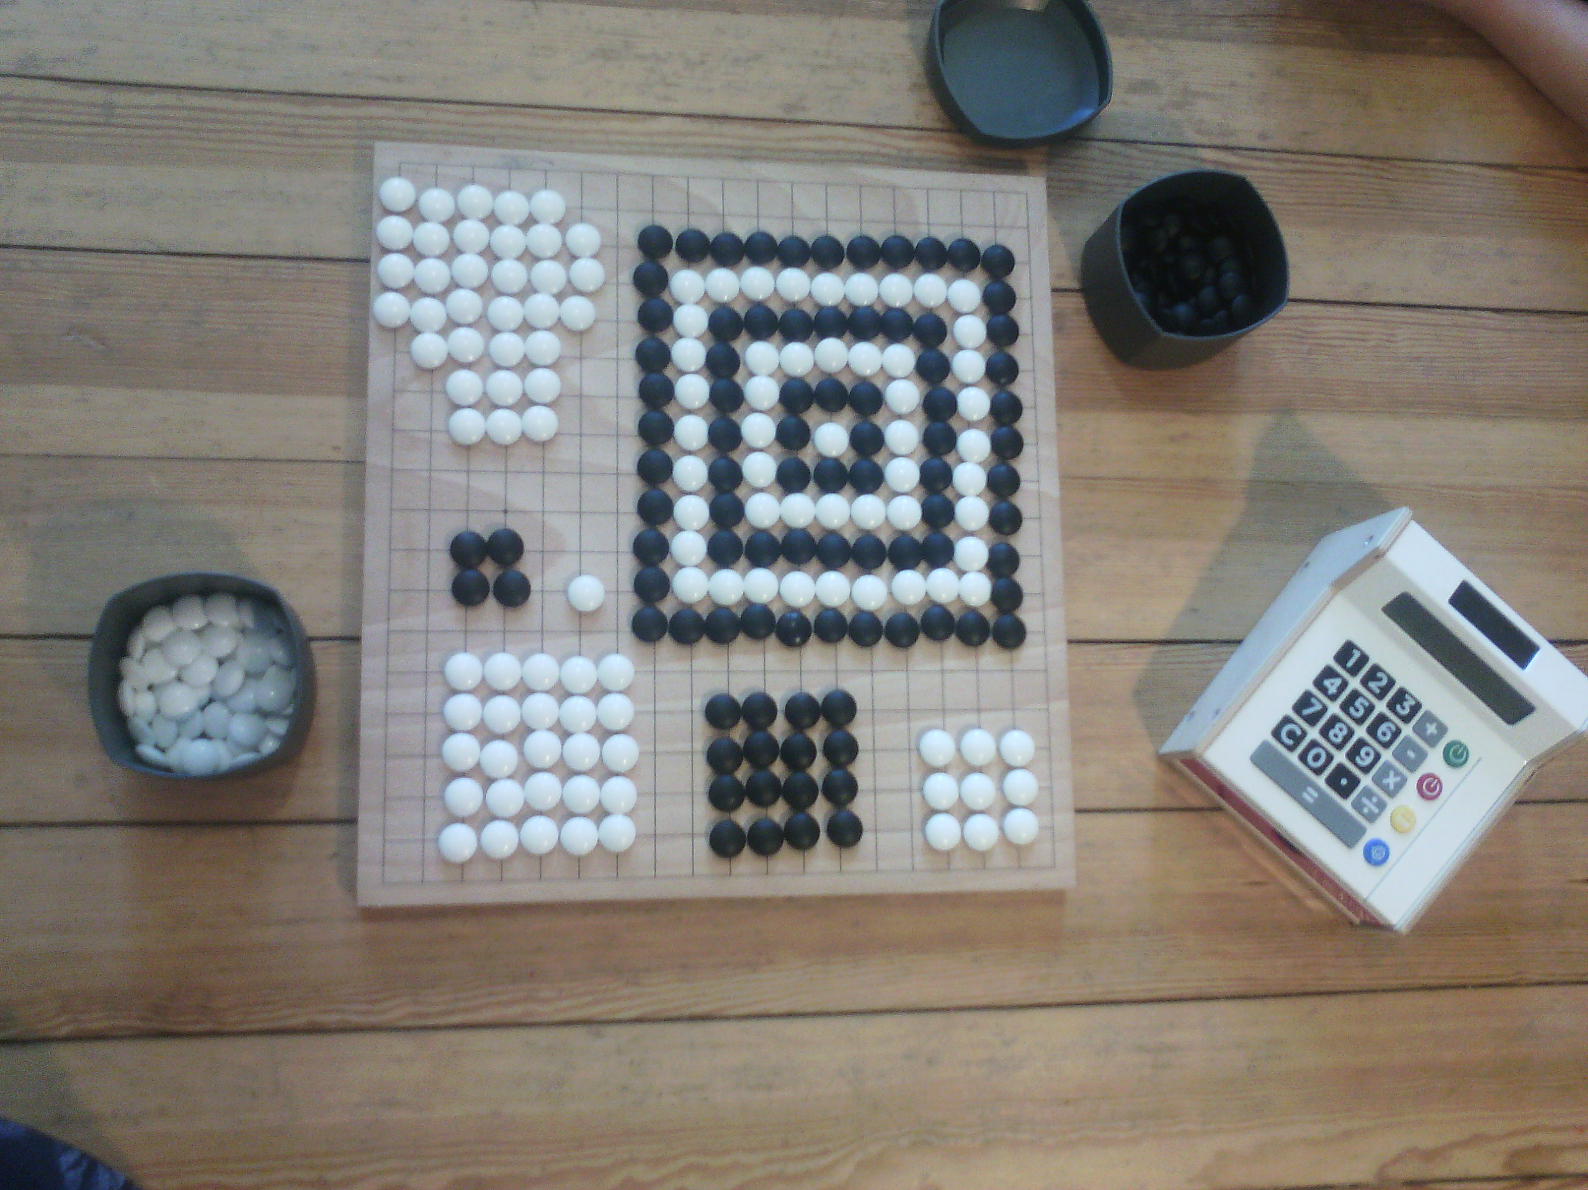
Games contain Data Science

Slide 5
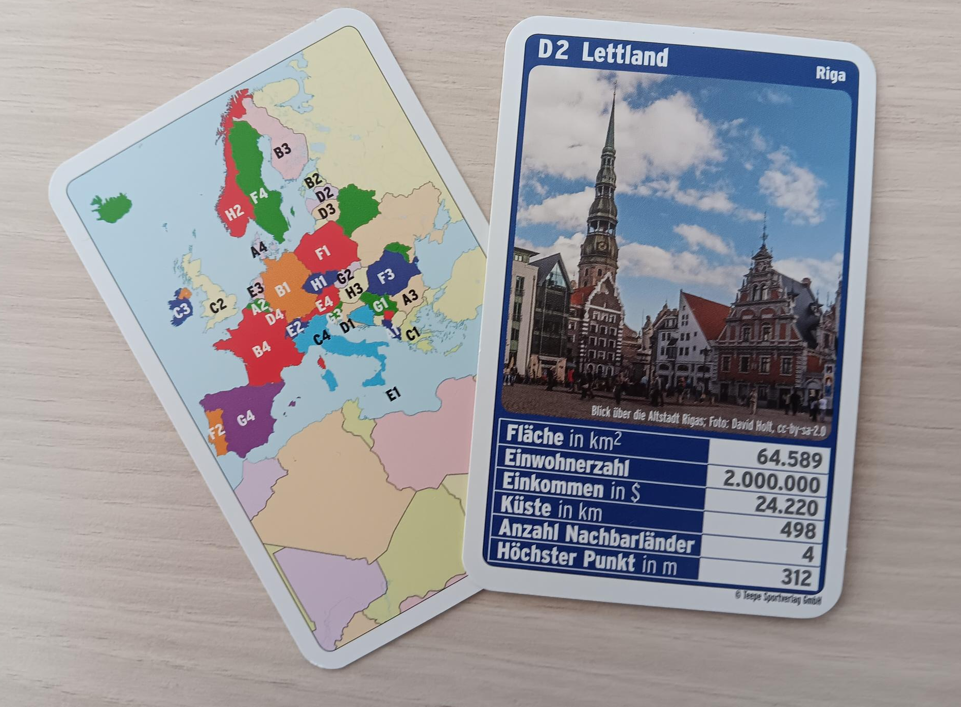
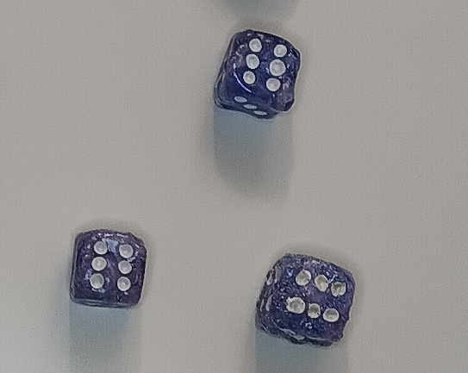
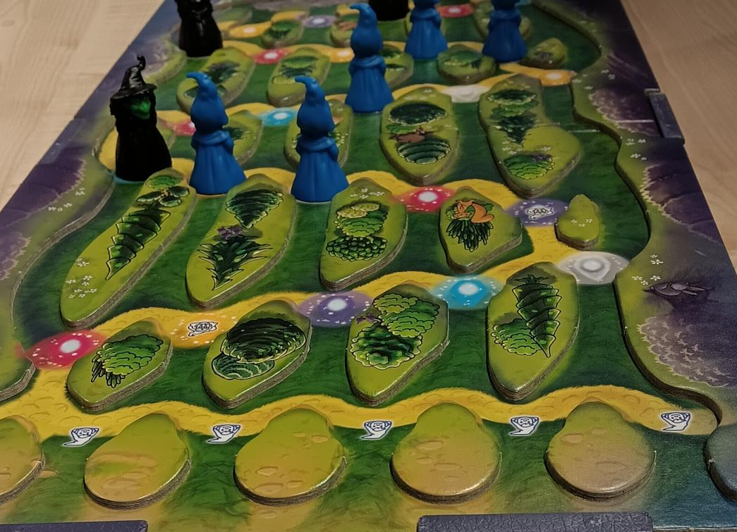
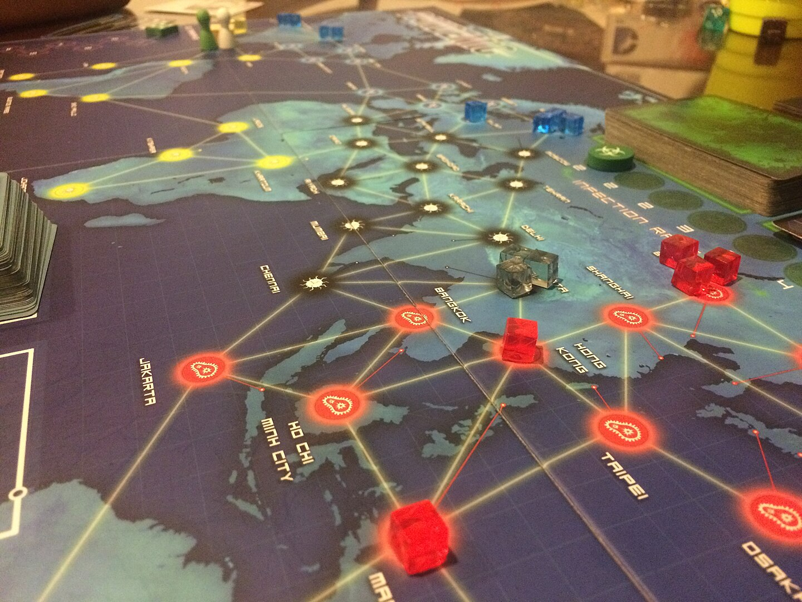
Quartet cards used for plotting
dice baked before χ²-testing
binomial distro in “Zauberberg”
graph centrality in “Pandemic”

Slide 6
Wordle
Preparation: almost none
Duration: <5 minutes
Effect: wake up class
repeat keywords

Slide 7
Agenda
1. Decision Trees
2. Bag of Words
3. Language Models
4. Bar Quiz
5. Q & A
6. game rotation

Slide 8
Decision Tree
Guess the animal

Slide 9
Random Forest
Preparation: print worksheets
(or bring drawing paper)
Duration: 15 minutes
Effect: simulate complete ML model
easy to follow up with theory and/or
practical exercises

Slide 10
Bag of Words
Guess which text document it is

Slide 11
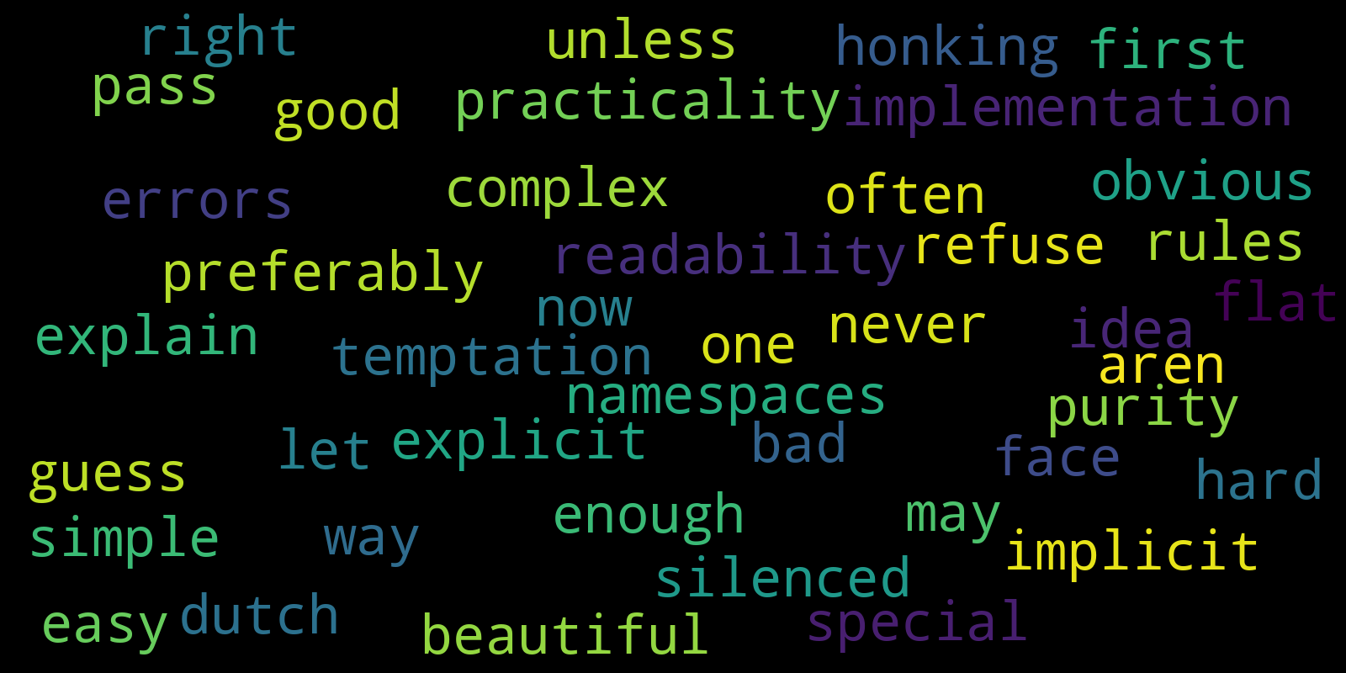
All words
Take 1: simply use all words:

Slide 12
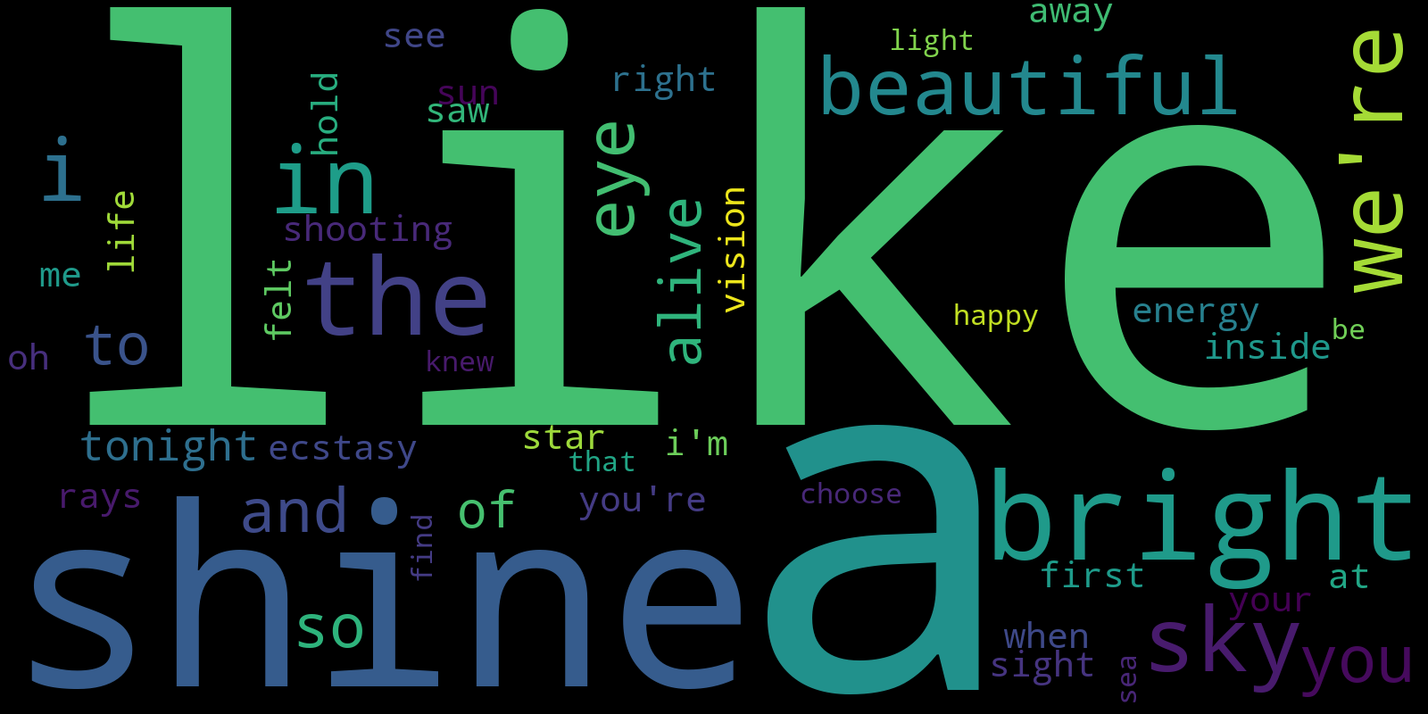
All words
Take 2: sort by frequency

Slide 13
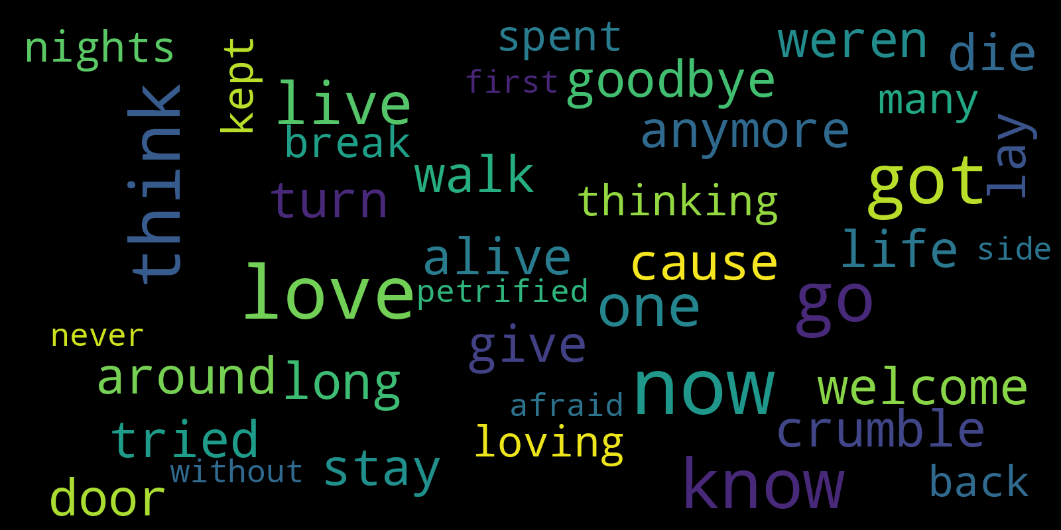
All words
Take 3: remove stop words

Slide 14
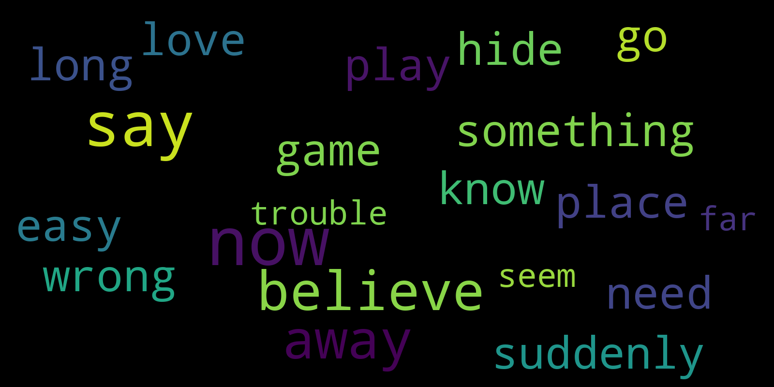
All words
Take 4: lemmatize (reduce to basic form)

Slide 15

All words
Take 5: Tf-Idf
(rank words higher if they rarely occur in any other song)

Slide 16
Bag of Words
Preparation: generate word clouds
(and think hard which documents class knows)
Duration: <10 minutes
Effect: simulate the main concepts
should be backed up with theory
and/or practical exercises

Slide 17
Small language model
Two volunteers: explain a concept to the audience.
take turns saying 1 word
(A B A B A B ...)
Audience: guess which concept it is

Slide 18
Small language model
Preparation: very little
Duration: <10 minutes
Effect: priming
prepares the ground for introducing
token prediction, softmax
also works as a game to repeat

Slide 19
Wisdom of the crowd
Task: We will ask you a question.
Decide which is the answer most people in the audience
will give.
Everytime your guess is correct, you get 1 point.

Slide 20
Wisdom of the crowd
Preparation: write down a few common questions
Duration: <10 minutes
Effect: discuss reasoning versus hallucination
also works as a short energizer

Slide 21
Team Quiz
Task: Form a team of 4-5 people
Answer the 10 questions on the sheets
(distribute them to parallelize)
NO PHONES OR COMPUTERS!

Slide 22
Team Quiz
Preparation: 1-3 hours to create the quiz
Duration: 30 minutes
Effect: team building
recap

Slide 23
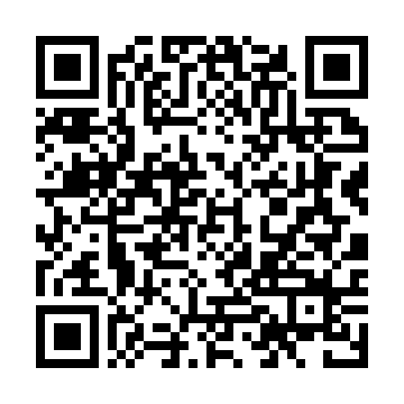
More Games
Find a table with a game
and a group of 5-6 people
read instructions
github.com/krother/probably_fun
→ workshop → instructions
play

Slide 24
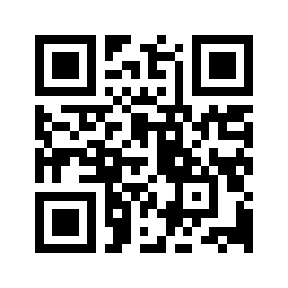

Course topics on www.academis.eu

