Slide 1
Defining Input & Output
Every program has three basic functions:
INPUT
PROCESSING
OUTPUT
These must be visible in the code!

Slide 2
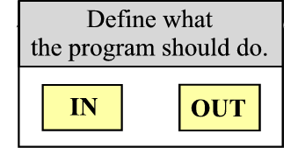
Defining Input & Output

Slide 3
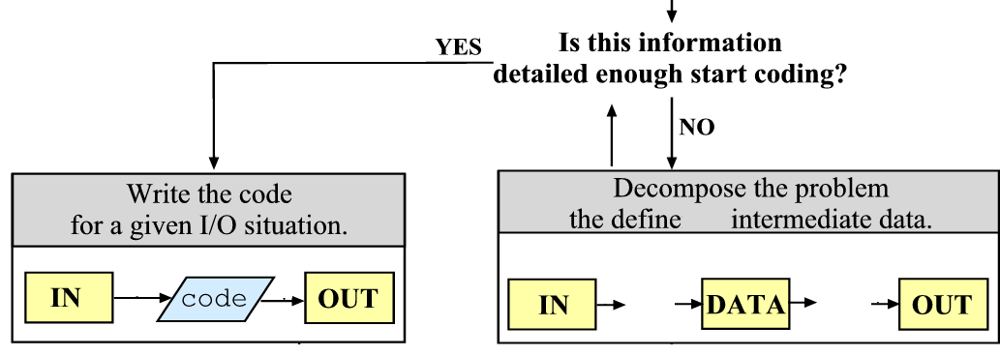
Defining Input & Output

Slide 4

Defining Input & Output
The basic program design describes all major steps (often more than two).
A good way to start programming is to create an empty function for each of these steps.

