Slide 1
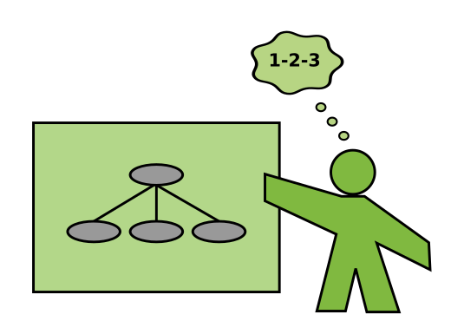
How to Teach Python
5 tips to prepare your next tutorial
Dr. Kristian Rother
© 2022 Dr. Kristian Rother – CC-BY 4.0

Slide 2
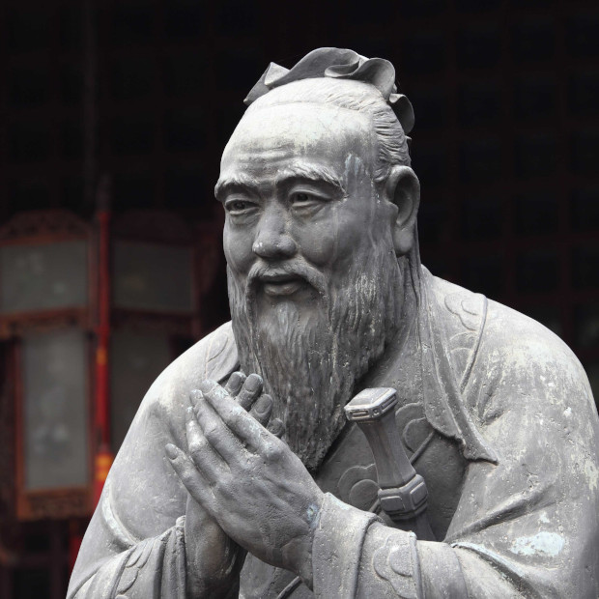
Confucius (孔夫子)
China, 500 BC
“If your plan is for one year, plant rice.
If your plan is for ten years, plant trees.
If your plan is for one hundred years,
educate children.”
Public domain image

Slide 3
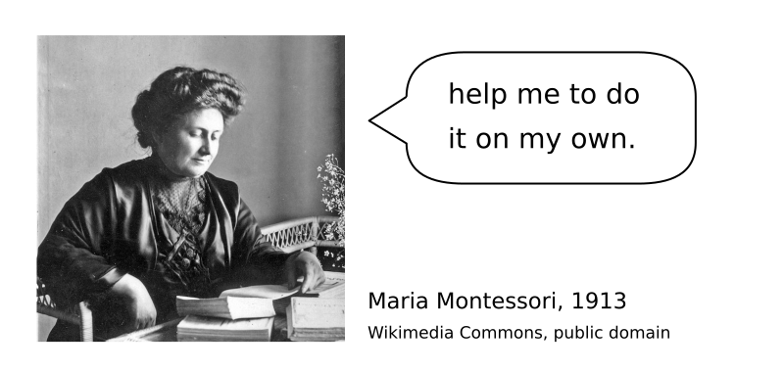
Teaching is about helping people grow

Slide 4

Goal: design a 180’ Numpy tutorial

Slide 5

What challenges might we face when teaching Numpy?

Slide 6

Writing a Speech without an audience in mind is like starting a love letter with
“to whomever it may concern”
John Zimmer
European Champion of Public Speaking mannerofspeaking.org

Slide 7
Hint #1:
Connect with your participants early
(1-2 weeks is usually sufficient)

Slide 8
What topics should a Numpy tutorial cover?

Slide 9
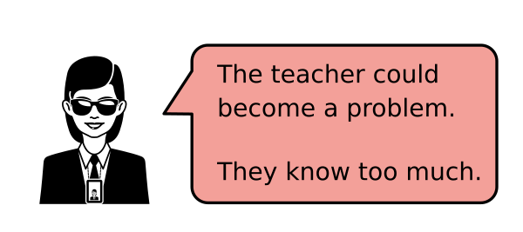
Frequent problem when experts teach:

Slide 10
Brains have a limited working memory
Hint #2: limit the number of new concepts per lesson
7 ± 2

Slide 11
Hint #3: Theme your Lessons
to engage your students use exactly one business case or fun theme

Slide 12
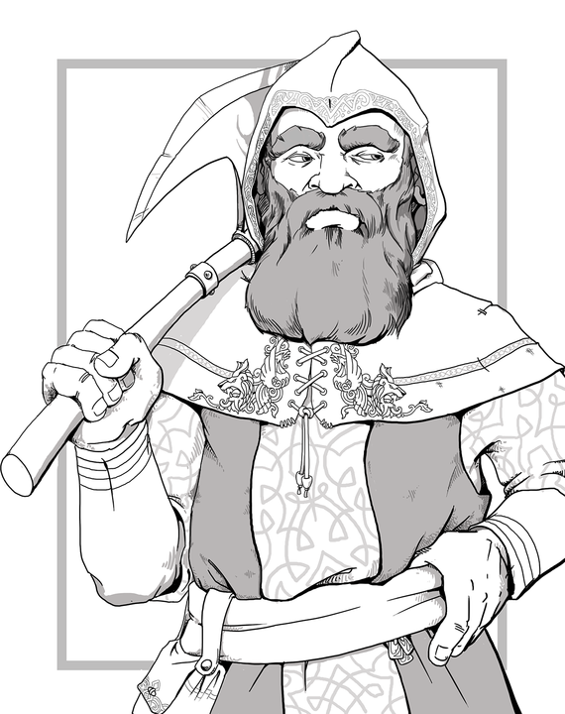
gold gold gold gold
gold gold gold gold
gold gold gold gold
mine mine mine mine
A song of the dwarves:
gold gold gold gold
gold gold gold gold
gold gold gold gold
mine mine mine mine
D&D dwarf Image by LadyofHats - Own work, CC0, Wikimedia Commons
https://commons.wikimedia.org/w/index.php?curid=53722671

Slide 13
gold gold gold gold
gold gold gold gold
gold gold gold gold
mine mine mine mine
A song of the dwarves:
gold gold gold gold
gold gold gold gold
gold gold gold gold
mine mine mine mine
very different words in the original but details lost in translation
place
verb
owner
security measures

Slide 14
Hint #4: Turn Code Examples into exercises see “faded examples” by Greg Wilson” https://teachtogether.tech/en/index.html#s:architecture-load
replace words and phrases by ...
shuffle the lines
Introduce bugs
...

Slide 15
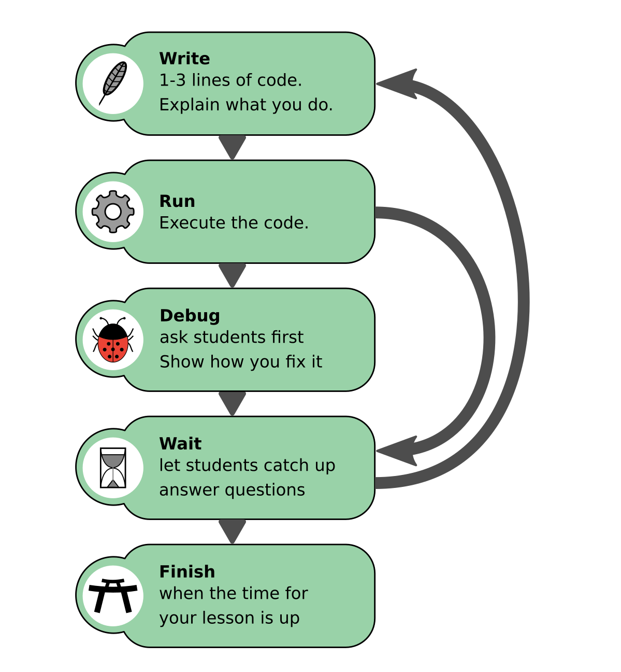
Hint #5:
Live Coding works

Slide 16
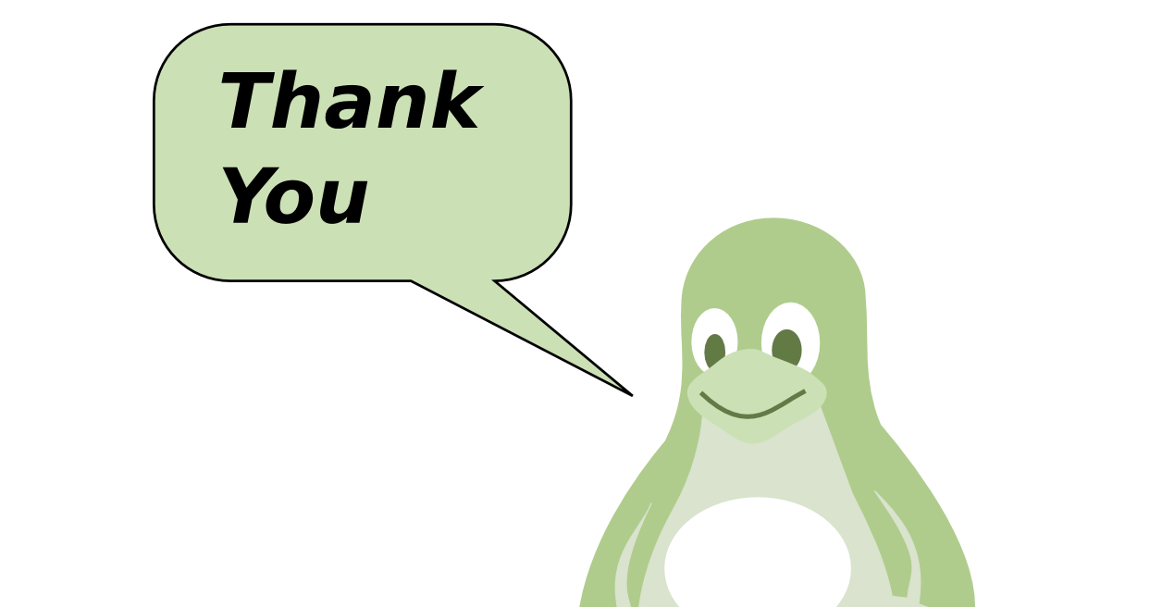
krother@academis.eu www.academis.eu

