Slide 1
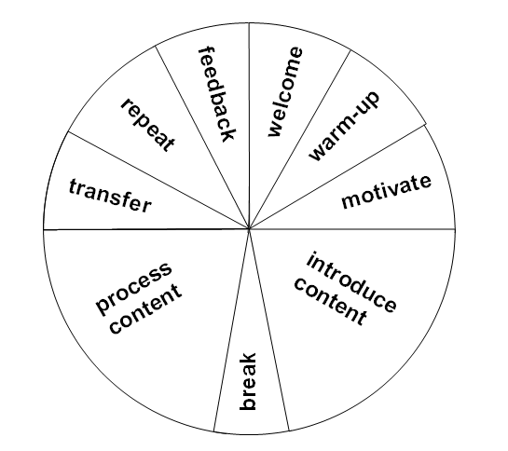
Lesson phases
Write up moderation techniques where they fit during a lesson.

