Slide 1
Course Syllabus: Carbohydrates
Chemical structure of carbohydrates
  monosaccharides
  glycosidic bonds
  polysaccharides
Biophysical properties:
  optical rotation
Carbohydrate metabolism
  glycolysis
  gluconeogenesis
Medical significance of carbohydrate metabolism
  carbohydrates and nutrition
  diabetes

Slide 2
Learning Goals: Carbohydrates
Students can draw glucose.
Students can recognize fructose, ribose, and saccharose
Students can define N- and O-glycosidic bonds.
Students can calculate the energy gained from glucose.
Students can evaluate whether their own nutrition is healthy.

Slide 3
Collecting concepts: Carbohydrates
Reproduce:
Students can draw glucose.
Students can recognize fructose, ribose, and saccharose
Students can define N- and O-glycosidic bonds.
Apply:
Students can calculate the energy gained from glucose.
Evaluate:
Students can evaluate whether their own nutrition is healthy.

Slide 4
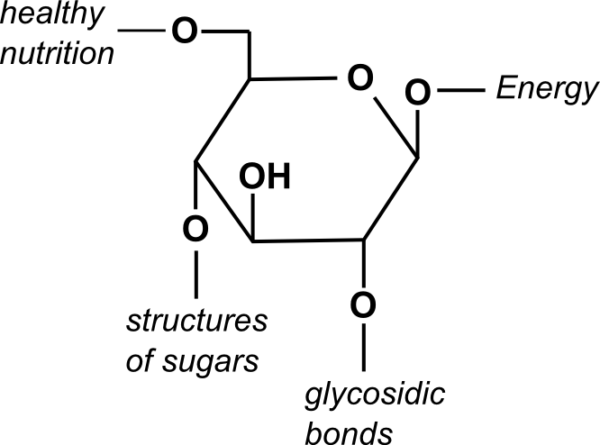
Carbohydrates

Slide 5
Lesson Plan: Carbohydrates
time
topic
method
09:00
What do you know about carbohydrates?
brainstorming
09:05
How do we get the energy our bodies need?
presentation
09:20
Annotate chemical structures
sheet with exercises
09:35
Answer questions
open discussion
09:40
True or false statements
quiz

