Slide 1
Progress bar
Include in a visual representation in a presentation or exercise of how much there is left to do.
Exercises to go:
○ ○ ○ ○ ○ ○ ○ ○

Slide 2
Poll by raising hands
Ask a question that can be answered by yes/no and ask for the answers by a raised arm.
„Who has prepared classes for more than 10 people?”

Slide 3
Brainstorming
Ask an open question and collect answers on the board. Do not comment or criticize anything (even if the answer is wrong!).
„What is important to prepare
a successful lesson”

Slide 4
Check & Cross
Write 8-15 concepts on the board.
Ask each student to briefly explain one of their choice. Mark each word that has been explained.
Blooms taxonomy
anchor
Lesson plan
feedback
content reduction
concept map
learning objective

Slide 5
2D Feedback
Ask everybody to add a cross in the plot.
For me, preparing lessons is
difficult
easy
boring
interesting

Slide 6
Upside down
Ask for the opposite of what you would like the students to learn.
Collect their suggestions.
„How to prepare the worst lesson possible?”

Slide 7
Discuss and Debrief
Ask a question and give students time to write down answers and discuss them with their neighbour.
After 1-2 minutes, collect results.
„What methods for teaching have you seen during this workshop?”

Slide 8
Simulation: Bubblesort
1) Shuffle the cards and lay them out in a row.
2) Look for a smaller card that is on the left of a bigger one.
3) Exchange the two so that the smaller card is on the left.
4) Repeat steps 2) and 3) until everything is sorted.
1.OK
2.OK
3.exchange
2
7
8
5
4

Slide 9
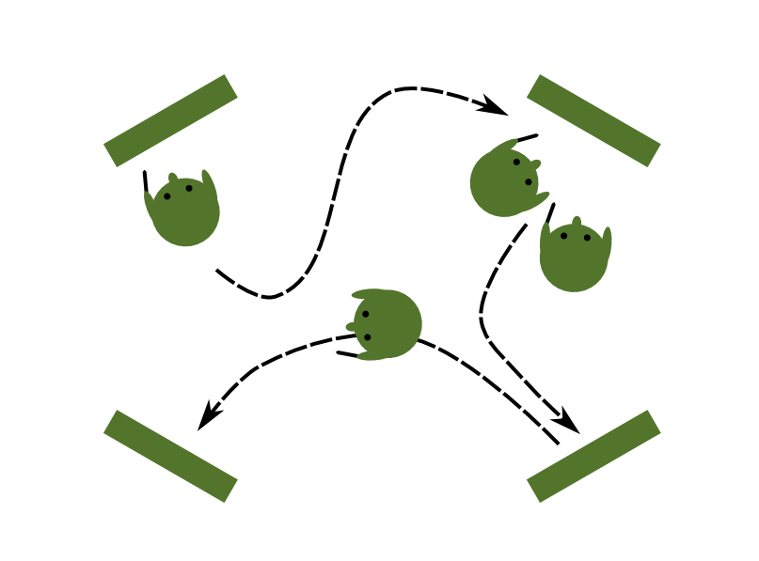
Four Corners
Prepare 4 questions on separate sheets of paper.
Give pens to the students and let them work the room.

Slide 10
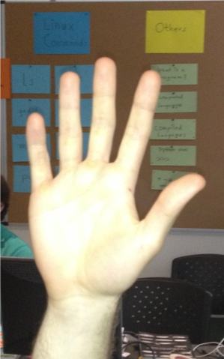
Fist or Five
Ask students to rate their learning success by showing between zero and five fingers. Gives you a rough impression how they feel at the end of a learning module.

Slide 11
Crossword
Write one word on an empty board. Ask students to insert concepts they learned during the day.
T
OBJECTIVES
A
C
H
I
N
G

Slide 12
Badges
Award the class badges for achievements during a course.
You can present them with a few badges so that they can set their own objectives for the next lesson.

Slide 13
Molecular Puzzle
The paper pieces represent components of the transcription machinery in yeast.
Assemble the transcription complex on the board or a large piece of paper. Draw a piece of DNA so that transcription can occur.
(may require extra knowledge)

Slide 14
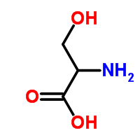
Structural Formula
The formula depicts the amino acid serine.
Reconstruct the structure from the given atoms.
Identify acidic and basic parts of the molecule.

Slide 15
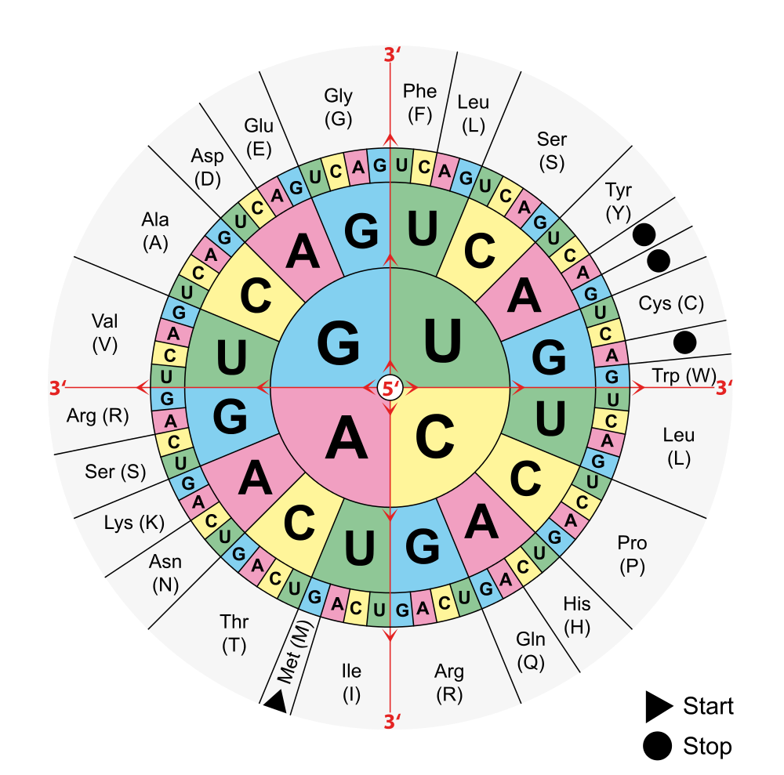
Example: Translation
You are given a part of the mRNA of hemoglobine:
AUGGUGCAUCUGACUCCUGAGGAGAAGUCUGCC
Translate it to a
protein sequence
using the triplet code.
Begin with the
start codon AUG.

Slide 16
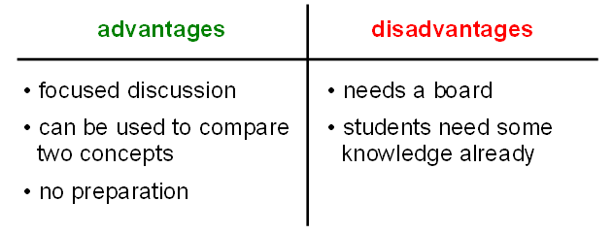
Pros and Cons
Collect pros and cons on the board.
The Pros and Cons method

Slide 17
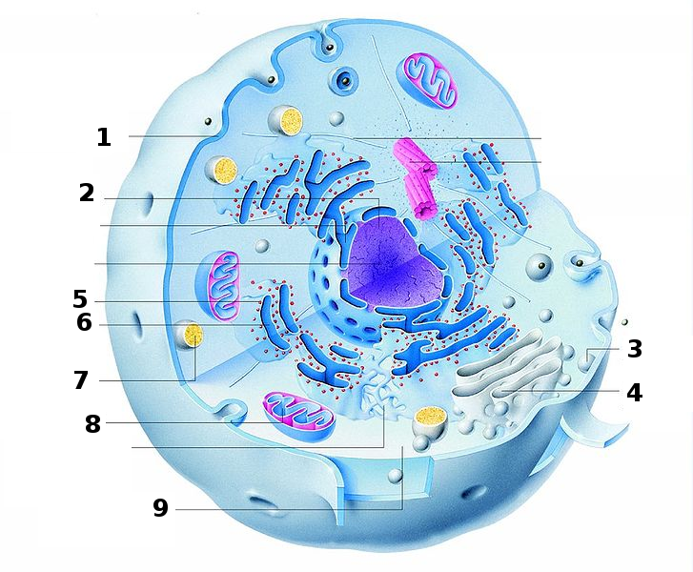
Name components of the cell

Slide 18
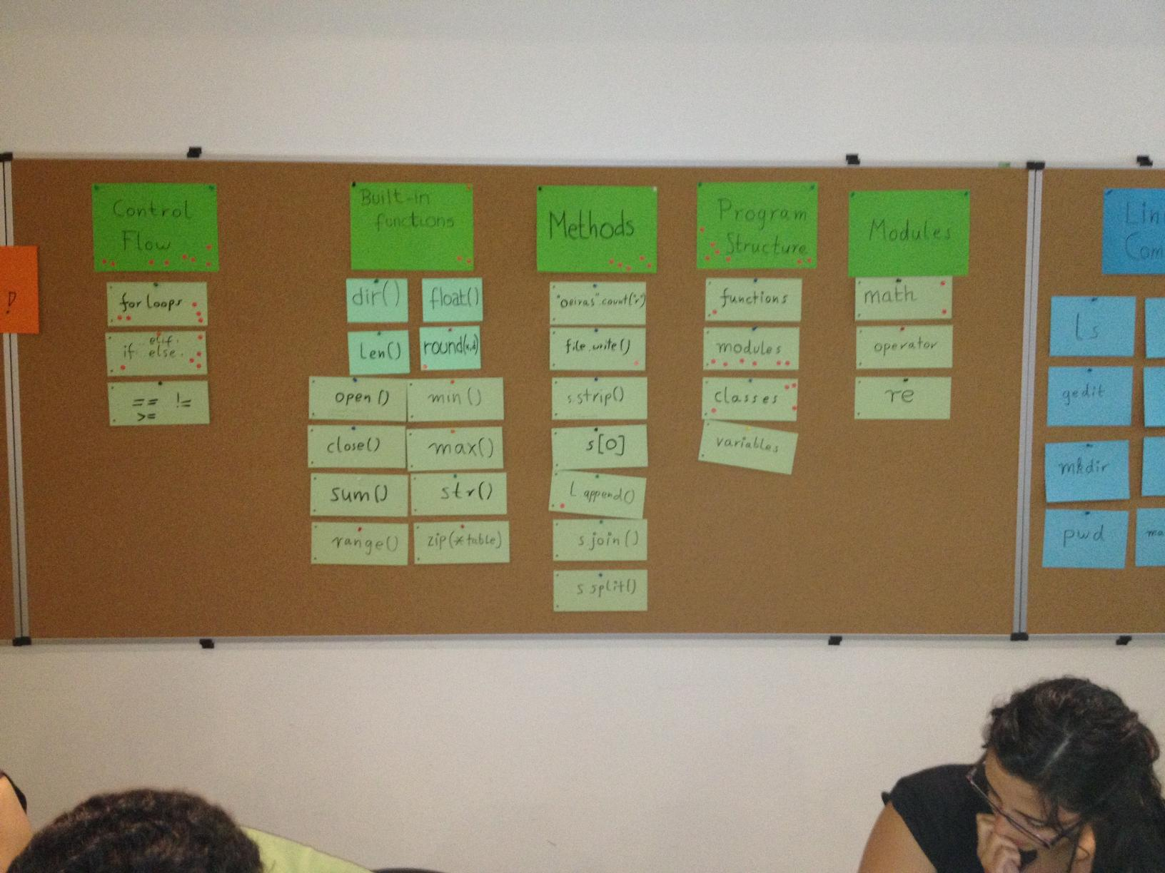
Knowledge Capacitor
Collect everything done so far in a visible place, so that students can recall concepts and see their progress.

Slide 19
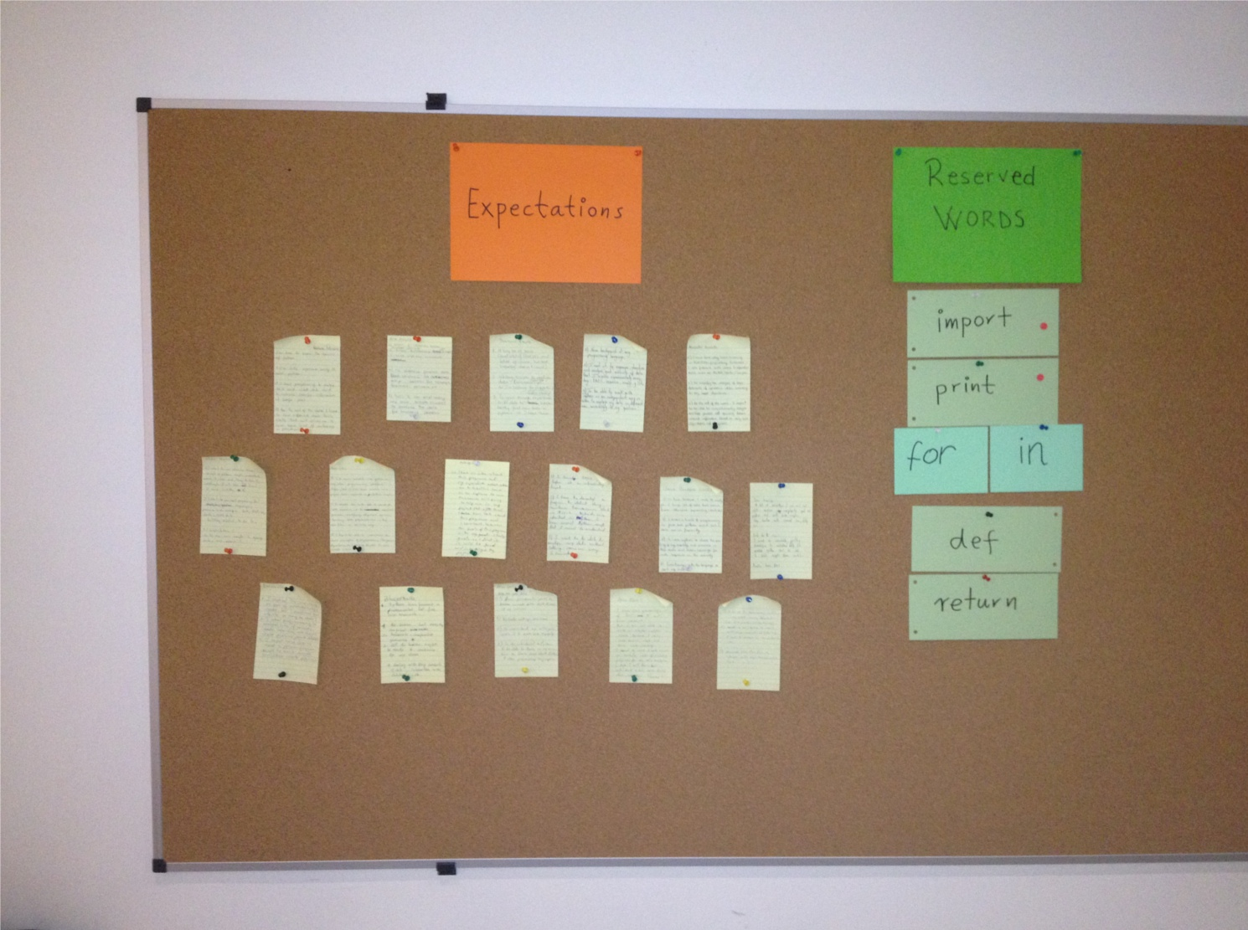
Expectations
Collect expectations from students at the beginning of a course, review them at the end.

Slide 20
Example: Neurochemistry
Attach the 9 neurochemistry cards to the board using magnets in random order.
Ask the students to sort them. Moderate the discussion.

Slide 21
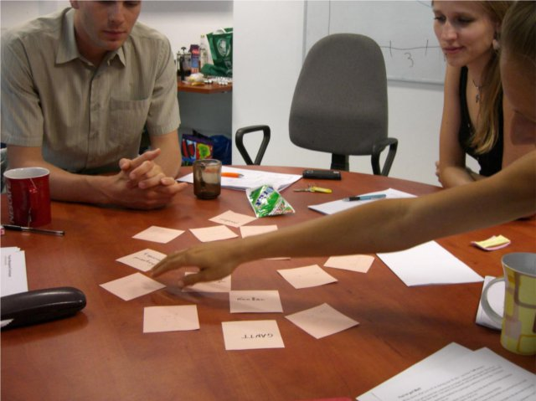
Memory
Place the cards face down on a table.
Students take turns turning a card and explaining the concept on it.

Slide 22
Example: Functional Groups
Name the chemical groups on the cards.

Slide 23
Motivation: sim email from your PI
From : boss@amu.edu.pl
To : you@amu.edu.pl
Subject: Interpreting BLAST results
Dear PhD student,
On the conference last week, I got a nice idea from a conversation with M.Portant. I made some BLAST queries with a couple of sequences of Phenylalanine-tRNAsynthetases (PheRS) from different organisms. The results need some cleanup, however. I saved the sequences in a set of files in the FASTA format. All files are in the same directory, and have the ending „.fasta”.
Because the sequence diversity of the aminoacyl-tRNA synthetase family is very high, there are probably many sequences from other aaRS proteins among the results. It is therefore necessary to filter out sequences that do not have the right tRNA specificity (marked by Phenylalanine, Phe etc in the sequence name). I think we might get something out of that that fits into your project. Could you find all the sequences for Phe and put them into a single FASTA file? We could then pass it to an alignment program. Your new programming skills might come in handy for that.
Best,
B.Bossy

Slide 24
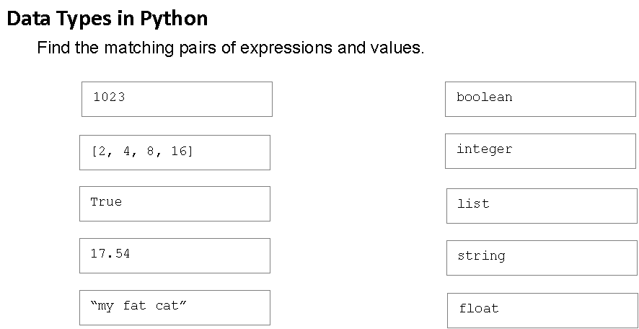
Find Pairs

