Slide 1
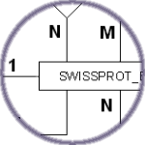
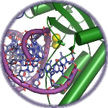
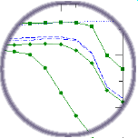


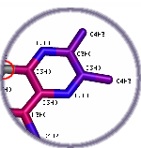
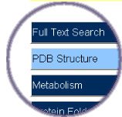
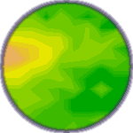
Multidimensional data integration
Analyzed DNA-binding sites
There is an annotation gap
www.columba-db.de
?
?

Slide 2
RNA structure prediction
Statistical
potential
components
build
structures
Secondary
structure
DNA
Proteins
(histones,
endonucleases,
polymerases,
...)

Slide 3
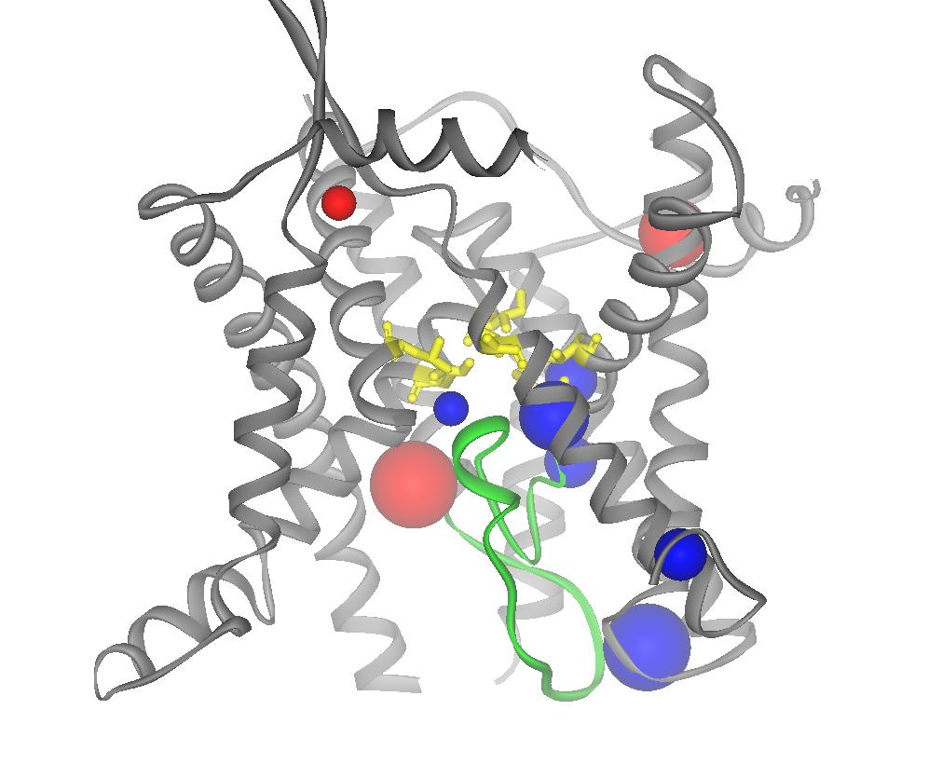
Molecular packing and packing defects
membrane
gates
helical
interfaces
helix geometry
polar cavities
nonpolar cavities

Slide 4
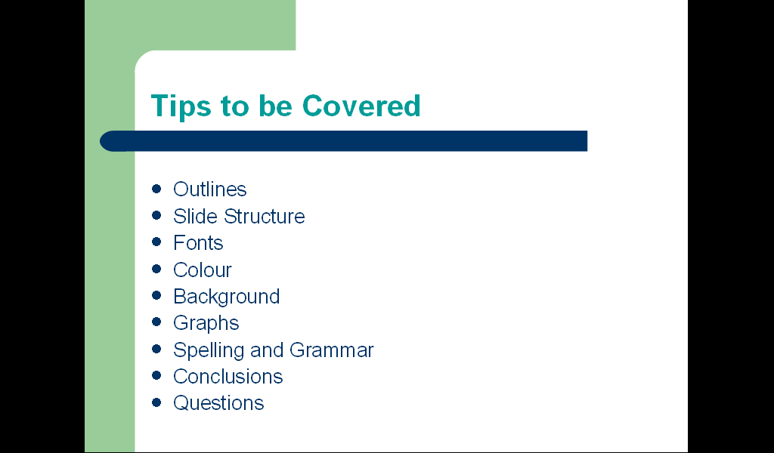

Slide 5
http://bioinf.charite.de
targets + ligands
similarity
Columba
Superligands
Superdrug
5,000
2,500
30,000
PDB ligands
known drugs
protein structures
PDB, CSD, Maybridge, ASINEX and other molecule databases

