Slide 1
DICOMweb Modality Services WG27 First Read
August 2024

Slide 2
Work item 2023-10-C – DICOMweb Modality Services
Introduction
The DICOM Standard defines several services. Two of these are targeted towards modalities, namely the Modality Worklist service (see PS3.4, Annex K, more specifically K.6.1) and the Modality Performed Procedure Step service (see PS3.4, Annex F, more specifically F.7-F.9). Currently, these services are defined using DIMSE.
Limitations of Current Standard
Both the Modality Worklist service and the Modality Performed Procedure Step service are not yet available in DICOMweb. This limits a) the uptake of DICOMweb for modalities and b) the support of workflow services for modalities that are (intended to be) part of a web-based ecosystem.
Description of Proposal
Add the Modality Worklist and the Modality Performed Procedure Step services to DICOMweb, in principle based on the existing DICOMweb Worklist service (UPS-RS; see PS3.18, section 11). This would boil down to creating an informative annex and any normative changes needed if gaps are discovered.

Slide 3
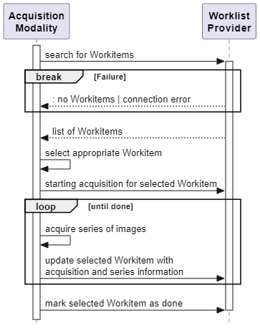
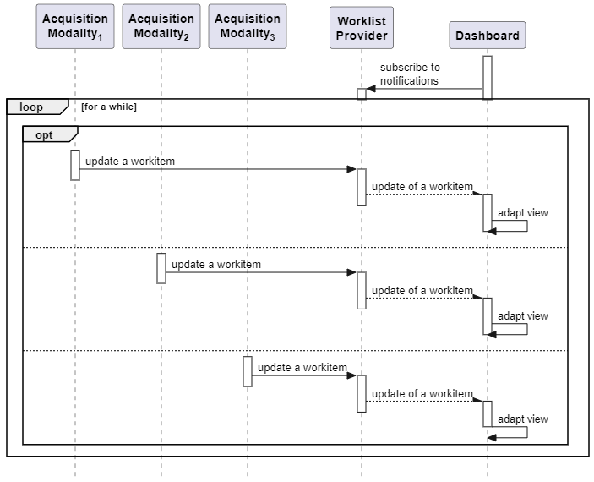
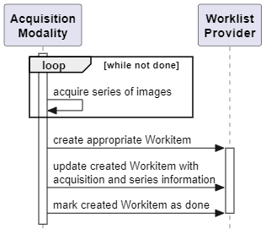
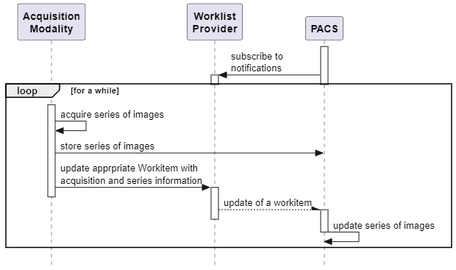
Scenarios Sketching the Context
Scheduled Acquisition Workflow
Acquisition Workflow Monitoring
Encounter-Based Acquisition Workflow
Reviewing Workflow

Slide 4
Overview – Relations between specifications
Symbol | Meaning
≡ | Equivalence
⊏ | Based-on
DICOMweb Modality Services (MSs-RS)
≡
DIMSE MWL DIMSE MPPS
⊏
⊏
DICOMweb Worklist Service (UPS-RS)
DIMSE UPS
Implicit mapping from MWL and MPPS to UPS.
Where is this mapping or
do we need to create it?
≡

Slide 5
Overview – Primitives of DICOMweb Modality Services
Get Applicable Workitems
Claim and Prepare Workitem
Report Progress on Workitem
Change Workitem State
Retrieve Workitem
Get Notified initialize
“The modality should inform the Information System as soon as possible that the performance of the Procedure Step has been started by sending the N-CREATE Service Request. … Some of the Attribute Values are already known at the beginning of the Procedure Step, they are required to be sent in the N-CREATE command.”
Note in PS3.4, F.7.2.1

Slide 6
Overview – Primitives of DICOMweb Modality Services (MappeD)
MSs-RS
≡
MWL
MPPS
Get Applicable Workitems_{MSs-RS} ≡ Query_{MWL}
Claim and Prepare Workitem_{MSs-RS} ≡ Create_{MPPS}
Report Progress on Workitem_{MSs-RS} ≡ Set Information_{MPPS}
Change Workitem State_{MSs-RS} ≡ Set Information_{MPPS}
Retrieve Workitem_{MSs-RS} ≡ Get Information_{MPPS}
Get Notified_{MSs-RS} ≡ Receive Event Notification_{MPPS}
Notes:
Applicable SOP Classes
C-FIND_{MWL} 1.2.840.10008.5.1.4.31
N-CREATE_{MPPS}, N-SET_{MPPS} 1.2.840.10008.3.1.2.3.3
N-GET_{MPPS} 1.2.840.10008.3.1.2.3.4
N-EVENT-REPORT_{MPPS} 1.2.840.10008.3.1.2.3.5

Slide 7
Overview – Primitives of DICOMweb Modality Services (MappeD)
MSs-RS
≡
MWL
MPPS
Get Applicable Workitems_{MSs-RS} ≡ C-FIND_{MWL}
Claim and Prepare Workitem_{MSs-RS} ≡ N-CREATE_{MPPS}
Report Progress on Workitem_{MSs-RS} ≡ N-SET_{MPPS}
Change Workitem State_{MSs-RS} ≡ N-SET_{MPPS}
Retrieve Workitem_{MSs-RS} ≡ N-GET_{MPPS}
Get Notified_{MSs-RS} ≡ N-EVENT-REPORT_{MPPS}
Notes:
Applicable SOP Classes
C-FIND_{MWL} 1.2.840.10008.5.1.4.31
N-CREATE_{MPPS}, N-SET_{MPPS} 1.2.840.10008.3.1.2.3.3
N-GET_{MPPS} 1.2.840.10008.3.1.2.3.4
N-EVENT-REPORT_{MPPS} 1.2.840.10008.3.1.2.3.5

Slide 8
Overview – Primitives of DICOMweb Modality Services (MappeD)
MSs-RS
≡
MWL
MPPS
Get Applicable Workitems_{MSs-RS} ≡ Query_{MWL}
Claim and Prepare Workitem_{MSs-RS} ≡ Create_{MPPS}
Report Progress on Workitem_{MSs-RS} ≡ Set Information_{MPPS}
Change Workitem State_{MSs-RS} ≡ Set Information_{MPPS}
Retrieve Workitem_{MSs-RS} ≡ Get Information_{MPPS}
Get Notified_{MSs-RS} ≡ Receive Event Notification_{MPPS}
Notes:
Applicable SOP Classes
C-FIND_{MWL} 1.2.840.10008.5.1.4.31
N-CREATE_{MPPS}, N-SET_{MPPS} 1.2.840.10008.3.1.2.3.3
N-GET_{MPPS} 1.2.840.10008.3.1.2.3.4
N-EVENT-REPORT_{MPPS} 1.2.840.10008.3.1.2.3.5

Slide 9
Overview – Primitives of DICOMweb Modality Services (MappeD)
MSs-RS
≡
MWL
MPPS
Get Applicable Workitems_{MSs-RS} ≡ Query_{MWL} ⊏ Search_{UPS-RS} ≡ Search_{UPS}
Claim and Prepare Workitem_{MSs-RS} ≡ Create_{MPPS} ⊏ Change Workitem State_{UPS-RS} ≡ Change State_{UPS} [ & Update Workitem_{UPS-RS} ] ≡ Set Information_{UPS}
Report Progress on Workitem_{MSs-RS} ≡ Set Information_{MPPS} ⊏ Update Workitem_{UPS-RS} ≡ Set Information_{UPS}
Change Workitem State_{MSs-RS} ≡ Set Information_{MPPS} ⊏ Change Workitem State_{UPS-RS} ≡ Change State_{UPS}
Retrieve Workitem_{MSs-RS} ≡ Get Information_{MPPS} ⊏ Retrieve Workitem_{UPS-RS} ≡ Get Information_{UPS}
Get Notified_{MSs-RS} ≡ Receive Event Notification_{MPPS} ⊏ <…>_{UPS-RS} ≡ Report a Change_{UPS}
⊏
⊏
UPS-RS
≡
UPS

Slide 10
Overview – Primitives of DICOMweb Modality Services (MappeD)
MSs-RS
≡
MWL
MPPS
Get Applicable Workitems_{MSs-RS} ≡ C-FIND_{MWL} ⊏ GET /workitems?{match}..._{UPS-RS} ≡ C-FIND_{UPS}
Claim and Prepare Workitem_{MSs-RS} ≡ N-CREATE_{MPPS} ⊏ PUT /workitems/{workitem}/state_{UPS-RS} ≡ N-ACTION_{UPS} [ & POST /workitems/{workitem}?..._{UPS-RS} ] ≡ N-SET_{UPS}
Report Progress on Workitem_{MSs-RS} ≡ N-SET_{MPPS} ⊏ POST /workitems/{workitem}?..._{UPS-RS} ≡ N-SET_{UPS}
Change Workitem State_{MSs-RS} ≡ N-SET_{MPPS} ⊏ PUT /workitems/{workitem}/state_{UPS-RS} ≡ N-ACTION_{UPS}
Retrieve Workitem_{MSs-RS} ≡ N-GET_{MPPS} ⊏ GET /workitems/{workitem}_{UPS-RS} ≡ N-GET_{UPS}
Get Notified_{MSs-RS} ≡ N-EVENT-REPORT_{MPPS} ⊏ <websocket call>_{UPS-RS} ≡ N-EVENT-REPORT_{UPS}
⊏
⊏
UPS-RS
≡
UPS

Slide 11
DIMSE Notifications vs DICOMweb notifications
For modality services, SCPs can send update messages
PS3.4, F.9.2 Notifications [of MPPS] “The Application Entity that claims conformance as an SCU to this SOP Class shall be permitted to receive the following notification. The Application Entity that claims conformance as an SCP to this SOP Class shall be capable of providing the notifications defined in Table F.9.2-1.” Q: Can notification indeed be unsolicited/unsubscribed?
PS3.4, CC.2.4 Report a Change in UPS Status (N-EVENT-REPORT) “This operation allows an SCP to notify an SCU of a change in state of a UPS instance or a change in state of the SCP itself. This operation shall be invoked by the SCP through the DIMSE N-EVENT-REPORT Service.”
PS3.18, 8.10: “Some RESTful services support Notifications.” Applicable transactions for MSs-RS:
Subscribe_{UPS-RS} POST /workitems/{resource}/… ≡ Subscribe to Receive UPS Event Reports_{MPPS} N-ACTION_{MPPS}
Unsubscribe_{UPS-RS} DELETE {/resource} ≡ Unsubscribe from Receiving UPS Event Reports_{MPPS} N-ACTION_{MPPS}
Suspend_{UPS-RS} POST {/resource} ≡ Suspend Global Subscription_{MPPS} N-ACTION_{MPPS}
Q: Resuming indeed not possible?

Slide 12
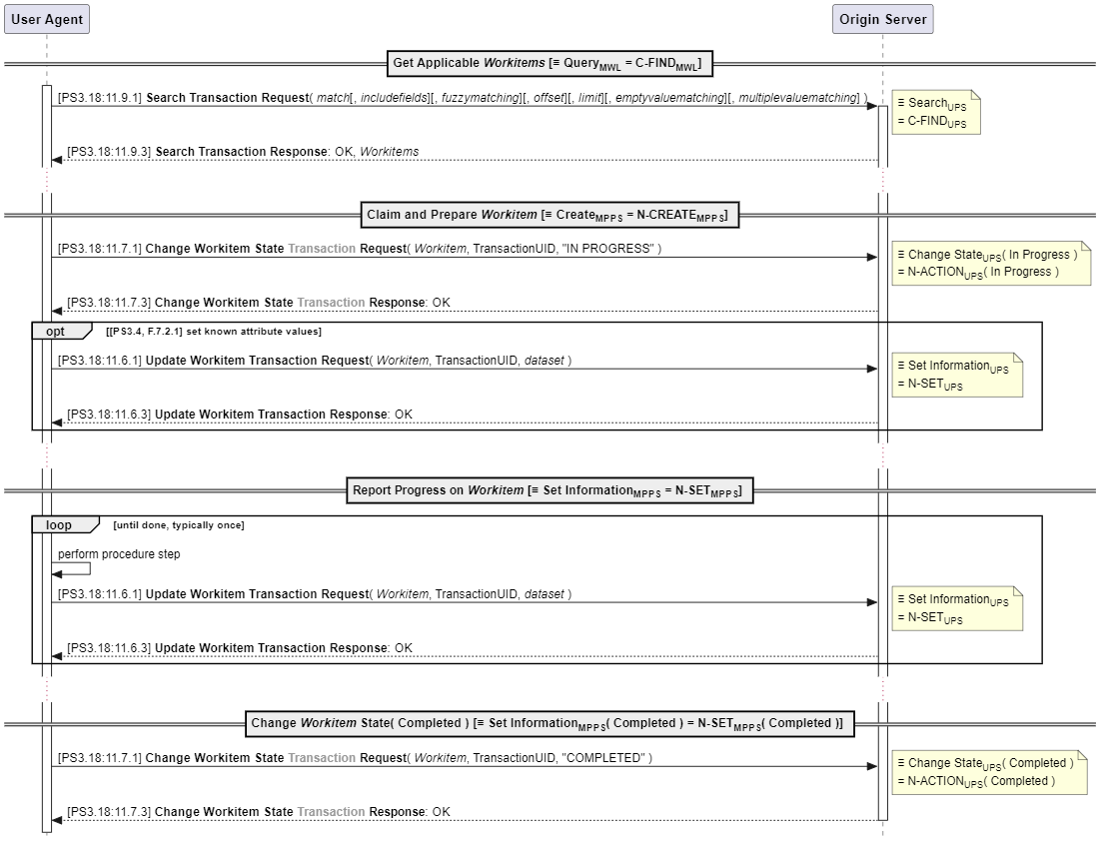
DICOMweb Modality Services – Happy Flow
Currently, sections 11.7 and 11.8 are not following the PS3.18 conventions, as they do not have ‘Transaction’ in their name. This has been reported to the editor.

Slide 13
DICOMweb Proxies with DIMSE
Observation
In DIMSE, the modality must copy information from the MWL to the MPPS. This is no longer needed when using UPS-RS, as (some of) the applicable information is already in the workitem.
So, when a DIMSE Modality wants to use an Origin Server for Modality Services, the job of the proxy is relatively easy, namely it can ignore some of the provided data.
The other way around, when a DICOMweb Modality wants to connect to an SCP for MWL and/or MPPS, the proxy must provide information, as the Modality will not provide it.

Slide 14
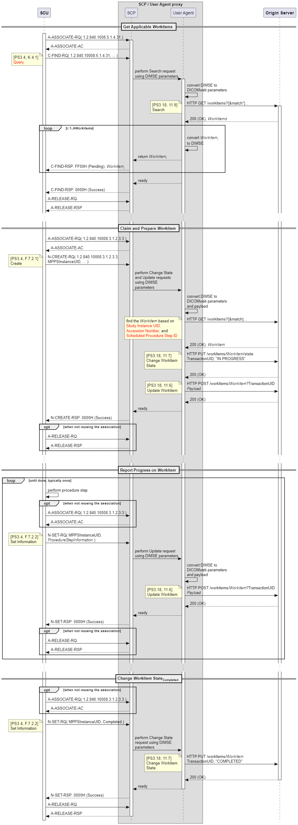
SCP / User Agent Proxy – MWL with UPS-RS

Slide 15
SCP / User Agent Proxy – MPPS Initialization with UPS-RS

Slide 16
SCP / User Agent Proxy – MPPS PROGRESS with UPS-RS

Slide 17
SCP / User Agent Proxy – MPPS Finalization with UPS-RS

Slide 18
Relating Workitems in MWL and MPPS
Note in PS3.4, F.7.2.1: “The modality should inform the Information System as soon as possible that the performance of the Procedure Step has been started by sending the N-CREATE Service Request. This allows an SCP of the Modality Worklist SOP Class (if supported) to update the Modality Worklist. Some of the Attribute Values are already known at the beginning of the Procedure Step, they are required to be sent in the N-CREATE command. Other mandatory Attributes are known only at the end of the Performed Procedure Step, they are assigned a value in the N-SET command.” Questions: 1. Clarify what is meant by ‘(if supported)’. 2. What attributes are already known at the beginning (and thus must be provided)? If these are not in DICOMweb workitems, these should be added at ‘claim time’. 3. Given the language, this note should not be a note.
PS3.17, J.2.1 Modality Conforms to Modality Worklist and MPPS SOP Classes (informative): “The modality may:
N-CREATE a MPPS SOP Instance and include its SOP Instance UID in the Image SOP Instances within the Referenced Performed Procedure Step Sequence Attribute.
Copy the following Attribute values from the Modality Worklist information into the Image SOP Instances and into the related MPPS SOP Instance:
Study Instance UID
Referenced Study Sequence
Accession Number
Requested Procedure ID
Scheduled Procedure Step ID
Scheduled Procedure Step Description
Scheduled Protocol Code Sequence
Create the following Attribute value and include it into the Image SOP Instances and the related MPPS SOP Instance:
Performed Procedure Step ID
Include the following Attribute values that may be generated during image acquisition, if supported, into the Image SOP Instances and the related MPPS SOP Instance:
Performed Procedure Step Start Date
Performed Procedure Step Start Time
Performed Procedure Step Description
Study ID”
Annex A of IHE RAD TF-2x reflects the adoption of the above, and contains clarifications, additions and a summary.

Slide 19
Next Steps
Get a supplement number
Sketch more scenarios (e.g. reviewing)
Continue the elaboration of proxies
Elaborate the ‘convert’ comments to set clear mappings to datasets / payloads

