Slide 1
Supplement 246 – DICOMweb Modality Workflow Services WG27 Public Comment
March 2025

Slide 2
Work item 2023-10-C – DICOMweb Modality Services
Introduction
The DICOM Standard defines several services. Two of these are targeted towards modalities, namely the Modality Worklist service (see PS3.4, Annex K, more specifically K.6.1) and the Modality Performed Procedure Step service (see PS3.4, Annex F, more specifically F.7-F.9). Currently, these services are defined using DIMSE.
Limitations of Current Standard
Both the Modality Worklist service and the Modality Performed Procedure Step service are not yet available in DICOMweb. This limits a) the uptake of DICOMweb for modalities and b) the support of workflow services for modalities that are (intended to be) part of a web-based ecosystem.
Description of Proposal
Add the Modality Worklist and the Modality Performed Procedure Step services to DICOMweb, in principle based on the existing DICOMweb Worklist service (UPS-RS; see PS3.18, section 11). This would boil down to creating an informative annex and any normative changes needed if gaps are discovered.

Slide 3
Progress
Since Tuesday
Presentation
Added slide with open issues
Reworked slides to reflect proposed approaches
Added slide with dual-headed server
Supplement
Added/rephrased open issues
Reworked text to reflect proposed approaches
Reworked comments
What happened since last meeting in January
Discussion in WG27
Created this presentation
Updated supplement 246
Added diagrams for bi-directional proxies
Added examples
Reworked comments from WG06
Agenda
Discuss and conclude on what HTTP method to be used for MPPS updates
Review this presentation
Continue line-by-line review of supplement
This slide is not to be included in the PC presentation

Slide 4
Discussion in WG27
Change of approach (based on MWL and MPPS) was very much appreciated
PATCH vs PUT and POST discussion: choose your battles
This slide is not to be included in the PC presentation

Slide 5
What HTTP Method is to be Used for MPPS Updates?
This is not about JSON PATCH!
HTTP PATCH versus PUT and POST
The PUT method provides a replacement of the entire resource (and thus requires bandwidth).
The POST method doesn’t have any generic semantics; the target resource processes the representation enclosed in the request according to the resource's own specific semantics
Drawback: “Server and client-side developers must write application-specific code to support it, then do QA on it, debug the corner cases, and eventually rewrite the API to fix the problems they inevitably find (partial updates can get subtle). Once you get a lot of these hanging around, it’s a pain.”
The PATCH method is a request method for making partial changes to an existing resource.
It is atomic, so either all or no changes
PATCH is well supported by origin servers and user agents (browsers).
This slide is not to be included in the PC presentation

Slide 6
What HTTP Method is to be Used for MPPS Updates?
Advantages of using HTTP PATCH method
Semantics of Update transaction will be in line with HTTP semantics; otherwise, DICOMweb will stay ‘special’
When adapting UPS-RS transactions to follow suit
These will then also be in line with HTTP semantics
The current PUT method for the Change Workitem State Transaction in UPS-RS is ‘weird’, as it requires a separate resource for state changes, which is not HTTP’s intent
This does not break any implementation (AFAWK)
Disadvantages of using HTTP PATCH
More or less implies to adopt the use of PATCH instead of POST and PUT in UPS-RS’ Update Workitem and Change Workitem State transactions
Is a breaking change of the spec
Proposal
Make this an Open Issue for PC, preferring PATCH
This slide is not to be included in the PC presentation

Slide 7
Overview of Services
The principle of basing the Modality Workflow Services on the existing DICOMweb Worklist Service (UPS-RS) has been relaxed due to the amount foreseen and identified standardization and implementation issues. The Modality Workflow Services are now based on their DIMSE counterparts.
Supplement 246 – DICOMweb Modality Workflow Services contains two new services:
Modality Scheduled Procedure Step Service, mimicking DIMSE’s Basic Worklist Management Service (PS3.4, Annex K).
Modality Performed Procedure Step Service, mimicking DIMSE’s Procedure Step SOP Classes (PS3.4, Annex F), where the DIMSE notifications are not covered.

Slide 8
Open Issues – Proposed Approaches
Do we want MPPS notifications like we have in DIMSE?
Exclude these from DICOMweb and make clear that an IHE SWF approach can be followed when needed.
What HTTP method do we want for doing updates on an MPPS resource?
The PATCH method seems most appropriate, as this is targeted towards partial changes.
Do we want to allow for partial changes of sequences in MPPSs (as this is currently not allowed in DIMSE)?
Although there is merit in this, it is proposed to write a CP for this when needed including DIMSE.
What should be the name of the service returning modality scheduled procedure steps?
It should be the Modality Scheduled Procedure Step Service (in contrast to something like Modality Worklist Service).

Slide 9
Modality Worklist Service – Resources and Transactions
Resource | URI Template | Description
Worklist | /modality-scheduled-procedure-steps | The collection of Modality Scheduled Procedure Steps managed by the origin server.
Transaction Name | Method | Payload |  | Description
 |  | Request | Success Response
Search | GET | none | dataset according to PS3.4, Table K.6-1 | Searches for Modality Scheduled Procedure Steps

Slide 10
Modality Worklist Service – DIMSE Relation and SYNTAX
Transaction | Operation | Reference | DIMSE Service
Search | Query Worklist | PS3.4, K.4 | C-FIND
Transaction | Request Syntax
Search | GET SP /modality-scheduled-procedure-steps?{&match*}{&includefield}{&fuzzymatching}{&offset}{&limit} SP version CRLF Accept: 1#media-type CRLF *(header-field CRLF) CRLF

Slide 11
Modality Performed Procedure Step Service – RES. & Trans.
Resource | URI Template | Description
Modality Performed Procedure Step | /modality-performed-procedure-steps/{mppsUID} | A Modality Performed Procedure Step.
Transaction Name | Method | Payload |  | Description
 |  | Request | Success Response
Create | PUT | dataset according to PS3.4, Table F.7.2-1 (N-CREATE) | none | Creates a new Modality Performed Procedure Step
Update | PATCH | dataset according to PS3.4, Table F.7.2-1 (N-SET) | none | Updates the target Modality Performed Procedure Step
Retrieve | GET | none | dataset according to PS3.4, Table F.8.2-1 | Retrieves the target Modality Performed Procedure Step

Slide 12
Modality Performed Procedure Step Service – DIMSE Rel.
Transaction | Operation | Reference | DIMSE Service
Create | Create MPPS Instance | PS3.4, F.7.2.1 | N-CREATE
Update | Set MPPS Information | PS3.4, F.7.2.2 | N-SET
Retrieve | Get MPPS Information | PS3.4, F.8.2.1 | N-GET

Slide 13
Modality Performed Procedure Step Service – SYNTAX
Transaction | Request Syntax
Create | PUT SP /modality-performed-procedure-steps/{mppsUID} SP version CRLF Accept: 1#media-type CRLF *(header-field CRLF) CRLF payload
Update | PATCH SP /modality-performed-procedure-steps/{mppsUID} SP version CRLF Accept: 1#media-type CRLF *(header-field CRLF) CRLF payload
Retrieve | GET SP /modality-performed-procedure-steps/{mppsUID}{?includefield*} SP version CRLF Accept: 1#media-type CRLF *(header-field CRLF) CRLF

Slide 14
Modality Workflow Services – Support of Transactions
Service | Transaction | Support
N.A. | Retrieve Capabilities | Required
Worklist Service | Search | Required
Modality Performed Procedure Step Service | Create | Required
 | Update | Required
 | Retrieve | Optional

Slide 15
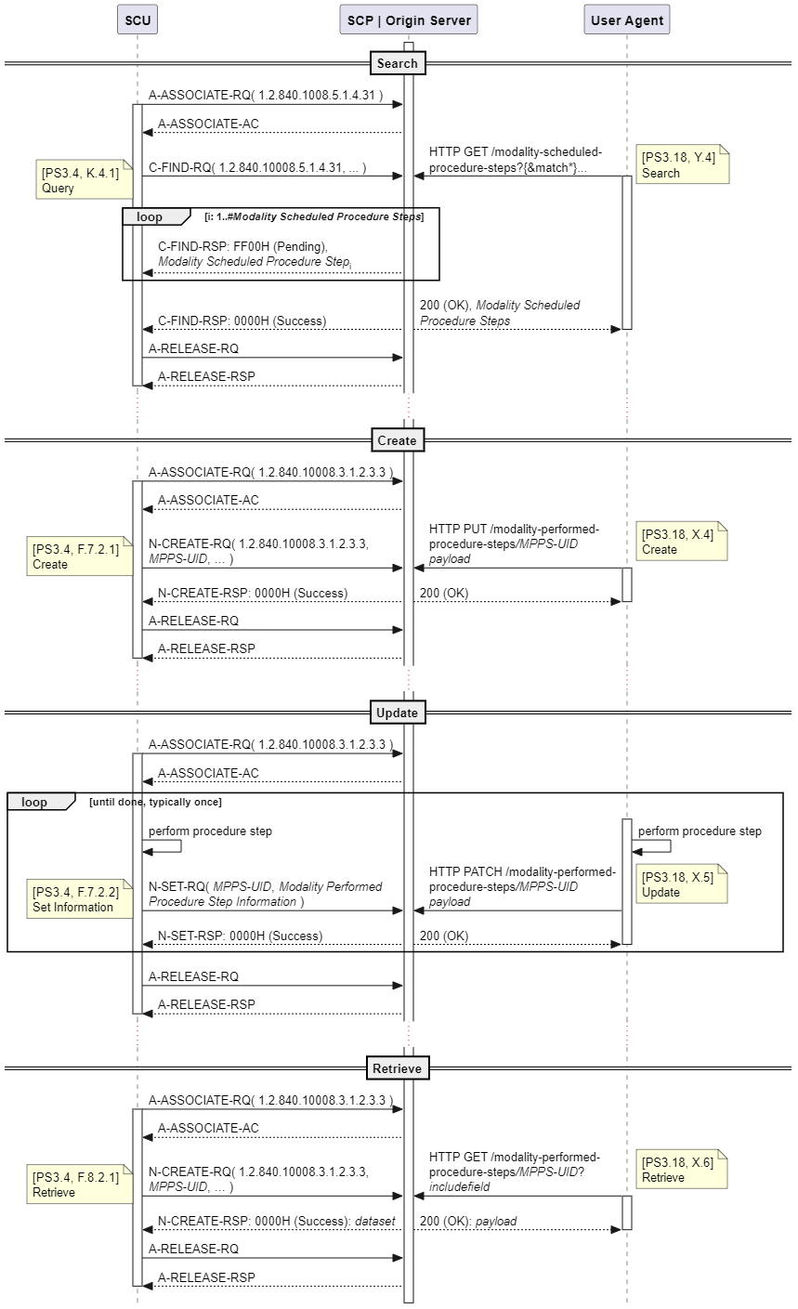
Example – Dual-Headed Server in Mixed Eco-System
Notes:
“It is likely that these modality workflow services are deployed in a mixed eco-system. Here, there would be one MPPS-handler, probably a PACS, and a community of modalities, some of which use the DIMSE service and some would use the DICOMweb service. There would also be a MPPS-consumer such as the RIS receiving ‘notifications’ or being able to retrieve MPPS status.” (look at the text and improve it) Use two threads in the SCP | Origin Server, to show their independence. SPS on different slide than PPS.

Slide 16
References
This presentation, the supplement, the examples and the analysis images (and much more) can be found at
https://github.com/krotz-dieter/dicomweb-dmwl-mpps

