Slide 1
Supplement 246 – DICOMweb Modality Workflow Services WG27 Public Comment
April 2025

Slide 2
Work item 2023-10-C – DICOMweb Modality Services
Introduction
The DICOM Standard defines several services. Two of these are targeted towards modalities, namely the Modality Worklist service (see PS3.4, Annex K, more specifically K.6.1) and the Modality Performed Procedure Step service (see PS3.4, Annex F, more specifically F.7-F.9). Currently, these services are defined using DIMSE.
Limitations of Current Standard
Both the Modality Worklist service and the Modality Performed Procedure Step service are not yet available in DICOMweb. This limits a) the uptake of DICOMweb for modalities and b) the support of workflow services for modalities that are (intended to be) part of a web-based ecosystem.
Description of Proposal
Add the Modality Worklist and the Modality Performed Procedure Step services to DICOMweb, in principle based on the existing DICOMweb Worklist service (UPS-RS; see PS3.18, section 11). This would boil down to creating an informative annex and any normative changes needed if gaps are discovered.

Slide 3
Overview of Services
The principle of basing the Modality Workflow Services on the existing DICOMweb Worklist Service (UPS-RS) has been relaxed due to the amount foreseen and identified standardization and implementation issues. The Modality Workflow Services are now based on their DIMSE counterparts.
Supplement 246 – DICOMweb Modality Workflow Services contains two new services:
Modality Scheduled Procedure Step Service, mimicking DIMSE’s Basic Worklist Management Service (PS3.4, Annex K).
Modality Performed Procedure Step Service, mimicking DIMSE’s Procedure Step SOP Classes (PS3.4, Annex F), where the DIMSE notifications are not covered.
To achieve notification-like behavior, it is recommended to mimic the approach taken in IHE’s Scheduled Workflow integration profile, where the Actor Modality Performed Procedure Step Manager forwards the creation and updating of Modality Performed Procedure Steps to other Actors that are interested in progress.

Slide 4
Open Issues With Proposed Approaches
Do we want MPPS notifications like we have in DIMSE?
Exclude these from DICOMweb and make clear that an IHE SWF approach can be followed when needed.
What HTTP method do we want for doing updates on an MPPS resource?
The PATCH method seems most appropriate, as this is targeted towards partial changes.
Do we want to allow for partial changes of sequences in MPPSs (as this is currently not allowed in DIMSE)?
Although there is merit in this, it is proposed to write a CP for this when needed including DIMSE.
What should be the name of the service returning modality scheduled procedure steps?
It should be the Modality Scheduled Procedure Step Service (in contrast to something like Modality Worklist Service).

Slide 5
Modality Scheduled Procedure Step Service Resources and Transactions
Resource | URI Template | Description
Modality Scheduled Procedure Steps | /modality-scheduled-procedure-steps | The collection of Modality Scheduled Procedure Steps managed by the origin server.
Transaction Name | Method | Payload |  | Description
 |  | Request | Success Response
Search | GET | none | dataset according to PS3.4, Table K.6-1 | Searches for Modality Scheduled Procedure Steps

Slide 6
Modality Scheduled Procedure Step Service DIMSE Relation and SYNTAX
Transaction | Operation | Reference | DIMSE Service
Search | Query Worklist | PS3.4, K.4 | C-FIND
Transaction | Request Syntax
Search | GET SP /modality-scheduled-procedure-steps?{&match*}{&includefield}{&fuzzymatching}{&offset}{&limit} SP version CRLF Accept: 1#media-type CRLF *(header-field CRLF) CRLF

Slide 7
Modality Performed Procedure Step Service RESources and Transactions
Resource | URI Template | Description
Modality Performed Procedure Step | /modality-performed-procedure-steps/{mppsUID} | A Modality Performed Procedure Step.
Transaction Name | Method | Payload |  | Description
 |  | Request | Success Response
Create | PUT | dataset according to PS3.4, Table F.7.2-1 (N-CREATE) | none | Creates a new Modality Performed Procedure Step
Update | PATCH | dataset according to PS3.4, Table F.7.2-1 (N-SET) | none | Updates the target Modality Performed Procedure Step
Retrieve | GET | none | dataset according to PS3.4, Table F.8.2-1 | Retrieves the target Modality Performed Procedure Step

Slide 8
Modality Performed Procedure Step Service DIMSE Relation
Transaction | Operation | Reference | DIMSE Service
Create | Create MPPS Instance | PS3.4, F.7.2.1 | N-CREATE
Update | Set MPPS Information | PS3.4, F.7.2.2 | N-SET
Retrieve | Get MPPS Information | PS3.4, F.8.2.1 | N-GET

Slide 9
Modality Performed Procedure Step Service SYNTAX
Transaction | Request Syntax
Create | PUT SP /modality-performed-procedure-steps/{mppsUID} SP version CRLF Accept: 1#media-type CRLF *(header-field CRLF) CRLF payload
Update | PATCH SP /modality-performed-procedure-steps/{mppsUID} SP version CRLF Accept: 1#media-type CRLF *(header-field CRLF) CRLF payload
Retrieve | GET SP /modality-performed-procedure-steps/{mppsUID}{?includefield*} SP version CRLF Accept: 1#media-type CRLF *(header-field CRLF) CRLF

Slide 10
Modality Workflow Services Support of Transactions
Service | Transaction | Support
N.A. | Retrieve Capabilities | Required
Worklist Service | Search | Required
Modality Performed Procedure Step Service | Create | Required
 | Update | Required
 | Retrieve | Optional

Slide 11
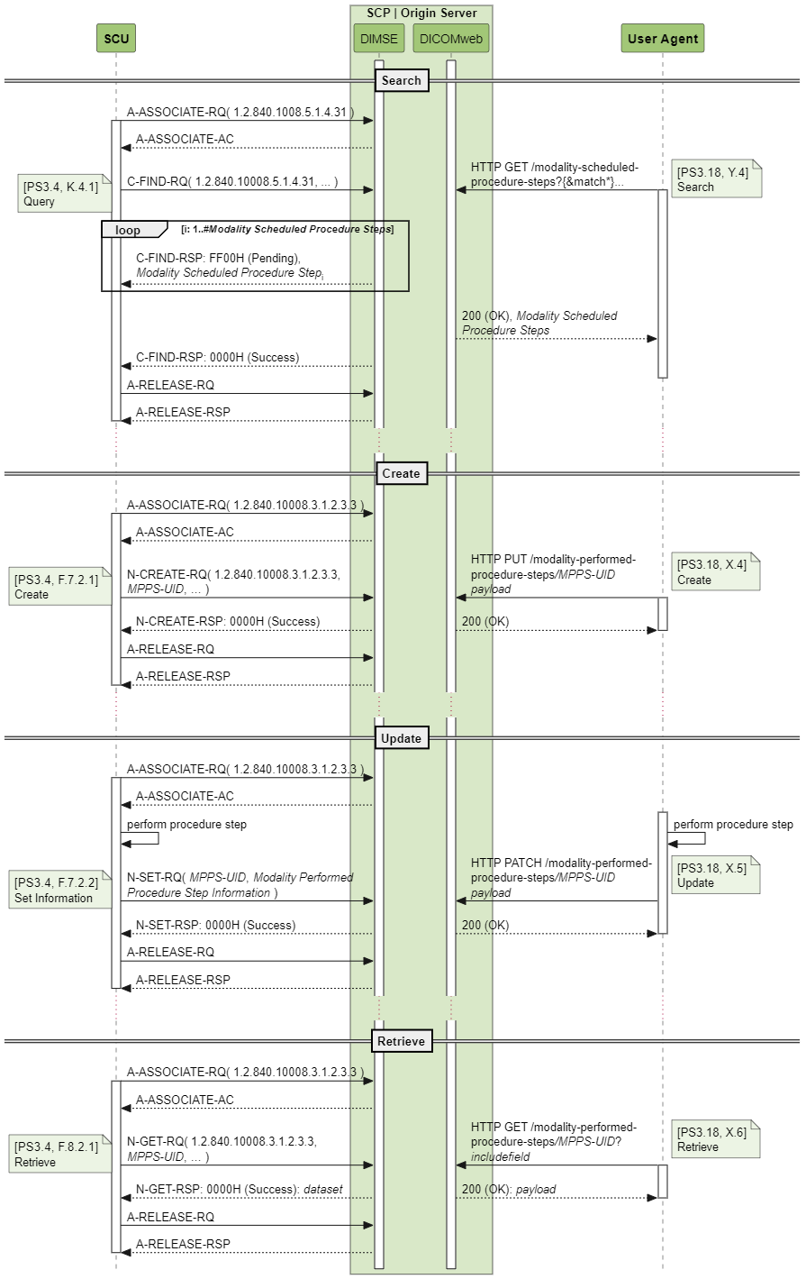
Example of a Dual-Headed Server in Mixed Eco-System Basic Worklist Service / Modality Scheduled Procedure Step Service
It is likely that the modality workflow services defined in this supplement are deployed in a mixed eco-system. Here, there could be one MPPS-handler, probably a PACS, and a community of modalities, some of which would use the DIMSE service and some of which would use the DICOMweb service. Below it is shown how such an eco-system could function for DIMSE’s Basic Worklist Service and DICOMweb’s Modality Scheduled Procedure Step Service.
Note that although some messages are drawn next to each other, this does not mean they need to happen at the same time. It is only done to indicate semantic equivalence.

Slide 12
Example of a Dual-Headed Server in Mixed Eco-System Modality Performed Procedure Step Service
Below it is shown how such an eco-system could function for DIMSE’s and DICOMweb’s Modality Performed Procedure Step Service.

Slide 13
References
This presentation, the supplement, the examples and the analysis images (and much more) can be found at
https://github.com/krotz-dieter/dicomweb-dmwl-mpps

