Slide 1
DICOMweb Modality Services WG27 First Read
May 2024

Slide 2
Work item 2023-10-C – DICOMweb Modality Services
Introduction
The DICOM Standard defines several services. Two of these are targeted towards modalities, namely the Modality Worklist service (see PS3.4, Annex K, more specifically K.6.1) and the Modality Performed Procedure Step service (see PS3.4, Annex F, more specifically F.7-F.9). Currently, these services are defined using DIMSE.
Limitations of Current Standard
Both the Modality Worklist service and the Modality Performed Procedure Step service are not yet available in DICOMweb. This limits a) the uptake of DICOMweb for modalities and b) the support of workflow services for modalities that are (intended to be) part of a web-based ecosystem.
Description of Proposal
Add the Modality Worklist and the Modality Performed Procedure Step services to DICOMweb, in principle based on the existing DICOMweb Worklist service (UPS-RS; see PS3.18, section 11). This would boil down to creating an informative annex and any normative changes needed if gaps are discovered.

Slide 3
Overview – Relations between specifications
Symbol | Meaning
≡ | Equivalence
⊏ | Based-on
DICOMweb Modality Services
≡
DIMSE MWL DIMSE MPPS
⊏
⊏
DICOMweb Worklist Service
DIMSE UPS
Implicit mapping from MWL and MPPS to UPS.
Where is this mapping or
do we need to create it?
≡

Slide 4
Overview – Primitives of DICOMweb Modality Services
Get applicable Workitems
Claim a Workitem
Report progress on Workitem
Mark Workitem as done
Retrieve Workitem
Get Notified

Slide 5
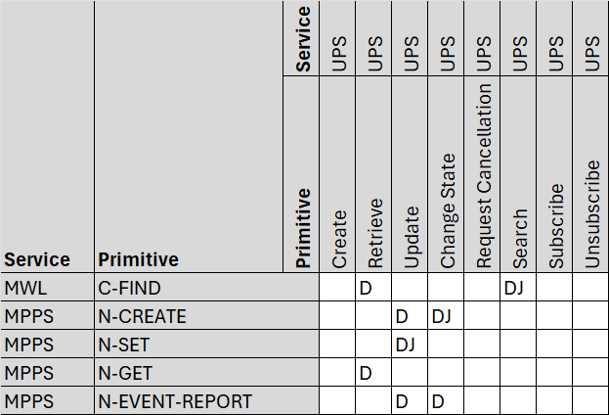
Overview – Primitives of DICOMweb Modality Services (MappeD)
Get applicable Workitems ≡ C-FIND_{MWL} ⊏ Search ≡ C-FIND
Claim a Workitem ≡ N-CREATE_{MPPS} ⊏ Change Workitem State ≡ N-ACTION
Report progress on Workitem ≡ N-SET_{MPPS} ⊏ Update Workitem ≡ N-SET
Mark Workitem as done ≡ N-SET_{MPPS} ⊏ Change Workitem State ≡ N-ACTION
DwMSs
≡
DiMWL DiMPPS
⊏
⊏
DwWS
≡
DiUPS
There are several differences between Dieter’s and Jeroen’s mapping. Direction of mapping does not matter, esp. when proxies are to be shown.
Why is a Retrieve needed for getting the worklist? The response has the worklist/work items. Even stronger, why does Retrieve exist at all?
Why should an N-CREATE map to an Update? What needs to be updated next to the state? All relevant information should already be in the applicable work item.
What mapping is needed for N-GET and N-EVENT-REPORT? Do we need to support the MPPS Retrieve and Notification SOP classes? Seems hardly used.

Slide 6
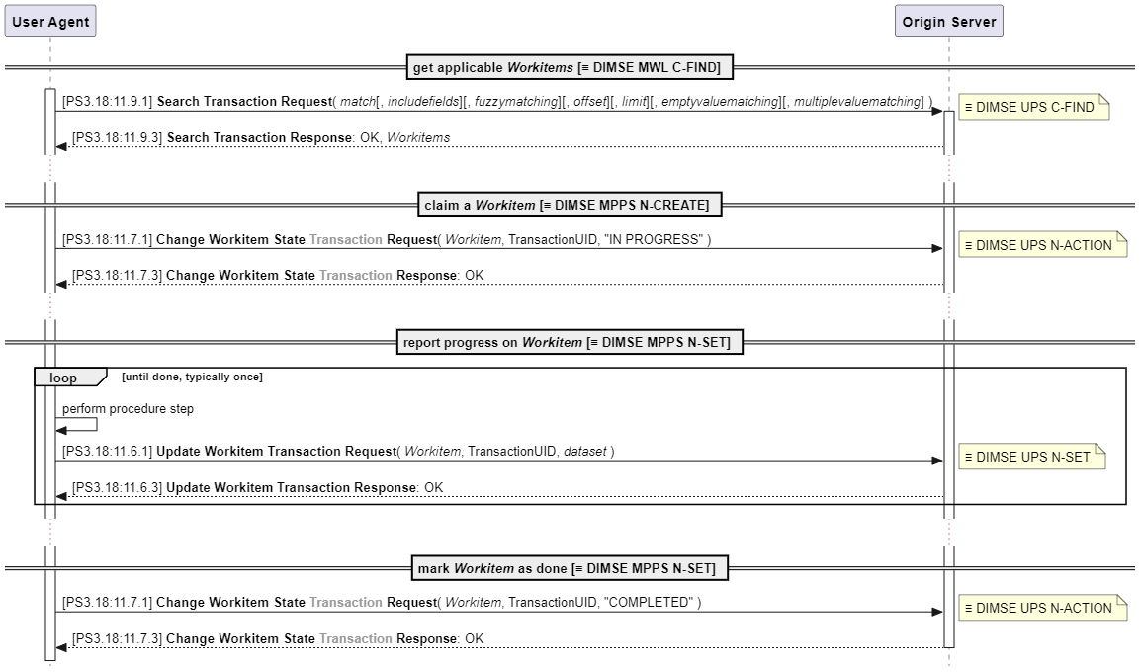
DICOMweb Modality Services – Happy Flow
Currently, sections 11.7 and 11.8 are not following the PS3.18 conventions, as they do not have ‘Transaction’ in their name. This has been reported to the Editor.

Slide 7
DICOMweb Proxies with DIMSE
In DIMSE, the modality must copy information from the MWL to the MPPS. This is no longer needed when using UPS (the applicable information is already in the workitem). So, when a DIMSE Modality wants to use an Origin Server for Modality Services, the job of the proxy is relatively easy, namely it can ignore some of the provided data. The other way around, when a DICOMweb Modality wants to connect to an SCP for MWL and/or MPPS, the proxy must provide information, as the Modality will not provide it.
Assumption: it is not an issue if hybrid modality workflows are not supported: a modality workflow started in DIMSE must continue and be finished in DIMSE and a modality workflow started in DICOMweb must continue and be finished in DICOMweb. The reason for this assumption that the underlying mechanisms are – chosen to be – different: DIMSE creates a workitem when performing MPPS, while DICOMweb uses an existing one. This may be an issue when hybrid workflows are permitted. (Note that it was a requirement from the DSC that the DICOMweb Modality Services must be built on top of DICOMweb Worklist Service, mapping two different mechanisms.)

Slide 8
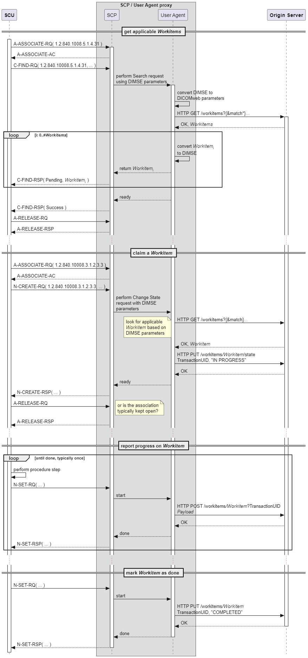
SCP / User Agent Proxy – MWL with UPS-RS

Slide 9
SCP / User Agent Proxy – Claim a Workitem with UPS-RS

Slide 10
Relating Workitems in MWL and MPPS
PS3.4, F.7.2.1: “The modality should inform the Information System as soon as possible that the performance of the Procedure Step has been started by sending the N-CREATE Service Request. This allows an SCP of the Modality Worklist SOP Class (if supported) to update the Modality Worklist. Some of the Attribute Values are already known at the beginning of the Procedure Step, they are required to be sent in the N-CREATE command. Other mandatory Attributes are known only at the end of the Performed Procedure Step, they are assigned a value in the N-SET command.” Questions: 1. Clarify what is meant by ‘(if supported)’. 2. How does the SCP identify the applicable work item based on the initial MPPS? 3. What attributes are already known at the beginning (and thus must be provided)? If some of these are not in DICOMweb workitems, these should be added at ‘claim time’.
PS3.17, J.2.1 Modality Conforms to Modality Worklist and MPPS SOP Classes (informative): “The modality may:
N-CREATE a MPPS SOP Instance and include its SOP Instance UID in the Image SOP Instances within the Referenced Performed Procedure Step Sequence Attribute.
Copy the following Attribute values from the Modality Worklist information into the Image SOP Instances and into the related MPPS SOP Instance:
Study Instance UID
Referenced Study Sequence
Accession Number
Requested Procedure ID
Scheduled Procedure Step ID
Scheduled Procedure Step Description
Scheduled Protocol Code Sequence
Create the following Attribute value and include it into the Image SOP Instances and the related MPPS SOP Instance:
Performed Procedure Step ID
Include the following Attribute values that may be generated during image acquisition, if supported, into the Image SOP Instances and the related MPPS SOP Instance:
Performed Procedure Step Start Date
Performed Procedure Step Start Time
Performed Procedure Step Description
Study ID”
Annex A of IHE RAD TF-2x reflects the adoption of the above, and contains clarifications, additions and a summary.

Slide 11
FLOW – Get applicable workitems

Slide 12
Flow – claim a workitem

Slide 13
Flow – report progress on workitem

Slide 14
Flow – mark workitem as done

