Slide 1
CS5800 – ALGORITHMS MODULE 5. DATA STRUCTURES & GRAPHS Lesson 1: Adjacency Matrices & Lists
Ravi Sundaram

Slide 2
Topics
Review of basic graph terminology
Recap of graph representations
Summary

Slide 3
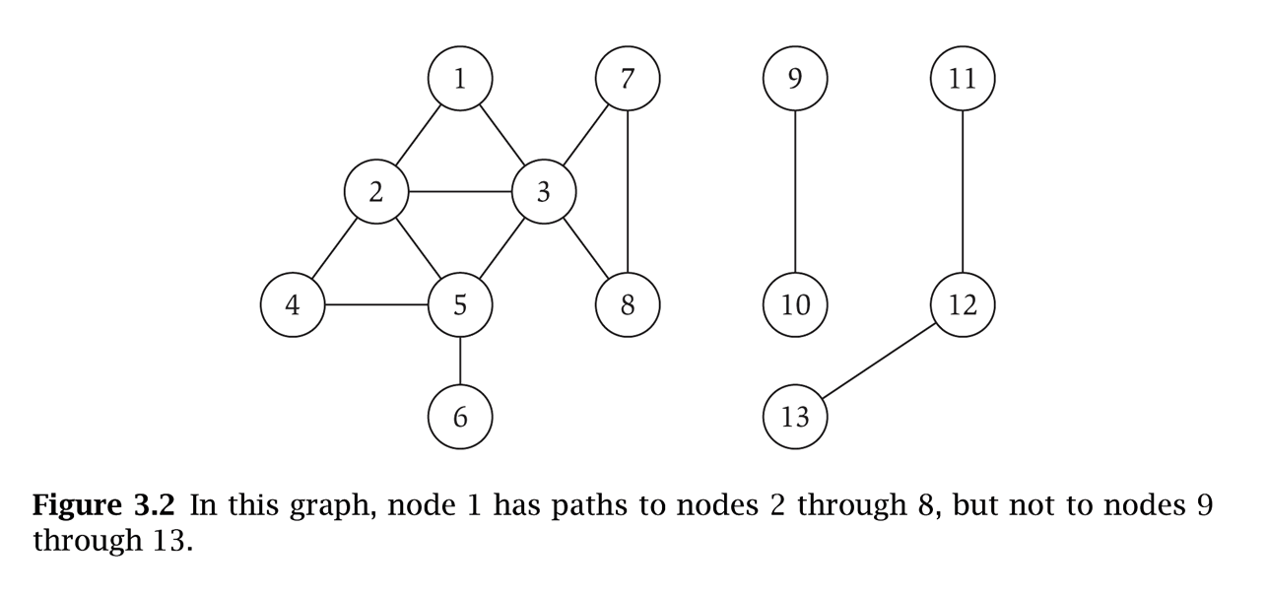
Undirected & Directed Graphs
Undirected graph. G = (V, E)
V = nodes.
E = edges between unordered pairs of nodes.
Captures pairwise relationship between objects.
Graph size parameters: n = |V|, m = |E|.
Directed graph.
E = arcs or directed edges, i.e. ordered pairs of nodes.
2
V = { 1, 2, 3, 4 }
E = { 1-2, 2-1, 2-4, 4-3 n = 4
m = 4
1
4
V = { 1, 2, 3, 4, 5, 6, 7, 8 }
E = { 1-2, 1-3, 2-3, 2-4, 2-5, 3-5, 3-7, 3-8, 4-5, 5-6 } n = 8
m = 11
3

Slide 4
Graphs
In an undirected graph, the edges are two-element subsets of V: {u, v}. Draw edges with lines.
In a directed graph, the edges are ordered pairs of vertices (u, v). Draw edges with arrows.
You can generally assume no self-loops.
Usually you don’t have multiple edges connecting the same two vertices — i.e., (u, v) is in the graph or not, but it isn’t there twice (E is a set). If a situation warrant multi-edges then the graph is called a multigraph

Slide 5
Applications
Computer networks
Shortest paths graph algorithm used for routing packets
Pathfinding
In both video games and real-world applications, maps are represented as graphs
The World Wide Web
Search engines want to find and penalize “link farms” that all link to each other … a property of the link graph
Basically any problem that involves reasoning about connections!

Slide 6
Graph Applications and models
Graph
Nodes
Edges
transportation
street intersections
highways
communication
computers
fiber optic cables
World Wide Web
web pages
hyperlinks
social
people
relationships
food web
species
predator-prey
software systems
functions
function calls
scheduling
tasks
precedence constraints
circuits
gates
wires

Slide 7
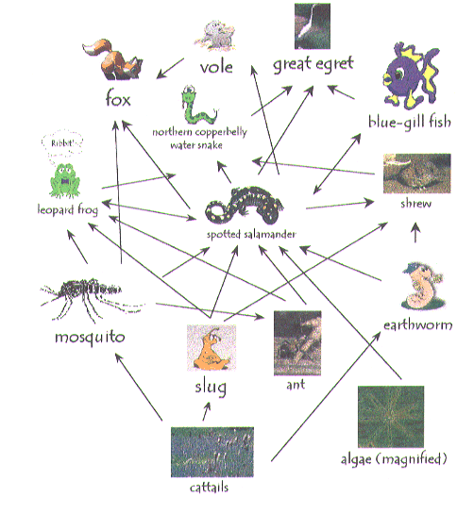
Ecological Food Web
Food web graph.
Node = species.
Edge = from prey to
predator.

Slide 8
Paths & Cycles
cycle C = 1-2-4-5-3-1
A path in an undirected graph G = (V, E) is a sequence P of nodes v₁, v₂, …, v_{k-1}, v_{k} with the property that each consecutive pair v_{i}, v_{i+1} is joined by an edge in E.
A path is simple if all nodes are distinct.
A cycle is a path v₁, v₂, …, v_{k-1}, v_{k} in which v₁ = v_{k}, k > 2, and the first k-1 nodes are all distinct.

Slide 9
Connectivity & Distance
Unweighted
Weighted
C
D
C
D
7
By default, graphs are unweighted: the distance from a vertex to its neighbor (vertex reachable in one step) is assumed to be 1.
The shortest path between two nodes is the path between those nodes that uses the fewest edges
Weighted graphs can represent distances and costs of paths between vertices (each edge gets a number that is its weight)
Shortest path (sometimes “cheapest path” to make a distinction) is path with smallest sum of weights.
Weakly
connected
B
Strongly
connected
B
A
C
A
C
An undirected graph is connected if for every pair of nodes u and v, there is a path between u and v.
In directed graphs, connectivity has two varieties.
A directed graph is weakly connected if it would be connected if it were undirected (ie, if the paths can “go the wrong way”)
A directed graph is strongly connected if there is a path from every node u to every other node v, and vice versa — each is reachable from the other.

Slide 10
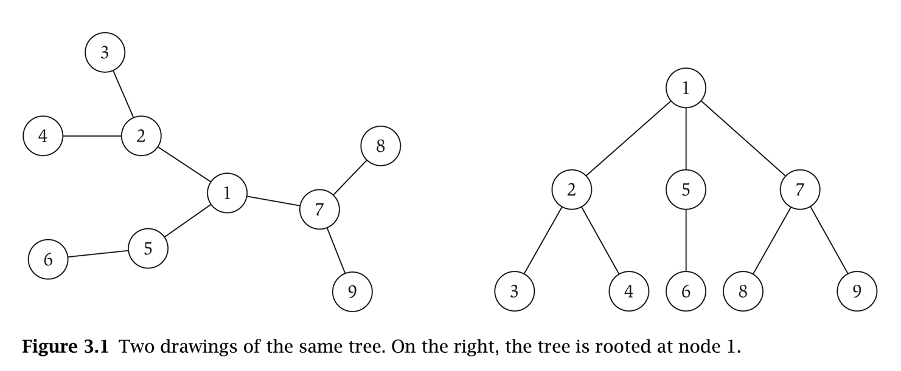
Trees & Rooted Trees
Same tree rooted at 1
A tree is an undirected connected
graph that does not contain a cycle.
Models hierarchical structure.
Theorem. Let G be an undirected graph on n nodes. Any two of the following statements imply the third.
G is connected.
G does not contain a cycle.
G has n-1 edges.
Rooted tree: choose a root node r and orient each edge away from r. Each edge goes from a parent to a child, directed paths from ancestors to descendants
A DAG (directed acyclic graph) is the directed analog of a tree, a directed graph that does not contain a directed cycle.
2
1
4
3

Slide 11
Graph Representation: Adjacency Matrix
Adjacency matrix. n-by-n matrix with A_{uv} = 1 if (u, v) is an edge.
Two representations of each edge.
Space proportional to n².
Checking if (u, v) is an edge takes Θ(1) time.
Identifying all edges takes Θ(n²) time.
1 2 3 4 5 6 7 8
1 0 1 1 0 0 0 0 0
2 1 0 1 1 1 0 0 0
3 1 1 0 0 1 0 1 1
4 0 1 0 1 1 0 0 0
5 0 1 1 1 0 1 0 0
6 0 0 0 0 1 0 0 0
7 0 0 1 0 0 0 0 1
8 0 0 1 0 0 0 1 0

Slide 12
Graph Representation: Adjacency List
Adjacency list. Node indexed array of lists.
Two representations of each edge.
Space proportional to m + n.
Checking if (u, v) is an edge takes O(deg(u)) time.
Identifying all edges takes Θ(m + n) time.
degree = number of neighbors of u
1
2
3
2
1
3
4
5
3
1
2
5
7
8
4
2
5
5
2
3
4
6
6
5
7
3
8
8
3
7

Slide 13
Summary
Graphs are useful for representing a wide variety of situations
Basic graph terminology: path, cycle, connected component, distance, DAG, trees…
There are two main ways to represent graphical data - Adjacency Lists and Adjacency Matrices (which exemplify the pros and cons of linked lists vs. arrays)
Main Takeaway: The organization of graphical data affects the running time of algorithms.

