Slide 1
CS5800 – ALGORITHMS
MODULE 5. DATA STRUCTURES & GRAPHS
Lesson 2: Graph Traversals
Ravi Sundaram

Slide 2
Topics
Why graph traversals?
Breadth-First-Search
  Shortest Path Tree
Depth-First-Search
  Combinatorics of long paths
Connected component
Unified approach to BFS & DFS
Summary

Slide 3

Why graph traversals?
Variety of applications in exploring and connectivity
  Facebook/LinkedIn
  Maze traversal.
  Kevin Bacon number.
  Fewest number of hops in a communication network
  s-t connectivity: given nodes s and t, is there a path between s and t?
  s-t shortest path: Given nodes s and t, what is the length of the shortest path between s and t?
  Planarity: can a given graph be drawn in the plane with no crossing edges?

Slide 4
Breadth First Search (BFS)
BFS intuition: Explore outward from s, adding nodes a "layer" at a time.
BFS algorithm.
  L₀ = { s }.
  L₁ = all neighbors of L₀.
  L₂ = all nodes that do not belong to L₀ or L₁, and that have an edge to a node in L₁.
  …
  L_{i+1} = all nodes that do not belong to an earlier layer, and that have an edge to a node in L_{i}.
For each i, L_{i} consists of all nodes at distance exactly i
from s.
s
L₁
L₂
L _{n-1}

Slide 5
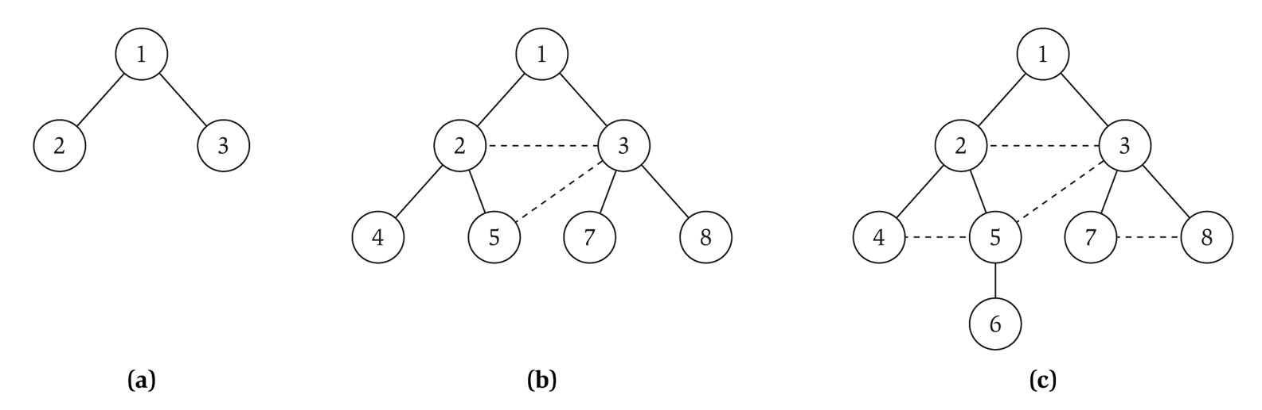
BFS Tree
The BFS tree is grown by adding an edge along which a node is encountered for the first time.
Orienting edges towards parents we see it forms a tree.
No edge in the graph can skip a level
L₀
L₁
L₂
L₃

Slide 6
BFS: Shortest Path Tree & Analysis
Theorem: The BFS tree is a Shortest Path Tree (SPT)
Pf: By induction on levels. Use the induction hypothesis that the BFS tree upto level i is the SPT on all nodes at most distance i from the root ▪
Theorem: Given an adjacency list representation of the graph BFS can be implemented to run in O(m + n) time.
Pf: when we consider node u, there are deg(u) incident edges (u, v) Total time processing edges is Σ_{u∈V} deg(u) = 2m ▪

Slide 7
Depth First Search (DFS)
DFS intuition: Explore in one direction as far as possible before backtracking.
DFS algorithm – recursive implementation
DFS(v)
Mark v
For each neighbor w of v
If w is unmarked
Then DFS(w)
Add (v, w) to Tree

Slide 8
DFS Tree
The DFS tree grows in long and skinny fashion, compared to the short and bushy BFS tree
Orienting edges towards parents we see it forms a tree.
All edges run between ancestor and descendant
1
1
1
7
2
3
2
3
2
3
4
4
5
8
5
6
(a)
(b)
(c)

Slide 9
DFS: Combinatorics & Analysis
Theorem: Any graph on n vertices without a path of length k has O(kn) edges
Pf: If the graph does not have a path of length k then the height of the DFS tree is at most k. Which means every node has at most k ancestors. But every edge runs between ancestor and descendant and hence the graph has at most kn/2 = O(kn) edges. ▪
Theorem: Given an adjacency list representation of the graph DFS can be implemented to run in O(m + n) time.
Pf: when we consider node u, there are deg(u) incident edges (u, v) Total time processing edges is Σ_{u∈V} deg(u) = 2m ▪

Slide 10
Connected Component
Connected component. Find all nodes reachable from s.
Connected component containing node 1 = { 1, 2, 3, 4, 5, 6, 7, 8 }.

Slide 11

Flood Fill
Flood fill. Given lime green pixel in an image, change color of entire blob of neighboring lime pixels to blue.
  Node: pixel.
  Edge: two neighboring lime pixels.
  Blob: connected component of lime pixels.
recolor lime green blob to blue

Slide 12

Flood Fill
Flood fill. Given lime green pixel in an image, change color of entire blob of neighboring lime pixels to blue.
  Node: pixel.
  Edge: two neighboring lime pixels.
  Blob: connected component of lime pixels.
recolor lime green blob to blue

Slide 13
Unified iterative approach to DFS and BFS
Push
Pop
Use Data-Structure = Queue for BFS, Stack for DFS
Add (r, φ = parent(r)) to Data-Structure
While not empty Data-Structure
Remove (v, u)
If not marked v
then add (v, u = parent(v)) to Tree
Mark v
For each neighbor w of v
Add (w, v) to Data-Structure
Enqueue
Dequeue

Slide 14
Summary
Graph traversals – several applications including exploration and connectivity
Many kinds of traversals of which two are used frequently – BFS and DFS
  BFS – generates a bushy tree, a shortest path tree
  DFS – generates a narrow spindly tree
  Both can be implemented in linear time, using queue for BFS and stack for DFS
Main Takeaway: Graphs can be traversed in linear time to solve connectivity problems

