Slide 1
CS5800 – ALGORITHMS MODULE 5. DATA STRUCTURES & GRAPHS Lesson 3: Priority Queues & Heaps
Ravi Sundaram

Slide 2
Topics
Priority Queue – what & why?
Naïve implementation & Ω(nlogn) Lower Bound
Binary Heap
Array implementation
Insertion – add as last element and percolate up
Deletion – replace with last element and percolate appropriately
Building heap in O(n) time
Summary

Slide 3
Priority Queues
A Priority Queue is a queue where elements have a priority, or key, so that elements with higher priority (a smaller key) are at the front of the queue.
Priority Queue is an abstract data structure that supports the following operations:
Insert(x) – inserts element x, assume key is same as x.
FindMin() – returns (pointer to) element with minimum key
Delete(x) – removes element x, assume pointer is same as x
DeleteMin() – removes element with minimum key (can be effected by Delete(FindMin()) so we ignore for rest of lecture
ChangeKey(x,k) – changes key of element x to k (can be effected by a delete followed by insert with changed key, so we ignore for rest of lecture)
Applications.
Dijkstra's shortest path algorithm.
Prim's MST algorithm.
Event-driven simulation.
Huffman encoding.
Heapsort.
. . .
Notes:
Event driven simulation: generate random inter-arrival times between customers, generate random processing times per customer, Advance clock to next event, skipping intervening ticks

Slide 4
Naïve implementation
Can implement as sorted block in array
Can implement as unsorted linked list
 | Array | Linked List
Insert | Θ(n) | Θ(1)
FindMin | Θ(1) | Θ(n)
Delete | Θ(n) | Θ(1)

Slide 5
Lower bound
Can we do better?
Can we implement each operation to be O(1)?
Theorem: At least one of the three operations must be Ω(logn)
Pf: Observe that we can sort n elements by inserting them into a heap and repeatedly removing the minimum. This takes n of each of the 3 operations. And we know that sorting has an Ω(nlogn) lower bound and hence at least one of these 3 operations must take at least Ω(logn) ∎
 | Array | Linked List | Binary Heap
Insert | Θ(n) | Θ(1) | O(logn)
FindMin | Θ(1) | Θ(n) | O(logn)
Delete | Θ(n) | Θ(1) | O(logn)

Slide 6
Binary Heap: Definition & Properties
Binary heap – two properties – structure and order
Almost complete binary tree.
filled on all levels, except last, where filled from left to right
Min-heap ordered.
every child greater than (or equal to) parent
Properties.
Min element is in root.
Heap with n elements
has height = ⎣log₂ n⎦.
06
n = 14 Height = 3
14
45
78
18
47
53
83
91
81
77
84
99
64

Slide 7
Binary Heaps: Array Implementation
Use an array: no need for explicit parent or child pointers.
Parent(i) = ⎣i/2⎦
Left(i) = 2i
Right(i) = 2i + 1
06
1
14
45
2
3
78
18
47
53
4
5
6
7
83
91
81
77
84
99
64
8
9
10
11
12
13
14
Notes:
parent and children formula require only simple bit twiddling operations

Slide 8
Binary Heap: Insertion
Insert element x into heap.
Insert into next available slot.
Percolate up until it is heap ordered.
06
14
45
78
18
47
53
83
91
81
77
84
99
64
42
next free slot

Slide 9
Binary Heap: Insertion
Insert element x into heap.
Insert into next available slot.
Percolate up until it is heap ordered.
swap with parent
06
14
45
78
18
47
53
83
91
81
77
84
99
64
42
42

Slide 10
Binary Heap: Insertion
Insert element x into heap.
Insert into next available slot.
Percolate up until it is heap ordered.
swap with parent
06
14
45
78
18
47
42
83
91
81
77
84
99
64
42
53

Slide 11
Binary Heap: Insertion
Insert element x into heap.
Insert into next available slot.
Percolate up until it is heap ordered.
STOP: heap ordered
06
14
42
78
18
47
45
83
91
81
77
84
99
64
42
53

Slide 12
Binary Heap: Delete
DeleteMin: delete minimum element from heap.
Exchange root with rightmost leaf.
Percolate down, exchanging with smaller child, until it is heap ordered.
O(logn) operations
Delete: remove element from heap.
Replace with rightmost leaf
Percolate up or down as appropriate
O(logn) operations

Slide 13
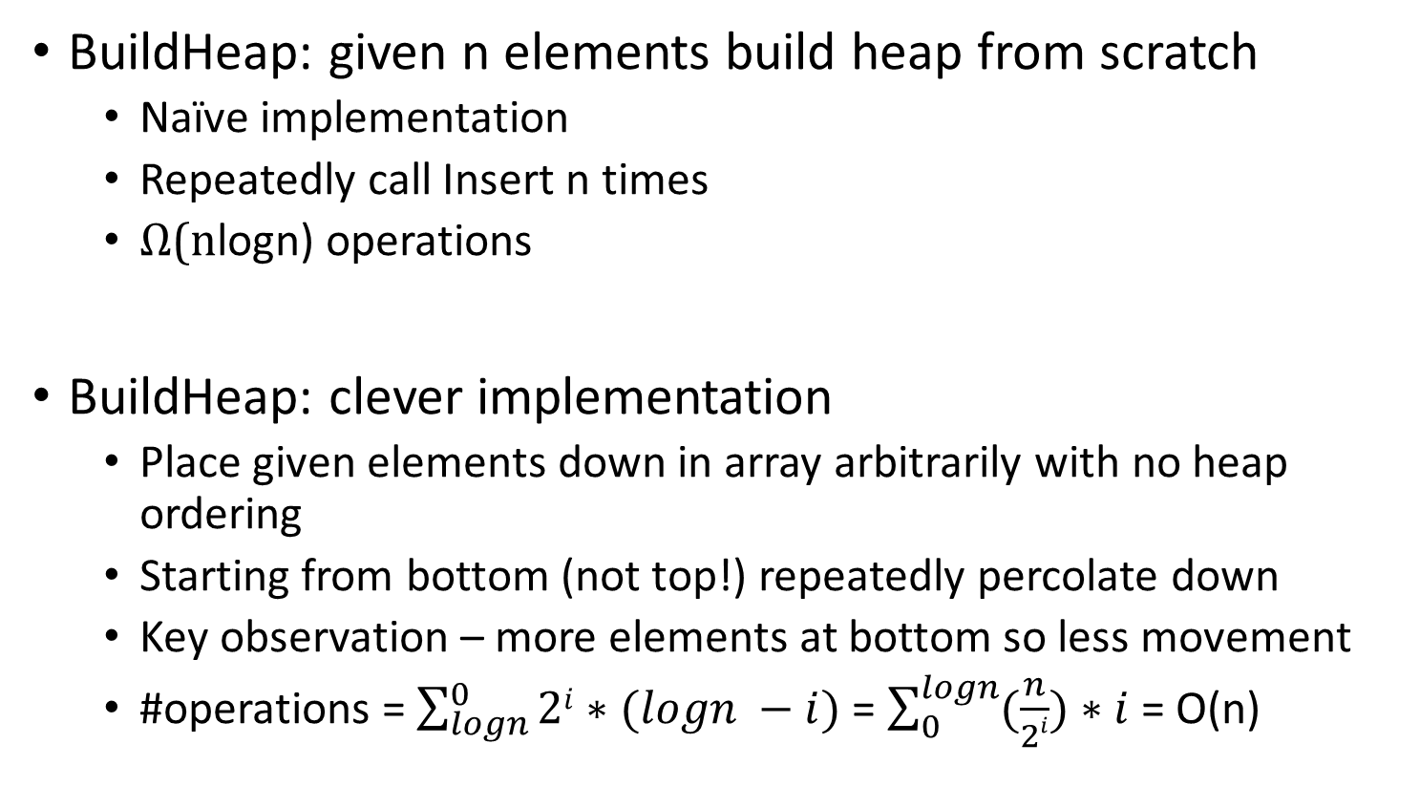
Binary Heap: BuildHeap
BuildHeap: given n elements build heap from scratch
Naïve implementation
Repeatedly call Insert n times
Ω(nlogn) operations
BuildHeap: clever implementation
Place given elements down in array arbitrarily with no heap ordering
Starting from bottom (not top!) repeatedly percolate down
Key observation – more elements at bottom so less movement
#operations = $\sum_{logn}^{0}{2i∗(logn −i)}$ = $\sum_{0}^{logn}{(\frac{n}{2i})∗i}$ = O(n)

Slide 14
Binary Heap: Heapsort
Heapsort.
Insert N items into binary heap.
Perform N delete-min operations.
O(N log N) sort.
No extra storage.

Slide 15
Summary
Priority Queue – useful data structure for greedy algorithms
Implementable using array
Insert, Delete, Extract-Min in O(logn) time
Entire heap – O(n) time
Main Takeaway: the binary heap implemented on the array is an easy realization of a priority queue, useful in many greedy contexts.

