Slide 1
Sedemac Hook
Development of a scalable prototype IoT (Internet of Things) system for automobiles

Slide 2
Goal
The project involves construction (either from scratch or by integrating devices available off the shelf) of a system which can acquire CAN (controller area network) data from a SEDEMAC automobile ECU and transmit the same to a server at SEDEMAC (through GSM for example). The idea is to explore the possibilities that *big data* offers for automotive data.

Slide 3
What exactly?
Logging CAN data from vehicles, analyzing the data and presenting the insights from data in such a way that is beneficial to automobile manufacturers

Slide 4
PLAN
1) Convert CAN signals to some things we can understand
2) Send that understood data to a secure place
3) Saving data in a proper format to bridge efficiently between 2) and 4)
4) Presenting data and making it accessible (Data Analytics).

Slide 5
Problem 1
Convert CAN signal to something you understand.
Sol: Connect the two CAN pins to an OBD port. Do some logic level shifts to the output of OBD port to make it Arduino understandable.
You understand OBD signal format!

Slide 6
Problem 1.1 : No CAN Signal
Sol : Emulator

Slide 7
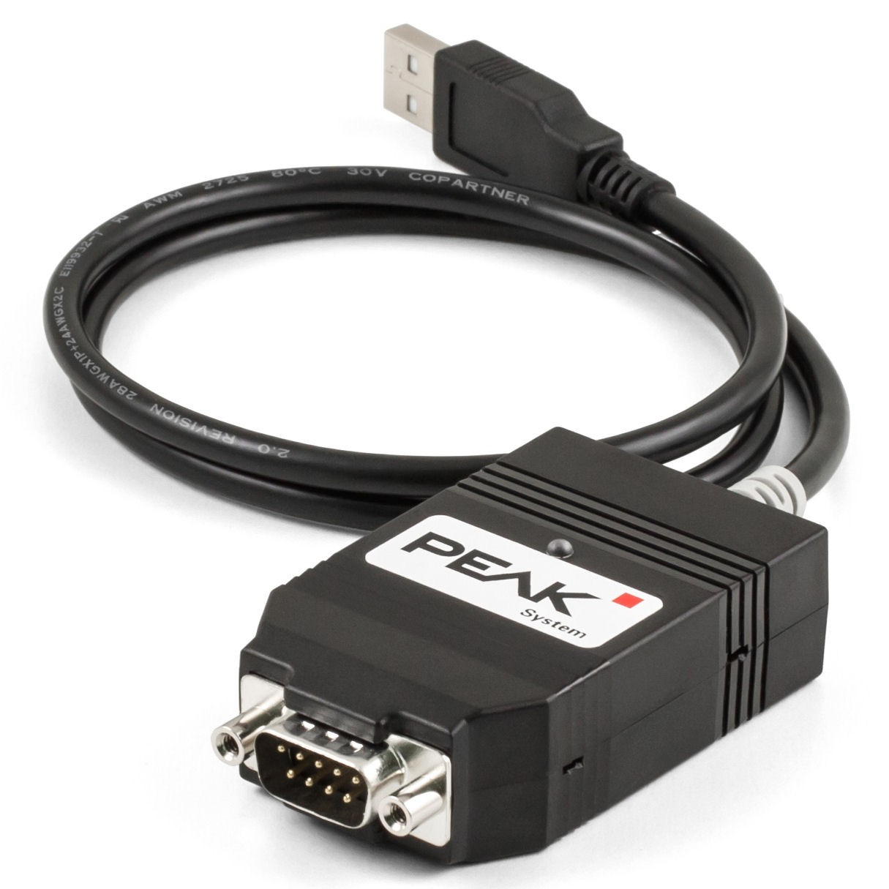
Peak CAN

Slide 8
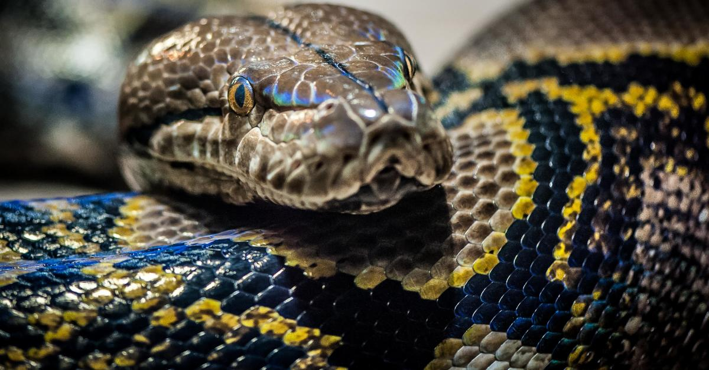

Slide 9
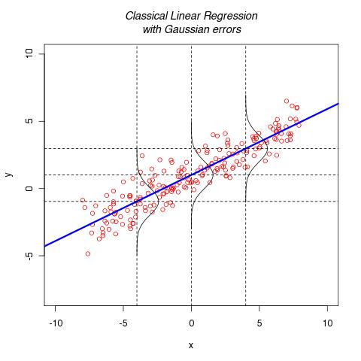

Slide 10
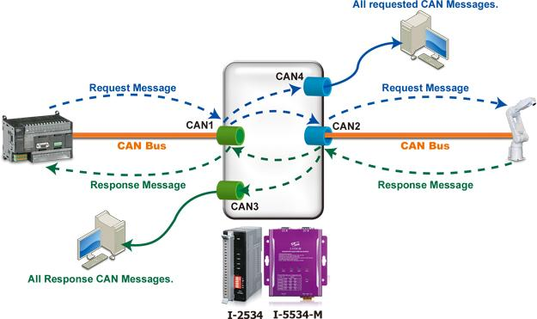

Slide 11
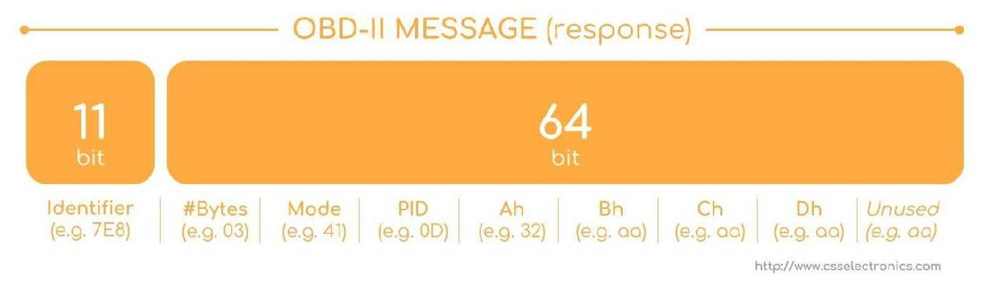

Slide 12
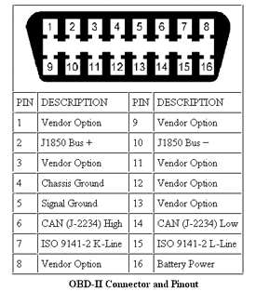
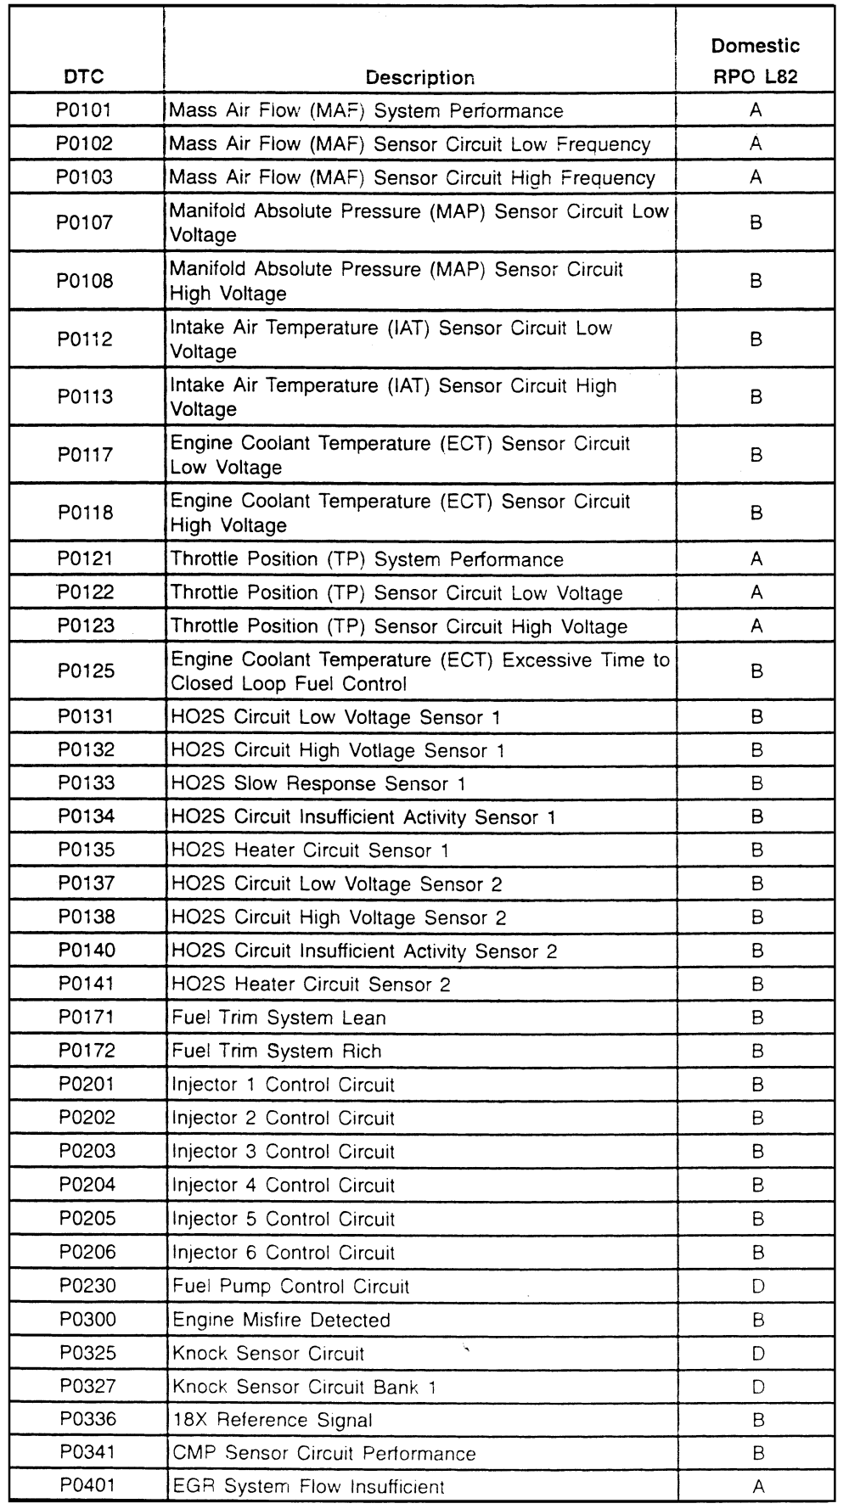

Slide 13
Problem 2 :
Reading & Sending Data.

Slide 14
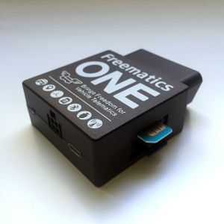
Solved

Slide 15
Features:
1) OBD port + GPS 2) Arduino 3) SIM800A 4) SD card

Slide 16
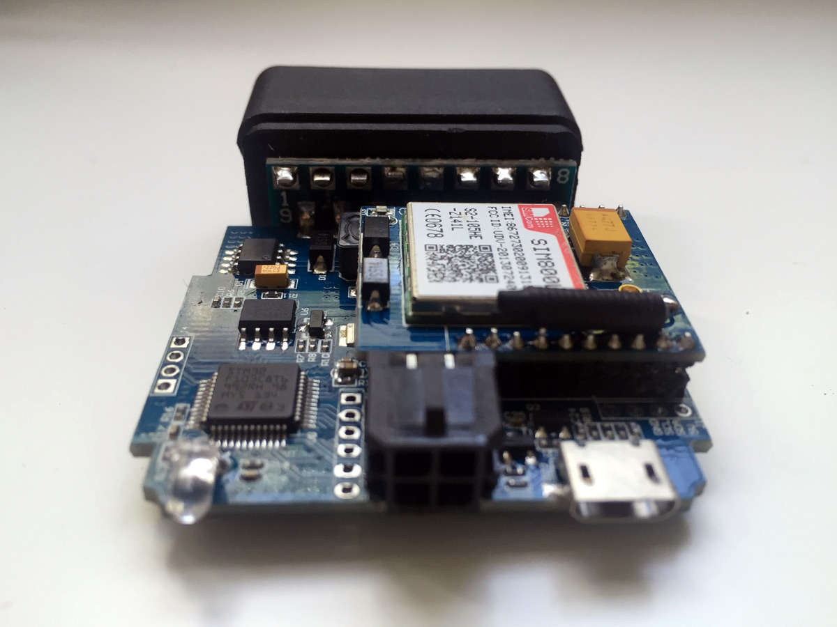
Inside

Slide 17
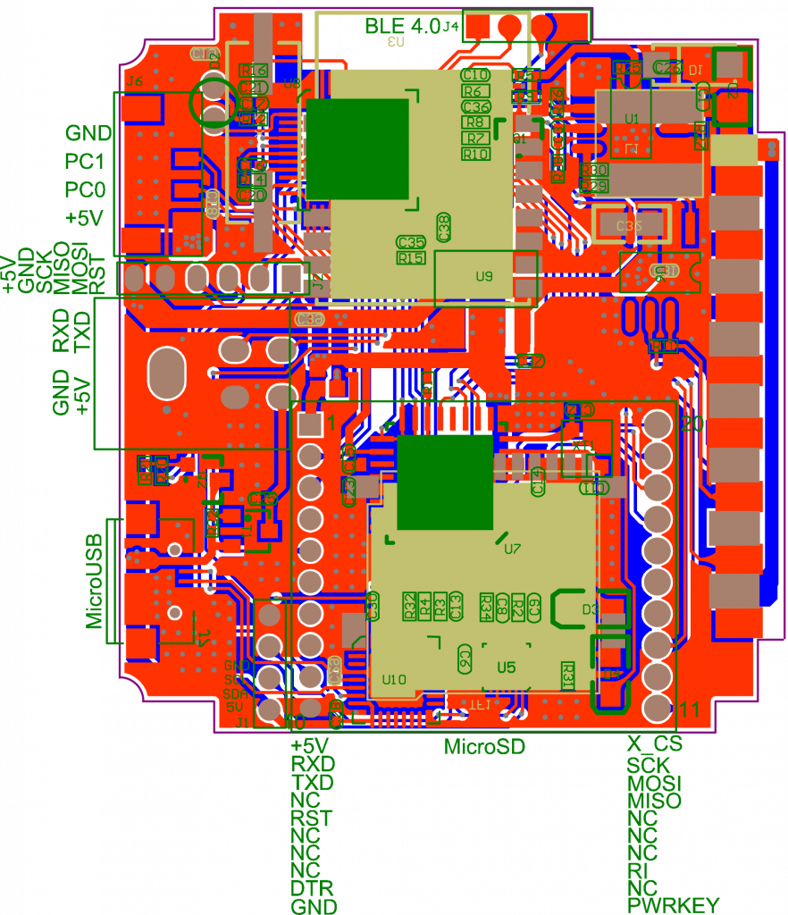
Circuit

Slide 18
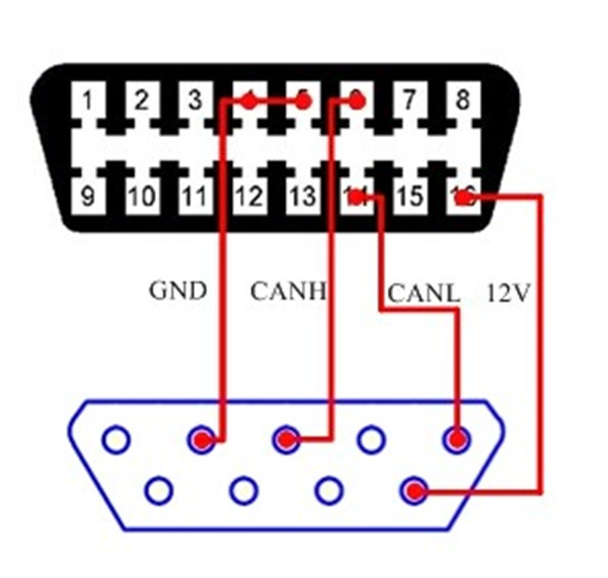
Connections :
Read CAN

Slide 19
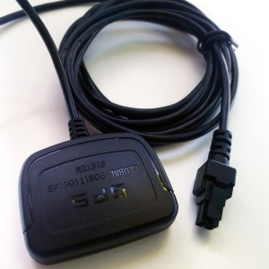
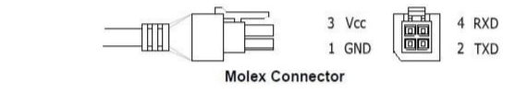
2) GPS

Slide 20
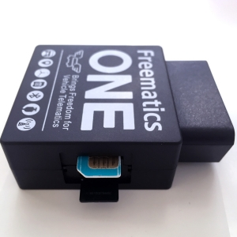
3) SIM & SD

Slide 21
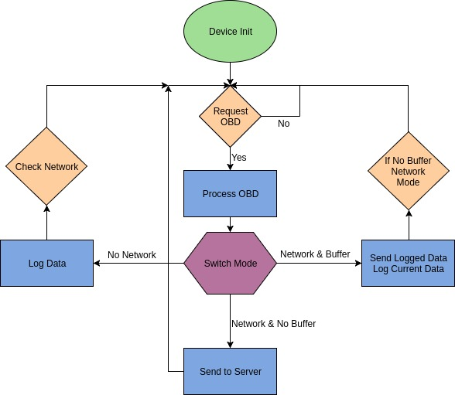
Algo :

Slide 22
Complications :
2kB dynamic memory.
SD card takes 512 bytes.
Device crashed.
GPS takes long to init.

Slide 23
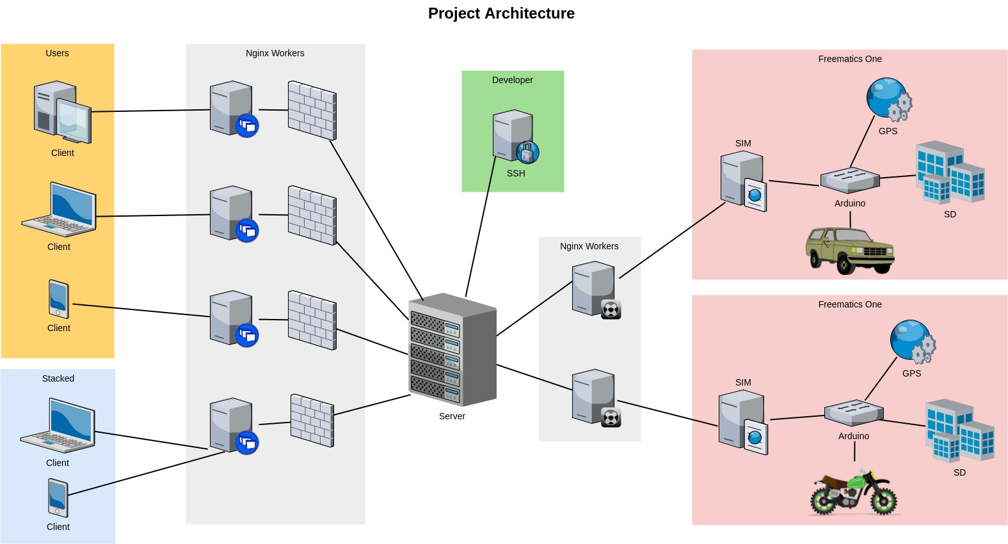

Slide 24
Server (Backend)
Objectives :-
Scalable backend to accommodate ever increasing number of users
Structured database for easier and quick SQL transactions
API endpoints to serve multiple purposes
Easy development of frontend platforms over the backend
Web-Frontend
Mobile App
Customised Scripts for Data Analytics

Slide 25
Server specifications (Backend)
Digitalocean cloud server
Nginx is used to deploy our Flask-App
Server side is developed on Flask (a python based framework)
Database designed in postgreSQL
API endpoints developed to serve the required purposes

Slide 26
Database Structure
Development so far
Separate table for individual vehicles to store raw data directly
Separate table to measure overall performance of vehicles
All the data transactions are done in JSON format which is easy to understand and access
Aim
Easily understandable
Fast Query
Makes Data Analytics of individual as well as cumulative vehicles efficient

Slide 27
Objectives Achieved
Multiple devices : Nginx server with ability to handle multiple simultaneous requests is used to host our server
Fast Query : The database is structured in three layers for easier access and efficient data analytics
Data Analytics : API endpoints developed to serve data from database directly in JSON format for easy interpretation and custom scripts
JSON Response Example: http://139.59.38.17/data/<device_id>/details
4. Python based Flask Framework is completely scalable

Slide 28
Three Layers of Table
Primary Table :- Used to directly store raw data coming from device. Every device has it’s own primary table named as DeviceID. For example Device1 and Device2
Secondary Table :- Used to store trip wise details of a particular vehicle. Will be helpful to analyse trip parameters like average trip distance or average trip speed. Every device will have its own secondary table named as device_derivedID. For example device_derivced1, device_derived2
Tertiary Table :- Used to store cumulative record of all the vehicles together. Will make overall analytics of all the vehicles much more simpler and efficient. Each device will have one row for it in this table.

Slide 29
Data as sent by device
Vehicle_1 Vehicle_2
erpm 2100 3200
engine_load 25 29
Vehicle_speed 32 39
Throttle_position 25 45
Runtime_crank 300 420
Latitude 18.5204 18.7904
Longitude 73.8567 73.9766
Altitude 350 450
data_time 12:10:34 12:10:45
data_date 29/06/17 29/06/17
New_data 1 0

Slide 30
Primary Table
Serial | erpm | engine_load | runtime | throttle_pos | latitude | longitude | altitude | speed | date | time
1 | 1200 | 23 | 460 | 33 | 18.2345 | 27.6789 | 540 | 43 | 29/06/17 | 13:10:00
2 | 1260 | 25 | 470 | 36 | 18.3012 | 27.7777 | 530 | 47 | 29/06/17 | 13:10:10
3 | 1300 | 29 | 480 | 41 | 18.3113 | 28.1234 | 550 | 49 | 29/06/17 | 13:10:20
Format in which Raw data is stored in Primary Table

Slide 31
Secondary Table
Serial | trip_duration | distance | avg_speed | avg_erpm | avg_load | latitude | longitude | altitude | start_time | date | end_time
1 | 00:50:00 | 10 | 460 | 22500 | 45 | 18.2345 | 27.6789 | 540 | 12:20:00 | 29/06/17 | 13:10:00
2 | 01:00:10 | 8 | 470 | 1900 | 34 | 18.3012 | 27.7777 | 530 | 12:10:00 | 29/06/17 | 13:10:10
3 | 00:23:00 | 25 | 480 | 3300 | 65 | 18.3113 | 28.1234 | 550 | 12:46:40 | 29/06/17 | 13:10:20
Format in which trip-wise details are stored in Secondary Table

Slide 32
Tertiary Table
ID | trips_no | avg_durtn | avg_dist | avg_speed | avg_erpm | avg_load | avg_throttle | latitude | longitude | total_dist | total_duratn
1 | 200 | 00:35:34 | 15 | 23 | 2500 | 45 | 32 | 18.2345 | 27.6789 | 3000 | 13:10:00
2 | 23 | 01:00:54 | 25 | 37 | 1900 | 34 | 41 | 18.3012 | 27.7777 | 575 | 13:10:10
3 | 134 | 02:01:41 | 33 | 41 | 3300 | 65 | 23 | 18.3113 | 28.1234 | 4422 | 13:10:20
Format in which cumulative records are stored in Tertiary Table

Slide 33
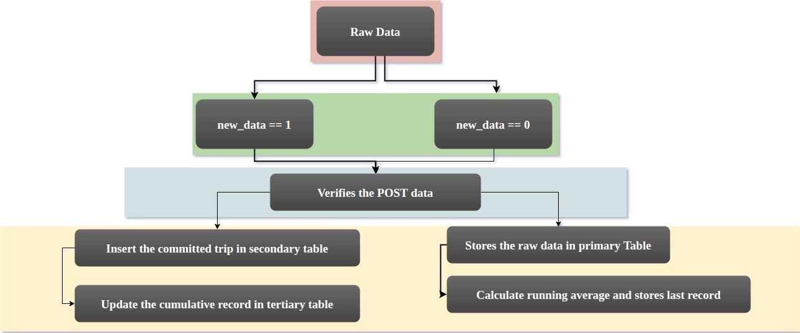
Data Flow Map

Slide 34
Server -API
Few examples :
Our URL : 139.59.38.17
API endpoint to fetch data :
139.59.38.17/data/<device_id>/charts/<chart_id>
API endpoint for location: http://139.59.38.17/data/location
API endpoint for last trip path : http://139.59.38.17/data/<device_id>/trip/<trip_id>
API endpoint to POST new data to server : 139.59.38.17/new

Slide 35
Problem 4
Sol: 139.59.38.17

Slide 36
Frontend
Phi-Matrix. Pixel Perfect.
Google Charts. Reliable.
Google Material Design. Responsive.

Slide 37
Track
Login.
Location.
Raw Data.
Visualization.

Slide 38
GITHUB
Github Repo : https://github.com/krpratik/sedemac-iot.git

