Slide 1
Inheritance

Slide 2







What is inheritance?
Grand Father
Father
Child
Inheritance is a mechanism in which one class acquires the property of another class.
Base Class
Derived
class
Parent Class
Child class

Slide 3



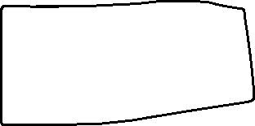
Why Inheritance?
Initial
Module
Testing
Initial
Module
Final
Module
Waste of time
Resource ,cost
Not feasible
M1
M1 + new Features

Slide 4







Inheritance Approach
Body
Wheels
Seats
Doors
Windows
AC
Fuel Tank
Suspension
Transmission
Base Model
Car
By using inheritance we :
Are reducing duplicate code.
Are increasing code reusability.
Can easy manage the code .
Maruti
800
Petrol engine
Gas
Diesel
engine

