Slide 1

Adaptive Secure Self-Healing Data Transmission Framework
Secure and Reliable Data Transmission over Unstable Networks

Slide 2

Problem Statement
Unstable networks cause packet loss and out-of-order delivery
Data can be intercepted or tampered with
Existing systems focus only on security or reliability, not both

Slide 3
Proposed Solution
Smart transmission system combining:
1
2
3
Security
Integrity
Self-healing
Highlight:
Adaptive encryption based on network
Automatic recovery of lost data

Slide 4
System Architecture
Network Intelligence
Data Processing (block splitting)
Encryption (AES + RSA)
Integrity (SHA-256 + blockchain)
Self-Healing (parity blocks)
Transmission (TCP + retry)
Receiver (verification + reconstruction)

Slide 5
Key Technologies Used
AES (Advanced Encryption Standard)
RSA-2048 (for key exchange)
SHA-256 (hashing)
Erasure Coding (XOR-based recovery)
Blockchain (immutable transaction ledger)

Slide 6
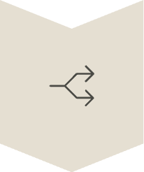






Working Flow
Split
Encrypt
Hash
Send
Verify
Recover
Reassemble

Slide 7
Results / Contributions
Secure data transmission
Detects tampering
Recovers missing data without retransmission
Works in unreliable networks
Mention "self-healing capability" clearly

