Slide 1
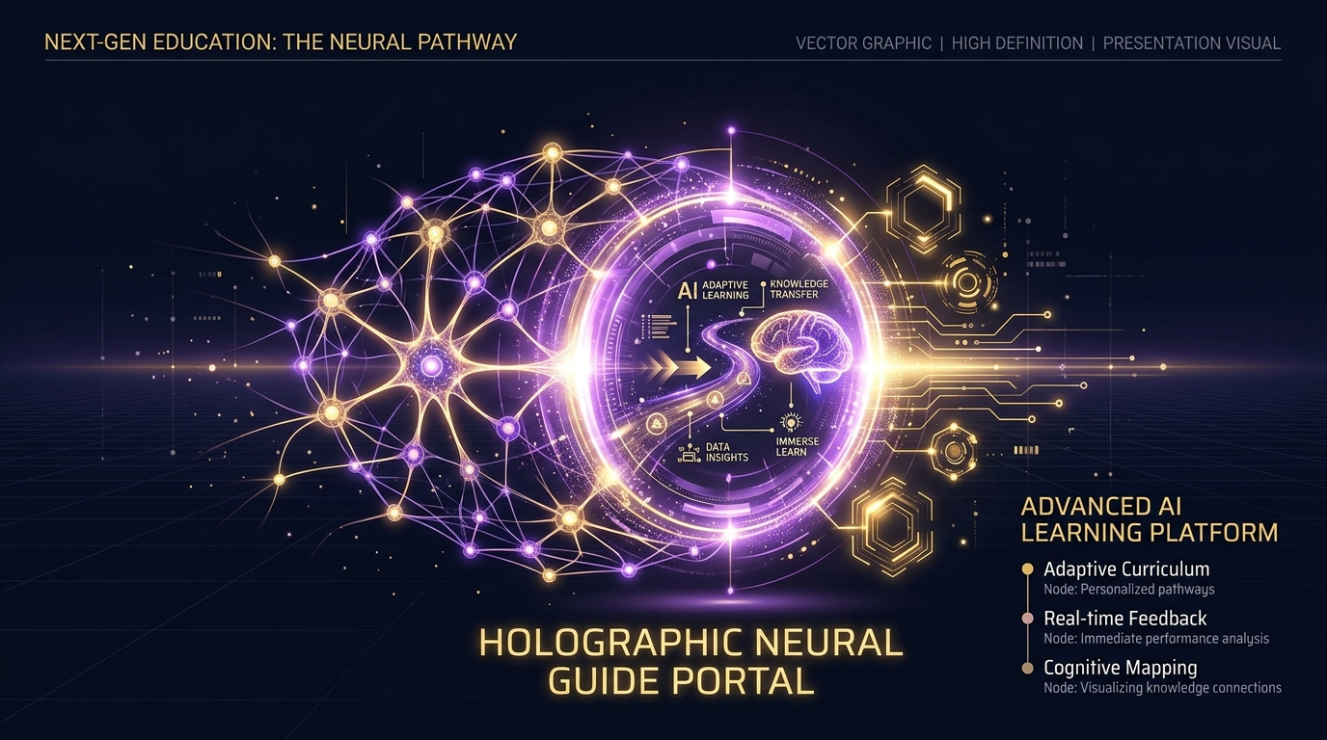
Vividya (विविद्या)
AI Life & Career Navigator
for Indian Students
Pitch & Presentation Deck

Slide 2
The Vision & Objective
• Demystify the path to placements for engineering and college students across tier-2/3 cities.
• Deliver a localized, voice-first AI companion speaking Hinglish, Hindi, and Marathi.
• Bridge high-stress academic preparation with career guides and interactive mock interviews.
• Automate planning, resume building, and evaluation under a single unified student dashboard.
Vividya (विविद्या) — AI Life & Career Navigator

Slide 3
The Placement & Academic Struggle
1. Disorganized Calendars: Generic schedulers cannot parse study hours, breaks, or specific topics from dynamic student conversations. 2. Clunky Resume Formats: Static formats are overwhelming, lack modular sections, and fail to provide quick ATS reviews. 3. Technical Interview Fear: Static DSA questions are easily accessible, but students cannot write explanations and get graded with critical reviews. 4. Placement Anxiety: High pressure leads to severe mental stress; students have no tools to log logs or access coping tools.
Vividya (विविद्या) — AI Life & Career Navigator

Slide 4
Our Innovation: The Connected Ecosystem
• Seamless Connection: Integrating natural tutor chat with calendar schedulers, resume audits, and mock interview rooms.
• Real-time Syllabuses: AI reads the student’s learning topic and dynamically compiles a multi-day focus syllabus.
• Regional Support: Multilingual translation enables complex voice learning in code-mixed languages like Hinglish.
• Zero Overhead: Complex features (like PDF rendering and local cache logs) are computed directly client-side.
Vividya (विविद्या) — AI Life & Career Navigator

Slide 5
Technical Architecture
• Frontend: Single Page Application built on React (Vite environment) styled with custom glassmorphism components.
• Backend: High-performance Express.js server connected with Mongoose ODM.
• Vector Storage: Qdrant client to store and scroll note chunk embeddings for Retrieval-Augmented Generation.
• Databases: MongoDB Atlas storing users, study plans, mock sessions, and parsed resume history records.
Vividya (विविद्या) — AI Life & Career Navigator

Slide 6
Advanced AI Integration
• NVIDIA NIM Inference: Invokes Meta Llama 3.1 8B Instruct model for tutor chat, syllabus creation, and code answers reviews.
• Sarvam AI Speech: Integrated with Saaras STT for voice capture and Bulbul TTS for audio feedback.
• Embedding Generation: Meta Llama structured embeddings enable lightning-fast content search inside user uploaded notes.
• AI Scoring Engine: Custom grading prompts evaluate mock responses to check logic, correctness, and speed.
Vividya (विविद्या) — AI Life & Career Navigator

Slide 7
Feature: Multilingual Voice Tutor
• Conversational Learning: Text and audio-driven interactions designed for interactive student questions.
• Language Auto-detection: Supports code-mixed input, translating technical terms correctly in Hindi/Hinglish.
• Note Integration: RAG context allows students to query notes, creating a personalized academic copilot.
Vividya (विविद्या) — AI Life & Career Navigator

Slide 8
Feature: Topic-Based Study Scheduler
• Automated Syllabus: Converts custom study topics (e.g. Backpropagation) into sequential lesson topics.
• Focus Allocation: Automatically configures session categories (Deep Study, Light Review, Coding).
• Timetable Calendar: Generates complete study plans containing smart rest slots and resource suggestions.
• Seamless Navigation: Redirects users from chat screens directly into their active interactive calendar grid.
Vividya (विविद्या) — AI Life & Career Navigator

Slide 9
Feature: Stepper Resume Builder
• Multi-Step Form: Refactored wizard form (Personal ➡️ Education ➡️ Experience ➡️ Projects ➡️ Extras).
• Client-Side Compilation: Loads html2pdf.js dynamically to compile templates into high-fidelity vector PDF files.
• Local Storage Caching: Saves the generated PDF as a Base64 string locally to prevent data loss on reloads.
• Integrated Previewer: Offers toggling views between standard HTML drafts and compiled PDF iframe viewers.
Vividya (विविद्या) — AI Life & Career Navigator

Slide 10
Feature: Interactive Mock Interviewer
• Customized Questions: Role-based questionnaire (Software Engineer, Data Analyst) across difficulty levels.
• Detailed Input: Interactive answer sheets let students write full explanations and conceptual descriptions.
• Live AI Grading: Evaluates answer logic, context, and code structure, returning scores out of 10.
• Resume History: Saves and scrolls past resume parses so students can track historical progress logs.
Vividya (विविद्या) — AI Life & Career Navigator

Slide 11
Deployment, Feasibility & Scalability
• Render Infrastructure: Backend deployed on Render using blueprint configs (render.yaml) for auto-deployment.
• Netlify Infrastructure: Frontend deployed on Netlify using SPA redirection hooks (netlify.toml) to prevent route refreshes.
• DB Scalability: Atlas cluster and Qdrant collections handle simultaneous note indexing efficiently.
• User Security: Cookies-based JWT token management secures user private profile data logs.
Vividya (विविद्या) — AI Life & Career Navigator

Slide 12
Summary & Impact
• Demystifies placement training for students across campuses in their own native languages.
• Drives productivity by matching academic schedulers with DSA mock evaluations.
• Delivers high innovation, robust technical implementation, and state-of-the-art AI integration.
• Live App Links: Frontend (netlify.app) and Backend (onrender.com) are fully online and verified!
Vividya (विविद्या) — AI Life & Career Navigator

