Slide 1

Car Care – AI-Based Vehicle Maintenance Management System
Team #4
AI-powered car maintenance and tracking solution

Slide 2
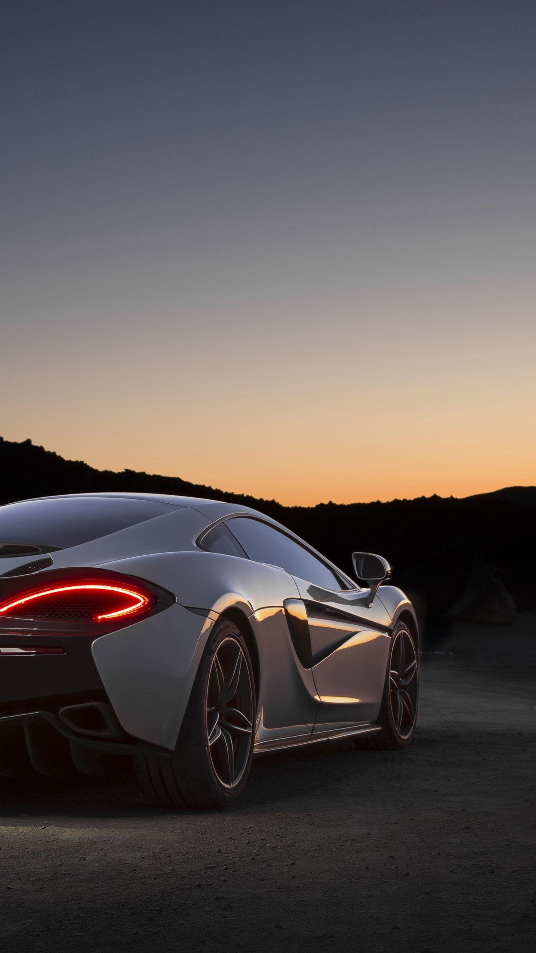
Problem Statement
Modern car owners struggle to track service schedules, repair history, and costs efficiently. Lack of a unified system leads to missed maintenance, increased expenses, and reduced vehicle lifespan. Finding reliable service centers and emergency support also remains a major challenge.

Slide 3
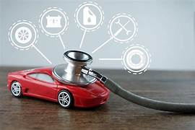
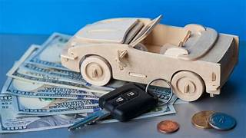
Product / Solution – Innovation
Car Care is an AI-driven vehicle maintenance platform that automates service scheduling, predicts maintenance needs, tracks expenses, and locates nearby garages. It enhances existing apps with predictive analytics, GPS-based assistance, and cost tracking. Uniquely integrates AI intelligence, automation, and real-time predictions into one unified system.

Slide 4
Product / Solution – Readiness Level
Stage: Wireframe Design / MVP
Prototype: Web + Mobile app interfaces developed
Key Features: AI maintenance prediction, service scheduler, GPS garage locator, cost tracking
Next Step: Functional MVP testing with users

Slide 5
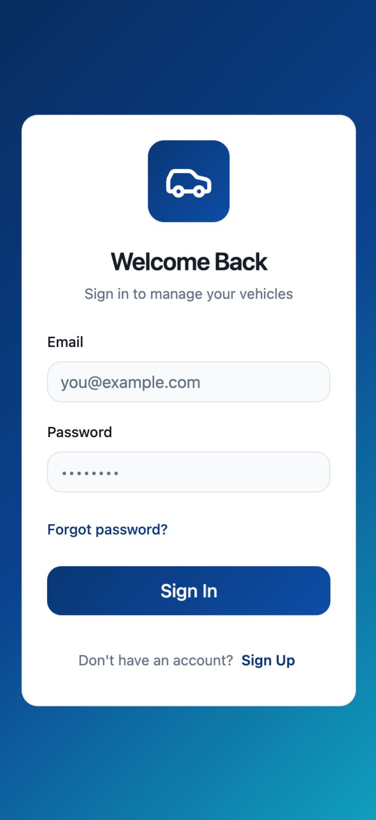
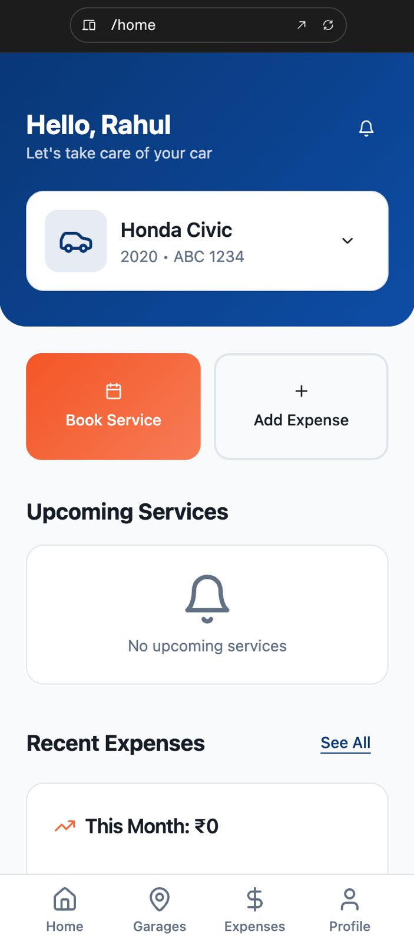
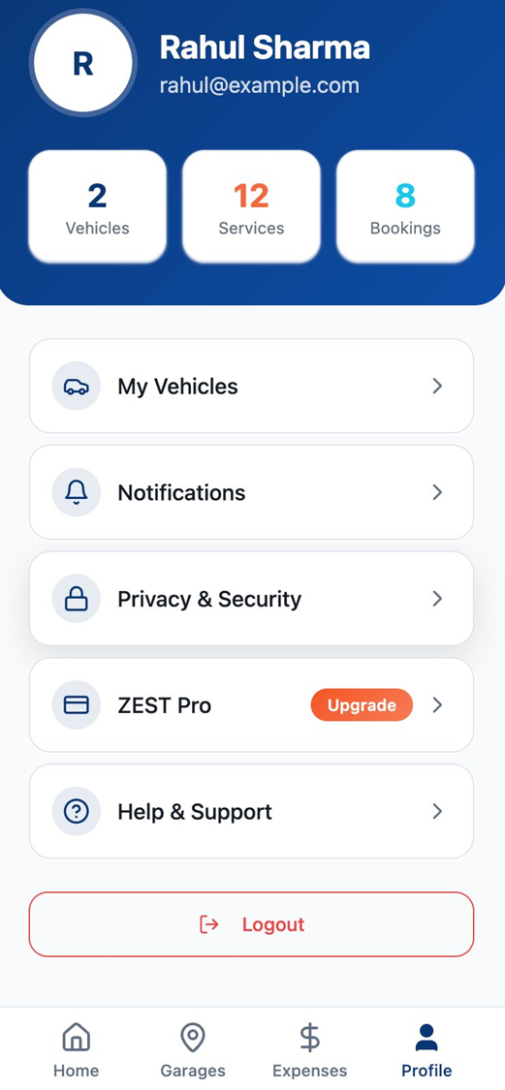
Wireframe Design

Slide 6
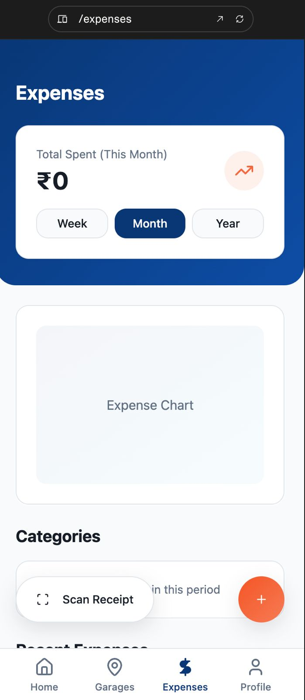
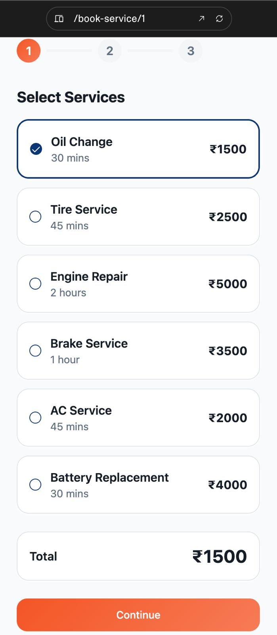
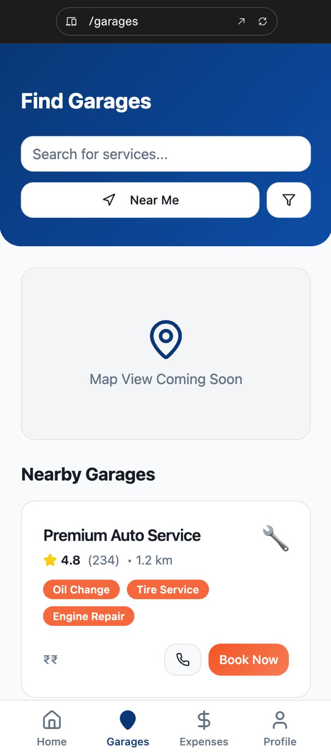

Slide 7
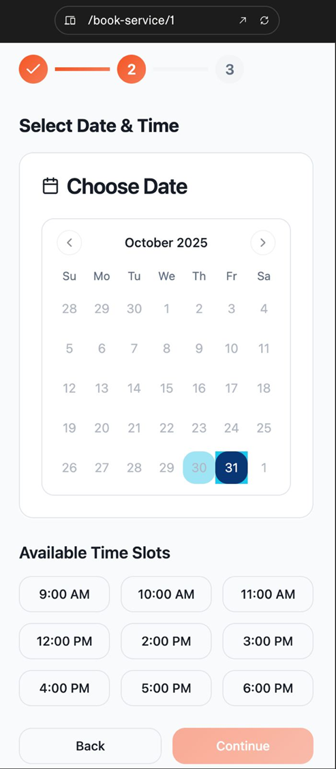
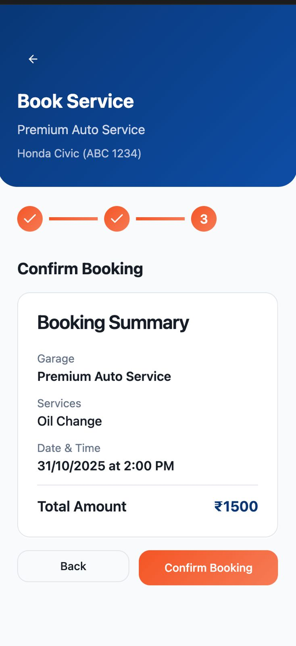

Slide 8
Ideal Customer Profile (ICP)
Individual car owners
Fleet management companies
Mechanics & service center

Slide 9
Model: Freemium + Subscription
Revenue: Service commissions, premium plans, partner ads
Channel: B2C & B2B (with garages/fleet operators)
Strategy: SEO, social media marketing, and garage partnerships
Business Model &
Strategy

Slide 10
Ideation Completed: Identified vehicle maintenance issues and AI objectives
Wireframe Design: Created layouts for web and mobile interfaces
MVP Development (Next): Build prototype with AI prediction and GPS locator
Testing & Validation: Collect feedback and refine features
Final Launch: Release full-scale CarCare platform with integrated features
Product Milestones
Product Milestones

Slide 11
Estimated Budget: ₹4–5 lakh (Development, Infrastructure, Marketing, Admin)
Support Required: Technical mentorship, funding for cloud hosting and marketing
Goal: Launch fully functional AI-based car maintenance app by SEE phase
Total Budget
&
Support

Slide 12
THANK YOU

