Slide 1

Generating Music with Machine Learning
Markov chain vs LSTM on MAESTRO piano MIDI
UE24CS352A Machine Learning mini-project | Team C-14
Krrish Singla (PES1UG24AM141) | Kasissnu Ssinha (PES1UG24AM130)
Notes:
Problem 22. We turn piano MIDI into tokens, train two models to predict the next token, and generate music by sampling.

Slide 2
Introduction
1
Motivation
Music has local structure that can be learned from data; generating it is a clean test of sequence models.
2
Problem (no. 22)
Generate new piano music with machine learning from real MIDI performances.
3
Objectives
Build a tokenizer, a Markov baseline and an LSTM; evaluate them fairly; ship a working demo.
Notes:
Frame it as next-token prediction, like a language model for music.

Slide 3
CS229 reference vs our work
CS229 reference (2018)
Our project
piano-midi.de MIDI, four models (Naive-Bayes-like, vanilla NN, LSTM, GRU)
Loss plus a 15-person listening test
LSTM test loss differs: 0.7986 (report) vs 0.6526 (poster); no LSTM accuracy
Future work: Transformer, velocity
MAESTRO v3: 200 pieces, 3.24M training tokens
356-token event vocabulary (chords and real timing)
Unigram, Markov and LSTM under one shared evaluation
Loss, perplexity and accuracy on 361,845 held-out targets
Notes:
We reused the idea, not the numbers: the paper's metrics were inconsistent, so we built our own fair comparison.

Slide 4
System overview: next-token prediction
1
2
3
4
5
Piano MIDI performance
356 event tokens
Model predicts next token
Sample and repeat
Generated .mid file
Generation is repeated next-token prediction, decoded back into MIDI. We compare how well each model predicts, and how it sounds.
Notes:
Pipeline: tokenize, train, evaluate, generate, demo.

Slide 5
Data and representation
200
3.24M
356
MAESTRO pieces
training tokens
token vocabulary
split by piece 160 / 20 / 20
386,786 val | 363,359 test
events, not fixed-grid notes
128 NOTE_ON
128 NOTE_OFF
100 TIME_SHIFT (10 ms to 1 s)
Keeps pitch and real timing, handles chords, decodes to standard MIDI.
Notes:
Subset of 200 of 1,276 MAESTRO files, fixed seed. Split by piece so nothing leaks between train and test.

Slide 6
Preprocessing and fair evaluation
1
Parse and tokenize
pretty_midi reads each file (drums ignored); notes become NOTE_ON, NOTE_OFF and TIME_SHIFT events.
2
Split by piece
160 train, 20 validation, 20 test pieces with a fixed seed: no piece sits in two splits.
3
Score on shared targets
Test tokens are cut into 1,419 windows of 256; every token after the first is a target (361,845 in total).
Notes:
Every model is scored on exactly the same 361,845 target tokens, so the numbers are directly comparable.

Slide 7
Two models, same tokens
Markov baseline
LSTM
Order-2 n-gram: counts what follows the last two tokens
Backs off to shorter contexts when unseen
90/10 mix with smoothed unigram probabilities
Fast and interpretable, but sees only two tokens
2 recurrent layers, 256 hidden units, 128-d embeddings
1,058,660 parameters, dropout 0.2
Adam, 8,000 steps on random 256-token windows
Up to 255 tokens of context; exported to numpy for the demo
Notes:
A unigram (no context) model is also reported as a sanity floor.

Slide 8
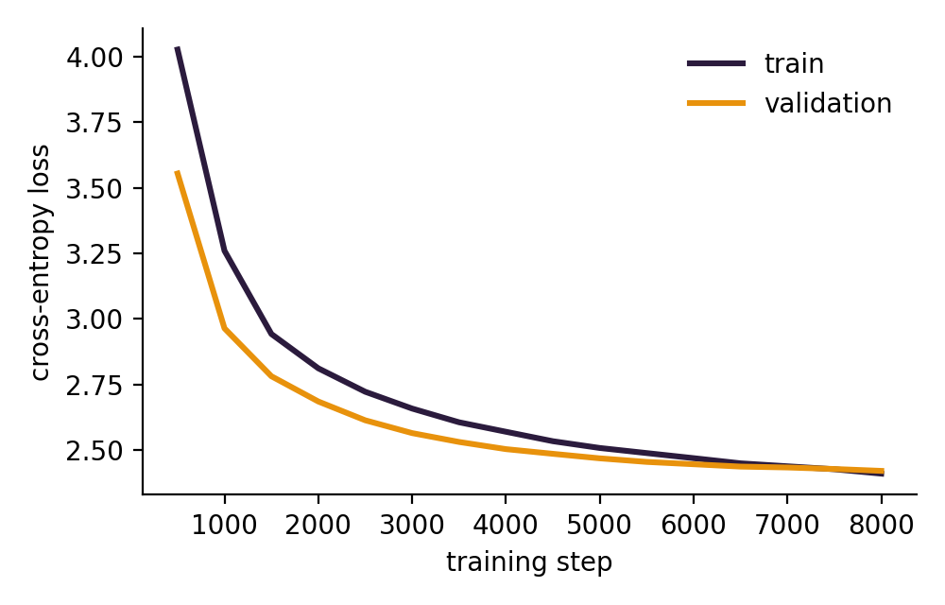
Training setup
Embedding | 128-d
LSTM | 2 layers x 256 hidden
Dropout | 0.2
Parameters | 1,058,660
Optimizer | Adam, lr 1e-3
Gradient clip | 1.0
Batch | 64 windows x 256 tokens
Steps | 8,000 (about 1.9 h, CPU)
Selection | best validation loss
Train and validation loss converge: no overfitting.
Notes:
Validation every 500 steps on fixed windows; the best-validation checkpoint is kept.

Slide 9
Results: the LSTM wins on every metric
Test accuracy
32.17%
LSTM
18.58%
Markov (order 2)
11.89%
Unigram
Loss: unigram 4.48, Markov 3.90, LSTM 2.40. Same 361,845 held-out targets for every model.
Notes:
Loss: 4.4810 / 3.8966 / 2.3982. Perplexity 88.32 / 49.23 / 11.00.

Slide 10
Analysis: what the numbers mean
1
2
3
Why the LSTM wins
Why accuracy is only 32%
What perplexity 11 means
Markov sees two tokens; the LSTM uses up to 255 tokens of context and generalizes beyond exact lookups.
Strict top-1 over 356 tokens; many continuations are valid and timing tokens differ by only 10 ms.
At each step the LSTM is as unsure as a choice among 11 tokens, against 49 for Markov and 88 with no context.
Notes:
Perplexity is the fairer metric; accuracy is useful for comparing models. Likely Q&A topic.

Slide 11
Generation and live demo
Generation
Streamlit demo
Seed: 32 tokens from a test piece
Sample the next token, repeat, decode to .mid
Temperature sets randomness; top-k 20 keeps likely tokens
Pick model, length, temperature, top-k and seed
Audio in the browser, piano roll, .mid download
Runs from numpy weights: no torch needed
</>
github.com/krrishsingla11/Music-Generation-ML-Mini-Project
Notes:
DEMO: streamlit run app.py. Generate with the LSTM, then Markov, at temperature 1.0 and compare.

Slide 12
Conclusions
What we found
Limitations and next steps
LSTM perplexity 11.0 vs 49.2 for Markov
Accuracy 32.2% vs 18.6%
Better prediction does not automatically mean better music
No velocity, key or meter modelling
200 of 1,276 pieces; listening survey not run
Next: velocity tokens, more data, a Transformer, a listener study
Notes:
Be ready to explain: split by piece, what perplexity means, why accuracy is low, and every file in src/.

Slide 13
Thank you
Questions?
github.com/krrishsingla11/Music-Generation-ML-Mini-Project
Krrish Singla (PES1UG24AM141) | Kasissnu Ssinha (PES1UG24AM130)

