Slide 1
Predicting Buy or Sell in the Bitcoin Market
BTC
Machine Learning with Business Data | Project Id 3
Krrish Singla | PES1UG24AM141
Shesanth K | PES1UG24AM261
Shamika Mahesh | PES1UG24AM259
Notes:
Introduce the team and the split: Krrish covers the problem, data, features and models; Shesanth covers EDA, the split and regression results; Shamika covers classification results, comparison, SHAP and the conclusion.

Slide 2
Introduction
Presenter: Krrish Singla
Predict a Buy or Sell signal for Bitcoin, and the expected next-hour return
Data: Bitstamp sample, Dec 2011 to Dec 2012, one row per minute
Compare 5 frameworks on simplicity, transparency, efficacy, RMSE, R² and MAE
5,125
26
5
3
hourly bars
input features
frameworks
prediction tasks
Notes:
Bitcoin trades around the clock and moves fast, so rules and models help turn data into signals. We frame it as Buy (1) or Sell (0), decided by short-term versus long-term trend, and also predict the expected next-hour return.

Slide 3
Data and hourly bars
Presenter: Krrish Singla
Source: BitstampData_sample.csv, 499,999 minute rows
Columns: open, high, low, close, volume in BTC and USD
Trades combined into hourly bars (first, max, min, last, sum)
5,125 bars kept, 3,209 empty hours dropped
Price range $3.80 to $16.41
95.1%
of minutes had no trade, so we use hourly bars
Notes:
Only 24,521 of 499,999 minutes had a trade. We combined trade minutes into hourly bars and dropped the 3,209 hours with no trades instead of inventing prices.

Slide 4
Features and targets
Presenter: Krrish Singla
26 features
Three targets
Returns over 1 to 12 bars
Trend: price vs 5, 20, 30-bar averages
RSI, stochastic, MACD
Volatility and candle shape
Volume, activity, hour of day
Buy/Sell now: 10-bar average above 60-bar average
Buy/Sell 12 bars ahead (our extra experiment)
Next-hour return (regression, capped at 5%)
Raw 10 and 60-bar averages are not inputs
Notes:
26 features use only current and past bars. The raw 10-bar and 60-bar averages are not inputs, so the model cannot just read the label.

Slide 5
The five frameworks
Presenter: Krrish Singla
Framework | Model and key settings | Size
XGBoost | Boosted trees, depth 3, rate 0.03, early stopping | 56 to 344 trees
Keras | 26-64-32-1, dropout 0.3, L2, Adam | 3,841 weights
PyTorch + fastai | tabular_learner, layers 64 and 32 | about 4,000
PyTorch + TabNet | 8-wide, 3 decision steps | about 4,300
PyTorch Lightning | Same 64-32 network as a LightningModule | 3,841 weights
Lightning is used in place of Lightning Flash, which is no longer maintained.
Notes:
All networks use the same small 64-32 architecture so the comparison is fair. Lightning replaces Lightning Flash, which is unmaintained and could not be installed.

Slide 6
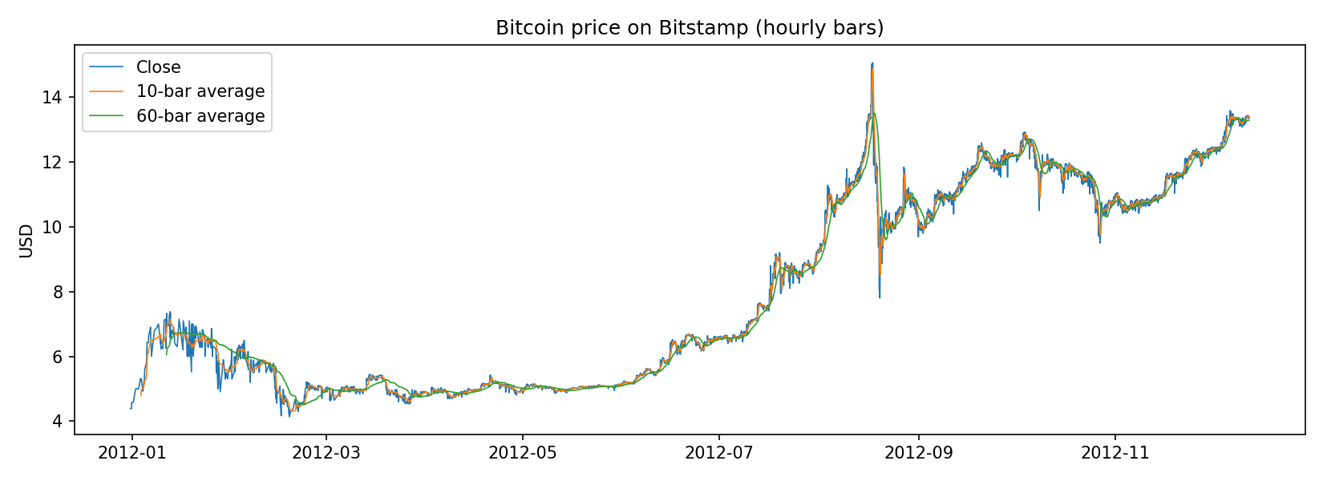
EDA: price and activity
Presenter: Shesanth K
No duplicates, no missing values
155 bars in Jan, 662 in Aug
23.1% of bars follow a gap of 2+ hours
Longest gap: 29 hours
Close price with 10-bar and 60-bar averages
Notes:
The market was thin early in 2012: 155 bars with trades in January against 662 in August. Nearly a quarter of bars follow a gap of two hours or more.

Slide 7
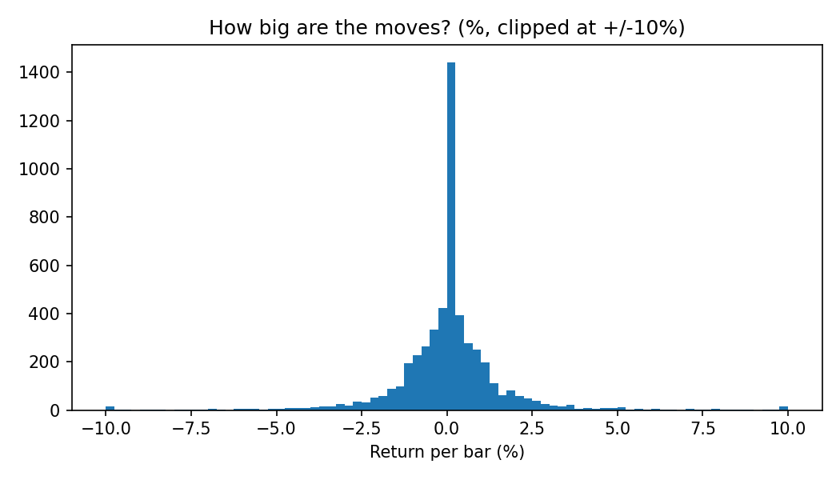
EDA: returns and the signal
Presenter: Shesanth K
Typical hourly swing 1.9%
127 bars moved more than 5%
Signal: 65.4% Buy, 34.6% Sell
Same signal as the previous bar 97.7% of the time
After a big move, the next bar tends to reverse (r = -0.34)
Notes:
Moves of +26.8% and -22.3% on 19 January are single small trades in a thin market, so we kept them. The signal repeats 97.7% of the time, which is why the 12-bar experiment is judged against repeating the current signal.

Slide 8
Time split and scoring
Presenter: Shesanth K
Set | Dates (2012) | Rows | Buy share
Train | 11 Jan to 28 Sep | 3,525 | 65.2%
Validation | 29 Sep to 4 Nov | 746 | 46.0%
Test | 5 Nov to 11 Dec | 759 | 84.5%
Regression: RMSE, MAE, R²
Classification: accuracy, balanced accuracy, F1, AUC
Baselines: average return, always Buy, repeat current signal
Test set scored once, at the end
Notes:
Split in time order with a 12-bar gap so nothing leaks. The test period is a strong uptrend, so always-Buy scores 84.5%; we report balanced accuracy, F1 and AUC too.

Slide 9
Regression results
Presenter: Shesanth K
Model | RMSE | MAE | R²
Baseline (average) | 0.0083 | 0.0056 | 0.000
XGBoost | 0.0073 | 0.0052 | 0.217
Keras | 0.0074 | 0.0053 | 0.210
PyTorch + fastai | 0.0073 | 0.0053 | 0.216
PyTorch + TabNet | 0.0073 | 0.0053 | 0.218
PyTorch Lightning | 0.0073 | 0.0052 | 0.234
Blend (XGB + Keras) | 0.0073 | 0.0052 | 0.223
Error is about 12% lower than the baseline. No framework wins consistently; the signal is a thin-market bounce-back.
Notes:
Every framework cuts the error about 12 percent versus predicting the average, and R-squared is 0.21 to 0.23. Differences between frameworks are within noise for 759 bars. The signal is mostly a thin-market bounce-back, not a trading edge.

Slide 10
Buy/Sell now results
Presenter: Shamika Mahesh
Model | Accuracy | Bal. acc. | F1 | AUC
Baseline (always Buy) | 84.5% | 0.500 | 0.916 | 0.500
XGBoost | 95.8% | 0.923 | 0.975 | 0.991
Keras | 96.2% | 0.922 | 0.977 | 0.991
PyTorch + fastai | 94.1% | 0.903 | 0.965 | 0.982
PyTorch + TabNet | 96.1% | 0.894 | 0.977 | 0.989
PyTorch Lightning | 96.3% | 0.933 | 0.978 | 0.989
Blend (XGB + Keras) | 96.8% | 0.933 | 0.981 | 0.993
All beat the 84.5% baseline, including on balanced accuracy. This is trend recognition, not forecasting.
Notes:
All five beat the always-Buy baseline of 84.5 percent, including on balanced accuracy, so the result is not just the uptrend. It is trend recognition, because the label and features come from the same prices.

Slide 11
12 bars ahead (extra)
Presenter: Shamika Mahesh
Model | Accuracy | Bal. acc. | F1 | AUC
Baseline (repeat signal) | 84.5% | 0.704 | 0.908 | 0.704
XGBoost | 84.7% | 0.723 | 0.909 | 0.825
Keras | 84.1% | 0.698 | 0.906 | 0.825
PyTorch + fastai | 82.1% | 0.731 | 0.890 | 0.825
PyTorch + TabNet | 85.4% | 0.713 | 0.914 | 0.828
PyTorch Lightning | 83.5% | 0.702 | 0.902 | 0.829
Blend (XGB + Keras) | 85.0% | 0.704 | 0.912 | 0.830
Not clearly above the baseline (1.3 points is noise on 759 bars). Only AUC is clearly higher: 0.82 to 0.83 vs 0.70.
Notes:
On validation the models beat the baseline by about five points, but on test the baseline is 84.5 percent and accuracy ranges from 82.1 to 85.4, so the gain was not confirmed. AUC stays clearly higher, so the models rank bars sensibly.

Slide 12
Framework comparison
Presenter: Shamika Mahesh
Simplicity
Transparency
Efficacy
XGBoost: few settings, 0.2 to 0.4 s
Keras 4 to 8 s, fastai 11 to 17 s
TabNet, Lightning: most set-up
XGBoost: importance and SHAP
TabNet: built-in feature masks
Keras, fastai, Lightning: black boxes
R² 0.21 to 0.23 (baseline 0)
Now: 94 to 97% (baseline 84.5%)
No consistent winner
Notes:
XGBoost trains in under half a second and can be explained with SHAP. The neural networks take 4 to 17 seconds for the same accuracy, and TabNet and Lightning need the most set-up.

Slide 13
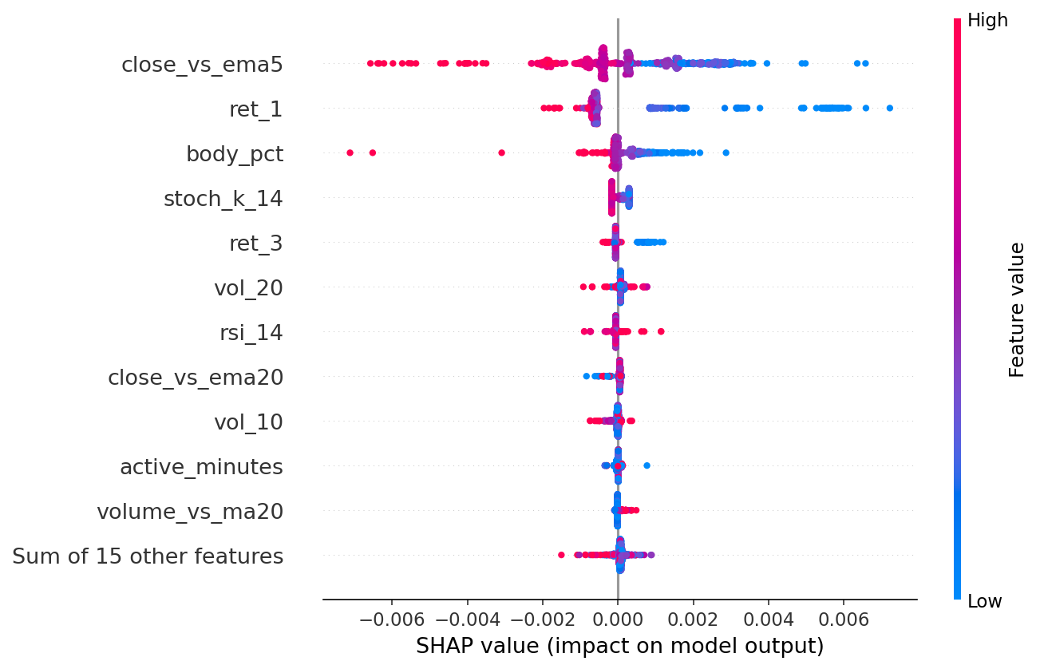
Blending and SHAP
Presenter: Shamika Mahesh
Blend: level with the best single model
High latest return: lower predicted next return
Top features: price vs 5-bar average, latest return
Built-in vs SHAP ranking agreement: 0.84, 0.67, 0.84
Notes:
Averaging XGBoost and Keras was level with the better single model. SHAP shows that after a jump the model predicts a lower next return, which matches the bounce-back seen in the EDA.

Slide 14
Conclusion
Presenter: Shamika Mahesh
All five frameworks recognise the current Buy/Sell trend well
Next-hour return is only slightly predictable, mostly a thin-market bounce-back
12-hour-ahead forecasts did not clearly beat repeating the current signal
XGBoost is the fastest and easiest to explain, with equal accuracy
Limits: one year of data, no trading costs, Lightning used in place of Flash
Notes:
Summarise the five findings and the limits, then invite questions.

