Slide 1
A generalized Benford's law for JPEG coefficients and its applications in image forensics
Shangqi Wu
Presentation of ECES 680
March 17th, 2016

Slide 2
Abstract
The paper introduces a novel statistics model based on Benford's law to analyze first digits of JPEG blocking and quantization coefficients.
This model can be applied to detection of JPEG compression and double compression trace, Q-factor estimation of JPEG images, etc.

Slide 3
Outline
Introduction to this approach
Block-DCT coefficients and Benford's law
JPEG coefficients and generalized Benford's law
Application in image forensics
Conclusions
Algorithm implementation & verification

Slide 4
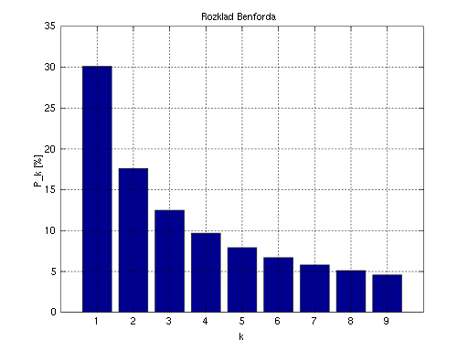
Introduction to Benford's Law
Benford's law, also called first-digit law, is a phenomenological law about the frequency distribution of most significant digits in many real-left numerical data.
Example:
Right graph is the distribution of most significant digit should look like in real-world numerical data – larger the digit is, less occurrence in data set.

Slide 5
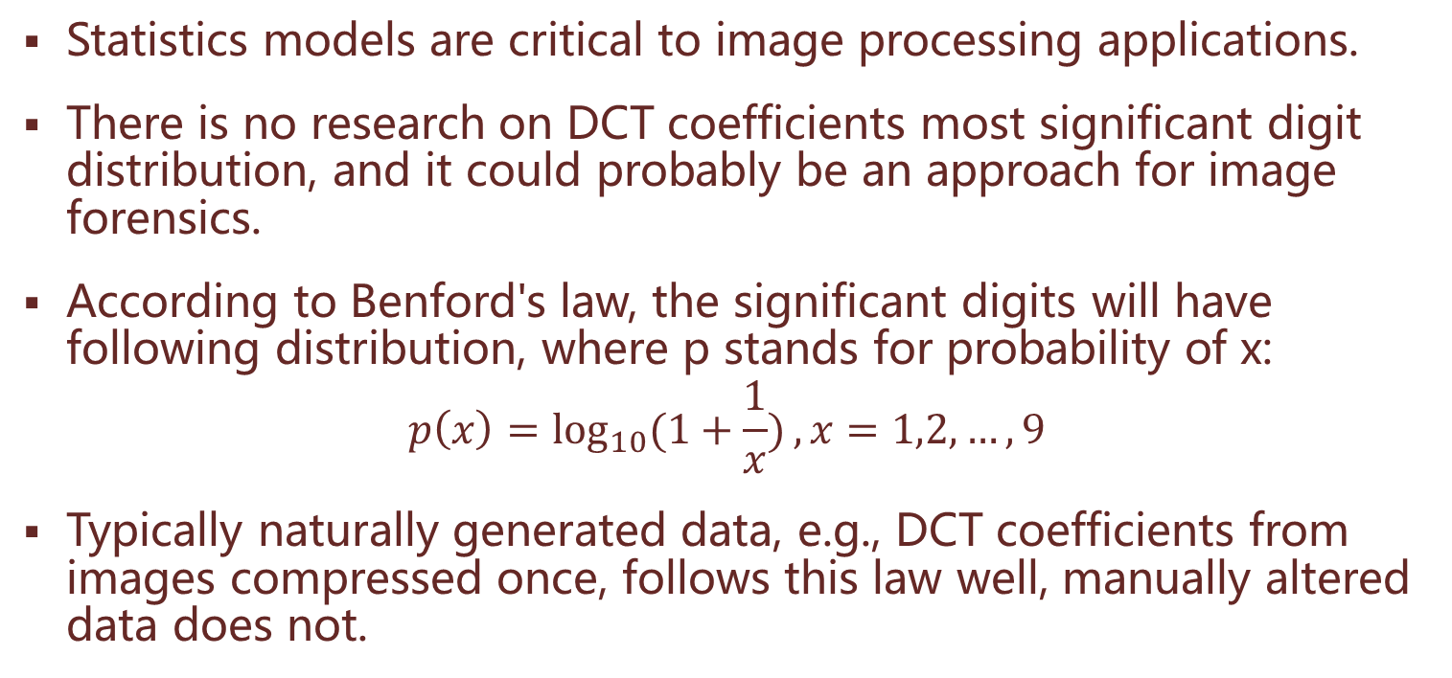
Introduction
Statistics models are critical to image processing applications.
There is no research on DCT coefficients most significant digit distribution, and it could probably be an approach for image forensics.
According to Benford's law, the significant digits will have following distribution, where p stands for probability of x:
$$p\left(x\right)=\log_{10}{(1+\frac{1}{x})},x=1,2,…,9$$
Typically naturally generated data, e.g., DCT coefficients from images compressed once, follows this law well, manually altered data does not.

Slide 6
Block-DCT Coefficients and Benford's Law
Block-DCT coefficients are block data before quantization.
AC components of coefficients are usually in Laplacian or Cauchy distribution.
This paper only researches on 8-bit gray level images, i.e., luminance.

Slide 7
DCT Coefficient Continued
The block-DCT coefficients distribution of 1338 images in UCID database was verified by Benford's law.
Yellow bars in right figure represent mean distribution of first digits of coefficients.
Red bars are standard Benford's law distribution.
Error bars are standard deviation of all images.

Slide 8
JPEG Coefficients and Generalized Benford's Law
Compared with block-DCT coefficients, JPEG coefficients are coefficients after quantization.
Right figure shows first digits distribution of JPEG coefficients first digit, which comes from JPEG compressed pepper image.

Slide 9
Adjusted First Digit Logarithmic Law
First digits distribution is altered after JPEG quantization, or compression.
After observing distribution pattern of compressed images, a logarithmic law modified from Benford's law is introduced.
Right figure shows difference between JPEG image with quality factor of 100 and standard Benford's law.

Slide 10
First Digit Logarithmic Law Continued
JPEG image, Q factor of 90
JPEG image, Q factor of 50

Slide 11
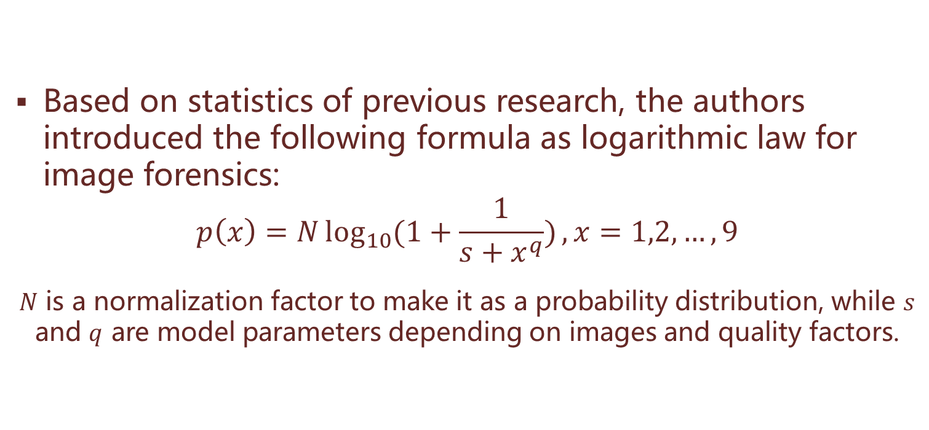
First Digit Logarithmic Law Continued
Based on statistics of previous research, the authors introduced the following formula as logarithmic law for image forensics:
$$p\left(x\right)=N\log_{10}{(1+\frac{1}{s+x^{q}})},x=1,2,…,9$$
$N$ is a normalization factor to make it as a probability distribution, while $s$ and $q$ are model parameters depending on images and quality factors.

Slide 12
Logarithmic Law Continued
Following figures show distributions of images from different databases, axis are in logarithmic scale. We can conclude that this law fits real-world images well.

Slide 13
Applications in Image Forensics
Detection of JPEG compression for bitmaps
Compress the decompressed or original bitmaps with quality factor of 100, then applying first digit law to JPEG coefficients
Estimation of quality factors of JPEG images
Under assumption of using standard JPEG quantization table
By recompressing decompressed images with different quality factors, finding the most fit first digit distribution of JPEG coefficients to logarithmic law
Detection of JPEG double-compression
Similar to single-compression detection, needing more future work

Slide 14
JPEG Compression Detection
Mean coefficient first digits distributions of original image and compressed images with quality factors of 90 and 70, respectively.

Slide 15
Quality Factor Estimation
The following figures show the procedure of iteratively recompressing to find the most fit quality factor.
Q-factor | Model Parameters |  |  | Fitting (SSE)
 | N | q | s
85 | 0.1966 | 0.475 | -0.9982 | 0.0082
83 | 0.4738 | 0.9793 | -0.9262 | 0.00072
80 | 1.227 | 1.571 | -0.4242 | 9.75616e-06
77 | 1.569 | 1.719 | -0.144 | 0.00016
75 | 3.537 | 2.388 | 1.41 | 0.00033

Slide 16
Double Compression Detection
By examining JPEG coefficients and applying first digit law, the difference of first digit distribution can be discriminated from following figures.

Slide 17
Conclusion
A reliable and simple approach to detect JPEG compression traces
Inspired by a statistics model that have never been applied to image forensics area
Future works:
To find more scenarios can be applied by this model
To propose a more generalized model that does not need image-dependable parameters, or introducing an effective way to configure the most fit set of parameters of current image model
To develop algorithms work properly without assumption of using standard JPEG quantization tables

Slide 18
Algorithm Implementation & Verification
Implemented with Matlab 2015b
Performed experiments with image No. 6 in UCID database
Compressed original images by Matlab default function
Worked with JPEG standard quantization tables

Slide 19
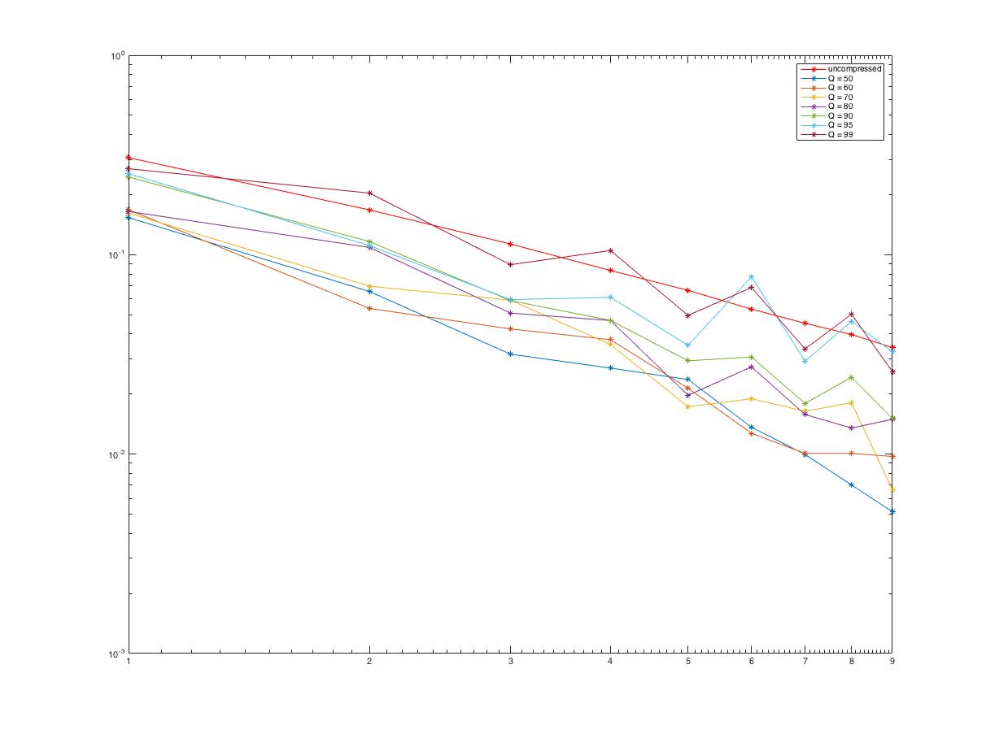
Implementation Continued
My implementation of application 1 described in the paper.

Slide 20
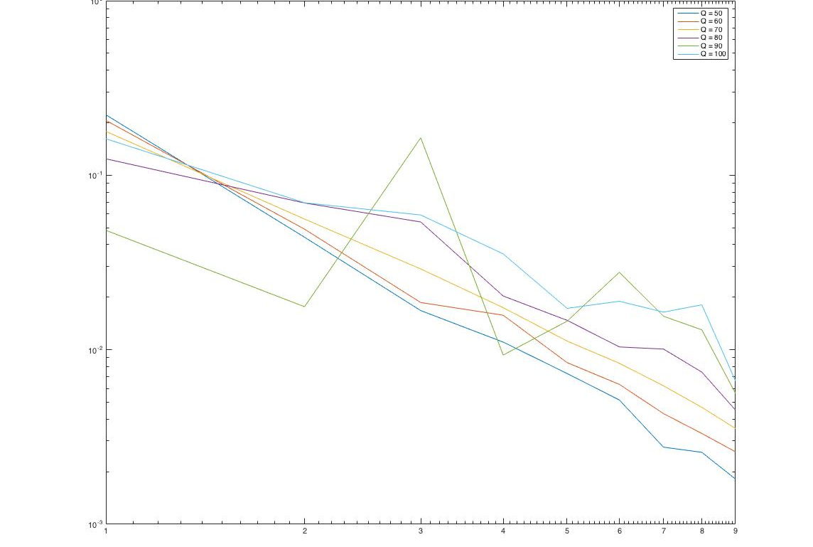
Implementation Continued
My implementation of application 2 described in the paper.

Slide 21
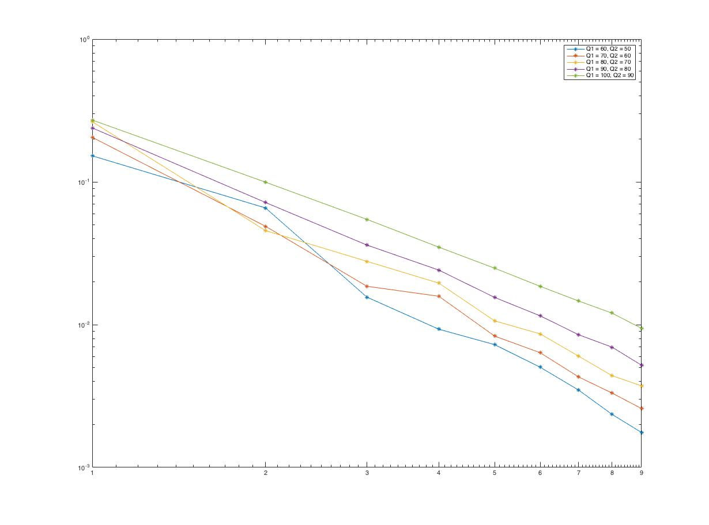
Implementation Continued
My implementation of application 3 described in the paper.

Slide 22
Thank you!
Shangqi Wu

