Slide 1
The West Nile Virus Went West
How does California’s climates, drought and water affect West Nile Virus outbreaks?
By Kama Baugher

Slide 2
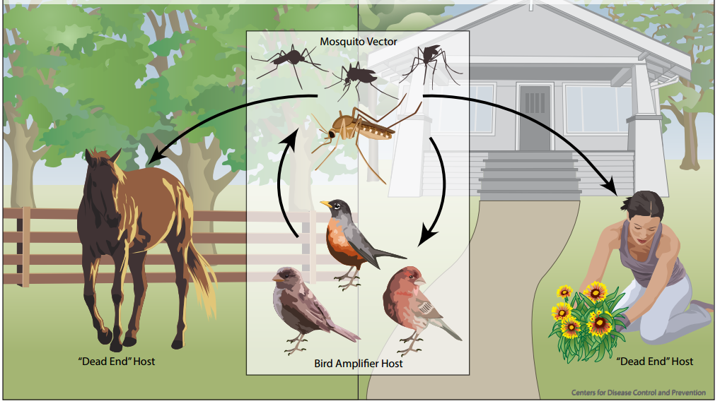
West Nile Virus Transmission Cycle
https://www.cdc.gov/westnile/transmission/

Slide 3
Humans get 3 different types of West Nile Virus (WNV) symptoms.
1: No symptoms. ~80% of cases
2. Symptomatic. ~20% of cases. Flu-like symptoms.
3. Neuroinvasive. Less than 1% of cases.
West Nile Virus infects the brain and/or spinal cord.
Happens to elderly, children, disabled
Encephalitis or meningitis, coma, convulsions
Neurological effects may be permanent
*The California Department of Health West Nile Virus Webpage, http://westnile.ca.gov/wnv_faqs_basics.php

Slide 4
Everything that affects birds, mosquitoes, and humans affects West Nile Virus (WNV) outbreaks:
Heat
Land Use/Cover
Type of mosquito
Cold
Human Socioeconomics
Human immunity
Birds: how many, what kind, when infected
Drought: “The primary climactic driver of increased West Nile virus epidemics”*
* Paull SH, et al. 2017 Drought and immunity determine the intensity of West Nile virus epidemics and climate change imapcts. Proc. R. Soc. B 284: 20162078

Slide 5
2007 study: Drought has opposite effects on WNV in Western versus Eastern U.S.
Drought in East = less WNV next year
Drought in West = more WNV next year
* On a large scale. This varies on the micro/local scale
Landesman W., et al., 2007 Inter-Annual Associations between precipitation and Human Incidence of West Nile Virus in the United States. Vector-Borne and Zoonotic Diseases, Vol. 7, No. 3, 2007.

Slide 6
More studies:
Shaman et al. in Southern Florida:
WNV increased with drought 2-6 months prior
Paull et al.
a meta-study
Prior-year drought is major cause in WNV outbreaks
Shaman et al. in Colorado
drought “weakly” increased WNV in the mountains
decreased WNV in the plains

Slide 7
Why does drought increase WNV in the West?
Theories:
-Maybe “droughts draw birds and mosquitos to man-made pools of water, and concentrate the birds, disease, mosquitos, and humans in one place.”
-Maybe “drought puts stress on birds’ immune systems”
- Maybe Culex mosquitoes different life cycle
- Maybe floods wash away mosquitoes

Slide 8
Study Objectives: Mimic Shaman’s 2010 Colorado study.
Study looked at precipitation, drought, recommended irrigation study
Why California?
Excellent data records
Has wet and dry climates, could mimic West versus East effect
Has irrigation, precipitation, drought

Slide 9
Data:
-2007 and 2012 irrigated acres per county in CA from Census of Agriculture
-Drought levels for CA, five levels of severity
-Population estimates from US Census Bureau
-Averaged monthly precipitation per county
-WNV cases from California Health and Human Services

Slide 10
Methods:
-Yearly data for irrigated land interpolated from 2012 and 2007 data points
-10 year precipitation data aggregated. Top 25% counties designated “wet”, others dry.
-Percent irrigation of counties calculated
-Correlation coefficients for WNV counts were calculated on precipitation,
levels of drought severity, percent irrigated land, acres of irrigated land,
drought, all for prior year and concurrent year, for California as a whole and for
wet and dry climate county sets.
-Monthly correlations for precipitation, drought levels, and WNV were
calculated with lag times of 2, 4, and 6 months to look for monthly or
seasonal correlations.
-The strongest correlations were noted and graphed or mapped.
-Ten year sum of WNV cases and precipitation with 2010 census population
and percent Irrigated land was attached to shapefile and mapped in ArcGIS
-Ordinary Least Square regressions were completed with WNV/population as
the dependent factor and percent irrigation and precipitation as explanatory factors

Slide 11
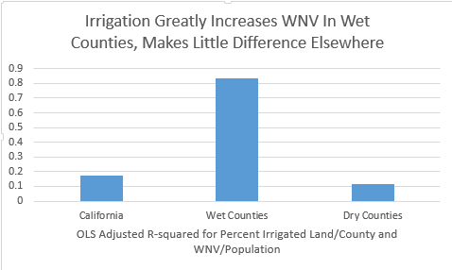
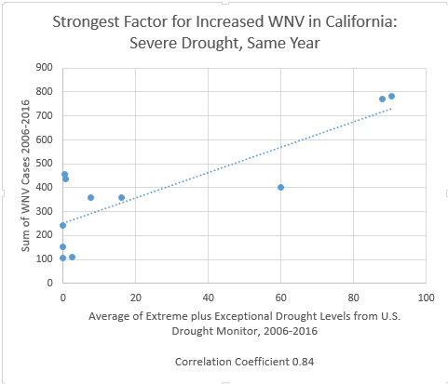
The two strongest factors increasing WNV:

Slide 12
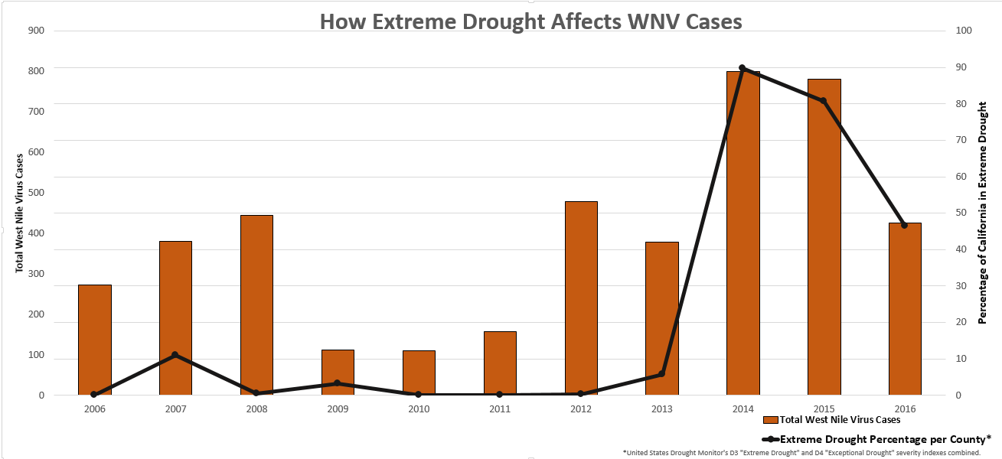

Slide 13
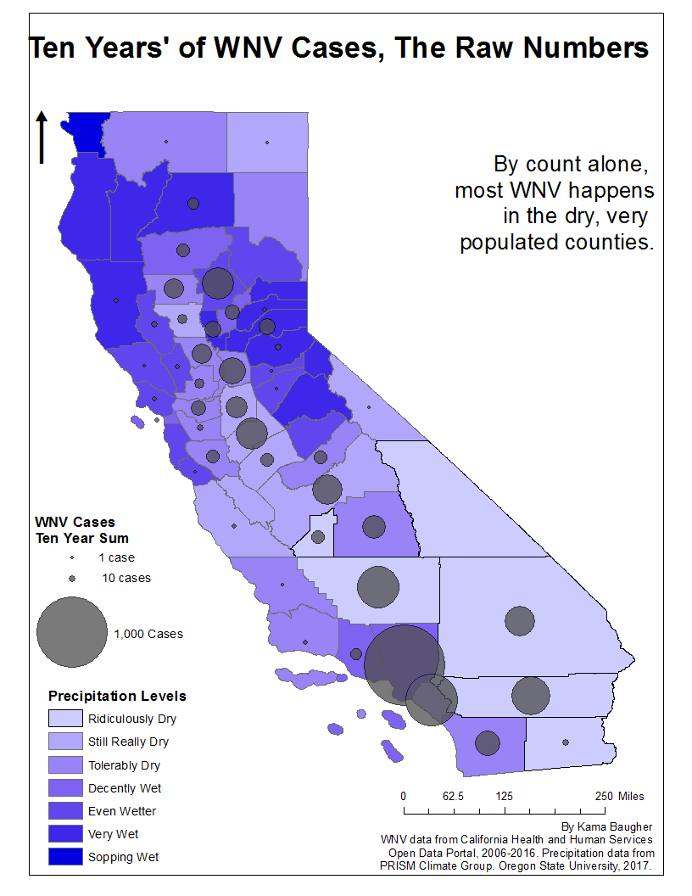
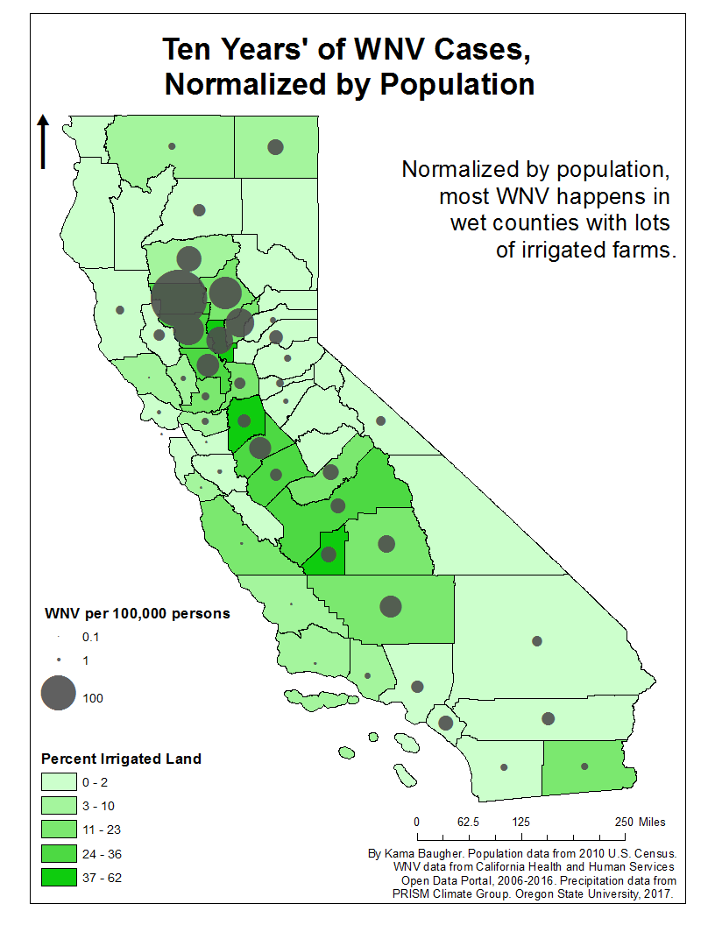

Slide 14
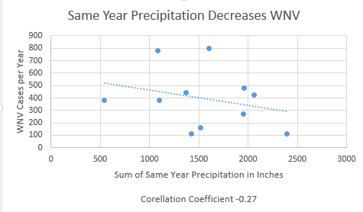
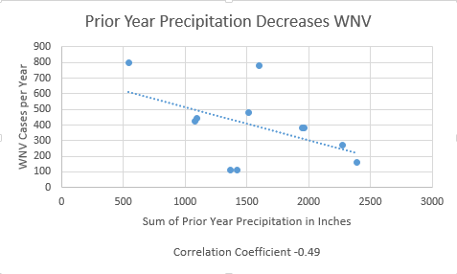

Slide 15
Conclusion:
Drought increases WNV in dry counties
Irrigation increases WNV in wet counties

Slide 16
What to do next:
Obtain date-of-onset data for WNV versus date-of-report
Multivariate statistical research on all variables
Specialize WNV and drought studies on species/climates

Slide 17
Studies
Chase, Jonathan M., and Tiffany M. Knight. "Drought-induced mosquito outbreaks in wetlands." Ecology Letters 6.11 (2003): 1017-024.
Johnson, B. J., and M. V. Sukhdeo. "Drought-induced amplification of local and regional West Nile virus infection rates in New Jersey.“
Journal of medical entomology. U.S. National Library of Medicine, Jan. 2013. Web. 25 Apr. 2017.
Landesman, William J., Brian F. Allan, R. Brian Langerhans, Tiffany M. Knight, and Jonathan M. Chase. "Inter-Annual Associations
Between Precipitation and Human Incidence of West Nile Virus in the United States." Vector-Borne and Zoonotic Diseases 7.3
(2007): 337-43. Web.
Paull, Sara H., Daniel E. Horton, Moetasim Ashfaq, Deeksha Rastogi, Laura D. Kramer, Noah S. Diffenbaugh, and A. Marm Kilpatrick.
"Drought and immunity determine the intensity of West Nile virus epidemics and climate change impacts." Proceedings of the
Royal Society B: Biological Sciences 284.1848 (2017): 20162078. Web.
Shaman, Jeffrey, Jonathan F. Day, and Marc Stieglitz. "Drought-Induced Amplification and Epidemic Transmission of West Nile
Virus in Southern Florida." Journal of Medical Entomology 42.2 (2005): 134-41. Web.
Shaman, Jeffrey, Jonathan F. Day, and Nicholas Komar. "Hydrologic Conditions Describe West Nile Virus Risk in Colorado."
International Journal of Environmental Research and Public Health 7.2 (2010): 494-508. Web.
Data Sources
"2012 Census Volume 1, Chapter 2: County Level Data California." USDA - NASS, Census of Agriculture. USDA, 2012. Web. 1 Apr. 2017.
"GIS Data Archive." United States Drought Monitor>Maps and Data>GIS Data. The National Drought Mitigation Center,
University of Lincoln, NE, n.d. Web. 25 Mar. 2017
"Population Estimate." American FactFinder. United States Census Bureau, 05 Oct. 2010. Web. 20 Mar. 2017.
"Recent Years (Jan 1981 - Sep 2016)." PRISM Climate Group. Oregon State University, 2017. Web. 17 Mar. 2017.
"Reports." The California Department of Public Health West Nile Virus Website. N.p., 2004. Web. Mar. 2017.
"Square Mileage by County." California State Association of Counties, 2014. Web. 15 Mar. 2017.
"West Nile Virus Cases, 2006-present | CHHS | Open Data." California Health and Human Services Open Data Portal. California Health and
Human Services , n.d. Web. 25 Apr. 2017.

