Slide 1
Cab Transaction using Facial Recognition and Matching
St. John College of Engineering and Management
Presented by:
Rohan Chavan (PID No.1152082)
Kshitij Shukla (PID No.2152053)
Saniket Patil (PID No.2162014)
Guided by:
Mr. Vivian Lobo

Slide 2
Contents:
Abstract
Introduction to Domain
Problem Definition
Proposed System
Objectives
Scope
Literature Survey
Requirement Analysis
System Architecture
System Design
Implementation
References
Department of Computer Engineering

Slide 3
Abstract:
After booking a Cab, at the end of the ride one can make the transactions with either cash, card, UPI, E-wallet etc. Sometimes these methods are not hassle free as they cause inconvenience to the customer. Therefore, a new system has been proposed for transactions, where face scan method will be used. The system in the cab will calculate the fare based on the distance and then it will authenticate the riders face and transact via connected central database. Face recognition begins with extracting the coordinates of features such as width of mouth; width of eyes, pupil, and compare the result with the measurements stored in the database and return the closest record (facial metrics). The main purpose of this research is to investigate different types of face recognition algorithms like Eigen face and Fisherface. The open CV provides these recognition algorithms. This is done by comparing the receiver operating characteristics curve to implement in the given Transaction using Facial Recognition. In addition, it is noted that Eigen Face delivers better results than Fisherface algorithms; Eigen face delivers between 70 to 80% accuracy between faces. If the user’s input image matched with the trained dataset image then the User Profile and Transaction details gets loaded, and the subsequent trip details gets stored in the User Profile database. The database is connected to frame web server.
Department of Computer Engineering

Slide 4
Introduction to Domain:
Facial Recognition:
A facial recognition system is a technology capable of identifying or verifying a person from a digital image or a video frame from a video source. There are multiple methods in which facial recognition systems work, but in general, they work by comparing selected facial features from given image with faces within a database. It is also described as a Biometric Artificial Intelligence based application that can uniquely identify a person by analysing patterns based on the person's facial textures and shape.
Department of Computer Engineering

Slide 5
Problem Statement:
The number of online banking users has increased in India and indeed the world; this has led to many experts in mobile banking software and mobile phone technology to research new and convenient methods for customers to perform banking transactions remotely via their mobile phones.
Mobile banking is also known as mobile phone bank. It is referred to as the using mobile phone for banking related business. But the problem is that it is not convenient for users to enter long high security passwords every time they want to make a transaction or remember their UPI VPA(Virtual Private Address), or even carry credit cards or debit cards everywhere.
That’s highly inconvenient to the users. So, we are proposing a system where you don’t have to carry cards or remember your VPAs.
Department of Computer Engineering

Slide 6
Proposed System:
The proposed system is expected to provide higher level of authentication (multifactor authentication) which will bring unauthorized access to the barest minimum.
Before access will be granted, the user will have to take a facial photograph to have access to his/her account, the geometry of the face, distance of the eyes and the nose is compared.
This photograph will be compared with the photograph in the bank server and the NCC server for verification, if it passes the verification, access will be granted, otherwise it will denied.
In the event of unauthorized access, a security alert message will be sent to the bank.
Department of Computer Engineering

Slide 7
Objectives:
To design real time face recognition system for cabs transactions.
To design a system where face can be used for logging into profile.
To design a system for cabs where face detection system can also be used to pay along with card or cash.
To design a System where once your load your profile you can initiate a transaction without any card.
To make this system robust and to be used in future in other applications.
To design a secure system for cab transaction using facial recognition technique.
To develop and improve existing algorithm to make Facial recognition accurately possible on twin person images.
To perform and evaluate the proposed system framework by comparing with existing facial recognition systems.
Department of Computer Engineering

Slide 8
Scope:
Improving facial recognition accuracy using as less user images as possible.
Security of the payment gateway engine.
easy user interface.
Department of Computer Engineering

Slide 9
Literature Survey I:
  In computer technology image based on identical twin, face recognition technology is challenging task. Traditional facial recognition system exhibit poor performance in differentiating identical twins and similar person under practical conditions. The following methods for differentiate identical twins. In existing methods, many techniques are used for twin’s identification like finger print, voice and iris recognition.
The process of finger print identification is used to identify unique person in industry or organizations. The method propose a scan image taken from the person and compare with database for identification. The iris recognition also similar method to finger prints identification.
Department of Computer Engineering

Slide 10
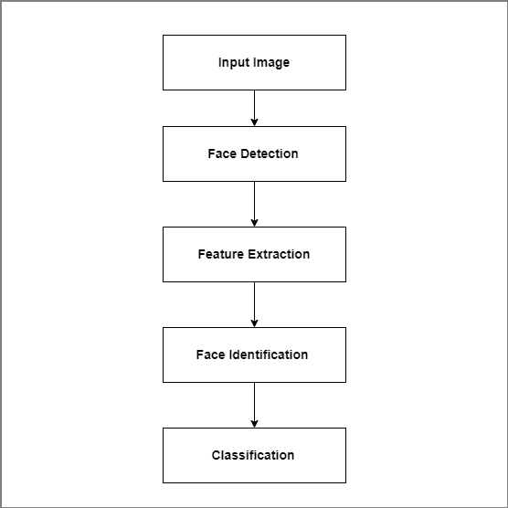
Literature Survey I: System Architecture:
Department of Computer Engineering

Slide 11
Literature Survey I:
Conclusion:
Conclusion of this paper to identify the twins and similar faces using Gabor filter and Multi-scale Fast Radial symmetry transform. Gabor filter is used to differentiate when faces are not similar. But multi-scale Fast Radial Symmetry Transform technique is used to differentiating identical twins and similar faces using facial aspects.
Department of Computer Engineering

Slide 12
Literature Survey II:
The proposed system is expected to provide higher level of authentication which will bring unauthorized access to the barest minimum. This photograph will be compared with the photograph in the bank server and the NCC server for verification, if it passes the verification, access will be granted, otherwise it will denied. In the event of unauthorized access, a security alert message will be sent to the bank.
Department of Computer Engineering

Slide 13
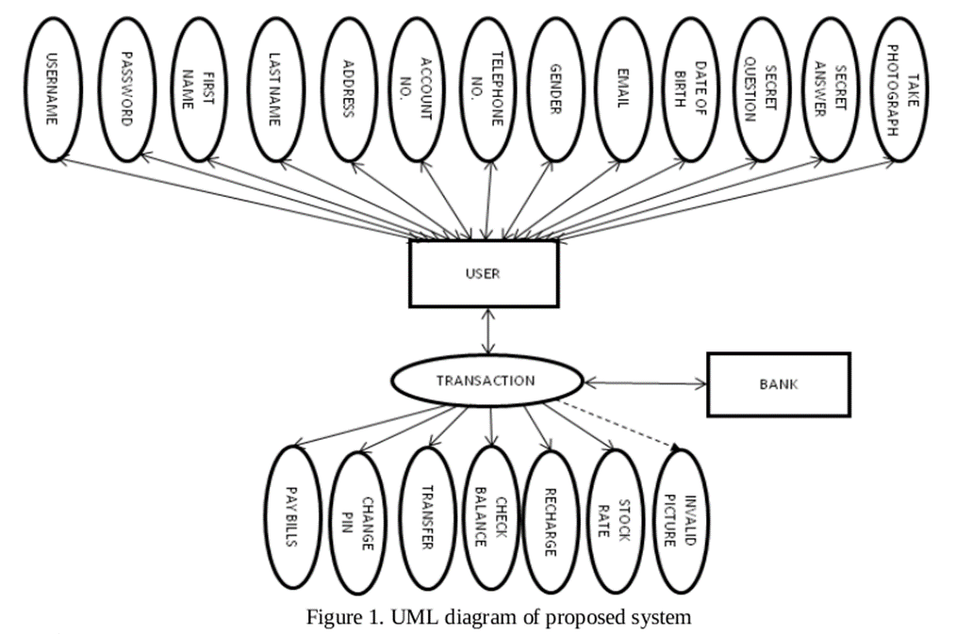
Literature Survey II:
System Architecture:
Department of Computer Engineering

Slide 14
Literature Survey II:
Conclusion:
In a bid to make the Nigerian economy cashless, attention should be focused on security. When the security is trusted, it will build customer satisfaction and discourage the use of cash. The number of mobile phone users increases by the day and the success of the security on mobile banking will encourage new users to adopt the trend.
Department of Computer Engineering

Slide 15
Literature Survey III:
Use of payment cards in various places such as shopping, restaurants, lodges and online payment for booking hotels, movie tickets, flight and train tickets etc are increasing day by day. Therefore, the problem is that a person has to carry payment cards along with him and keep the cards secure to use it all the time. Face recognition payment system is safe, secure and even easy to use. It is reliable and more efficient compared to other payment technologies.
A general design of online payment system using face recognition is proposed. The methods adopted for face recognition are by finding the Eigen faces and Euclidean distance.
Department of Computer Engineering

Slide 16
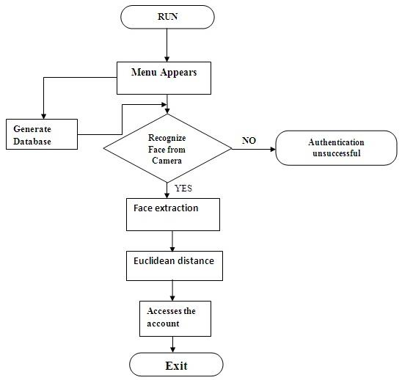
Literature Survey III:
Department of Computer Engineering

Slide 17
Literature Survey III:
Conclusion:
In this paper, the biometric face recognition based payment system is used in all kinds of payments. For any online payments, the user need not use debit or credit card. A person need not carry card and remember the password for the transaction. Face recognition system is being proposed for all transactions. This is found to be more safe, secure and even easy to use.
Department of Computer Engineering

Slide 18
Requirement Analysis:
Functional Requirements:
Software should be able to detect the persons from the video input correctly.
Input person should be compared and placed accurately.
Only the first time chunk in which person has appeared should be considered.
Persons with half appearance should be detected.
Department of Computer Engineering

Slide 19
Requirement Analysis:
Non-Functional Requirements:
Software should process video in minimal time.
Input provided should be a valid person.
Software should search in both picture as well as video format.
It should be able to handle video length of 600 seconds.
Department of Computer Engineering

Slide 20
Requirement Analysis:
Hardware Requirements:
Intel Core i3
RAM 4GB
Minimum HDD of 3GB
Web Camera
Department of Computer Engineering

Slide 21
Requirement Analysis:
Software Requirements:
OS: win 7 or above / Any Linux
Xampp / Lamp Stack
Python 3.x
OpenCV
Department of Computer Engineering

Slide 22
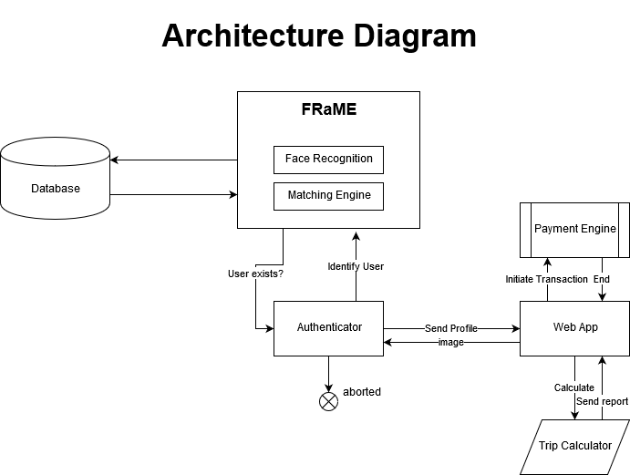
Fig. Cab Transaction Using Facial Recognition and Matching
Department of Computer Engineering

Slide 23
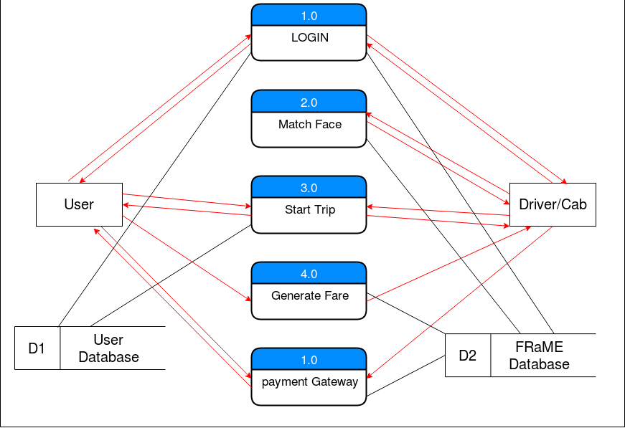
DFD

Slide 24
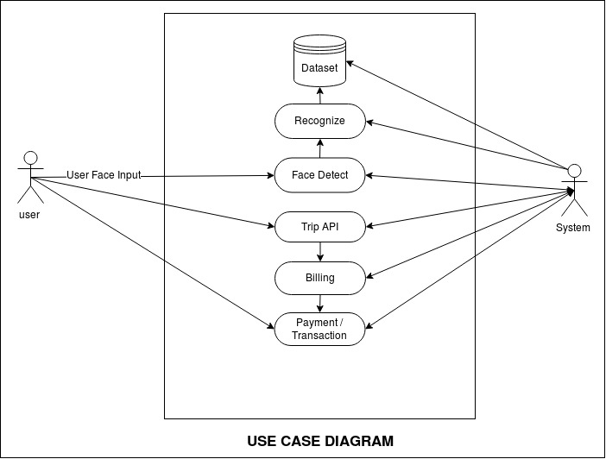
System Design:
Use Case Diagram
Department of Computer Engineering

Slide 25
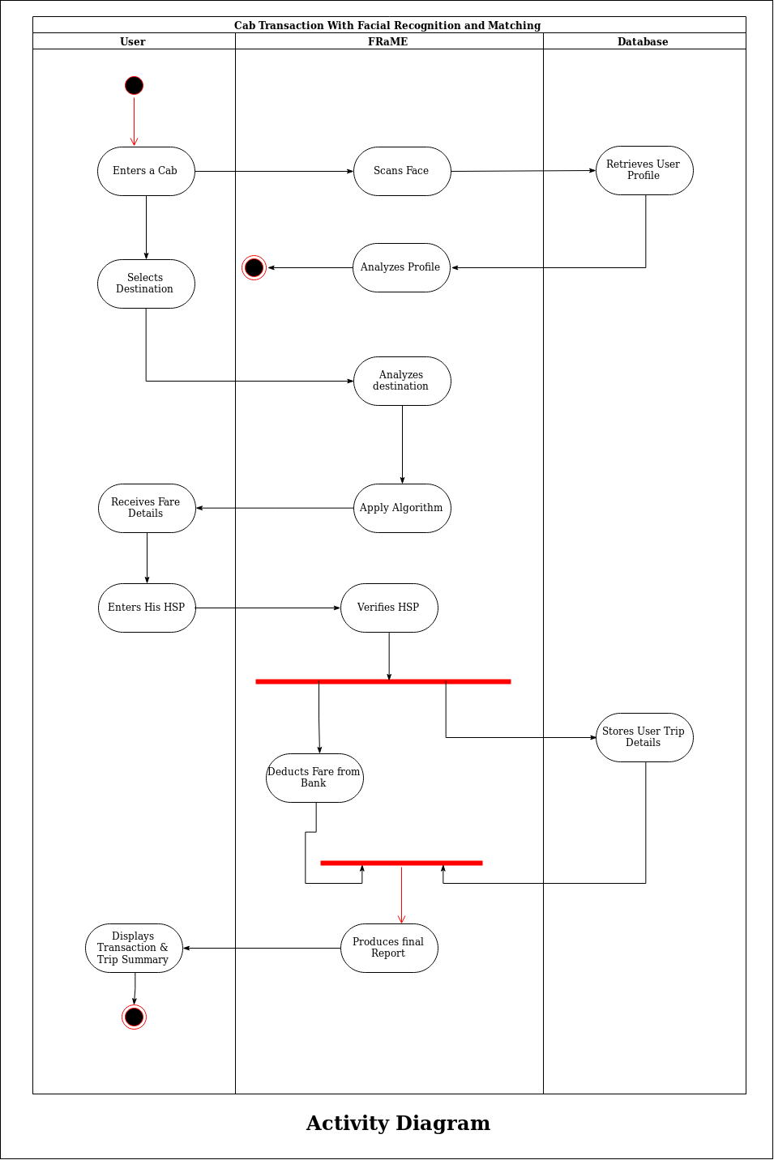
Activity Diagram

Slide 26
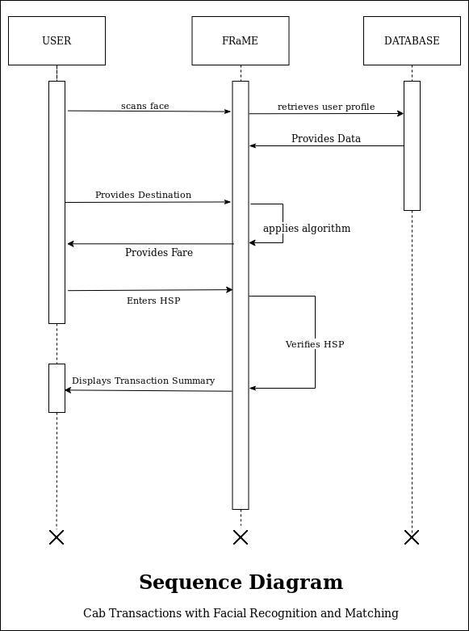
Sequence Diagram:

Slide 27
Implementation:
There are three easy steps to computer coding facial recognition, which are similar to the steps that our brains use for recognizing faces.These steps are:
Data Gathering: Gather face data (face images in this case) of the persons you want to identify.
Train the Recognizer: Feed that face data and respective names of each face to the recognizer so that it can learn.
Recognition: Feed new faces of that people and see if the face recognizer you just trained recognizes them.
OpenCV has three built-in face recognizers and thanks to its clean coding, you can use any of them just by changing a single line of code. Here are the names of those face recognizers and their OpenCV calls:
EigenFaces – cv2.face.createEigenFaceRecognizer()
FisherFaces – cv2.face.createFisherFaceRecognizer()
Local Binary Patterns Histograms (LBPH) – cv2.face.createLBPHFaceRecognizer()

Slide 28
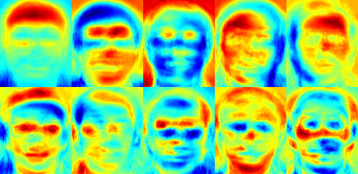
1. Eigenfaces face recognizer
Extract the principal components from the new picture.
Compare those features with the list of elements stored during training.
Find the ones with the best match.
Return the ‘person’ label associated with that best match component.

Slide 29
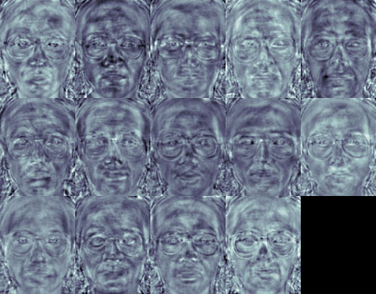
2.Fisherface face recognizer
This algorithm is an improved version of the last one. As we just saw, EigenFaces looks at all the training faces of all the people at once and finds principal components from all of them combined. By doing that, it doesn't focus on the features that discriminate one individual from another. Instead, it concentrates on the ones that represent all the faces of all the people in the training data, as a whole

Slide 30
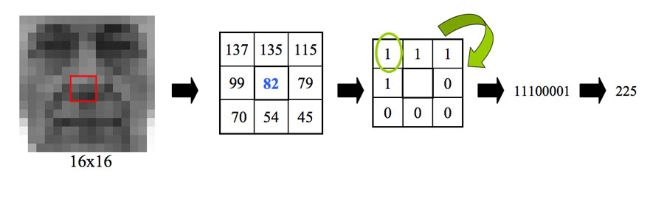
3.Local binary patterns histograms (LBPH) Face Recognizer
The Eigen faces and Fisherface are both affected by light and so cannot guarantee perfect light conditions. LBPH face recognizer is an improvement to overcome this drawback. The idea with LBPH is not to look at the image as a whole, but instead, try to find its local structure by comparing each pixel to the neighbouring pixels.

Slide 31
References:
[1] R.Prema, Dr. P.Shanmugapriya., et al. "A Face Recognition Techniques for Differentiate Similar Faces and Twin Faces." International conference on Energy, Communication, Data Analytics and Soft Computing (ICECDS 2017).
[2] Falaye Adeyinka Adesuyi, Osho Oluwafemi, Alabi Isiaq Oludare, Adama Ndako and Amanambu Victor Rick. "Secure Authentication for Mobile Banking Using Facial Recognition." IOSR Journal of Computer Engineering (IOSR-JCE) e-ISSN: 2278-0661, p- ISSN: 2278-8727 Volume 10, Issue 3 (Mar. - Apr. 2013), PP 51-59 “www.iosrjournals.org”.
[3] Surekha.R.Gondkar, Saurab. B, Dr. C.S.Mala. "Biometric Face Recognition Payment System”. International Journal of Engineering Research & Technology (IJERT). Special Issue – 2018, ISSN: 2278-0181, Volume 6, Issue 13 “Published by, www.ijert.org”.
[4]Face Recognition Using OpenCV and Python, Available from “https://www.superdatascience.com/blogs/opencv-face-recognition”.
Department of Computer Engineering

