Slide 1

DdoS Detection using ANN
Group Members:
Rohan Chavan - 4
Kshitij Shukla - 84
Saniket Patil - 85

Slide 2
Introduction to Domain
Artificial Neural Network
Artificial Neural Networks are Computational Systems that are inspired by biological neural networks that constitute animal brains.
Such Systems learn to do tasks by seeing examples.
For example, in Image recognition they may learn to recognize cats by seeing multiple images of cats
They can do this without any prior knowledge about the subject.

Slide 3
Abstract
DDoS is a attack that targets a node or a medium with its false packets to decline the network performance and its resources.
NN is a powerful tool to defend networks from such attacks.
Hence, In our proposed soultion a mitigation process is invoked as soon as an attack is detected by a detection system using known patterns.
These patterns are the patterns that separate known traffic from Malicious traffic.
Our system will be able to Flag any malicious traffic and therby save network from losing performance.

Slide 4
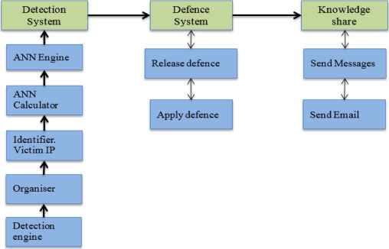
Architecture Diagram

Slide 5
Future Scope
It is a fact that network layer attacks which contain packet manipulations are now relatively easier to detect with modern detection and mitigation tools.
However, application layer DDoS defense needs more research for development of highly effective defense tools.
Future scope will be to Train ANN to detect DDoS on application layer.
This would be achieved by implementing Artificial Intelligence in Intrusion Detection Systems.

Slide 6
Conclusion
We will use trained ANN algorithm to identify TCP and UDP attacks using the basic key patterns that distinguish between authentic traffic from DdoS attacks.
A mirror image of real network environment will be used to start the learning process.
We will launch different DdoS attacks during the flow of the legitimate traffic through the network.
Thank You.

