Slide 1
PROTEINS

Slide 2
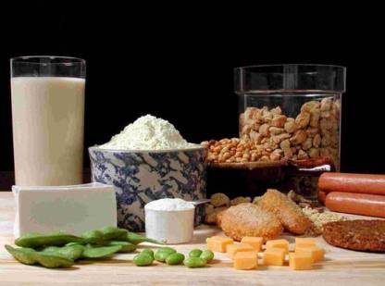
INTRODUCTION
Proteins are the nitrogenous macromolecules composed of different amino acids linked by peptide bond.
COMPOSITION OF PROTEINS
In addition of carbon , hydrogen and oxygen present in carbohydrate and lipid , Proteins also contains Nitrogen.
Some of proteins also contains Sulfur , phosphorus , Cu ,Mn ,Zn etc.
SOURCES OF PROTEINS
1) Dietary source-- 1st class protein: Meat,
milk, fish
2nd class protein: Pulses,
cereals, beans
2) Endogenous source– From digestive enzymes and worn out cells of digestive tract.

Slide 3
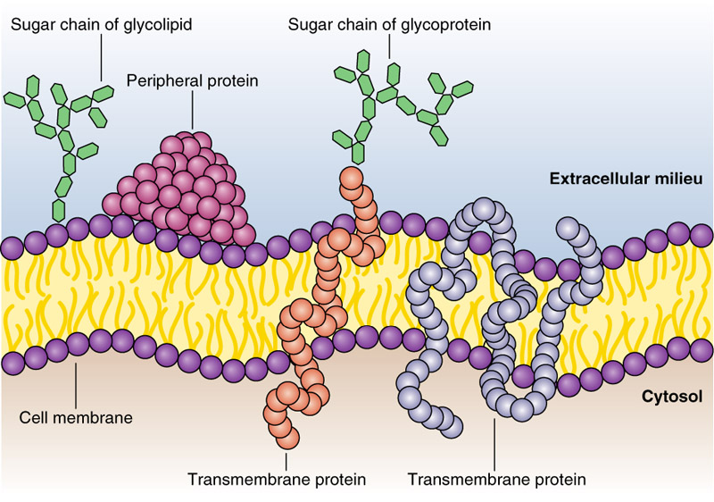
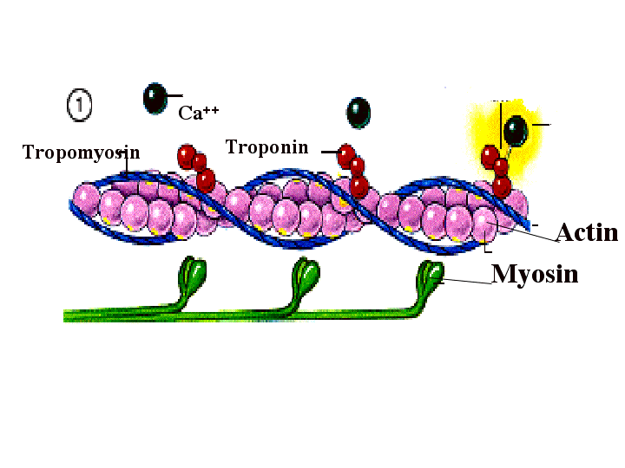
FUNCTIONS ( BIOMEDICAL IMPORTANE ) OF PROTEINS
1.STRUCTURAL FUNCTIONS
Proteins are the structural component of cell membrane and acts as Channel , carrier or Peripheral protein.
Proteins are responsible for structure and strength of body .eg; Collagen and Elastin fibers acts as ground substance for various organs.
2.DYNAMIC FUNCTIONS
Biochemical catalysts known as ENZYMES are proteins.
Proteins known as immunoglobulins provides humoral immunity
Several hormones are proteins in nature.
The contractile proteins ( actin and myosin) helps to contract Muscle and microvilli.

Slide 4
FUNCTIONS ( BIOMEDICAL IMPORTANE ) OF PROTEINS
The Transport proteins carry out the function of transporting various substances in body fluids.
Storage proteins bind with specific substances and store them. Eg; Iron is stored as ferritin.
Few proteins are constituents of respiratory pigments and occur in electron transport chain eg: cytochrome, myoglobin, Hemoglobin.
Plasma proteins exerts the osmotic pressure and maintain water and electrolyte balance.
3 .ENERGY SUPPLIER
During starvation , Proteins acts as major supplier of energy.
The structural proteins serve as energy supplier in emergency condition.
1 gm of protein gives 4 kcal of energy.

Slide 5
PROPERTIES OF PROTEINS
1.TASTE
They are tasteless.
2. ODOUR
They are odourless.
When heated to dryness they turn to brown colour and give burning feather odour.
3.MOLECULAR WEIGHT
Generally ,Proteins have large molecular weight and hence called Macromolecule.
Eg: Serum albumin = 69,000.
4.VISCOSITY
The viscosity depends on the molecular shape; more the rough surface , greater is the viscosity.
5.DENATURATION OF PROTEINS
Disorganization of native protein structure is known as denaturation,
Denaturation is done by heat, radiations, and chemicals.

Slide 6



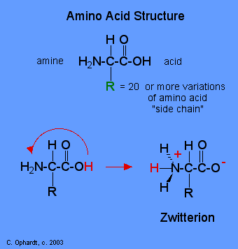
PROPERTIES OF PROTEINS
6.AMPHOTERIC NATURE OF PROTEINS
Proteins contains amino acids which has two functional groups– acidic (-COOH) and basic group( -NH2)
So Protein can donate or accept proton, hence regarded as ampholytes.
In acidic media the protein exist as cations by accepting a proton , while on alkaline media the protein exist as anion by donating a proton.
7. ZWITTERION OR HIBRID IONS
At a specific Ph called an isoelectric Ph , a protein exist as a dipolar ion known as Zwitterions.
Zwitterions carries equal number of positive and negative charge, Hence net charge of protein molecule at isoelectrical Ph is 0 .
Eg; Isoelectric Ph for albumin is 4.7
COOH
H+
H+
Amphoteric nature of protein

Slide 7
PROPERTIES OF PROTEINS
8. Precipitation of proteins.
Proteins can be separated from biological fluids by the precipitation.
Precipitation can be done by various ways;
a) Precipitation at isoelectric Ph eg; Separation of casein at Ph 4.6
b) Precipitation by Sating out Eg : Albumin and globulin can be separated from serum by using neutral salts like ammonium sulphate.
c) Precipitation by Salts of heavy metals like Hg, Fe++ ,Zn in alkaline medium.
By using this property we can use Protein ( Egg ) as antidote in Heavy metal poisoning
d) Precipitation by organic solvents like alcohol.
9.COLOUR REACTIONS OF PROTEINS
Proteins gives colour reactions with several compounds which are useful to identify nature of amino acids.
eg; Xanthoproteic reaction: When aromatic amino acids are treated with conc. HNo3 it produces Yellowish precipitate.

Slide 8
STRUCTURURAL ORGANIZATION OF PROTEINS
Protein structure can be described in four level of organization.
1) Primary structure:
Primary structure is a linear sequence of amino acids held together by peptide linkage.
The free - NH2 group of terminal amino acid is called N-Terminal end and Free –COOH end is called C-terminal end.
The counting of amino acids starts from N- terminal end.
2) Secondary structure:
It is the twisting of Primary structure.
Twisting may be Helical , Zigzag linear or mixed.
The shape is stabilized by hydrogen bonds.
3) Tertiary Structure:
The three dimensional structure of functional protein is called tertiary protein.
Bonds for tertiary structure are : Besides Peptide bond and hydrogen bonds ,it contains disulphide bond ( -S-S-) , Ionic and hydrophobic interaction.
4) Quaternary structure:
Some of Proteins contains two or more Polypeptide chains Known as subunits.
The Spacial arrangement of these sub units are known as Quaternary structure.
Bonds : The sub units are held together by non covalent bonds like hydrogen bond, ionic interactions.
Eg: Hemoglobin

Slide 9
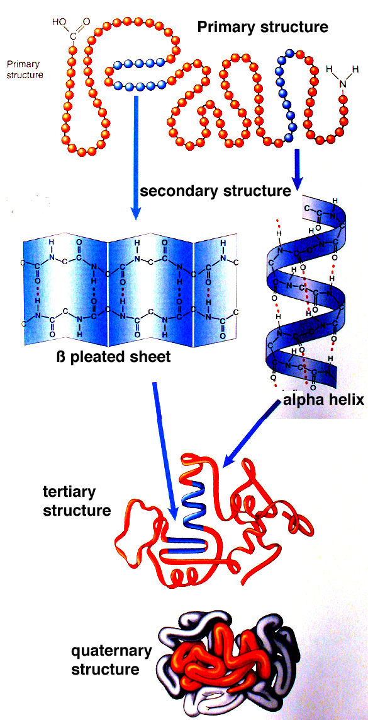
STRUCTURURAL ORGANIZATION OF PROTEINS

Slide 10
DENATURATION OF PROTEINS
The processes of disorganization of native Protein structure is known as Denaturation.
Denaturation causes loss of Secondary, Tertiary and Quaternary structure of proteins.
Agents of denaturation
1) Physical agents: Heat , Radiations
2) Chemical agents: Acids , alkali organic solvents.
Characteristics of denaturation
A) Chemical alteration:
Greatly decreased solubility of protein.
Denaturation is usually irreversible but can be reversible
B) Physical alteration :
The Primary structure of protein with peptide bond remains intact where as other structure are lost.
The viscosity increased where as surface tension decreased.
C) Biological alteration:
The Denatured Protein are biologically inactive
Denatured proteins are easily digested ( cooked proteins)
NOTE
Coagulation: Irreversible denaturation of protein resulting into precipitation of protein

Slide 11
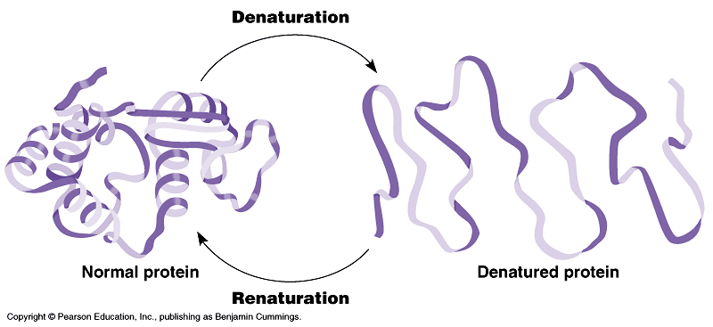
DENATURATION OF PROTEINS

Slide 12
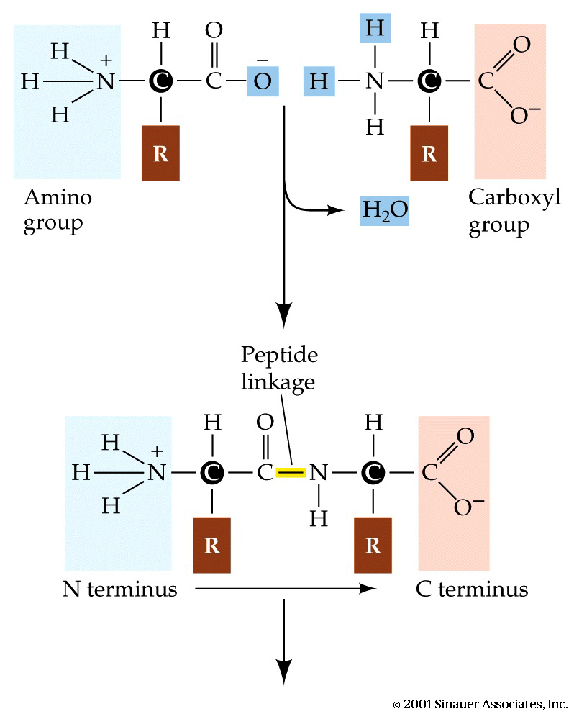
PEPTIDE BOND
The –COOH group of one amino acid can be joined to the – NH2 group of another by covalent bont known as PEPTIDE BOND.
In the processes of formation of peptide bond a molecule of water is eliminated.
When two amino acids are bound together by peptide bond then it is known ad dipeptide and if third amino acid is added it is called as tripeptide.
Up to 10 amino acids it is called peptide ; 11 to 100 amino acids are collectively called Polypeptide and more than 100 amino acid chain is called protein.

Slide 13
CLASSIFICATION OF PROTEINS
Proteins can be classified in several ways
Functional classification.
On the basis of solublity and physical properties.
On the basis of shape and size
On the basis of Nutrition.
FUNCTIONAL CLASSIFICATION
1) Structural proteins: Collagen of bone, Keratin of Hair.
2) Catalytic proteins: Enzymes.
3) Transport Proteins : Hemoglobin , Serum albumin.
4) Hormones: Some hormones are protein in nature Eg: Growth hormone, Insulin.
5) Contractile Proteins : Actin and myosin.
6) Defense Proteins : Immunoglobulin ( Antibodies)
7) Storage Proteins : Ferritin stores iron.
8) Genetic Proteins: Nucleoproteins.

Slide 14
CLASSIFICATION OF PROTEINS
ON THE BASIS OF SOLUBILITY AND PHYSICAL PROPERTIES
1) Simple proteins:
On hydrolysis , these proteins gives only aminoacids.
Eg : Albumin ,Globulin , Histone
2) Conjugated proteins :
The protein in addition to amino acid containins a non – protein group known as Prosthetic group.
Eg: Nucleoprotein = Histone + DNA
Eg: Glycoprotein = Proteins + Carbohydrate.
Eg: Hemoglobin = Globin ( protein) + Heme.
3) Derived Proteins :
These are of two types
a) Primary derived Proteins: These are denatured proteins
Eg : Coagulated protein.
b) Secondary Derived proteins: These are hydrolytic product of proteins
Eg: peptones, Polypeptide , Peptides.

Slide 15
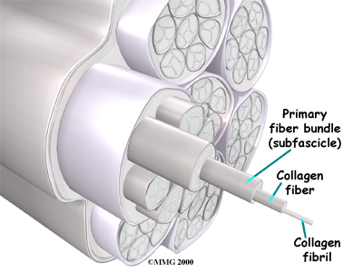
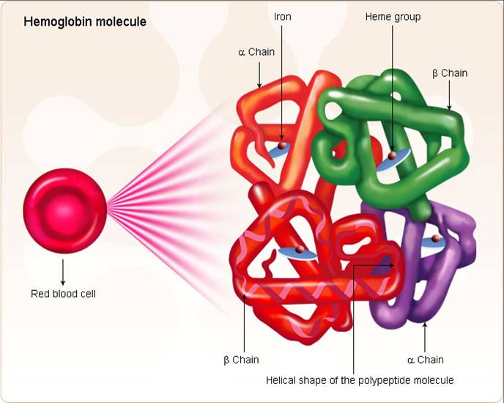
CLASSIFICATION OF PROTEINS
ON THE BASIS OF SHAPE AND SIZE
1) Fibrous Proteins:
The length of protein is more.
Eg: Collagen , Keratin of hair , nail.
2) Globular proteins:
The width of protein is more.
Eg: Albumin, Globulin , Hemoglobin.
ON THE BASIS OF NUTRITION
1.First class protein( complete protein):
These type of proteins contains all essential amino acids
Eg: Meat, milk, fish, Egg
2. Second class Protein ( Incomplete Protein)
These type of protein lacks essential amino acids.
Eg :Pulses, cereals, beans

Slide 16
AMINOACIDS

Slide 17
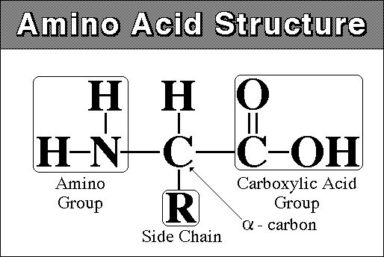
INTRODUCTION
Amino acids are monomers of protein.
These are the group of organic compound containing two functional groups– one Amino group (NH2) and other carboxyl ( COOH) group.
Amino acids are termed as Alpha amino acids , If both carboxyl and amino groups are attached to same carbon atoms.
The alpha carbon atom contains Side chain which is different for each different types of amino acids.
Amino acids shows optical isomers ( except glycine) as L and D isomers .
Al the proteins are composed of L- Alpha amino acids.
There are 20 different types of amino acids

Slide 18
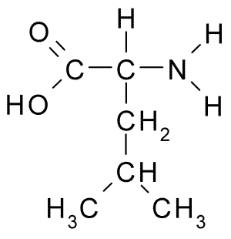
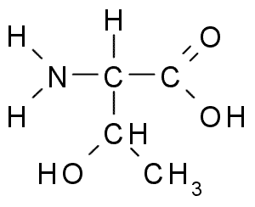
CLASSIFICATION OF AMINO ACIDS
Amino acids can be classified on different ways.
1. On the basis of structure and chemical nature
2. On the basis of polarity
3. On the basis of Nutritional requirement
4. On the basis of metabolic fate.
ON THE BASIS OF STRUCTURE AND CHEMICAL NATURE
A) Amino acid with aliphatic side chain:
These are simple amino acids containing aliphatic side chains
Eg: Glycine , Alanine , Valine, Leucine, Isoleucine.
B) Amino acid containing hydroxyl group ( -OH)
Eg : Serine, Theronine .
Leucine
Theronine

Slide 19
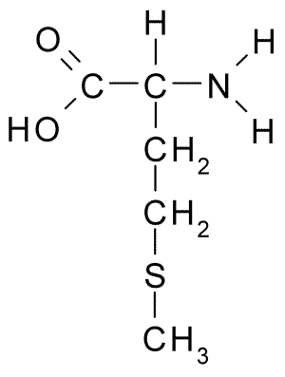
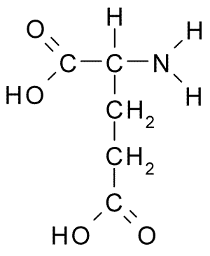
CLASSIFICATION OF AMINO ACIDS
C) Amino acid with Sulpher
Eg: Cysteine, Methionine
D) Acidic amino acids
Eg: Aspartic acid, Asparagine , Glutamic acid , Glutamine.
E) Basic amino acids
Eg: Lysine ,Arginine ,Histidine
F) Aromatic amino acids
Eg: Phenylalanine , Tyrosine , Tryptophan, Proline.
ON THE BASIS OF POLARITY
A) Non polar amino acids:
They have no charge on ‘R’ Group( side chain)
These are hydrophobic amino acids.
Eg: Alanine, leucine valine.
B) Polar amino acids
Amino acids contains charged moiety as OH , Sulpher , or amide group.
Eg cysteine, Serine, Glutamine, Glutamic acids.
Methionine
Glutamic acid

Slide 20
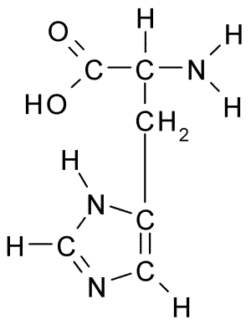
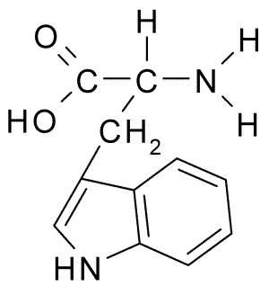
CLASSIFICATION OF AMINO ACIDS
ON THE BASIS OF NUTRITIONAL REQUIREMENT
A) Essential amino acids
These are the amino acids which cannot be synthesized by the body and must be taken in diet and essential for growth and development
There are 8 essential amino acids
Eg: Valine , Leucine ,Isoleucine ,Phenylalanine, Threonine , Tryptophan, Methionine and Lysine
B) Semi –Essential amino acids
These are amino acids are partly synthesized in our body.
There are two such kinds of amino acids.
Eg: Arginine , Histadine
Histadine
Tryptophan

Slide 21
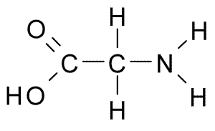
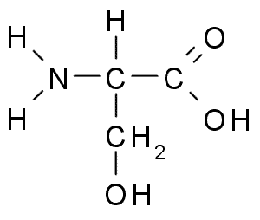
CLASSIFICATION OF AMINO ACIDS
C) Non –Essential amino acids
These are the amino acids that can be synthesized by our body.
There are 10 such amino acids
Eg: Rest of al amino acids.( Glycine , serine)
ON THE BASIS OF METABOLIC FATE
A) Glycogenic amino acids:
These amino acids can act as precursor of glucose eg: Alanine , Glycine , Methionine
B) Ketogenic amino acids:
Fat can be synthesized from these amino acids Eg: Leucine , lysine
Glycogenic and ketogenic :
Alanine, tryptophan
Glycine
Serine

Slide 22
FUNCTIONS OF AMINO ACIDS
1. It acts as monomeric unit of Proteins.
2. Some amino acids can be converted to glucose or fat .
3. Some Amino acids helps in detoxification eg: Glycine.
4. Cystine and Methionine are the source of sulpher
5.Specific amino acids give some specialized products
Tyrosine forms Thyroid Hormones.
Tryptophan can synthesize Niacin
Glycine is needed to synthesize Heme.
Histidine changes to Histamine.
Purine and pyramidine uses several amino acids.

Slide 23
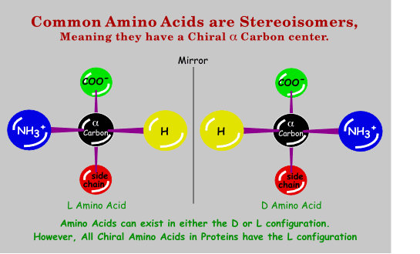
PROPERTIES OF AMINO ACIDS
A) PHYSICAL PROPERTIES:
1. Solubility:
Most of amino acids are soluble in water.
2. Isomerism :
a) Stereoisomerism:
Due to presence of Asymmetrical alpha carbon atom , Amino acids shows Stereoisomerism (Except glycine)
If NH2 group is in left side than it L form and if on right side it is D form.
b) Optical isomerism:
Due to presence of Asymmetrical alpha carbon atom , Amino acids shows optical isomerism (Except glycine)
It is either Dextrorotatory (d) or levorotatory (l)

Slide 24
PROPERTIES OF AMINO ACIDS
3. Ampholytic properties of amino acids
Amino acids has two functional groups– acidic (-COOH) and basic group( -NH2).
So amino acids can donate or accept proton, hence regarded as ampholytes.
In acidic media the amino acids exist as cations by accepting a proton , while on alkaline media the amino acids exist as anion by donating a proton.
4. . ZWITTERION OR HIBRID IONS
At a specific Ph called an isoelectric Ph , a amino acids exist as a dipolar ion known as Zwitterions.
Zwitterions carries equal number of positive and negative charge, Hence net charge of amino acid at isoelectrical Ph is 0 .
Eg; Isoelectric Ph for albumin is 4.7
COOH
H+
H+
ampholyte

Slide 25
PROPERTIES OF AMINO ACIDS
B) CHEMICAL PROPERTIES:
1.Reaction due to – COOH group
a) They form Esters with alchols
b) Decarboxylation
Amino acids undergoes decarboxylation and produces amines
Eg:
c) Reaction with ammonia
It forms amide
Eg: Glutamic acid + NH2 = Glutamide.
2.Reaction due to NH2 group
a) It reacts with acid to form salt
b) Transamination
Transfer of amino group from one amino acid to keto acid can form new amino acids.
c) Oxidative deamination
Removal of amino group as ammonia.
COOH
R– CH2– NH2

Slide 26
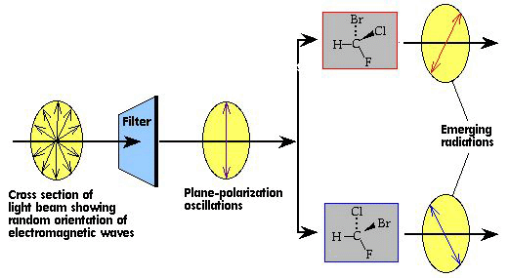
BASIS OF OPTICAL ISOMERS

