Slide 1
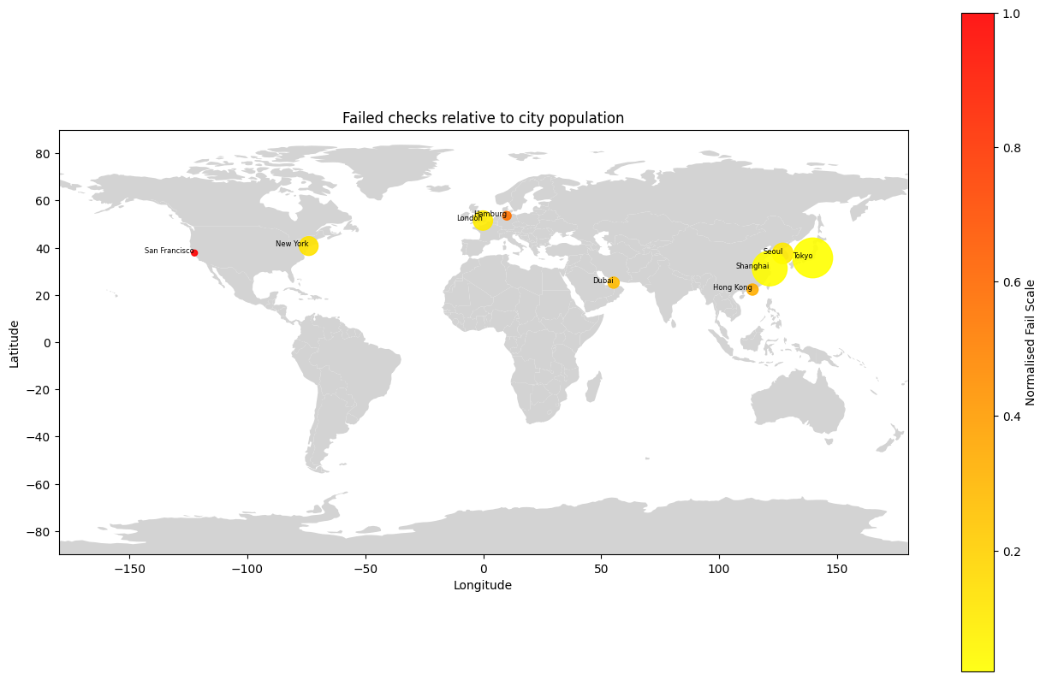
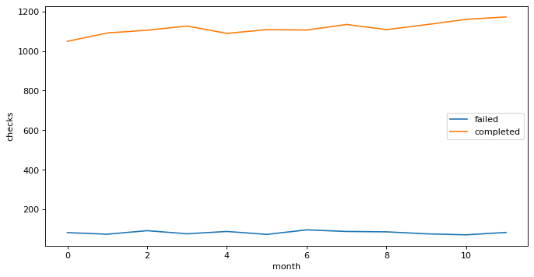
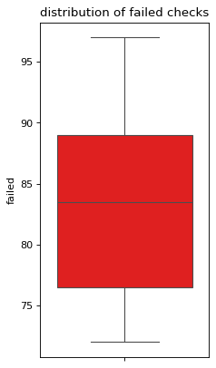
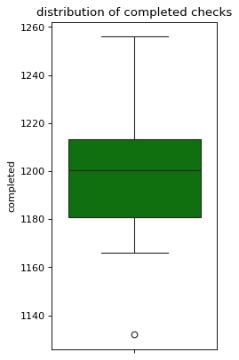
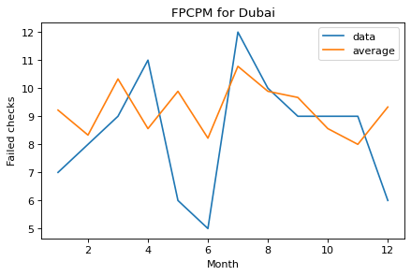
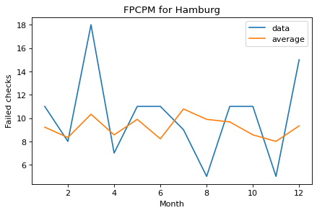
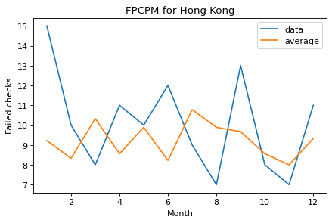



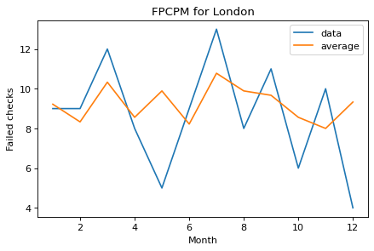
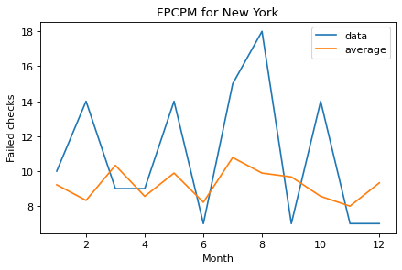
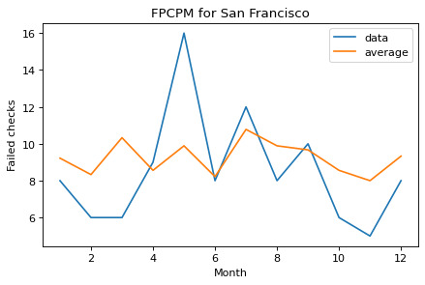



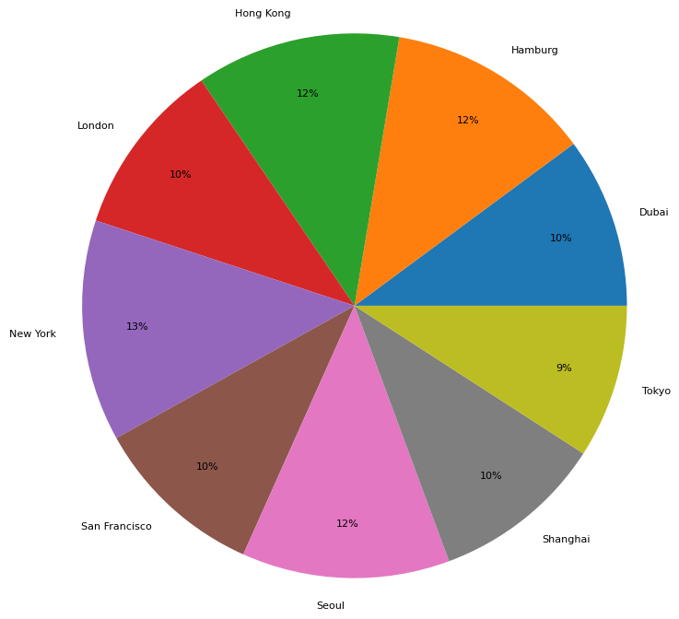
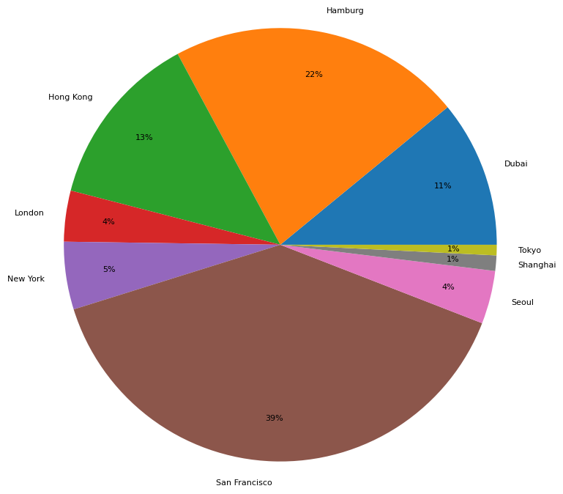
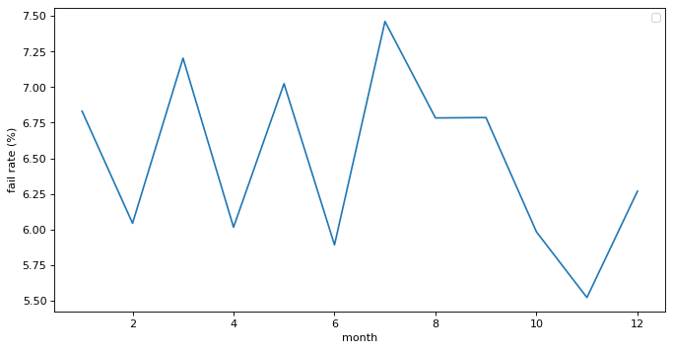
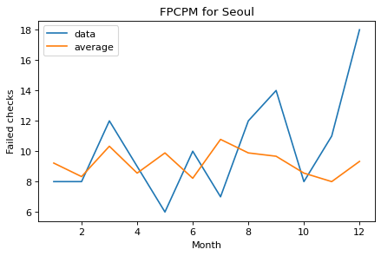
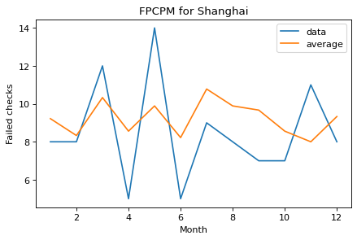
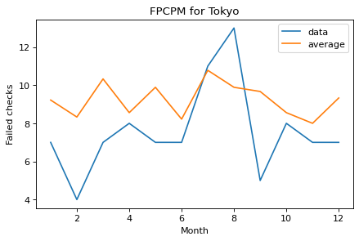



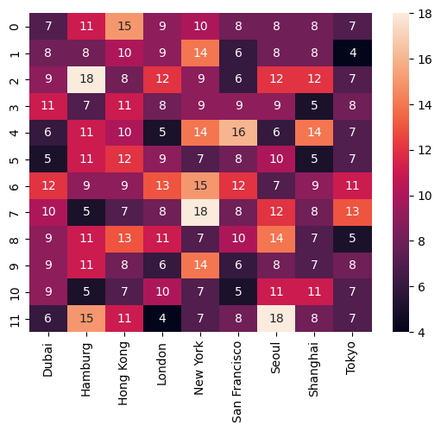
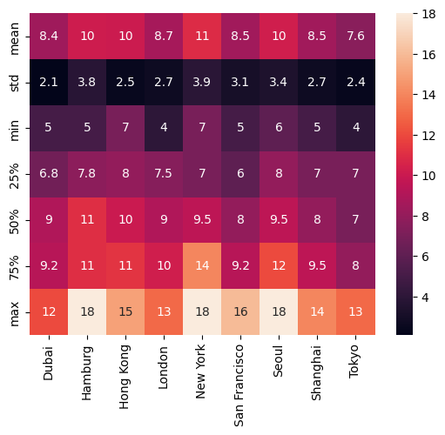
Recruitment Risk Analysis, Kavia Shirkoohi
Failed checks per city per population
Failed checks per month
Assume completed checks mean successful checks.
Failed checks per city per month
The data shows a constant trend across months, with little dependence on season. It appears geographic data is more notable. However, we calculated the fail rate as the number of failed checks divided by completed checks for each month.
Proportion of failed checks per city
Proportion wrt population*
*We don’t know for certain how many checks were completed per country. Populations are from 2022 census.
Highest Risk: July (7.45%), Lowest Risk: November (5.52%)
Despite the most failed checks being in the cities mentioned, we must take into account the expected volume of checks conducted. From here, San Francisco has an unusually large proportion of failed checks compared to its relatively low population. Hamburg is also flagged, for similar reasons. We can treat Seoul and New York as false positives due to the considerably larger population sizes. San Francisco and Hamburg are flagged as high-risk locations.
For further analysis, we would require the total checks per country per month, or at least successful checks.
Riskiest time and place:
San Francisco in May, and Hamburg in March.
Keep in mind that data has significance due to proportion of failed checks to city population.
Future research
The cities with the most failed checks were Hamburg, New York and Seoul. However, we do not know how many checks were originally performed. We can only make an estimate based on the city population.
Obtain total checks per city per month as a better measure than a city population estimate.
Investigate San Francisco and Hamburg.
Investigate July 2022.

