Slide 1

POWER BI PROJECT
IPL Cricket Performance Intelligence Dashboard
Match, team and player analytics across IPL seasons
Presented by Shivabalaji K R
Anudip DBA_AI | 01/10/2026

Slide 2
Agenda
01 Project overview
Goal, tools and scope
02 Data sources
CSV to XLSX, multiple files
03 New tables
Teams table from source files
04 Data model
Relationships and DimSeason
05 Report pages
Overview, Team Analysis, Player Stats
06 DAX
Measures used and why
07 Image URLs
Links pasted in Excel
08 UI and interactivity
Theme, slicers, bookmarks
IPL Cricket Performance Intelligence Dashboard

Slide 3
Project overview
3
Report pages
8
Tables in the model
Multiple
Source files linked
2
Reset-filter bookmarks
Objective
To develop an interactive IPL Cricket Performance Intelligence Dashboard using Power BI, Excel, and DAX to transform multiple IPL datasets into meaningful insights on matches, team performance, player achievements, and season-wise championship statistics.
Tools and skills used
Power BI Desktop: model, DAX, report design
Excel: source data (CSV files converted to XLSX)
DAX measures and new tables
Adding image URLs
IPL Cricket Performance Intelligence Dashboard

Slide 4
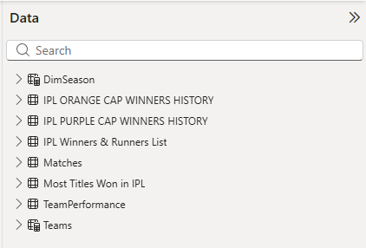
Data sources and preparation
CSV files
Convert to XLSX
Load into Power BI
Data model
Report pages
Tables loaded
Matches
Teams (created from source files)
TeamPerformance
DimSeason
IPL Winners & Runners List
Most Titles Won in IPL
IPL Orange Cap Winners History
IPL Purple Cap Winners History
IPL Cricket Performance Intelligence Dashboard

Slide 5
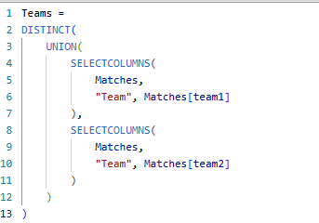
Creating new tables from source files
How it was built
Source files used: Matches records 2008 to 2026, Team wise home and away match results, Player performance and awards data sets
Steps in Power Query / DAX: Cleaned and transformed source data, standardized team/season values, created relationships, and developed dynamic KPI measures using DAX.
Columns created: Team, Short_Name, State, Home_City, Trophy_Winner
Why: Created a standardized team reference list to support team filtering, state-based mapping, consistent naming, and dashboard analysis.
Teams table (Power Query / DAX)
IPL Cricket Performance Intelligence Dashboard

Slide 6
Data model view
How the tables are connected
Matches
IPL ORANGE CAP WINNERS HISTORY
Season > Season
Teams
DimSeason
Season
IPL PURPLE CAP WINNERS HISTORY
Season > Season
Team Performance
IPL WINNERS & RUNNERS LIST
Season > Season
Most Titles Won in IPL
IPL Cricket Performance Intelligence Dashboard

Slide 7
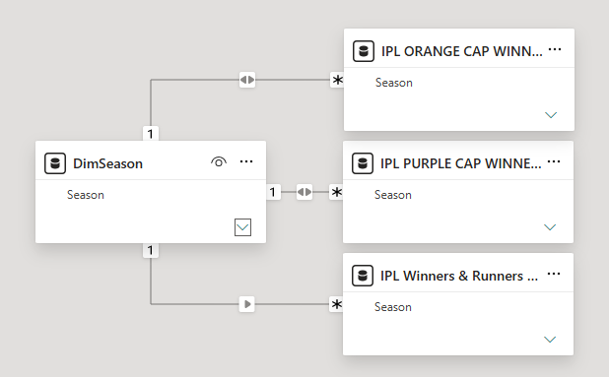
Relationships and the season slicer
Linked in Model view, then used in slicers
From (many) | To (one) | Type | Filter direction
IPL ORANGE CAP WINNERS HISTORY[season] | DimSeason[Season] | Many to one | Single
IPL PURPLE CAP WINNERS HISTORY[season] | DimSeason[Season] | Many to one | Single
IPL Winners & Runners List[season] | DimSeason[Season] | Many to one | Single
IPL Cricket Performance Intelligence Dashboard

Slide 8
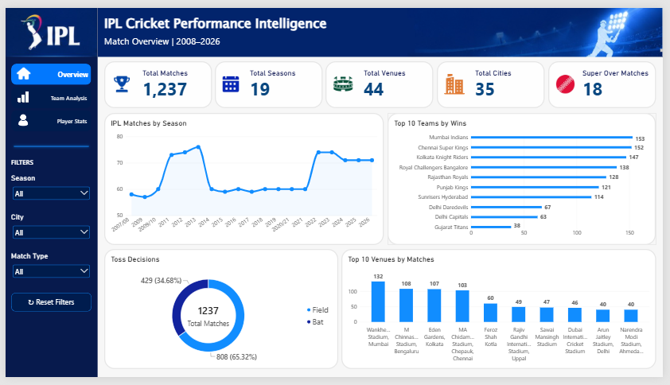
Page 1: Overview
Matches at a glance
What is on this page
KPI cards: Total Matches, Seasons, Venues, Cities, Super Over Matches
Area chart: Matches by season
Clustered bar: Teams by wins
Donut: Toss decision
Column chart: Matches by venue
Slicers: Season, City, Match type
Page navigator and Reset Filters button
IPL Cricket Performance Intelligence Dashboard

Slide 9
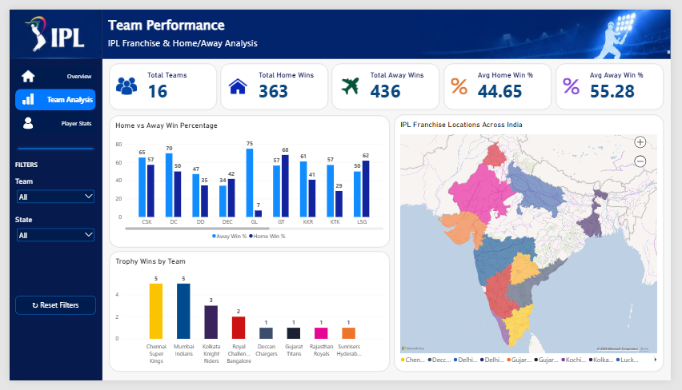
Page 2: Team Analysis
Home vs away strength and trophies
What is on this page
KPI cards: Total Teams, Home Wins, Away Wins, Avg Home Win %, Avg Away Win %
Clustered column: Home vs Away Win % by team
Column chart: trophy winners by team
Filled map by state
Slicers: season, team, state
Reset Filters button
IPL Cricket Performance Intelligence Dashboard

Slide 10
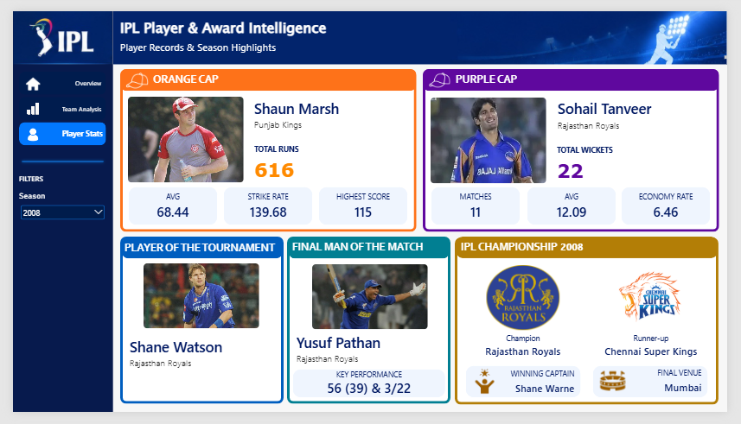
Page 3: Player Stats
Orange Cap, Purple Cap and finals by season
What is on this page
Orange Cap panel: player, team, runs, average, strike rate, highest score
Purple Cap panel: player, team, wickets, economy, average, matches
Final panel: champion, runner, venue, winning cap
Final Man of the Match and performance
Player of Tournament and MVP team
Season slicer drives every panel
Player and team images load from URLs
IPL Cricket Performance Intelligence Dashboard

Slide 11
DAX used in the project
Measures grouped by table
Matches
Total Matches
Total Seasons
Total Venues
Total Cities
Super Over Matches
Team Wins
Team Performance
Total Teams
Total Home Wins
Total Away Wins
Home Win %
Away Win %
Avg Home Win %
Avg Away Win %
Player Stats
Orange Cap: Player, Team, Runs, Average, Strike Rate, Highest Score
Purple Cap: Player, Team, Wickets, Economy, Average, Matches
Finals: Champion, Runner, Venue, Winning Captain, Man of the Match, Selected Season, MOM Performance
Performance, Player of Tournament, Winner Team
DAX examples
Total Matches (Matches)
Total Matches = COUNT(Matches[id])
Home Win % (TeamPerformance)
Home Win % = AVERAGE(TeamPerformance[home_win_percentage])
Champion (Winners & Runners)
Champion =
SELECTEDVALUE('IPL Winners & Runners List'[Winner])
IPL Cricket Performance Intelligence Dashboard

Slide 12
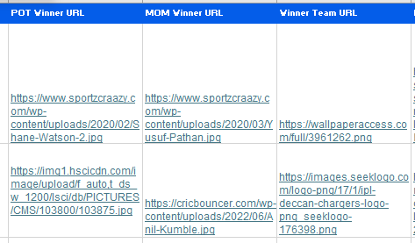
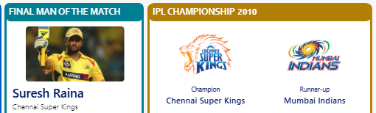
Adding images through URLs
Links pasted in Excel and displayed in the report
Copy image link from Google
Paste in the Excel image column
Load table into Power BI
Set column as Image URL
Show in Image visual
IPL Cricket Performance Intelligence Dashboard

Slide 13
UI and interactivity
Theme and canvas
IPL Navy and White, 1920 x 1080 pages
Branding
Header banner and logo images
Navigation
Left panel with page navigator
Slicers
Dropdown slicers for season, city, team, state
KPI cards
Key numbers at the top of each page along with icons
Reset buttons
Bookmarks that clear all filters
IPL Cricket Performance Intelligence Dashboard

Slide 14
Key takeaways and next steps
What I learned
Data modelling with a season dimension
Writing DAX measures based on the data available and for suitable KPIs
Combining multiple source files
Designing a consistent UI
Page duplication with applied filters, costs a huge time.
Next steps
Host images online/drive
Add upload option to load data for upcoming seasons.
Adding the ball-by-ball data, to cherish Individual player analytics.
Publish to Power BI Service
IPL Cricket Performance Intelligence Dashboard

Slide 15
Thank you
SHIVABALAJI K R
Questions and feedback welcome

