Slide 1
SENTIMENT ANALYSIS
PYTHON MINI PROJECT

Slide 2

Problem Statement
Sentiment Analysis using Python based on different inputs
An output will be given based on the input given by the user. The input will be in three formats:
Text input
Movie reviews from database
Voice input
The given input will then be analyzed to determine whether it is positive, negative or neutral.

Slide 3

Objectives
To learn the different approaches and real world applications of sentiment analysis.
To provide a more user friendly way to provide sentiment analysis for text and voice based input.
To provide a statistical view of a large dataset like movie reviews and revealing users views on the particular item using sentiment analysis.

Slide 4
Scope and need of the project
The applications of sentiment analysis are broad and powerful. The ability to extract insights from social data is a practice that is being widely adopted by organizations across the world.
It can also be an essential part of a company’s market research and customer service approach. Not only can a company see what people think of their own products or services, they can see what they think about their competitors too. The overall customer experience of the users can be revealed quickly with sentiment analysis, but it can get far more granular too.
Companies can get powerful insights to boost their marketing strategy. For example, marketers can keep an eye on industry trends by analyzing sentiment towards new features or products on social media.

Slide 5

Literature Survey
LITERATURE REVIEW ON SENTIMENT ANALYSIS, ISSN 2277-8616
The emotions in textual data is analyzed and processed in Sentiment Analysis. In other words the Sentiment Analysis specifies that the given information is positive, negative or neutral about a specific topic or product. Due to this scenario it is widely termed as Opinion Mining. For processing the textual information Sentiment Analysis adapts the approaches of NLP (Natural language processing), AI (Artificial Intelligence) and ML (Machine Learning). Conclusively analysis of sentiment deals with the people's opinion about a particular topic or product.

Slide 6

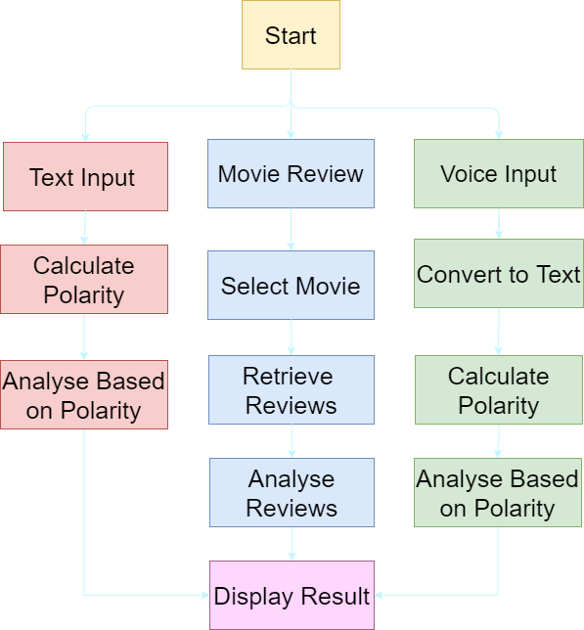
Project flow diagram

Slide 7




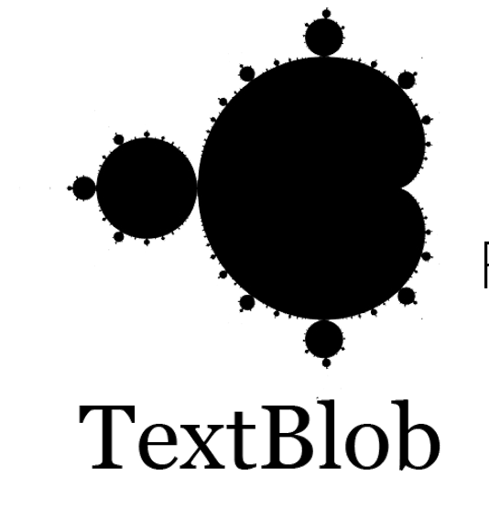

Usage of Technologies
We have used the following languages/libraries for making the project
Python 3 was used as the main language to write the base code for the app.
SQL
SQL was used as the main language for database management.
Python
Kivy was used to build the GUI for the app.
Wamp
Server
Wamp Server was used to host the SQL server.
Kivy
Python 3 was used as the main language to write the base code for the app.
Speech
Recognition
SQL was used as the main language for database management.
TextBlob

Slide 8

Social Impact
To determine the thinking of people on a particular issue
This will tell about the extent to which people can go, thinking about a topic given to them and how they put forward their opinions, views and ideas plus how our machine will deal with this thought processing and how correctly it will categorize the same into positive, negative.

Slide 9
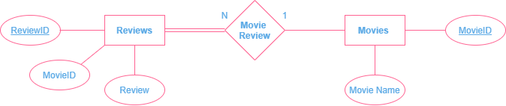
ER DIAGRAM

Slide 10
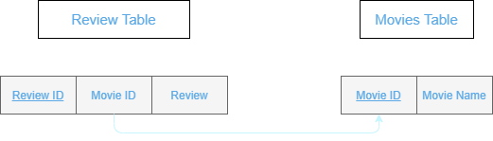
BACKEND

Slide 11
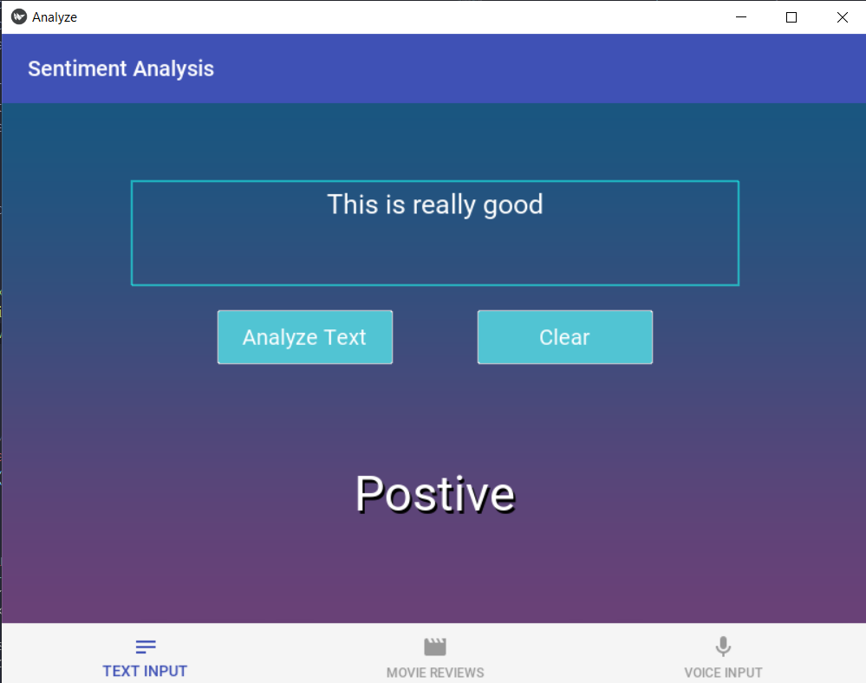
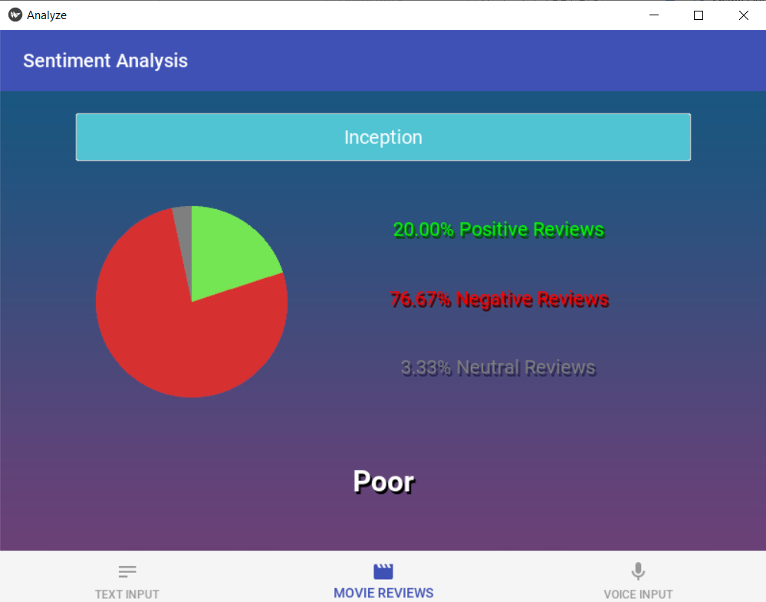
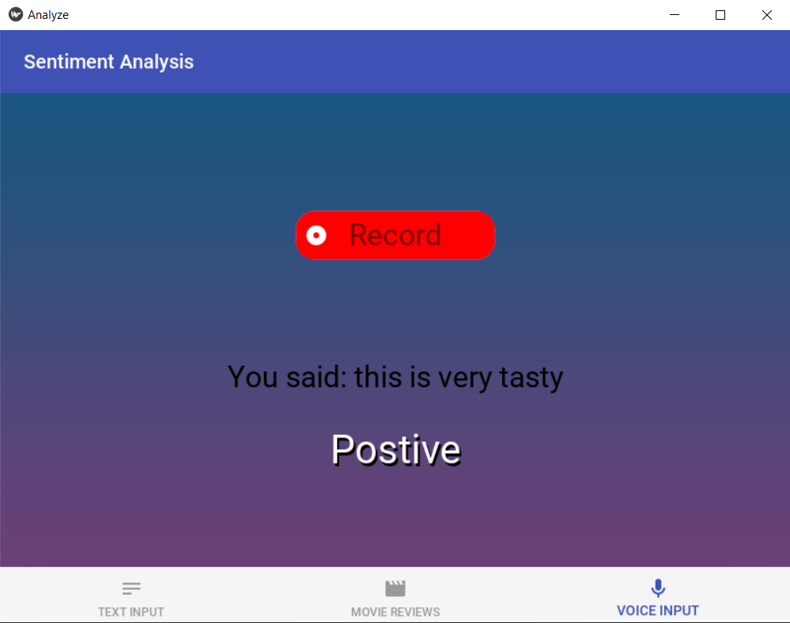
Implementation
Text input screen
Movie Review Screen
Voice Input Screen

Slide 12
Conclusion
In this paper, movie reviews and Statements are classified into positive, negative or neutral . The system proposed in the paper can be used to classify a huge database of movie reviews. This will help movie producers to check the status of their movie. Future work, this API can be trained for other reviews like smartphones, laptops or clothes etc.

Slide 13


References
Hemamalini, Dr.S. Perumal, LITERATURE REVIEW ON SENTIMENT ANALYSIS, ISSN 2277-8616
Kivy framework — Kivy 2.0.0 documentation
TextBlob: Simplified Text Processing — TextBlob 0.16.0 documentation
PyAudio · PyPI
PyMySQL · PyPI
SpeechRecognition · PyPI
KivyMD 0.104.2.dev0 documentation
Use Sentiment Analysis With Python to Classify Movie Reviews – Real Python
Sentiment Analysis: How Does It Work? Why Should We Use It? | Brandwatch

Slide 14
THANK YOU
Krishna Kansara 17
Soham Shimpi 51
Hanish Valecha 62

