Slide 1
SENTIMENT ANALYSIS
PYTHON MINI PROJECT

Slide 2

Problem Statement
Sentiment Analysis using Python based on different inputs
An output will be given based on the input given by the user. The input will be in three formats:
Text input
Movie reviews from database
Voice input
The given input will then be analyzed to determine whether it is positive, negative or neutral.

Slide 3

Objectives
To learn the different approaches and real world applications of sentiment analysis.
To provide a more user friendly way to provide sentiment analysis for text and voice based input.
To provide a statistical view of a large dataset like movie reviews and revealing users views on the particular item using sentiment analysis.

Slide 4
Scope and need of the project
The applications of sentiment analysis are broad and powerful. The ability to extract insights from social data is a practice that is being widely adopted by organizations across the world.
It can also be an essential part of a company’s market research and customer service approach. Not only can a company see what people think of their own products or services, they can see what they think about their competitors too. The overall customer experience of the users can be revealed quickly with sentiment analysis, but it can get far more granular too.
Companies can get powerful insights to boost their marketing strategy. For example, marketers can keep an eye on industry trends by analyzing sentiment towards new features or products on social media.

Slide 5

Literature Survey
Hemamalini, Dr.S. Perumal, LITERATURE REVIEW ON SENTIMENT ANALYSIS, ISSN 2277-8616
Kivy framework — Kivy 2.0.0 documentation
TextBlob: Simplified Text Processing — TextBlob 0.16.0 documentation
PyAudio · PyPI
PyMySQL · PyPI
SpeechRecognition · PyPI

Slide 6

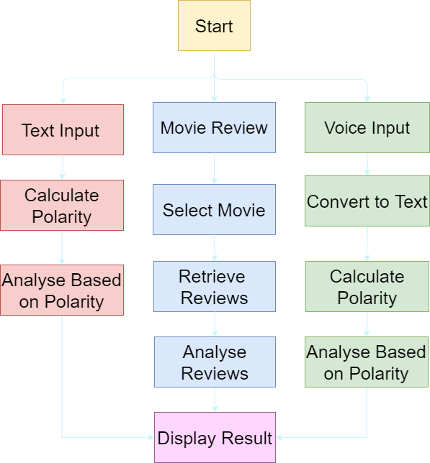
Project flow diagram

Slide 7




Usage of Technologies
We have used the following languages/libraries for making the project
Python
Python 3 was used as the main language to write the base code for the app.
SQL
SQL was used as the main language for database management.
Kivy was used to build the GUI for the app.
Wamp
Server
Wamp Server was used to host the SQL server.
Kivy

Slide 8
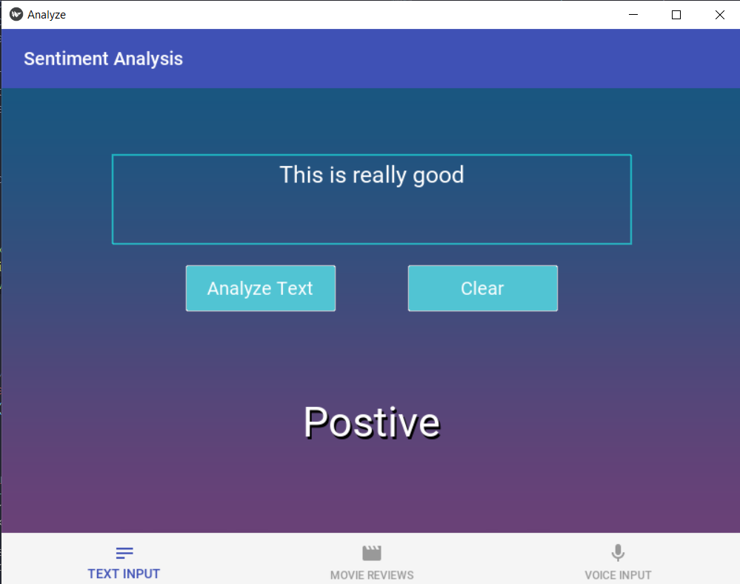
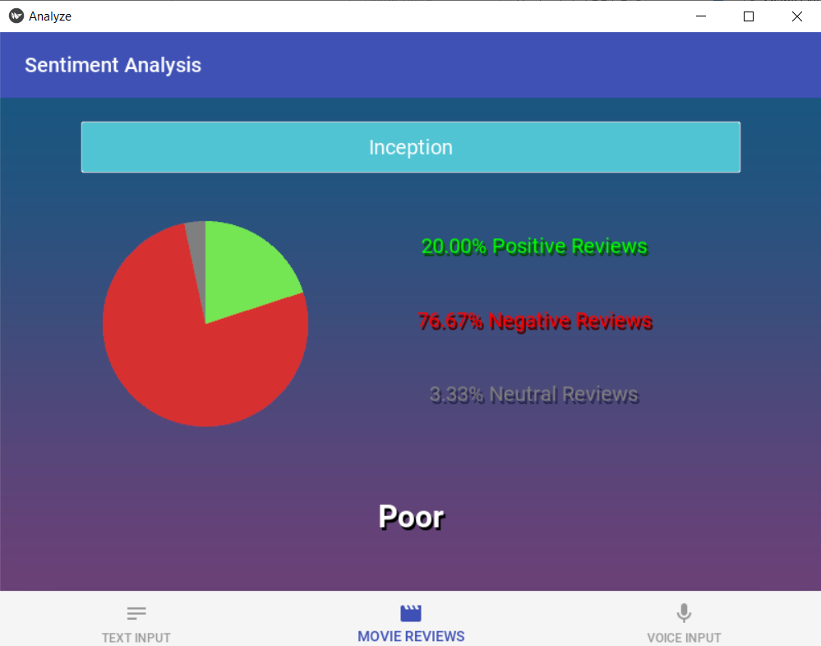
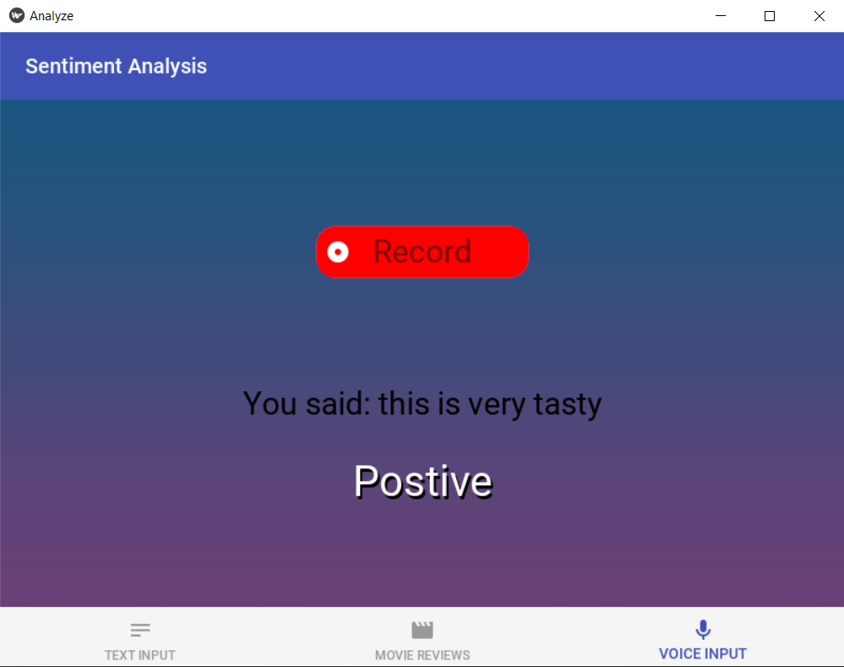
Expected outcome/Result
Text input screen
Movie Review Screen
Voice Input Screen

Slide 9
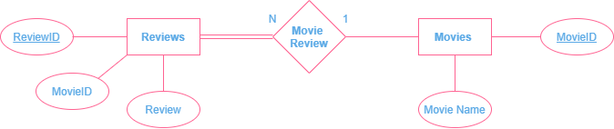
ER DIAGRAM

Slide 10
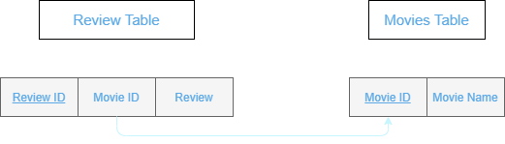
BACKEND

Slide 11

THANK YOU
Krishna Kansara 17
Soham Shimpi 51
Hanish Valecha 62

