Slide 1
Capstone 2 Summary
Flower Classifier
Springboard Data Science Career Track
Kristopher Simino

Slide 2
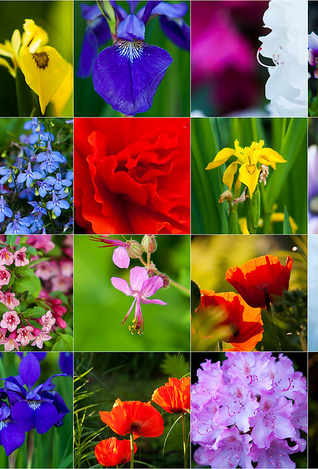

Introduction
Apply transfer learning by using a pretrained CNN
Pretrained networks trained on 1000 various classes
New data is 104 similar looking classes.

Slide 3
Data Acquisition and Wrangling
Kaggle dataset
Given test set not usable
New test set taken from training set
Remaining training set augmented
Set | Number
Training | 114,912
Validation | 3,712
Test | 3,177

Slide 4
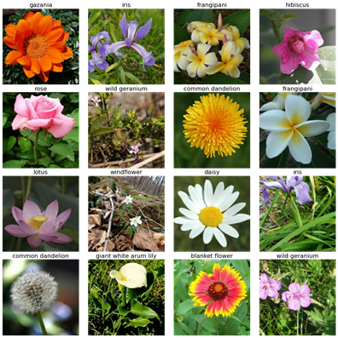
Dataset
The images are mostly closeup in a natural setting
To extend the training set, random images were zoomed, cropped, flipped, and had saturation, brightness and contrasted adjusted

Slide 5
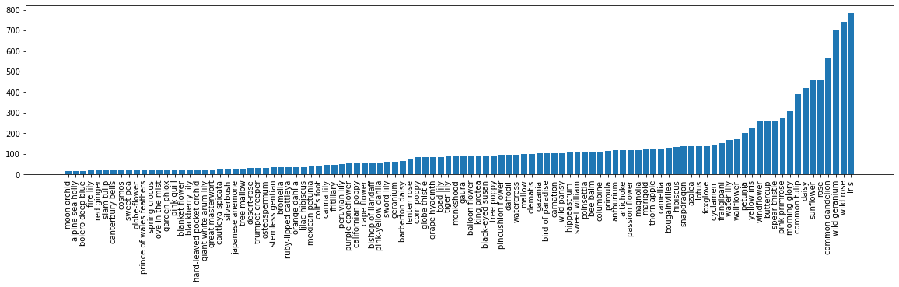
Potential Data Issues
Distribution highly skewed
Top five species account for more than 25%
Bottom five species account for less than 1%

Slide 6
Modeling
VGG
InceptionNet V3
ResNet50
16 layers
308, 604 Trainable parameters
42 layers
1,076,604 Trainable Parameters
50 layers
1,076,604 Trainable Parameters
Each trained for 30 epochs
Used same learning rate scheduler

Slide 7
Results
InceptionNet outperformed the others
ResNet far behind the other two
 | Accuracy | Precision | Recall | F1 Score
InceptionNet V3 | 76.1% | 77.0% | 68.7% | 71.1%
VGG | 63.7% | 62.1% | 58.5% | 58.7%
ResNet50 | 12.0% | 4.0% | 2.5% | 1.8%

Slide 8
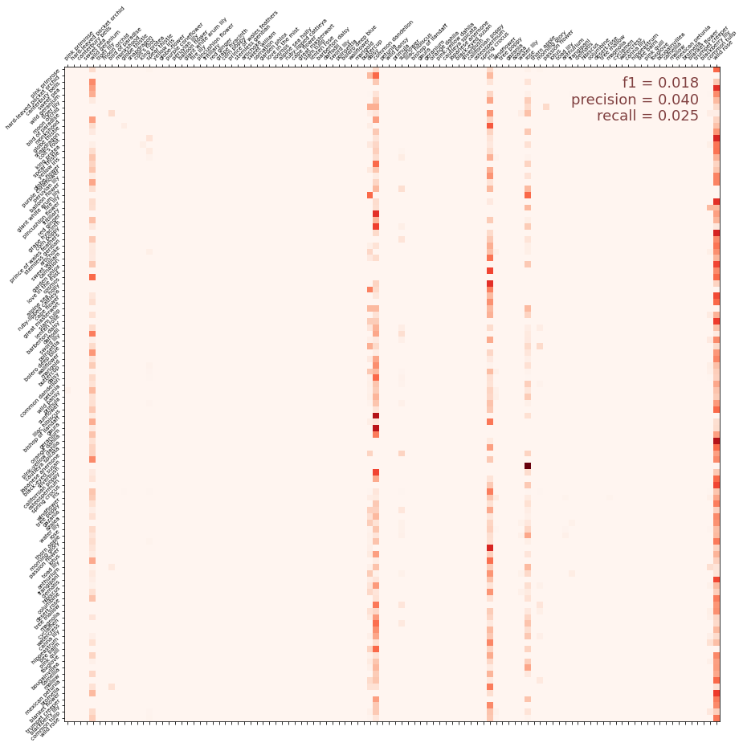
ResNet50
ResNet had poor results because it mostly put the images into only five classes
They were the top five largest classes

Slide 9
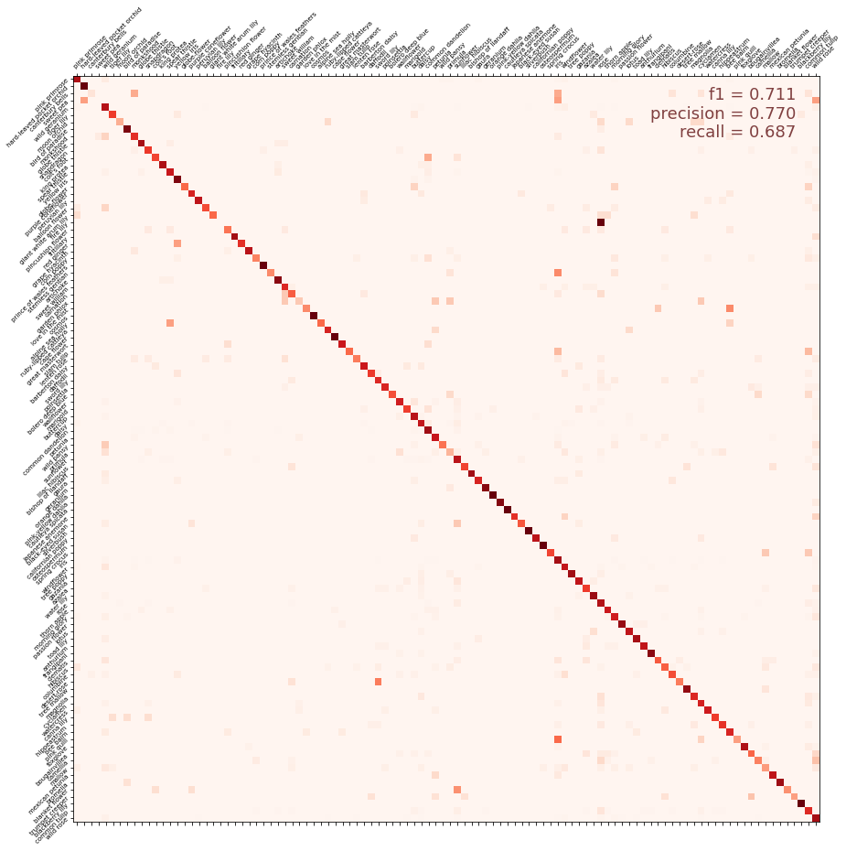
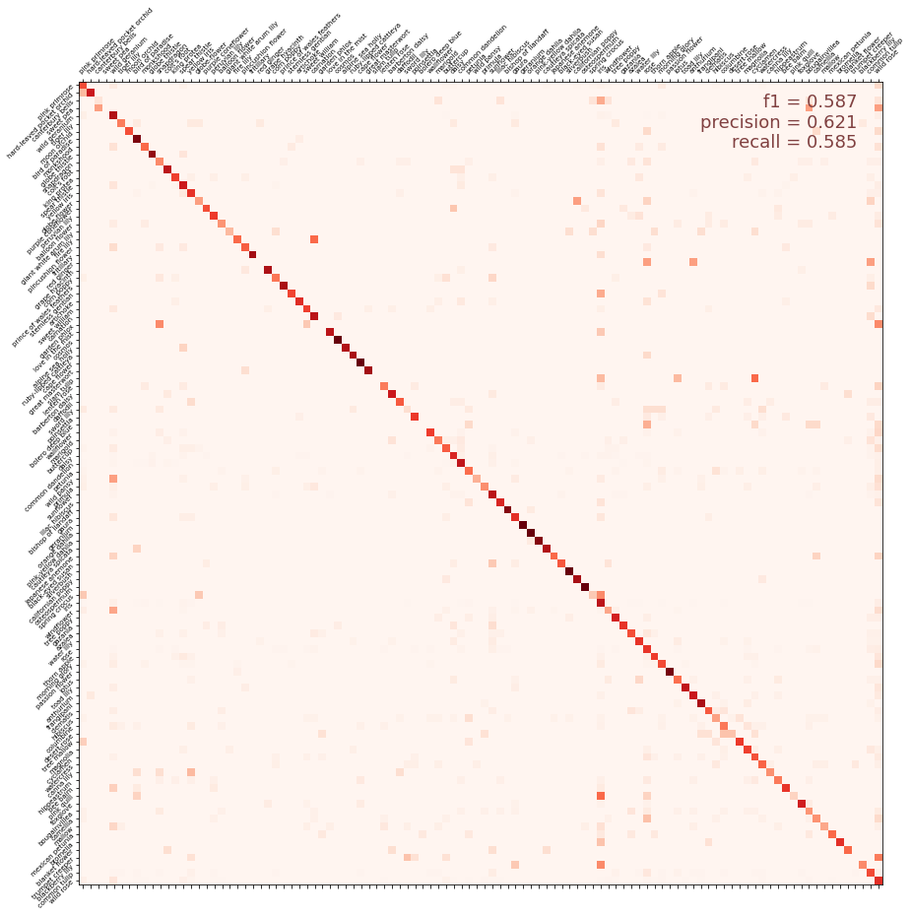
Similar Results
InceptionNet
VGG

Slide 10
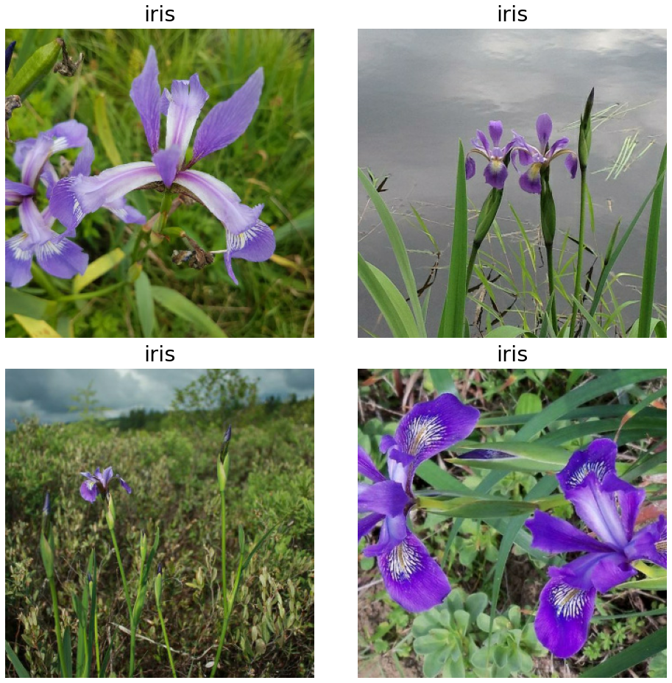
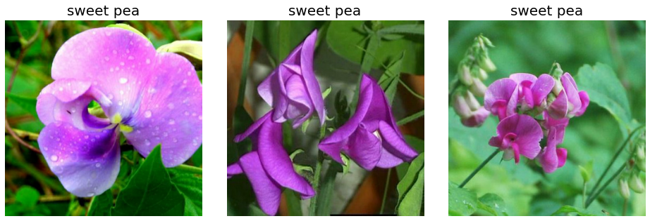
Visual Inspection Example
Sweet Pea
Iris

Slide 11
Conclusion and Future Work
Pretrained networks appear to produce good results with little adjustment
Which architecture you choose and the distribution of classes in the data have a great impact on the results.
Better results could be obtained by
a more balanced distribution of classes. Achieved by collecting more data of the rarer species or by weighting the augmentation process in the preprocessing phase to favor the rarer species.
a careful selection of hyperparameters could further improve results.
experimenting with different architectures.

