Slide 1
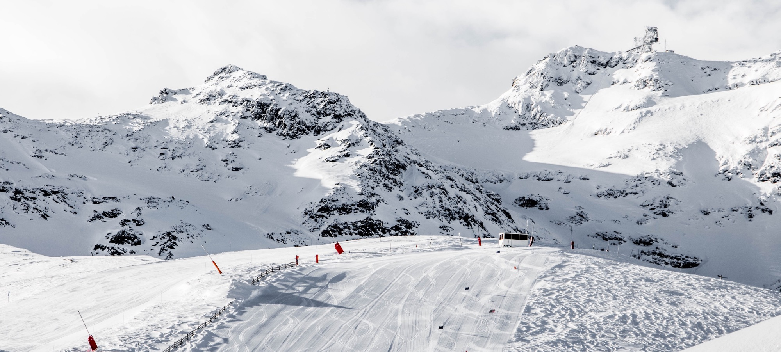
Big Mountain Resort
Pricing Strategy Model Presentation
Notes:
© Copyright Showeet.com – Free PowerPoint Templates

Slide 2
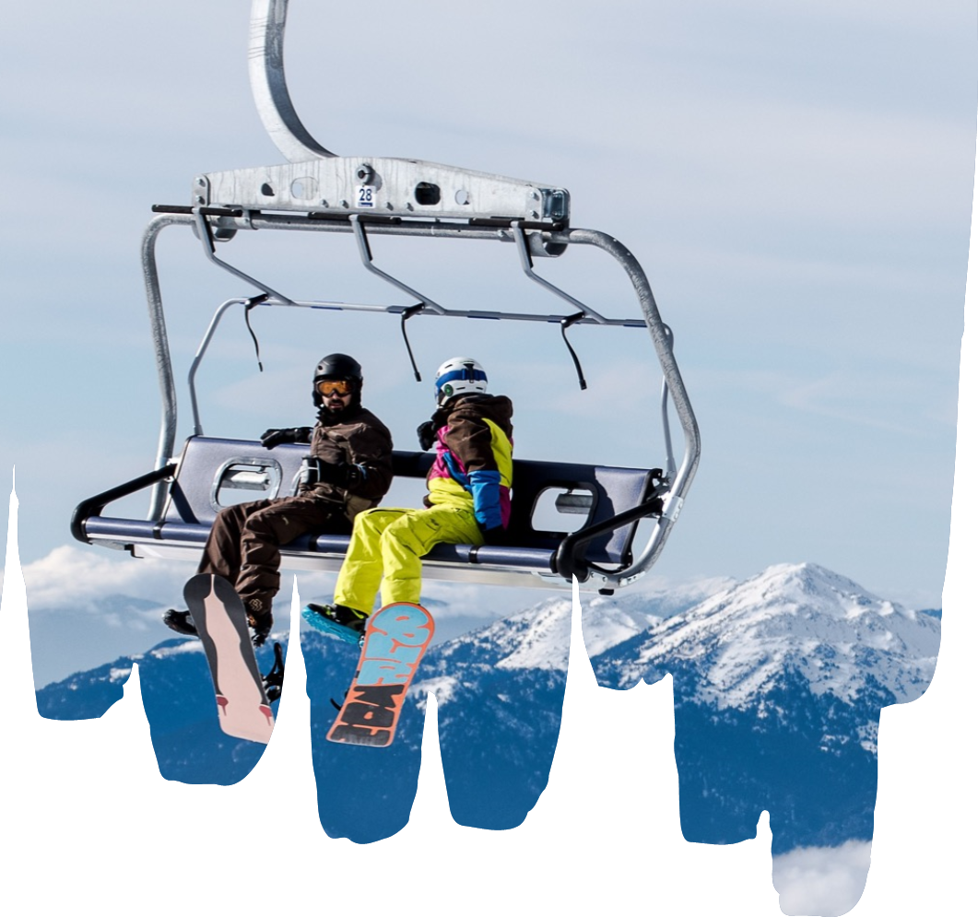
Problem Identification
The addition of a new ski lift has increased operating costs by $1,540,000
Does the current ticket price reflect the best value for Big Mountains facilities?
What cost cutting measures can be taken to reduce operating costs?
Notes:
© Copyright Showeet.com – Free PowerPoint Templates

Slide 3
Key Findings and recommendation
Key findings
Recommendation
Big Mountain’s ticket pricing is high for Montana but low for the whole market
For all the primary features that affect ticket pricing, Big Mountain ranks above average.
The random forest model predicts a reasonable price increase of at least $4 and as much as $15
For the upcoming year, increase the ticket price to $86 and shut down two of the least used runs.
The following year, add an additional run, increase the vertical drop 150 feet, and add two acres of snow making. This will justify a price increase of $10

Slide 4
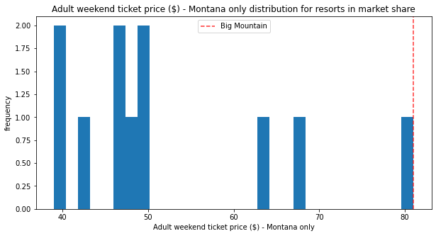
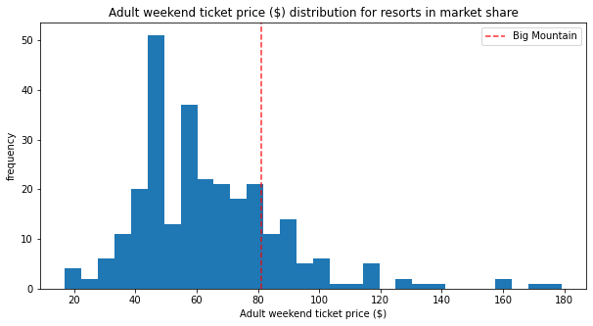
Ticket price in the market
Priced high for Montana
But low in the range of the whole market

Slide 5
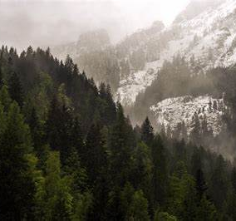
Random forest model
The eight most significant features that impact ticket price:
vertical drop
snow making acreage
total number of chairs
number of fast quads.
number of runs
longest run
number of trams
amount of skiable terrain

Slide 6
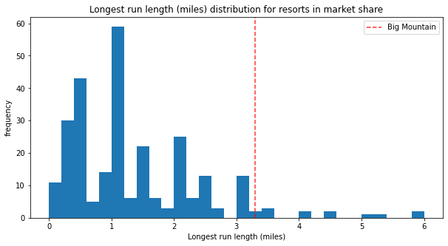
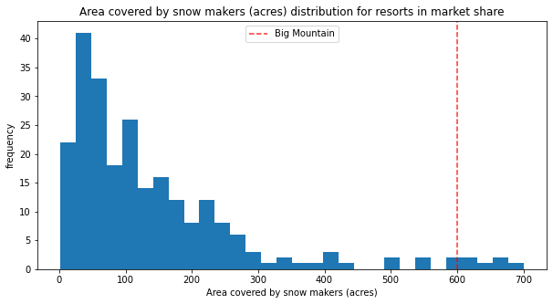
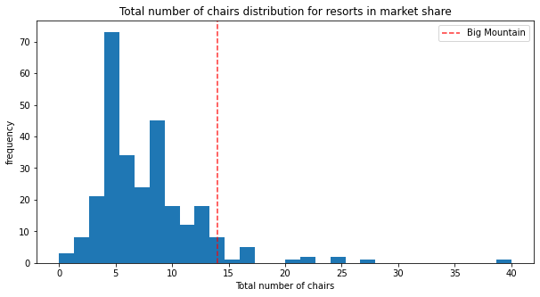
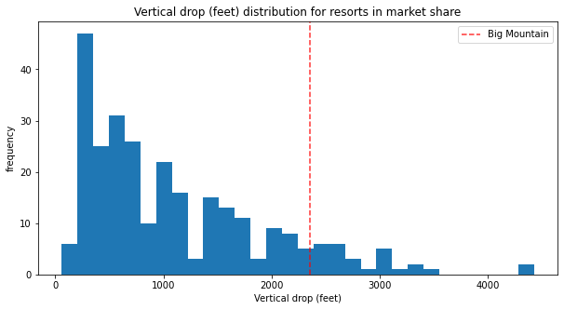
Ranks high among significant features

Slide 7
Summary and conclusion
Big Mountain is not getting full value for its facilities
Certain facilities can be closed or expanded to improve pricing value
Assumptions are made about other resort’s pricing
Additional data could be helpful, e.g., operating costs

Slide 8
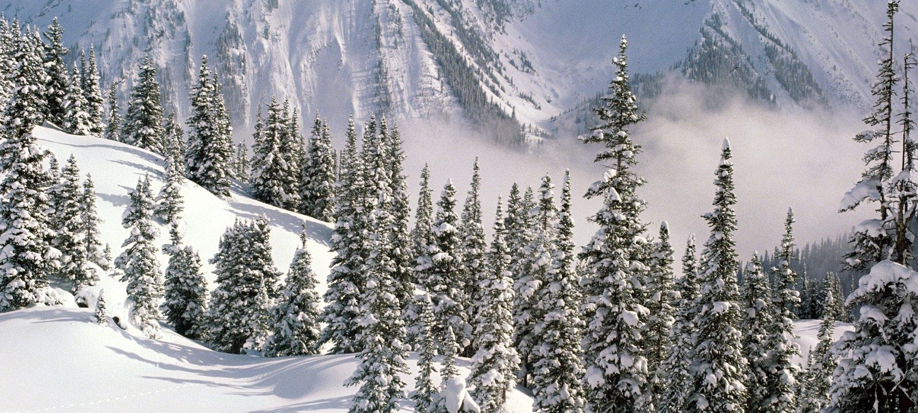
END
Report link

