Slide 1
Error Analysis &
Results Verification
Week 7 Update
Krishnasree Kelat

Slide 2
Verified Results
Feature Set | Dims | Seg % | Trk % | Notes
trigram_dwell | 216 | 63.7 | 70.0 | Best overall (10-raga)
trigram | 200 | 62.1 | 70.0 | Dwell adds +1.6% seg only, 0% trk
dwell_vadi | 16 | 60.3 | 65.0 | Strong for 16 dims
pcd | 120 | 53.9 | 55.0 | Pitch distribution alone
full_combined (14-raga) | 538 | 38.3 | 39.6 | Curse of dimensionality
BiLSTM | - | 42.6 | 45.3 | Folds: 24.6% - 68.5%
mfcc | 58 | 6.3 | 5.0 | Below random chance (7.1%)
MFCC Track Acc
Dwell Contribution
Harikambhoji
8.2%
→ 5.0%
Even worse - strengthens H2
+6pp combined
→ +1.6pp seg, 0pp trk
Majority voting smooths it out
F1 = 0.13
→ 0.0% flat & hier
Stronger evidence for H4
Notes:
MFCC Accuracy got worse – It wasn’t 8.2, instead was 5.0% which is worse than random; Strenghtens H2
Dwell doesn’t add 6 percentage points. It adds 1.6 at segment level, and zero at track; It was a miscalculation
H4 is stronger after hierarchial classification for Harikamboji

Slide 3

H4: Confusion Follows Melakarta Kinship
Harikambhoji Family (5 of 14 ragas)
Error Attribution (14-raga)
962 errors / 2,107 segments
Harikambhoji
0.0%
Parent melakarta
39.3% misrouted (wrong family)
60.7% within-family confusion
Begada
41.9%
Janya
Kamas
42.1%
Janya
What This Means
Kambhoji
24.4%
Janya
Harikambhoji scores 0% in BOTH flat and hierarchical classifiers. The system cannot distinguish the parent from its children.
Musicologically predictable: the parent melakarta uses all notes neutrally. Its janyas 'own' the distinctive phrases. The parent has no signal because it IS the average of its children.
Mohanam
39.4%
Janya (pentatonic)
Notes:
Five of our 14 ragas belong to this one melakarta family - Begada, Harikambhoji itself, Kamas, Kambhoji, and Mohanam.
This is musicologically predictable.
The parent melakarta uses all its notes neutrally
it doesn't 'own' any distinctive phrases.
Its janyas have taken the distinctive phrases for themselves.
This actually mirrors what musicians say - Harikambhoji is one of the hardest ragas to identify in performance."

Slide 4
Hierarchical Classification: Two-Stage Approach
Stage 1: Family Routing
Stage 2: Within-Family
Verdict
→
Does NOT improve over flat classification. Within-family confusion is too severe.
SVM on directional_pcd features
Routes segments to 1 of 9 families
L1 accuracy: 76-93% per fold
SVM on directional_transition
Distinguishes siblings within family
Only matters for multi-raga families
Raga | Flat | Hierarchical | Delta | n
Bhairavi | 88.8% | 90.7% | +1.9% | 366
Harikambhoji | 0.0% | 0.0% | 0.0% | 129
Kamas | 42.1% | 25.4% | -16.7% | 114
Kambhoji | 24.4% | 24.8% | +0.4% | 258
Mohanam | 39.4% | 33.5% | -5.9% | 170
Begada | 41.9% | 39.7% | -2.3% | 174
Kamas drops 42.1% to 25.4% (-16.7pp). Routing to the correct family does not help when siblings share the same note vocabulary. Gamaka-level features needed.
Notes:
Classifier
The takeaway is that routing to the correct family doesn't help when siblings share the same note vocabulary. The within-family problem is too severe at this feature level. To resolve these, you'd need gamaka-level features that capture the continuous pitch movements that distinguish these ragas - which is a finding about what our current features can't capture, and points toward future work.“

Slide 5
SVM vs LSTM: Updated Fold Analysis
Fold Variance
SVM range: 35.7pp
LSTM range: 43.9pp
SVM is more stable across data splits
Why SVM Wins
Cognitive Expert-informed features encode the right inductive bias upfront
Musical Pakad and vadi knowledge baked into 216 features, not learned from data
ML Feature engineering beats representation learning in low-data regimes (2,107 samples)
Notes:
Why does SVM win? Three perspectives. Cognitively, the hand-crafted features encode the right inductive bias upfront - we've already told the model what to look for. Musically, pakad and vadi knowledge is baked into the 216 features rather than being discovered from data. From an ML perspective, feature engineering beats representation learning when you only have 2,107 samples and strict GroupKFold preventing any within-track leakage.“

Slide 6
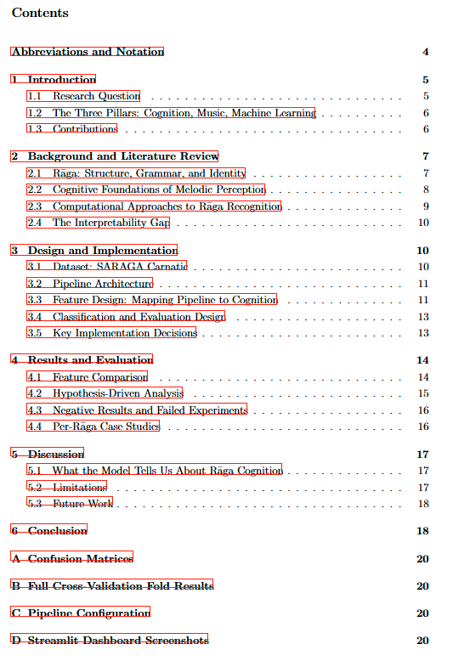


Report Progress
Structure (6 sections, ~18 pages)
1. Introduction
Research Q, Three Pillars, Contributions
2. Background & Lit Review
Musical / Cognitive / ML / Gap
3. Design & Implementation
Dataset, Pipeline, Feature-Cognition Map
4. Results & Evaluation
Feature comparison, H1-H7, Negatives
5. Discussion
Cognitive implications, Limitations
6. Conclusion
Qualified yes, key numbers

Slide 7
Cross-Tradition: Hindustani Results
Dataset
Feature | Dims | Seg % | Trk %
dwell_vadi | 16 | 35.4 | 60.0
pcd | 120 | 24.6 | 30.0
directional_pcd | 408 | 19.4 | 40.0
trigram_dwell | 216 | 16.0 | 20.0
trigram | 200 | 12.9 | 20.0
mfcc | 58 | 9.7 | 10.0
7 ragas, 10 tracks
350 segments
Random chance = 14.3%
The Winner Flipped
Carnatic: trigram wins
Hindustani: dwell wins
Reflects a real musicological difference between traditions.
Cognitive
Musical
ML
Hindustani emphasises note sustain and meend (glides) over phrase patterns. Dwell-time captures this emphasis-centric perception.
Carnatic is phrase-driven (structured gamakas). Hindustani is emphasis-driven (long meend, sustain). The features that win reflect this difference.
10 tracks makes trigram vocabulary too sparse. But dwell_vadi (16d) is robust even with minimal data - confirms extreme feature efficiency.
Notes:
- Post filtering dataset got smaller
Winner flipped; the dwell vadi lasted longer and the trigrams collapsed: that’s because Hindustani music focuses on sustain and length rather than phrase patterns. Carnatic is phrase driven with gamakas, Hindustani is emphasis driven with long sustain.
MFCCs are still below random + Track levl voting helps: H2/H7 can be confirmed
I'm framing this as preliminary cross-tradition validation in the report - a 2-paragraph discussion, not a whole chapter. The key narrative is: the pipeline transferred with zero changes, the cognitive features that matter shifted in a musicologically predictable way, and the universal findings - MFCC failure and evidence accumulation - hold across traditions."

Slide 8
Next Steps
Today
Tomorrow
This Week
By March 27
Correct results table in LaTeX
Write Section 4 with verified numbers
Add Hindustani as 2-paragraph discussion
Tonic error propagation study
Trigram interpretability - match to known pakad
Write Section 5 (Discussion)
Complete full draft (all 6 sections)
Add confusion matrices to appendix
Dashboard screenshots for appendix
Final polish and proofreading
Verify all citations in .bib file
Submit report
Target: Complete draft March 20 | Final submission March 27 | Inspector discussion: 30 min on report content
Notes:
For next steps, I have a clear timeline. Today I'm correcting the results table and writing Section 4 with verified numbers, plus adding the Hindustani discussion. Tomorrow is the tonic error propagation study and trigram interpretability - matching top trigrams per raga to known pakad patterns from the literature. By the end of this week I want a complete draft of all 6 sections

