Slide 1
How Do We Hear a Raga?
An Interpretable Cognitive Model of Melodic Recognition
Krishnasree Kelath | 2540124
Are the features that cognitive theory predicts listeners rely on the same features that best classify ragas computationally?
Musical Theory
Cognitive Science
Machine Learning
Raga = melodic grammar, not just a scale
Pakad (phrases), gamaka (ornaments),
vadi/samvadi (note hierarchy)
Statistical learning (Saffran) -> trigrams
Tonal hierarchies (Castellano) -> dwell
Categorical pitch perception -> swara bins
6-stage pipeline, 7 feature families
GroupKFold (Sturm: no data leakage)
6 hypotheses (H1-H6)
Gap in Existing Work
Koduri / Rao
Pitch class distributions — interpretable but discard sequential information
Gulati (2016)
Deep CNN on time-delay melody — accurate but black-box, no musical explanation
Singh (2023)
Post-hoc explainability on neural nets — explains where, not what or why
Sturm (2014)
MIR systems learn recording artefacts, not music — motivates GroupKFold evaluation

Slide 2
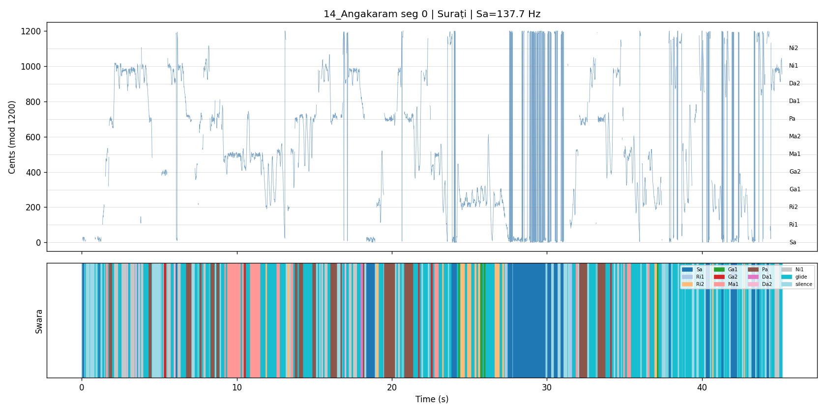
Pipeline & Feature Design
6-Stage Pipeline
7 Feature Families
1. Preprocess: resample 22050 Hz, 45s windows / 15s hop, exclude ragamalika
dwell_vadi (16d)
Duration per swara + vadi/samvadi flags
Castellano
trigram (200d)
Top-200 swara trigram frequencies
Saffran
trigram_dwell (216d)
Trigrams + dwell combined
Both
2. Pitch: CREPE (deep CNN, polyphonic-robust) + pYIN fallback
pcd (120d)
10-cent pitch class distribution
Koduri
pcd_trigram (320d)
PCD + trigrams
—
3. Tonic: smoothed harmonic scoring (Sa + Pa + Sa' energy)
directional_pcd (408d)
Ascending/descending split features
—
mfcc (40d)
Spectral envelope (timbral baseline)
Peretz
4. Swara Mapping: 12 bins x 100 cents, 40-cent tolerance, glide exclusion
5. Features: trigrams (top 200), dwell-time, PCD, transitions, directional
6. Classify: SVM-RBF + GroupKFold + majority voting -> track prediction
Figure: Swara mapping — continuous pitch to categorical tokens (Stage 4)

Slide 3
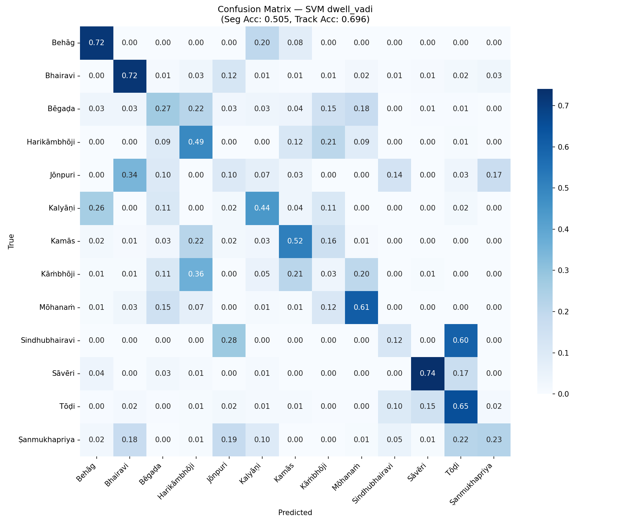
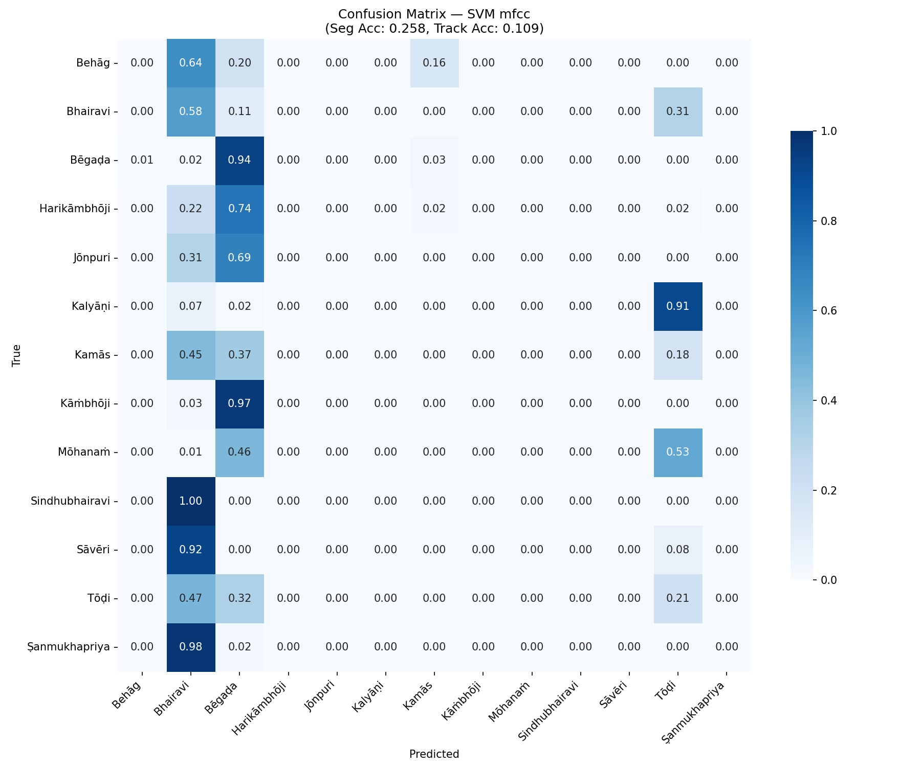
Results, Limitations & Future Work
Key Results (13 ragas, 46 tracks, estimated tonic)
Hypothesis Summary
69.6%
58pp
H1 +
Trigrams encode pakad (seq > PCD by 7pp)
H2 +
Structural not timbral (MFCC = random)
Track Accuracy
Above MFCC
H3 +
Parsimony: 16d > 216d > 408d
dwell_vadi — just 16 features
Raga is structural, not timbral (H2)
H4 +
Confusion follows melakarta kinship
H5 +
Dwell-time captures vadi emphasis
24pp
3.27x
H6 -
Directional uninformative (gamakas blur ascent/descent)
Above BiLSTM
Family Confusion
Limitations
Cognitive features > learned (H3)
Within > between, p=0.0004 (H4)
-> Tonic ceiling 87% — polyphonic audio, violin Pa confusion
-> Small dataset: 73 tracks, 13 ragas, 14.6:1 class imbalance
-> Equal-tempered bins lose raga-specific micro-intonation
-> Token collapse discards gamaka contour (Harikambhoji 0%)
-> Cognitive claims = correlation, not behavioural experiments
Future Work
-> Vocal source separation -> lift tonic ceiling beyond 87%
-> Gamaka-aware features -> fix Harikambhoji family confusion
dwell_vadi: 69.6%
MFCC: 10.9% (near random)
-> Larger dataset + more ragas for statistical power
-> Hindustani cross-tradition validation (pilot complete)

