Slide 1
Electronics
Sensors

Slide 2
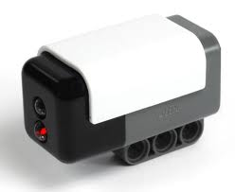
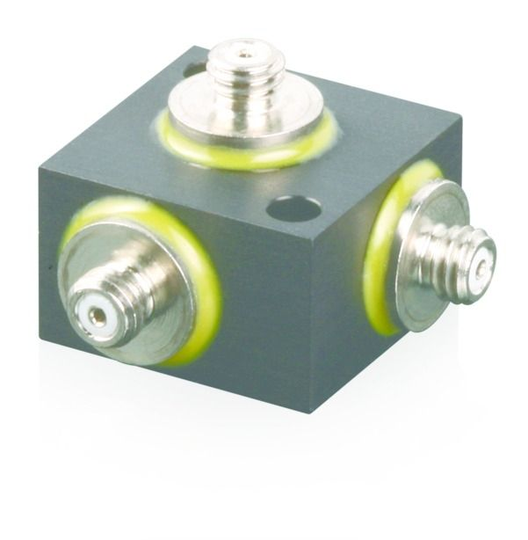
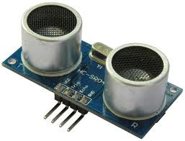
Sensors
A sensor is a converter that measures a physical quantity and converts it into a signal which can be read by an observer or by an (today mostly) electronic instrument.
For example: our eyes
Three-axes accelerometer
Light Sensor
Ultrasonic Sensor

Slide 3

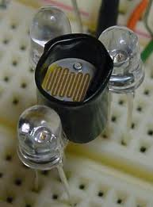
Colour
How do we see colour?
When white light falls on an object, it absorbs light of some particular frequencies and reflects the other.
The reflected light is perceived to be of a certain colour.

Slide 4
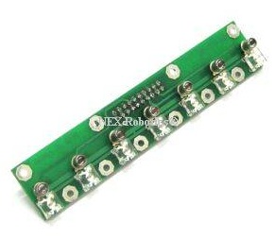
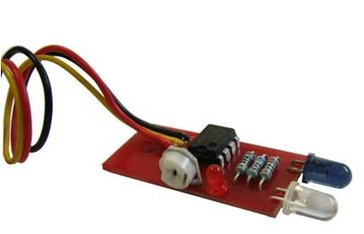
Colour sensors
IR Sensors
LED Sensors
Doubt
IR LED emits light
Reflected light received by Phototransistor and converted to voltage.
Higher voltage signifies reflected light of more intensity
Works on same principle but coloured LEDs used.
Can differentiate better among objects of two different colours but same intensity.

Slide 5
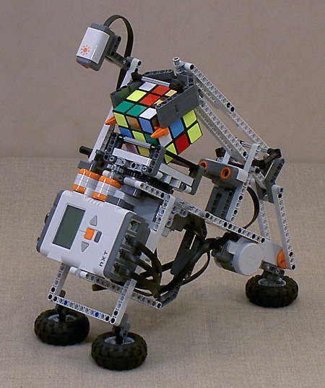
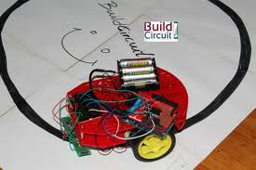
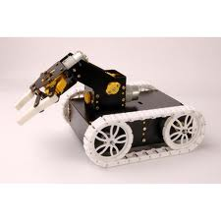
Applications
Line follower
Pick and place
Rubik’s cube solver

Slide 6
How a line follower works
Array of 5 to 7 color sensors placed in a line.
Objective: Black line must always be in the middle i.e. only the middle sensor must show black
If the immediate left sensor shows black, the robot moves to the left to correct position

Slide 7
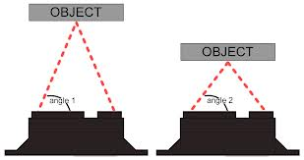
Distance Sensors
Doubt
Sharp Sensors
Analog distance sensor that uses infrared to detect an object’s distance.
Uses triangulation method
The further the object is
away from the sensor, the
steeper the angle will be

Slide 8
O B J E C T
doubt
Emitted Light
Reflected Light
Angle calculated
Light detected here
I R Distance Sensor

Slide 9
Ultrasonic Sensors
Sends high frequency sound waves whose echo is received by the receiver.
The time interval between
sending the signal and
receiving echo is calculated
by using a clock pulse
Does not work when the object is of soft, sound absorbing material

Slide 10
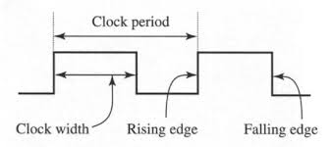
Sharp sensor Vs Ultrasonic sensor
Sharp Sensor
Ultrasonic sensor
Works on the triangulation method i.e. angle of the light calculated
Gives an analog output that needs to be converted to digital by Analog To Digital Converter
Works by using a clock pulse and counting the time pulses between the sent and received signals
Gives a digital output

Slide 11
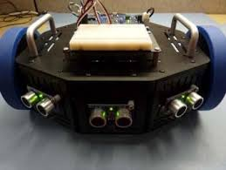
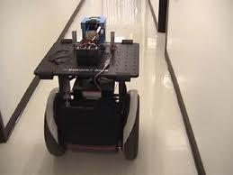
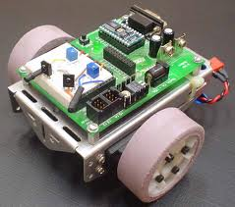
Uses of distance sensors
Feature to avoid obstacle
Wall following robots
Easy maneuvering.

Slide 12


Slide 13
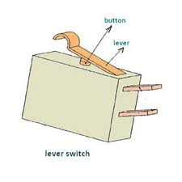
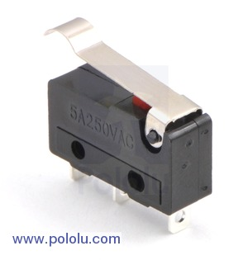
Bump Sensors
Like buttons or switches, bump sensors pull high on a logic pin when pressed.
On being pressed the circuit is completed, hence we get a signal.

Slide 14
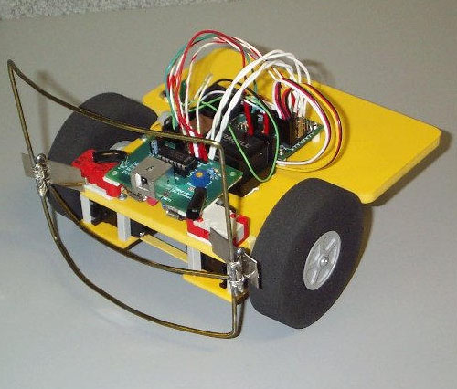
Bump Sensor

Slide 15
Accelerometer
Used for measuring acceleration of a body.
It can also measure inclination of a body with respect to earth.
Finds many applications in self balancing robots, alarm systems, human motion monitoring, levelling sensor, inclinometer.

Slide 16
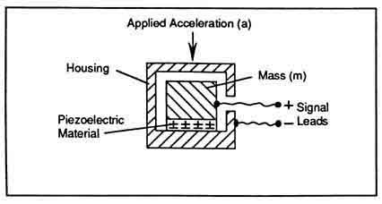
Accelerometer (working)
It comprises a mechanical sensing element and converts the signal from the mechanical to the electrical domain.

Slide 17
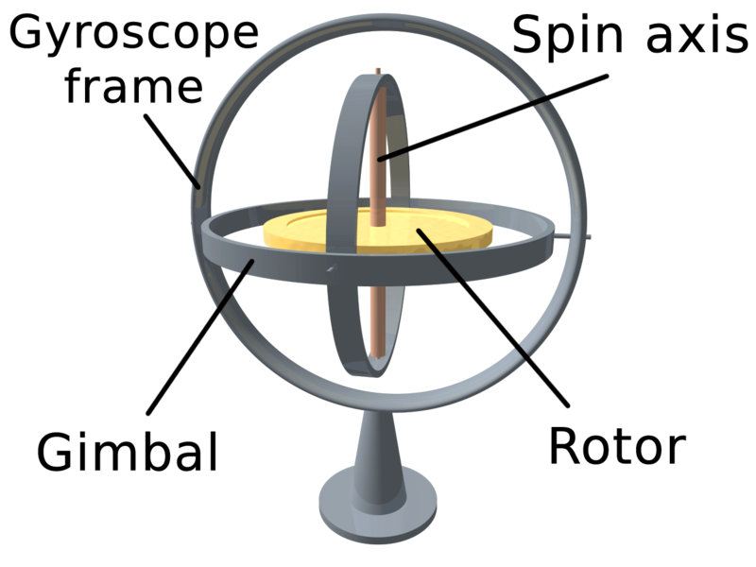
Gyroscope
A gyroscope is a device for measuring or maintaining orientation, based on the principles of angular momentum.
Mechanically, a gyroscope is a spinning wheel or disc in which the axle is free to assume any orientation.

Slide 18
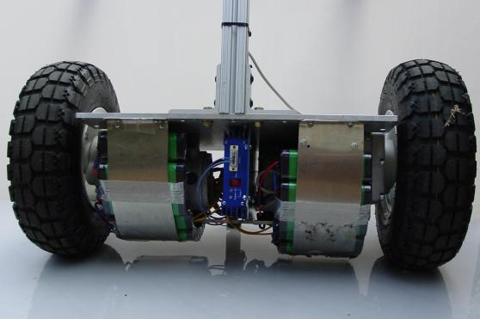
Gyrometer
A Gyrometer (or gyroscope) is a device for measuring orientation along one or several axis.
It measures the rotation of the robot on the vertical axis to determine its orientation with respect to the arena.
A Gyrometer can be used for several purposes like:
Racing cars
Balancing
Anti roll stabilizers
Ship stabilizer
Computer pointing devices

Slide 19
Self balancing Robot
Gyrometer or accelerometer used to measure the orientation and acceleration due to gravity
The Gyrometer will tell if the robot is rotating. If it's 0, then the robot is not rotating, that is: it's perfectly still, or going in one direction with some fixed speed keeping balanced. It doesn't say anything about where is up and where is down.
The accelerometer tells if the robot is accelerating forward or backward or any other direction

Slide 21
Encoder
The encoder is a sensor attached to a rotating object to determine displacement, velocity, or acceleration of a rotating sensor.
As it does not take skidding into consideration, there may be inaccurate readings
It should be very precise as even a small error of few degrees in encoders multiplies over large distances

Slide 22

Encoders: Working Incremental Measuring System
A Line pattern on glass or plastic disc is made
As these patterns are read a pulse is counted
The signals is analysed by counting up or down with each pulse and stored in digital count.

Slide 23
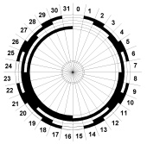
Absolute Measuring System
Every position of the measurement is identified by a definite code on a glass or plastic disc.
The code is in the form of light and dark regions within different tracks.
This combination relates to an absolute numerical value.

Slide 24
Queries?

