Slide 1
Microcontrollers and Programming
By: Akanksha Patel

Slide 2
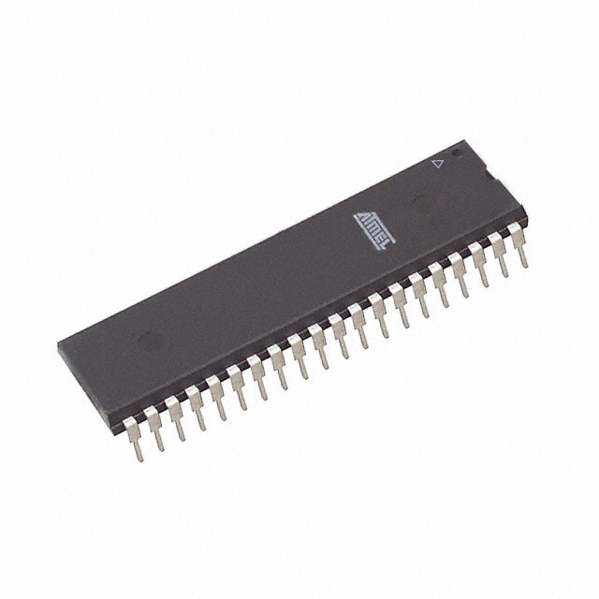
Microcontrollers
Microcontroller is a small computer placed on a single IC.
It includes processor, memory and other peripherals.
It acts as the brain of the robot and takes decisions according to the programming done by the user

Slide 3
Development boards
Printed circuit boards that provide all the circuitry necessary for a useful control task like I/O circuit, clock generator, stored program etc.
We use two type of development boards:
AVR
Arduino

Slide 4
AVR
AVR is a microcontroller manufactured by Atmel
We use atmega16A microcontroller.
Atmega 16A is used in AVR and atmega 328 is used in arduino.

Slide 5
Ports
Ports : Points of transferring data on the MCU
Present as pins on the IC.
Ports are named as Port A, Port B, Port C and Port D.
Other pins are used for power supply, clock etc.

Slide 6
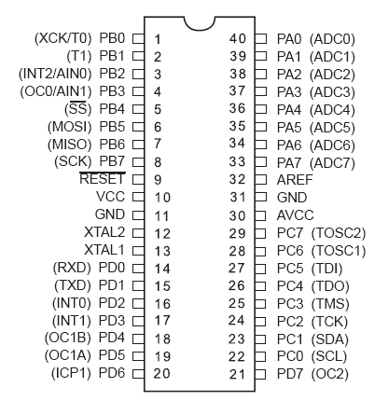
ATmega16A

Slide 7
Compiler
Avr studio
It converts the code written in c in hex file(machine language).

Slide 8
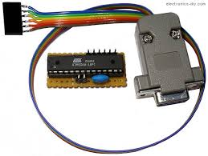
Programmer
Programmer(matches the frequency of computer with the board)
It could be inbuild (arduino) or we will have to use it externally(AVR) .

Slide 9
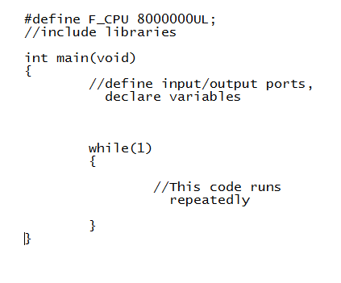
What to include in the program?
Define clock (max 16MHz)
Libraries
main()
while(1)

Slide 10
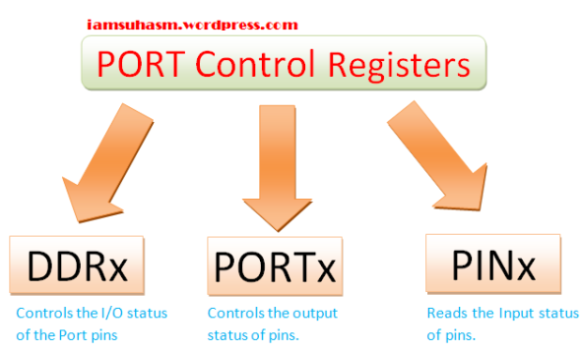
Basic I/O Operations
Working with ports:

Slide 11
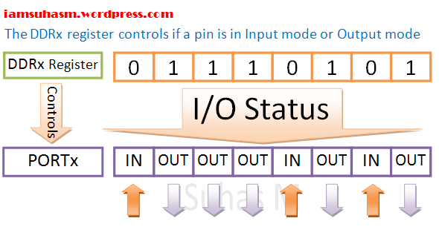
DDRx Register
First define the pins as input/output.
DDRx = 0b01110101;

Slide 12
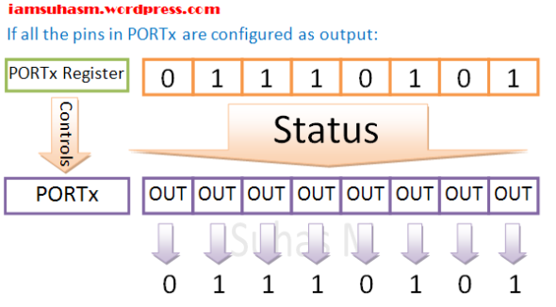
PORTx Register
It has two functions:
It sets the pins high/low (depending on 1/0) if the pin is set as output.
It manages the internal pull registers.

Slide 13
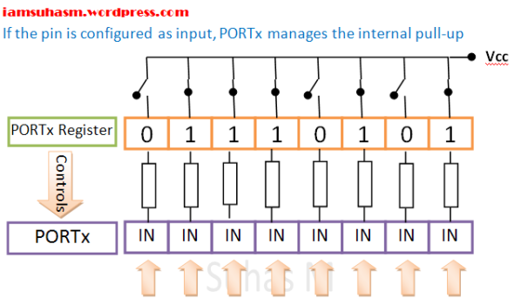

Slide 14
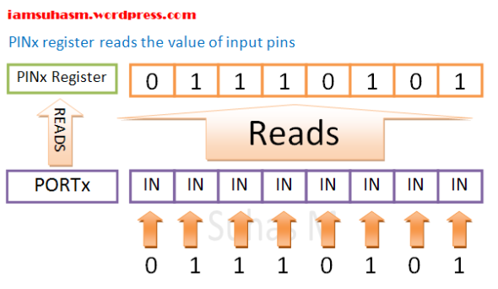
PINx Register
Reading the status of an input pin

Slide 15
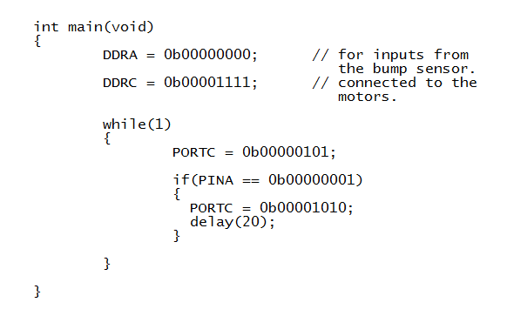
Example: Bump sensor

Slide 16
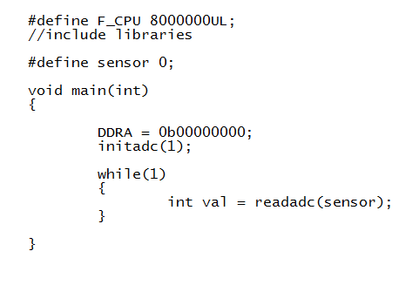
Using Analog to Digital Converter
ADC: Converts analog signals to understandable digital signals
In avr, Port A has been specified for ADC.

Slide 17
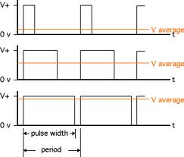
Pulse Width Modulation
PWM: Technique of getting analog result with digital means.
timerinit()
In avr, D4 and D5 pins are specified for PWM.

Slide 18
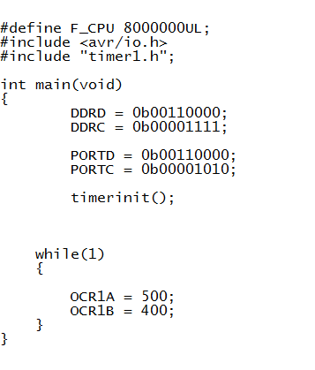

Slide 19
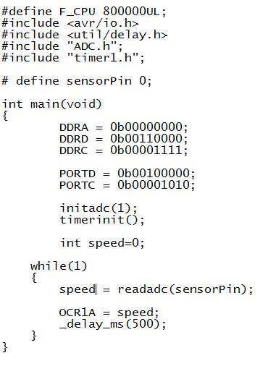
Example: Potentiometer

