Slide 1

ROBOTICS LECTURE SERIES INTRODUCTION TO MICROCONTROLLERS
Apoorva Muthineni

Slide 2
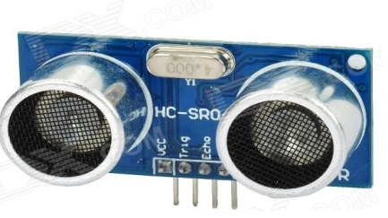
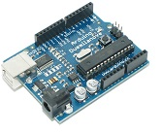
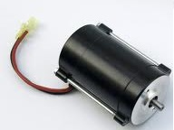
Why Microcontrollers?
Sensors take input
Actuators give output
Then why do we need microcontrollers?
Microcontrollers take input from the sensors, process the data and trigger output accordingly.
INPUT
Signal
PROCESSING
Signal
OUTPUT

Slide 3
MICROCONTROLLERS
A microcontroller can be considered as a very small and simple version of a computer on a single IC which is used for a specific purpose.
It has a CPU, flash memory ,RAM, EEPROM and many on- chip peripherals .
Notes:
Question like asking where the microcontrollers used.

Slide 4
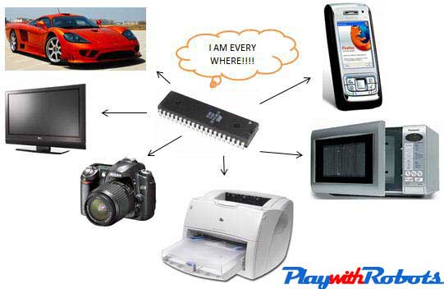

Slide 5
Basic Tools for AVR MCU
PC
In system programmer(ISP): The device which connects our MCU to PC
A target board
AVR MCU
A C compiler which is free in AVR: It converts high level language into machine language(.hex file)
A programmer software: It loads this .hex file in flash memory of MCU.

Slide 6
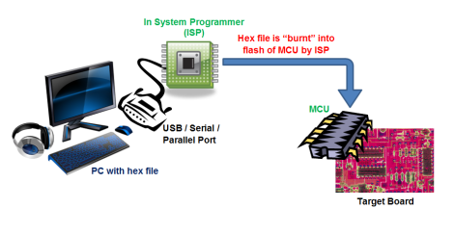

Slide 7
MAIN TERMS USED IN MCU
Clock: It is basically a signal that oscillates between high and low with a fixed time period
Clock source: Generally crystal oscillators are used to provide a clean, voltage and temperature independent clock source.
Flash memory: Program that is to be executed by microcontroller is stored here.
EG: Usually used for program code and data constants.

Slide 8
SRAM: Static Random Access Memory, this is the volatile memory of microcontroller. That means when power is turned off, it loses all its data.
EG: variables assigned by us in code are stored here.
EEPROM: It is Electrically Erasable Programmable ROM. It retains its data even after power off.
If we want some variables to be stored permanently,
then they will be stored here.
Ports : A PORT is a point where data internal to the MCU comes out. EG: PORT A, B,C etc
VCC: Power Supply
GND: Ground

Slide 9
MEMORY
These pins on MCU can be controlled by a program.
MCU contains flash memory where it stores this program.
The flash memory can be erased easily and a new program can be burned.

Slide 10
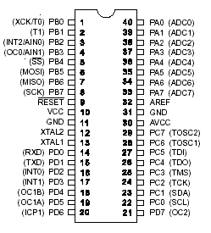
AT mega 8
AT Mega 16

Slide 11
AVR(AT MEGA 16)
A PORT is the point where data internal to the MCU comes out. Simply, a combination of pins in an MCU is a PORT.
A port contains 8 GPIO(General Purpose Input Output pins).
There are four ports namely A,B,C and D in ATMEGA16.
Not all pins are GPIO pins, there are some pins (like Vcc, GND, XTAL, etc) which are for other functions and cannot be turned on/off for interfacing

Slide 12
GPIO has two modes:
Input mode: In this mode, the MCU can read the values at the pins . They take in the sensor data.
Output mode:
HIGH- Vcc
LOW-Ground
. It is used to send commands to external hardware like servos, LEDs, etc

Slide 13
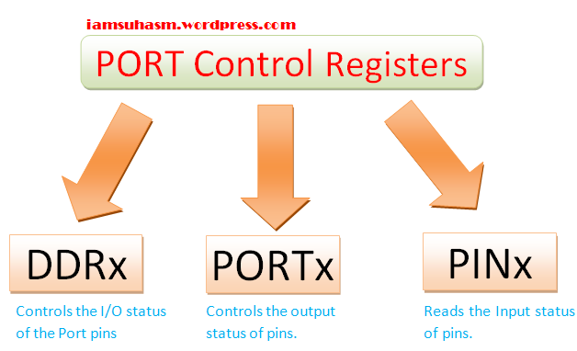
Each port in AVR has three related registers.
Notes:
Explanation abt registers with a diagram

Slide 14
Internal Peripherals
In addition to this, each IO pin is defined for an additional purpose like ADC, USART, timers ,etc. These are called peripherals.
The secondary features of these pins become active only if you enable certain bits of some registers

Slide 15
Internal Peripherals
ADC
TIMER
USART
SPI
Every peripheral has specific registers to provide communication between CPU and that particular peripheral.

Slide 16
ADC
Analog ports are necessary to connect sensors to our robot.
ADC ports receive analog signals and convert them into digital number within certain numerical range depending on the resolution
ADC channels are shared with PORTA of AVR.

Slide 17
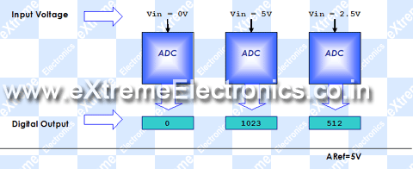

Slide 18
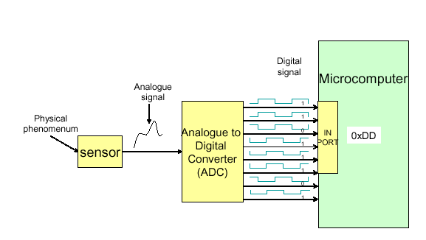

Slide 19
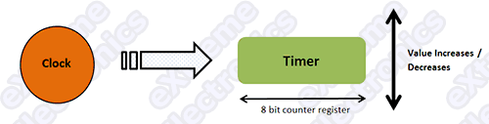
TIMERS
A timer in general is a register which counts up/down.
They have a resolution of 8-16 bits.
A 8 bit timer can count from 0-255.
They run parallel and independent of CPU and interact with CPU by issuing interrupts.

Slide 20
Interrupts
They are of two types.
Overflow interrupt: It is called when timer reaches its maximum value.
Compare Match interrupt: It is called when timer reaches a certain value predefined by us.

Slide 21
PWM
A PWM is used to generate analog outputs depending on value of duty cycle instead of regular digital outputs by MCU.
Duty Cycle: It is the percentage of the total time the output is high.
Duty cycle=(time_{on}/time period)*100

Slide 22
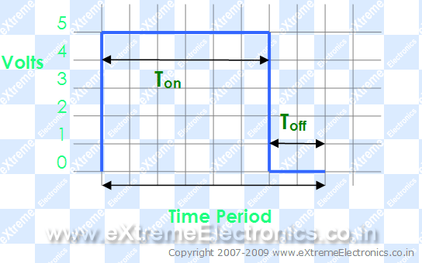
A PWM waveform
Duty Cycle = 75% Analog Voltage Out = 75% of Vcc (5v) = 3.75 Volts

Slide 23
PWM signal generation
In AVR MCU, PWM signals are generated by TIMER units.
There are two methods from which we can generate PWM signals from AVR TIMER0 (for Atmega16 and ATmega32 MCUs).
1. Fast PWM
2. Phase Correct PWM

Slide 24
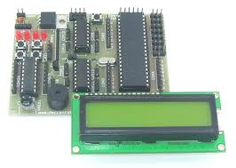
LCD
We need to interface an LCD to our microcontroller so that we can display messages, outputs, etc.
Sometimes using an LCD becomes almost inevitable for debugging and calibrating the sensors

Slide 25
Motor Drivers
The current from MCU output pins is not enough to run a motor.
Therefore, we need an external driver circuit which can act as a bridge between IC and motors.
We can make a circuit or there are IC available for same purpose. Eg. L293,L293D,etc

Slide 26
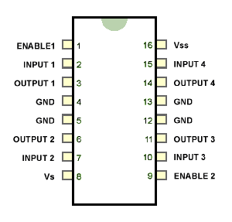
H bridge using L293D

Slide 27
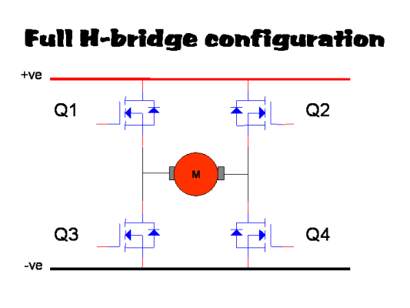
H Bridge
It’s a circuit to allow the rotation of motor in both direction

Slide 28
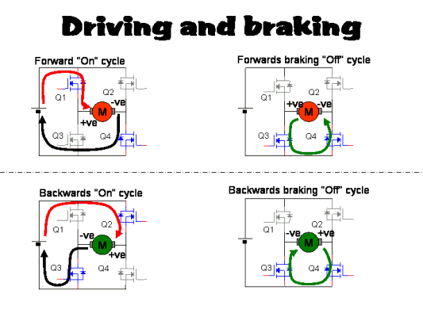
Working of DC motor
Driving and Braking using H Bridge

Slide 29
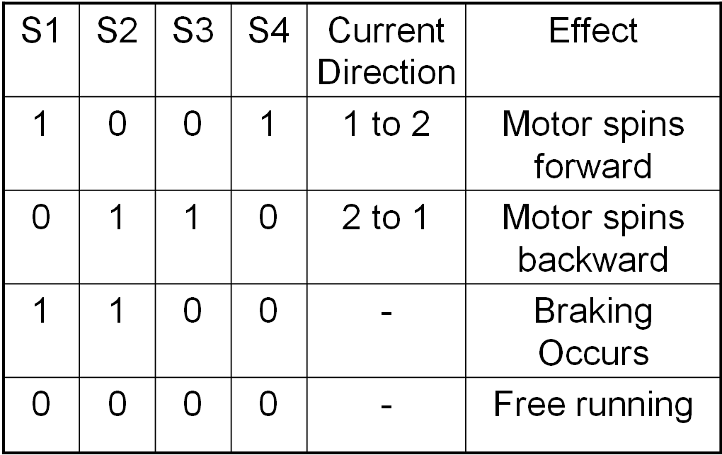
Working of DC motor
H-Bridge in short

Slide 30
Development Boards
Here we are going to discuss about 2 types of development boards in particular.
1. Arduino
2. AVR

Slide 31
ARDUINO
Arduino is an AVR-based prototyping board with an emphasis on ease of use.
It has separate pins for digital and analog purposes.
There are 6 analog in pins and 14 digital in/out pins ground, Vcc …
It consists of PWM output pins seperately.
It also features a USB interface allowing serial communication through a USB device, eliminating the need for a separate AVR programmer.

Slide 32
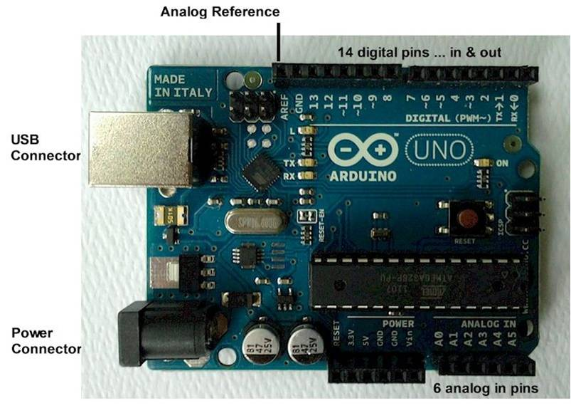
ARDUINO

Slide 33
Why ARDUINO??
The main reason is its programming environment.
IDE includes many helpful libraries .
While programming Arduino, you are least bothered with the internal hardware and registers of the microcontroller. All you do is call the functions written in the libraries (which are already provided)
You can use Arduino if you want to prototype your project very fast, and are not much concerned about the programming part.

Slide 34
AT MEGA 16

Slide 35
AVR
In this, communication between PC and MCU is done using a programmer.
It consists of a on-board driver.

Slide 36
QUERIES??

