Slide 1




Marketing Campaign Performance Analysis
NewCo Campaign Review
Juglair Kristel Claire
December 2025

Slide 2


1. Situation & Objectives
2. Key Findings
3. Deep Dive
4. Recommendations
5. Appendix
Agenda

Slide 3


1. Situation & Objectives
CONTEXT
OBJECTIVES
APPROACH
NewCo runs two campaign versions:
  Campaign A: Friendly, informal tone
  Campaign B: Professional, sales-oriented tone
Distributed across Email, Instagram, Web Banner
Identify the best campaign-channel combinations
Examine customer engagement (sales and time)
Hypothesis-driven analysis using Excel pivot tables
From business questions to actionable insights

Slide 4
2. Key Findings
A. CHANNEL PERFORMANCE
B. CAMPAIGN-CHANNEL
C. NEW CUSTOMERS
Which channel generated most revenues?
Looking across both campaign versions, which channel-campaign combination had the strongest performance overall (highest sales)?
Which customer segment represent high potential?

Slide 5
A. Channel Performance
Which channel generated most revenues?
Email campaigns as main generator of total revenues (54% of sales, specifically $7.9k).

Slide 6
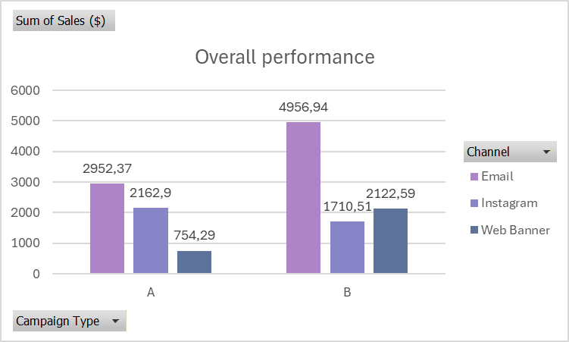
B. Campaign and Channel combination
Which channel-campaign combination had the strongest performance overall?
The strongest campaign-channel combination in terms of sales was Email + Campaign B.

Slide 7
C. New customers acquisition
Which customer segment represent high potential?
New customers represent a high potential of growth ($5.8k of total sales against $8.8k sales of existing customers).
Email + Campaign A was the most effective combination for attracting new customers.

Slide 8
D. MESSAGE EFFECTIVENESS
Which message style brought in the most overall revenue, regardless of customer type?
3. Deep Dive
E. ENGAGEMENT BEYOND SALES
Success is measured on more than just sales. Which channel resulted in the longest average time on site for people who did not end up making a purchase?

Slide 9
D. Message effectiveness
Which message style brought in the most overall revenue, regardless of customer type?
Campaign B (professional, sales-oriented tone) brought the most overall revenue, accounting for 60% of total sales ($8.7k).

Slide 10
E. Engagement beyond sales
Which channel resulted in the longest average time on site for people who did not end up making a purchase?
Among non-converters, Instagram users spent an average of 3,733 seconds on site, nearly as much as Email users, indicating strong engagement potential.

Slide 11
Increase investment in Email + Campaign A to continue driving new customer acquisition.
Maintain Email + Campaign B to support overall revenue generation.
Leverage Instagram primarily as an awareness and engagement channel, with potential retargeting strategies.
Test follow-up email messages to optimize conversion while preserving the trust-building tone.
4. Recommendations

Slide 12
Implement recommendations in Q1
Track performance metrics monthly
Review and adjust strategy after 60 days
Next steps

Slide 13
Dataset source: https://www.theforage.com/simulations/bcg/data-for-decision-makers-tod0?reloaded=true
Methodology:
Excel: Pivot tables, chart creation
Data Analysis: Hypothesis testing, cohort analysis, segmentation
Business Intelligence: KPI definition, performance metrics, strategic recommendations
Sample Size: 500
Key Metrics: Revenue, Time on Site, Conversion Rate, New vs. Existing Customers
5. Appendix

