Slide 1





INTRO
ANALYSIS
CONCLUSIONS
sales exploratory data analysis
Juglair Kristel Claire
PAGE 01

Slide 2

INTRO
ANALYSIS
CONCLUSIONS
Business context
Dataset & cleaning
Zara operates in fast-fashion and it is characterized by:
Short product cycles
Seasonality
Global supply chain
Fast data driven decision making
Analyze sell data and find relevant pattern of seasonality, materials, origin of the products and market segmentation to support decision making process about business, pricing and sourcing.
Tools: Kaggle | Excel | PowerQuery | PowerBI
PAGE 02

Slide 3


INTRO
ANALYSIS
CONCLUSIONS
Business Questions
1. Which countries contribute most to sales?
2. What drives sales across seasonality?
3. Which materials perform best?
4. Are there any difference between Men and Women?
PAGE 03

Slide 4
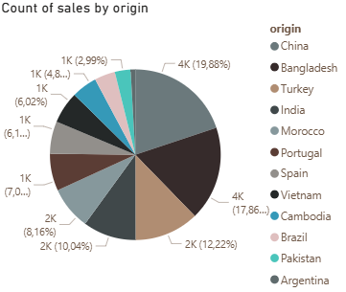
INTRO
ANALYSIS
CONCLUSIONS
Geographic insights
Sales are concentrated in a limited number of sourcing countries (mainly in Europe and Asia) → high dependance to specific productive areas
Supply chain risk → opportunity of diversification of suppliers
PAGE 04

Slide 5

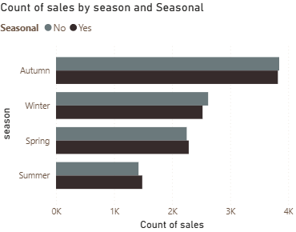
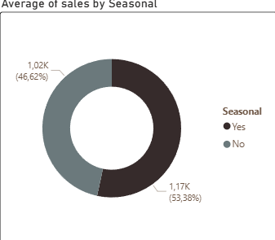
INTRO
ANALYSIS
CONCLUSIONS
Seasonality insights
Seasonal products consistently outperform non-seasonal ones
Autumn and Winter registered a higher level of sales
Reinforce prior planning of seasonal collections
Reduce non-seasonal stocks during peak periods
PAGE 05

Slide 6
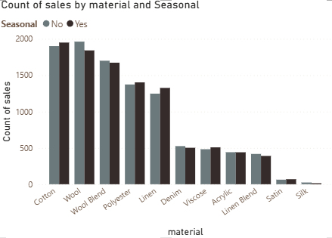
INTRO
ANALYSIS
CONCLUSIONS
Material insights
Satin and Silk have lower demand
Cotton, wool, polyester and linen have higher demand
Optimization of sourcing material
Reduce overproduction on low demand materials
PAGE 06

Slide 7
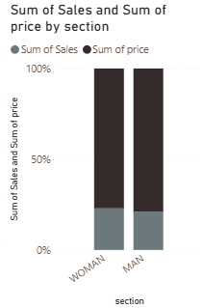
INTRO
ANALYSIS
CONCLUSIONS
Section insights
Women drive volume
Men drive margin due to a higher selling price
Differentiated strategies by pricing and tastes
PAGE 07

Slide 8



INTRO
ANALYSIS
CONCLUSIONS
BUSINESS IMPLICATIONS
Inventory optimization
Sourcing strategies
Pricing differentiation
PAGE 08

Slide 9

INTRO
ANALYSIS
CONCLUSIONS
Limitations
Next steps
No data of costs available for planning strategies
No time series forecasting
Price sensitivity study
Seasonality demand forecasting
Inventory data integration
PAGE 09

Slide 10

INTRO
ANALYSIS
CONCLUSIONS
THANK
YOU
Explore the dashboard below
PAGE 10

Slide 11


