Slide 1
The MVVM Pattern & Implementation in WinJS
Concepts of Model-View-ViewModel, Pros and Cons, Implementing MVVM in WinJS
George Georgiev
Technical Trainer
itgeorge.net
Telerik Software Academy
academy.telerik.com

Slide 2
Table of Contents
Model-View-ViewModel Pattern
Origin, Required tech & Usage
Overview
View responsibilities
Model responsibilities
ViewModel responsibilities
Advantages & Criticism
Implementing MVVM in WinJS
Building views, models and view-models
Solving lack of two-way-binding

Slide 3
The MVVM Pattern
Concepts, Origin

Slide 4
The MVVM Pattern
Model-View-ViewModel
Architectural pattern
Based on the MVC pattern
Origin: Microsoft, Martin Fowler
Utilization of data-binding in WPF/XAML
Clear separation of UI and Back-end logic
Data binding & Observability
Required APIs
Data binding, preferably two-way
Markup for UI

Slide 5
The MVVM Pattern
MVVM Components
Model – keeps the raw data
View – provides the UI for the user
View model – Converts models to models for the view ("viewables")
Controller – parallel to the view model, similar to controllers in MVC
Still in debate, not very widely used
Binder – handles declarative binding
Syncs the ViewModel and the View

Slide 6
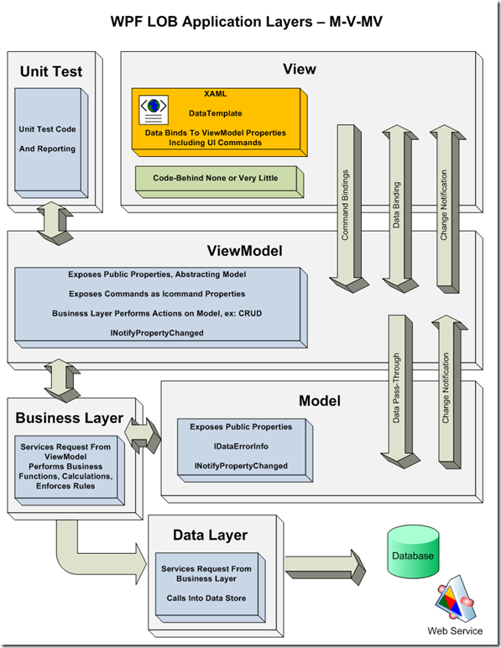
MVVM – Pattern Components

Slide 7
The MVVM Pattern
Model component
Domain specific data (e.g. accounts, songs, etc.)
Models are essentially DTOs
Set of fields containing data
E.g. JSON coming from a web service
Models have no behavior
Their job is to store & represent data
In some frameworks have validation & Ajax calls
Not very correct

Slide 8
The MVVM Pattern
View
UI markup, rendered to the user
Buttons, inputs, text, media, etc.
Active element
Takes care of synchronizing with the ViewModel
Uses data bindings, events, etc.

Slide 9
The MVVM Pattern
ViewModel
A "model for the view"
Provides bindable objects for the view
Special data converter
Converts Model data to ViewModels
Provides data operations & Business logic
Downloading, Uploading, Storage, etc.
Uses the Model
Usually divided into Business logic & Data Layer

Slide 10
Implementing MVVM in WinJS
Building View, Models and ViewModels

Slide 11
The MVVM Pattern
WinJS supports all basic APIs for MVVM
Has data bindings and observables
Things to keep in mind when implementing
ViewModel exposes observables for binding
Should have a data access layer
Should NOT interact with the DOM at all
View binds to observables from ViewModel
And Adds handlers for user input
To workaround the lack of two-way binding
Defining models could be skipped in some cases
E.g. JSON from a service doesn't need exact

Slide 12
Implementing MVVM in WinJS
Live Demo

Slide 13
The MVVM Pattern and Implementation in WinJS
http://academy.telerik.com

