Slide 1




Telerik School Academy
http://schoolacademy.telerik.com
Meeting #5 – March 2011 – JavaScript and ASP.NET
Homework Assignments
Svetlin Nakov
Telerik Corporation
www.telerik.com

Slide 2
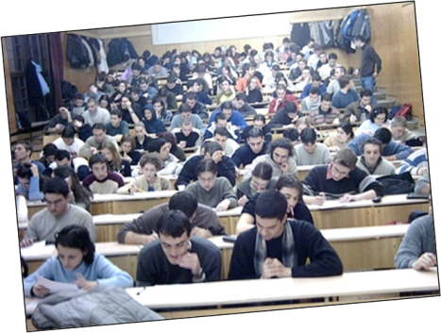
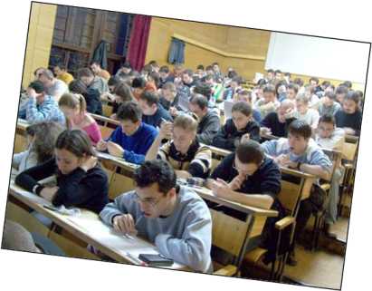
Prepare IT Test Questions

Slide 3
Prepare IT Test Questions
Prepare at least 20 questions for preparation for the National Olympiad's IT test
Prepare at least one question for each category from the official conspectus
Try to create complex, non-trivial questions
Categories are officially published at http://edusoft.fmi.uni-sofia.bg/documents/Conspect0910.pdf
Follow strictly the IT test template: IT-Test-Questions-Template.pptx

Slide 4



JavaScript

Slide 5
JavaScript
Create an HTML page that has two text fields (first name and last name) and a button. When the user clicks the button, a message should show the text in the text fields followed by the current time.
Create a Web page that asks the user about his name and says goodbye to him when leaving the page.
Modify the previous HTML page to have a text field for email address and on clicking the button check if the email is valid (it should follow the format <something>@<host>.<domain>).
Create a Web page that shows 20 <div> elements with random location, size and color.

Slide 6
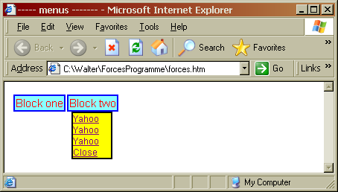
JavaScript (2)
Create a drop-down menu
Use table for the main menu blocks
Use hidden <DIV> elements (display: none; position:absolute; top:30px)
Use JavaScript and onmouseover and onmouseout event to change display: none/block

Slide 7
JavaScript (3)
Create a DTHML page that has <div> containing a text that scrolls from right to left automatically
Use setInterval() function to move the text at an interval of 500 ms
Use overflow:hidden for the <div>
Use scrollLeft and scrollWidth properties of the <div> element

Slide 8
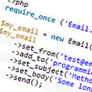



jQuery

Slide 9
jQuery
Create a HTML web page with 15 image tags. Using jQuery print the alt and src attributes of all image tags.
Figure out how many elements on the page are hidden (hint: .length).
Create a HTML web page with some <div> tags. Select all of the div elements that have a class of "module" and make them green.
Declaratively make an unordered list. Using jQuery add 5 new items to the end the unordered list.

Slide 10
jQuery (2)
Try to write a simple HTML/jQuery based Tic-Tac-Toe game.
Write a simple HTML page, starting from empty file with only <head> and <body> tags. Add two <div> tags, in one of them a numbered list of 3 points, an anchor linked to Telerik Academy Web site and a paragraph with yellow background. Build it at runtime, using only jQuery (no HTML).
Write a photo gallery slideshow using jQuery and AJAX to load the next image from the server dynamically at runtime.

Slide 11
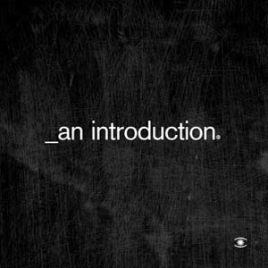
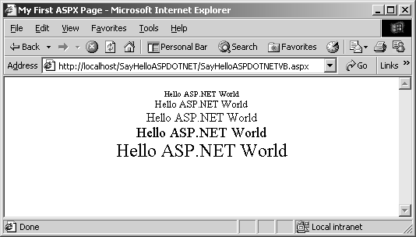

ASP.NET Architecture

Slide 12
ASP.NET Architecture
Start Visual Studio 2010 and make new Web Site. Look at the files generated and tell what's purpose of each file. Explain "code – behind" model. Print "Hell ASP.NET" from code – behind and from UI. Show automatic generated files in executing directory using Assembly.GetExecutingPath().
Create a Web page which saves empty file in ProgramFiles directory. Configure directory security so IIS process to be able to write in there.
Catch all the events in page lifecycle using appropriate method or event handler.

Slide 13
ASP.NET Architecture (2)
Do some kind of tracing of these events.
Create an HTML form that posts the contents of a textarea field to a server and the server prints it in another field. Don’t use code-behind.
Create an ASP.NET web form which posts the contents of a textarea field to a server and the server prints it in another field.
Use the src attribute of the @Page directive to create a page that doesn’t need to be precompiled.

Slide 14
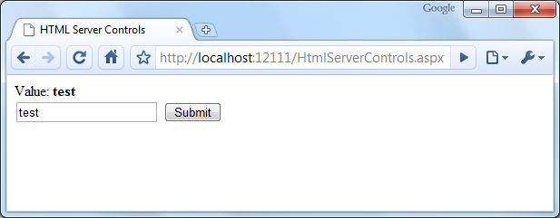
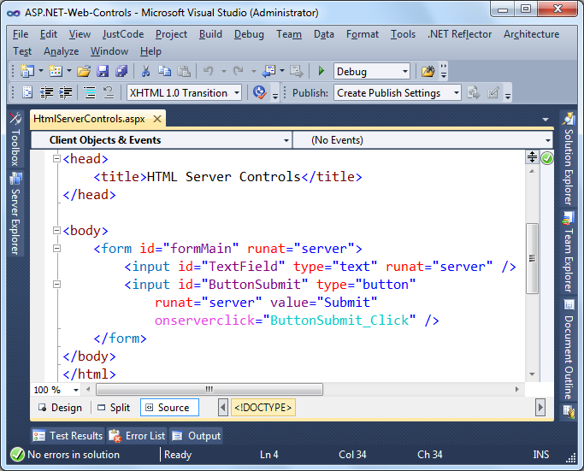
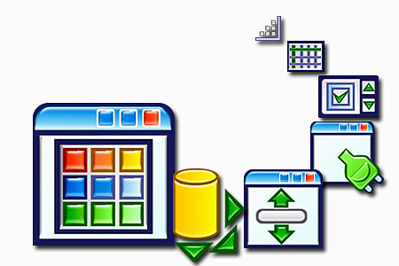
ASP.NET HTML and Server Controls
Notes:
*
6/6/201307/16/96
(c) 2005 National Academy for Software Development - http://academy.devbg.org. All rights reserved. Unauthorized copying or re-distribution is strictly prohibited.*
14##

Slide 15
ASP.NET Server Controls
Using the HTML server controls create a random number generator Web application. It should have two input fields defining a range (e.g. [10..20]) and a button to generate a random number in the range.
Re-implement the same using Web server controls.
Define a Web form with text box and button. On button click show the entered in the first textbox text in other textbox control and label control. Enter some potentially dangerous text. Fix issues related to HTML escaping – the application should accept HTML tags and display them correctly.

Slide 16
ASP.NET Server Controls (2)
Make a simple Web form for registration of students and courses. The form should accept first name, last name, faculty number, university (drop-down list), specialty (drop-down list) and a list of courses (multi-select list). Use the appropriate Web server controls. After registration you should display summary of the entered information as formatted HTML. use dynamically generated tags (<h1>, <p>, …).
Implement the "Tic-tac-toe" game using Web server controls. The user should play against the computer which should implement some kind of intelligence.

Slide 17
ASP.NET Server Controls (3)
Make a simple Web Calculator. The calculator should support the operations like addition, subtraction, multiplication, division, square root and module. Also the calculator should be able to work with decimal numbers. Validation is essential!

Slide 18



ASP.NET State Management

Slide 19
ASP.NET State Management
Create an ASP.NET Web Form, which prints the type of the browser and the client IP address requested .aspx page.
Create a ASP.NET Web Form which appends the input of a text field when a button is clicked in the Session object and then prints it in a <asp:Label> control. Use List<string> to keep all the text lines entered in the page during the session lifetime.
Create two pages that exchange user input data with cookies. The first page is a login page. The second one should redirect to the first one if there’s no cookie. The cookie must expire in 1 minute.

Slide 20
ASP.NET State Management (2)
Create a JavaScript function that deletes the ViewState hidden field variable. What happens at postback?
Implement a graphical Web counter. It should display as JPEG image the total number of visitors of the requested .aspx page since the start of the Web application. Keep the number of visitors in the Application object. What happens when the Web server is stopped?
Re-implement the previous task to keep the total number of visitors in SQL Server database.

Slide 21
ASP.NET State Management (3)
Implement the Tic-Tac-Toe game which allows Internet users to play one against another. Multiple game sessions should be supported to run in parallel. The main page (Default.aspx) should list all games in the application (games now playing, finished games and games waiting for a second player). The user could start a new game or join existing game which has only one player or view who is the winner of any finished game. When starting new game or joining an existing game, the player should enter his or her name. Players who wait for an oponent to join to their game or to enter a valid move should check repeatedly at 1 second.

Slide 22

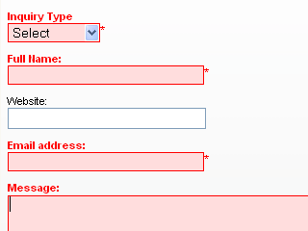


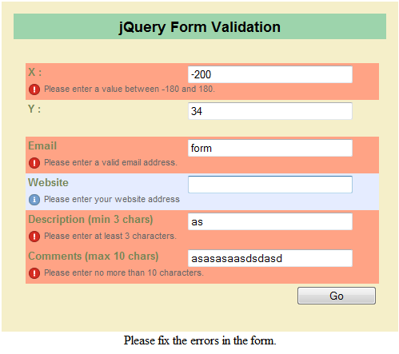


ASP.NET Validation Controls
Notes:
2008 NASD
22##

Slide 23
Exercises
Create a form to register users with fields for preferred user name, password, repeat password, first name, last name, age, email, local address, phone and an “I accept” option. All fields are required. Valid age is between 18 and 81. Display error messages in a ValidationSummary. Use a regular expression for the email and phone fields.
Separate the fields in groups and validate them using Validation Groups. The Validation Groups should be at least three – Logon Info, Personal Info, Address Info.
Notes:
2008 NASD
23##

Slide 24
Exercises (2)
Add a radio button to choose the gender (male / female). If the user is male, dynamically display a list of check boxes for choosing his favourite cars (e.g. BMW, Toyota, etc.). If the user is female display a drop-down list to allow her select her favourite coffee (e.g. Lavazza, New Brazil, etc.). Note that selecting a coffee is optional for the female users. Implement this by server PostBacks.
Implement the previous with client-side JavaScript.

Slide 25
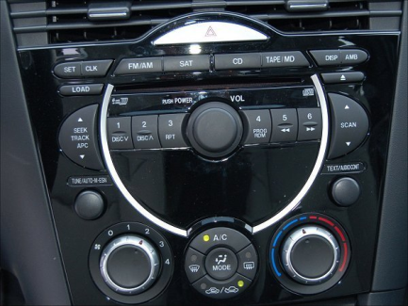


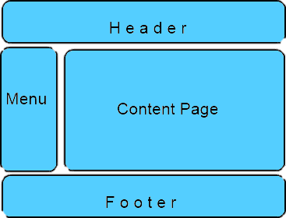

User Controls and Master Pages

Slide 26
User Controls and Master Pages
Implement a simple Web application using Master Pages. The application should be like a user profile – separate pages for Profile, Friends, Additional Info, etc. Add a site map (Web.sitemap), site path and navigation menu in the master page.
Create a user control that visualizes a menu of links. The control should have a property to initialize the menu links (a list of items, each containing a title and URL). Use DataList and data binding to visualize the menu links. Implement a property to change the font and the font color. Don’t use the Menu control!
Add to the previous application the possibility to view the Web application in Bulgarian and in English.

Slide 27

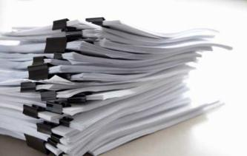

Submission Instructions and Deadline

Slide 28
Submission Instructions
Homework solutions should be submitted at the following Web site:
http://nakov.devbg.org/schoolacademy-uploads/
Solutions should be packed in a single ZIP or RAR archive (up to 8 MB)

Slide 29
Further Instructions
The deadline for the homework is:
A week before the next training session
Everybody is free to use help from friends, teachers or Internet
Submission of the same work by different authors may result in a disqualification
Ask your questions in the Telerik School Academy official discussion group:
http://groups.google.com/group/it-olymp

Slide 30
Homework Assignments
?
?
?
?
?
Questions?
?
?
?
?
?
http://schoolacademy.telerik.com

