Slide 1




Telerik School Academy
http://schoolacademy.telerik.com
Meeting #6 – April 2011 – Web-Technologies
Homework Assignments
Svetlin Nakov
Telerik Corporation
www.telerik.com

Slide 2


Prepare IT Test Questions

Slide 3
Prepare IT Test Questions
Prepare at least 20 questions for preparation for the National Olympiad's IT test
Prepare at least one question for each category from the official conspectus
Try to create complex, non-trivial questions
Categories are officially published at http://edusoft.fmi.uni-sofia.bg/documents/Conspect0910.pdf
Follow strictly the IT test template: IT-Test-Questions-Template.pptx

Slide 4


Data Binding

Slide 5
Data Binding
Create a Web form resembling the mobile.bg car publishing form. Add two DropDownLists for the producer (VW, BMW, …) and for the model (A6, Corsa,…). Create a class Producer – each producer should have a Name and a collection of models. Bind a list of producers to the first DropDownList. The second should be bound to the models of this producer. You should have a check box for each “extra” the car has, ordered in 4 columns – coming from a list “extras”. Implement the type of engine as a horizontal radio button selection – options come from a fixed array. Display all collected information in <asp:Literal>.

Slide 6
Data Binding (2)
By using a GridView display the names of all employees from Northwind database as hyperlinks. All links should redirect to another page where details about the employee are displayed in a DetailsView. Add a back button to return back to the previous page.
Implement the previous task by using a FormView instead of DetailsView.
Display the information about all employees in a table. Use Repeater and apply styles.
Re-implement the previous using ListView.

Slide 7
Data Binding (3)
Create a Web Form that reads arbitrary XML document and displays it as tree. Use the TreeView Web control on the left side display the inner XML of the selected node on the right side.

Slide 8
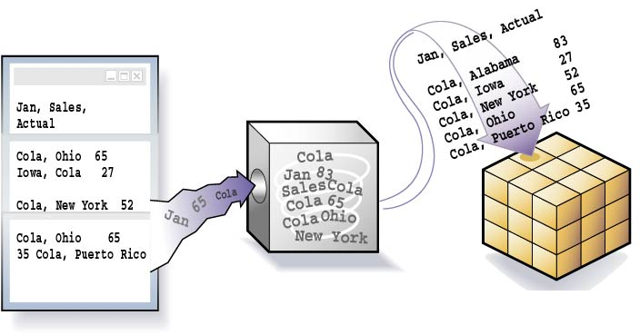


ASP.NET Data-Driven Web Applications

Slide 9
ASP.NET Data-Driven Web Applications
Create a Web form that contains a GridView control. Bind it to the Categories table from the Northwind database using EntityDataSource and EF data classes. Implement selection, editing and deleting of rows. Enable sorting and paging.
Implement inserting of new categories by adding a DetailsView control bound to the same data source.
Reimplement the same functionality with ObjectDataSource.

Slide 10
ASP.NET Data-Driven Web Applications (2)
Using EntityDataSource, ASP.NET data-bound controls and Entity Framework create a Web application to display information about towns and countries stored in SQL Server database. Each country has name, language, national flag and list of towns. Each town has name, population and country. Use a set of text boxes to show a single country in the left side of the main form along with navigation buttons (Next / Previous) to change the currently selected country. Use GridView on the right side of the form for the towns of the currently selected country. When the current country changes, load and display its towns.

Slide 11
ASP.NET Data-Driven Web Applications (3)
Add to the system a new information object: continents. Countries are considered to reside in exactly one of the continents. Use ListBox to display the continents. Implement master-detail navigation: when a continent is selected, its corresponding countries are loaded. When a country is selected, its towns should be loaded.
Implement editing of all information objects in the system (add / edit / delete). Implement adding as a separate .aspx page.

Slide 12

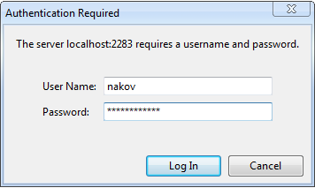
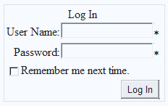
ASP.NET Authentication and Authorization

Slide 13
Authentication and Authorization
Create a database School in SQL Server. Using aspnet_regsql.exe add the SQL Server membership tables to support users / roles.
Using the ASP.NET Web Site Configuration Tool create a new role "Student" and two users that have the new role. Create a login page and try to enter the site with one of these two accounts.
Create a Web site and restrict access to a it for unregistered users. Implement login page, user registration page and logout link in the master page. The site should have the following pages:

Slide 14
Authentication and Authorization (2)
Login.aspx – accessible to everyone
Register.aspx – accessible to everyone – allows visitors to register
Main.aspx – accessible to logged-in users only
Admin.aspx – accessible to Administrators roles only – allows users to be listed and deleted
Implement a site map and navigation menu that defines the pages in the Web site and specifies which pages which roles require. Hide the inaccessible pages from the navigation.

Slide 15
Authentication and Authorization (3)
Create your own membership provider that uses a database of your choice. Define the tables:
Users(ID, username, PasswordSHA1)
Roles(ID, Name)
Create the following ASP.NET pages:
Login.aspx – accessible to everyone
Register.aspx – accessible to Administrators only
Main.aspx – accessible to logged-in users only

Slide 16



ASP.NET AJAX

Slide 17
ASP.NET AJAX
Create an AJAX-enabled Web site which shows Employees among and their Orders in two GridView controls (use the Northwind database and LINQ to SQL.) Put the GridView for the orders inside an update panel. Add UpdateProgress which shows an image while loading (simulate slow loading with Thread.Sleep()).
When the user selects a row in employees GridView, the UpdateProgress must be activated and the panel must be updated with the orders of the selected Employee.

Slide 18
ASP.NET AJAX (2)
Using Timer and UpdatePanel implement very simple Web-based chat application. Use a single database table Messages holding all chat messages. All users should see in a ListView the last 100 lines of the Messages table. Users can send new messages at any time and should see the messages posted by the others at interval of 500 milliseconds.
Using the AJAX Control Toolkit create a Web photo album showing a list of images (stored in the file system). Clicking an image should show it with bigger size in a modal popup window. The album should look like the Windows Photo Viewer.

Slide 19



Submission Instructions and Deadline

Slide 20
Submission Instructions
Homework solutions should be submitted at the following Web site:
http://nakov.devbg.org/schoolacademy-uploads/
Solutions should be packed in a single ZIP or RAR archive (up to 8 MB)

Slide 21
Further Instructions
The deadline for the homework is:
A week before the next training session
Everybody is free to use help from friends, teachers or Internet
Submission of the same work by different authors may result in a disqualification
Ask your questions in the Telerik School Academy official discussion group:
http://groups.google.com/group/it-olymp

Slide 22
Homework Assignments
?
?
?
?
?
Questions?
?
?
?
?
?
http://schoolacademy.telerik.com

