Slide 1




Complex and List Data-binding
Doncho Minkov
Senior Technical Trainer
http://minkov.com
Telerik Software Academy
http://academy.telerik.com

Slide 2

Table of Contents
The ViewModel
DataContext of the View
Binding List Controls
Binding enumerable objects to List controls
Using Data Templates
DataTemplate
HierarchicalDataTemplate
Complex Data Binding
The CurrentItem and navigating in the items
Sorting, Filtering, Grouping

Slide 3
The ViewModel
The way to abstract the UI from the BL

Slide 4
The ViewModel
The ViewModel is a Model-of-the-View
Exposes public properties for View to bind
ViewModel objects are the objects that do most of the work
Except UI
The ViewModels needs to:
Perform data storage operations
Contain business logic

Slide 5
The ViewModel
In most cases a ViewModel is a POCO object
Nothing special about it
Contains little or no XAML/WPF/SL dependencies and references
Yet the ViewModel cannot be absolutely decoupled from the XAML platform
In some cases it needs to inherit from INotifyPropertyChanged

Slide 6
The ViewModel
Live Demo

Slide 7
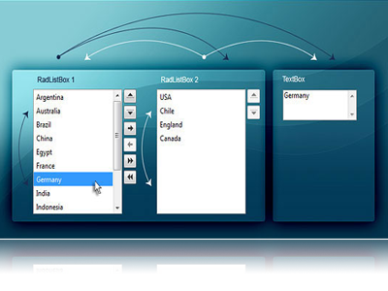
Binding List Controls
DisplayMemberPath and SelectedValuePath

Slide 8
Binding List Controls
List controls like ListBox and ComboBox display multiple items at a time
Can be bound to a collection in the ViewModel/DataContext
Can keep track of the current item
When binding the DisplayMemberPath specifies the property to be displayed
The SelectedValuePath specifies the property to be used as selected value (some ID)

Slide 9

DisplayMemberPath
If we want to show every object of the PhonesStore class and display one of its properties
The ListBox class provides the DisplayMemberPath property
<ListBox
ItemsSource="{Binding Phones}"
DisplayMemberPath="Model"
IsSynchronizedWithCurrentItem = "True"
/>

Slide 10
SelectedValuePath
The ItemsControl class provides a path to describe the selected value of a piece of data
Data which is often used when the selection changes or an item is double-clicked
<ListBox Name="ListBoxPeople" ItemsSource="{Binding}"
DisplayMemberPath="Name" SelectedValuePath="Age" />
private void ListBoxPeople_SelectionChanged(
object sender, SelectionChangedEventArgs e)
{
int index = ListBoxPerson.SelectedIndex;
if (index < 0) { return; }
Person item = (Person) ListBoxPerson.SelectedItem;
int value = (int) ListBoxPerson.SelectedValue; …
}

Slide 11
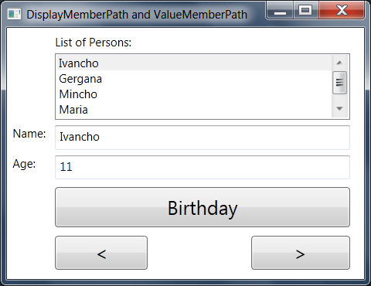
DisplayMemberPath and SelectedValuePath
Live Demo

Slide 12
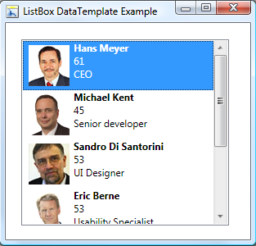
Using Data Templates

Slide 13
Using Data Templates
Data templates allow displaying more than one property from a custom class
A data template is a tree of elements to expand in a particular context
For example, for each Phone object, you might like to be able to concatenate the Vendor, Model and Year together
This is a logical template that looks like this
Year: Vendor Model

Slide 14
Using Data Templates (2)
To define this template for items in the ListBox, we create a DataTemplate element
<ListBox ItemsSource="{Binding}">
<ListBox.ItemTemplate>
<DataTemplate>
<TextBlock>
<TextBlock Text="{Binding Year}" />:
<TextBlock Text="{Binding Vendor}" />
<TextBlock Text="{Binding Model}" />
</TextBlock>
</DataTemplate>
</ListBox.ItemTemplate>
</ListBox>

Slide 15
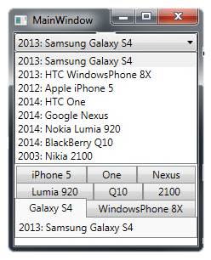
Using Data Templates (2)
The ListBox control has an ItemTemplate property
Accepts an instance of the DataTemplate class
The ListBox shows all the items in the collection

Slide 16
Using Data Templates
Live Demo

Slide 17
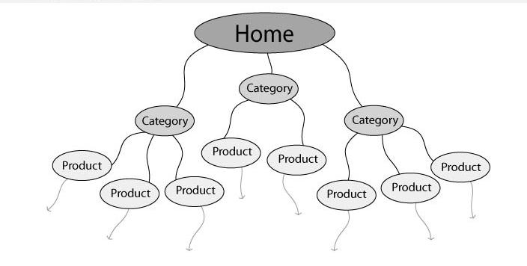
Hierarchical Binding

Slide 18
Hierarchical Binding
Hierarchical binding generally involves some number of levels, unknown until runtime
E.g. a tree of items, each with few child items
Control that can expand itself as appropriate, like a menu or a tree needs hierarchical binding
WPF has built-in support for hierarchical binding using a special kind of data template
Knows both how to display the current level of data and where to go for the next level

Slide 19

Hierarchical Binding (2)
Binding a TreeView control’s root item
Provide a data template
<DataTemplate DataType="{x:Type local:Family}">
<TextBlock Text="{Binding Path=FamilyName}" />
</DataTemplate>
</Window.Resources>
…
<TreeView DataContext="{StaticResource Families}">
<TreeViewItem ItemsSource="{Binding}"
Header="Families" />
</TreeView>

Slide 20
Hierarchical Binding (3)
HierarchicalDataTemplate element
Provides the ItemsSource property so that the tree can keep digging into the data
<HierarchicalDataTemplate DataType="{x:Type local:Family}"
ItemsSource="{Binding Path=Members}">
<TextBlock Text="{Binding Path=FamilyName}" />
</HierarchicalDataTemplate>
<HierarchicalDataTemplate DataType="{x:Type local:Person}"
ItemsSource="{Binding Path=Traits}">
<TextBlock>
<TextBlock Text="{Binding Path=Name}" />
(age: <TextBlock Text="{Binding Path=Age}" />)
</TextBlock>
</HierarchicalDataTemplate>

Slide 21
Hierarchical Binding
Live Demo

Slide 22


Complex Data Binding
Binding to a Collection of Items

Slide 23
Complex Binding
XAML provides a way to bind non-list controls to collection of objects
i.e. bind TextBox.Text to a collection of phones
<Grid DataContext="{Binding Phones}">
<TextBox Text="{Binding Vendor" />
<TextBox Text="{Binding Model" />
<TextBox Text="{Binding Year" />
</Grid>
This binds to the first item (the CurrentItem) from the collection

Slide 24


Complex Data Binding
Live Demo

Slide 25

Accessing the "Current Item"

Slide 26
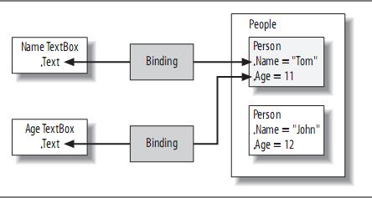
Accessing the "Current Item"
The text box properties can be bound to only a single object at a time
The binding engine is giving them the current item in the list of objects

Slide 27
Accessing the "Current Item"
Collection view in WPF
A mediator between the data bound control and the collection of items
Accessed through CollectionViewSource
The job of the collection view is to provide services on top of the data
Control of the current item
Sorting
Filtering
Grouping

Slide 28
Navigating Between Items
We can change which item is current
Using the MoveCurrentTo(…) methods of the ICollectionView interface
ICollectionView GetDefaultView<T>(IEnumerable<T> items)
{
return CollectionViewSource.GetDefaultView(items);
}
public void Next()
{
var view = this.GetDefaultView(this.Phones);
view.MoveCurrentToNext();
if (view.IsCurrentAfterLast)
{
view.MoveCurrentToLast();
}
}

Slide 29

Navigating Between Items
Live Demo

Slide 30
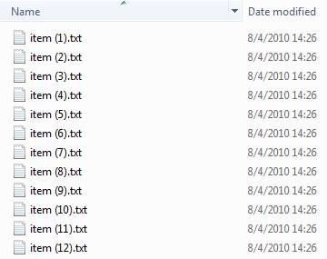

Sorting Items

Slide 31
Sorting Items
The view allows us to do a number of things to the data before it’s displayed
Including changing the order in which the data is shown
The simplest way to sort is by manipulating the SortDescriptions property of the view
Also we can provide the view with a custom sorting by implementing IComparer

Slide 32
Sorting Items (2)
Sorting items view in WPF:
public void Sort()
{
var view = this.GetDefaultView(this.Phones);
if (view.SortDescriptions.Count == 0)
{
view.SortDescriptions.Add(
new SortDescription("Vendor",
ListSortDirection.Ascending));
view.SortDescriptions.Add(
new SortDescription("Model",
ListSortDirection.Ascending));
}
else { view.SortDescriptions.Clear(); }
}

Slide 33

Sorting Items
Live Demo

Slide 34
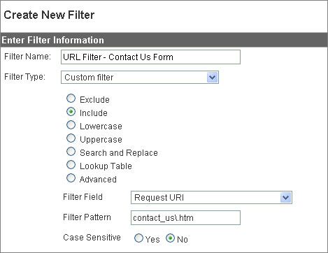
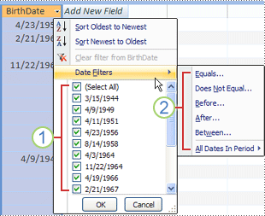
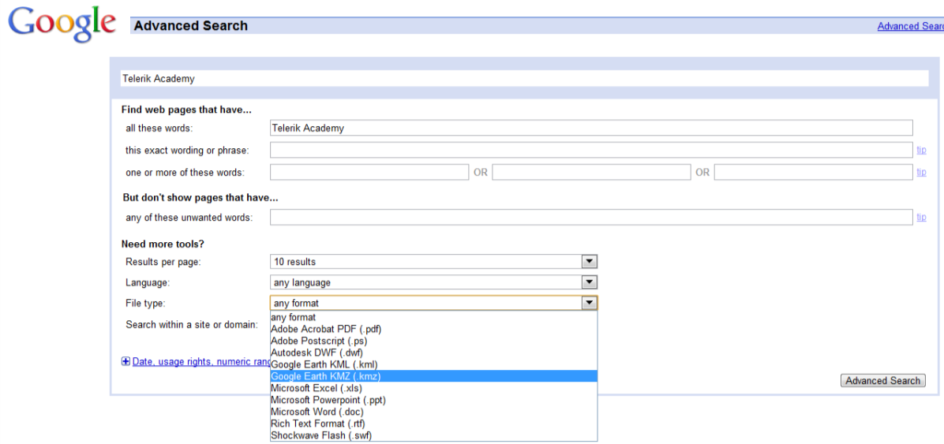
Filtering

Slide 35
Filtering
If we want to filter the objects from the view by some criteria
We need to feed the view an implementation of the Predicate<object> delegate
Takes a single object parameter and returns a Boolean
private void buttonFilter_Click(object sender,
RoutedEventArgs e)
{
ICollectionView view = GetFamilyView();
// the example continues

Slide 36
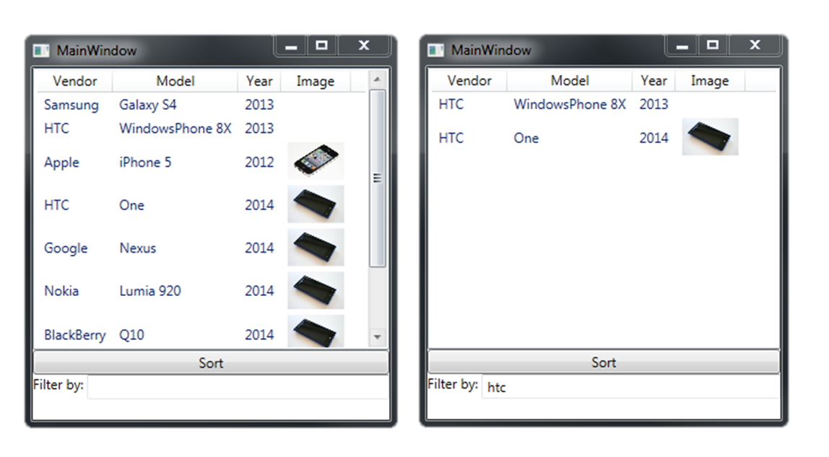
Filtering (2)
Filters phones by a math in the vendor or model
public void Filter(string filterText)
{
var view = this.GetDefaultView(this.Phones);
if (filterText == string.Empty) view.Filter = null;
else
{
view.Filter = (item) =>
{
var phoneItem = item as PhoneViewModel;
return phoneItem.Vendor.Contains(filterText) ||
phoneItem.Model.Contains(filterText);
};
}
}

Slide 37
Filtering Items
Live Demo

Slide 38

Grouping

Slide 39
Grouping
To set up grouping
Establish the groups you would like to use
Manipulating the GroupDescriptions collection on your view
if (view.GroupDescriptions.Count == 0)
{
view.GroupDescriptions.Add(
new PropertyGroupDescription("Year"));
}
else
{
view.GroupDescriptions.Clear();
}

Slide 40
Grouping (2)
The PropertyGroupDescription object
Takes the name of the property you would like to use for grouping
GroupStyle
Collection of group visualization related information
<ListBox … ItemsSource="{Binding}" >
<ListBox.GroupStyle>
<x:Static Member="GroupStyle.Default" />
</ListBox.GroupStyle>
</ListBox>

Slide 41
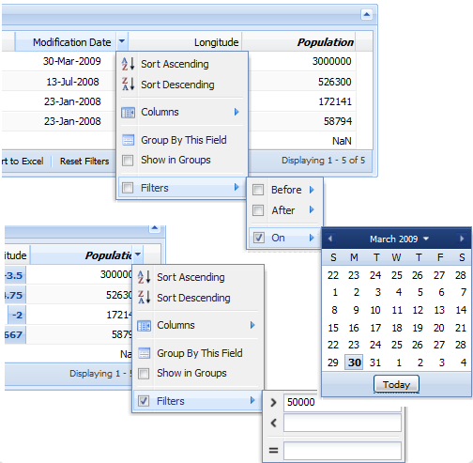
Grouping
Live Demo

Slide 42
Complex and List Data-binding
http://academy.telerik.com

Slide 43
Exercises
Write a program to manage a simple system with information about towns and countries. Each country is described by name, language, national flag and list of towns. Each town is described by name, population and country. You should create navigation over the towns and countries. Enable editing the information about them. Don't use list controls but only text boxes and simple binding
Rewrite the previous exercise using list controls.

Slide 44
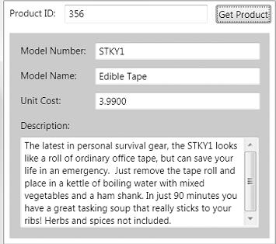
Exercises (2)
Create a database with two tables – Categories and Products. Each category has category name. Each product has category, model number, model name, unit cost, and description. Consider the simple window look like the screenshot below:
Design a form to view products by ID and bind all controls to their relevant columns from the database tables.

