Slide 1





Data Binding
Data Binding, Binding Properties
Svetlin Nakov
Manager Technical Training
www.nakov.com
Telerik Software Academy
http://academy.telerik.com

Slide 2
Table of Contents
Why We Need Data Binding?
Simple Binding
Binding a Control Property to Object Property
Data Contexts
Binding Class and its Properties
Binding Control to Another Control
Value Conversion
Data Validation
Using Relative Sources
Using Update Source Triggers

Slide 3


Why We Need Data Binding?

Slide 4
Why We Need Data Binding?
The purpose of most applications is to:
Display data to users
Let them edit that data
Developers' job is:
Bring the data from a variety of sources
Expose the data in object, hierarchical, or relational format
With WPF’s data binding engine, you get more features with less code

Slide 5
Why We Need Data Binding? (2)
Data binding is pulling information out of an object into another object or property
Data binding means automatically change the value of a property when the value of another property is changed
Many Windows applications are all about data
Data binding is a top concern in a user interface technologies like WPF or Silverlight
WPF and Silverlight provide very powerful data binding mechanisms

Slide 6


Simple Binding

Slide 7
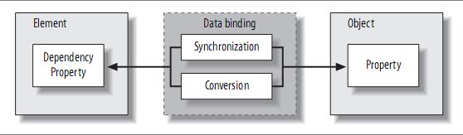
Simple Binding
Binding in WPF and Silverlight is the act of registering two properties with the data binding engine
Letting the engine keep them synchronized
The synchronization and conversion are duties of the data binding engine in WPF

Slide 8
Simple Binding (2)
Binding a property to a data source property:
The shorthand binding syntax:
Binding between the Text property of the TextBox and an object called SomeName
SomeName is a property of some object to be named later
<TextBox ...>
<TextBox.Text>
<Binding Path="SomeName" />
</TextBox.Text>
</TextBox>
<TextBox Text="{Binding Path=SomeName}" />

Slide 9
Data Contexts

Slide 10
Data Contexts
In XAML every FrameworkElement and every FrameworkContentElement has a DataContext property
DataContext is an object used as data source during the binding, addressed by binding Path
If you don’t specify a Source property
The XAML binding engine goes up the element tree in searching of a DataContext

Slide 11
Data Contexts (2)
Two controls with the same logical parent can bind to the same data source
Providing a DataContext value for both of the text box controls
<!-- DataContextWindow.xaml -->
<Grid Name="GridMain">
…
<TextBlock …>Name: </TextBlock>
<TextBox Text="{Binding Path=Name}" … />
<TextBlock …>Age:</TextBlock>
<TextBox Text="{Binding Path=Age}" … />
<Button Name="ButtonBirthday Content="Birthday!" … />
</Grid>

Slide 12
Data Contexts (3)
Setting an object as a value of the grid’s DataContext property in the MainWindow constructor:
public partial class MainWindow : Window
{
Person person = new Person("Tom", 11);
public MainWindow()
{
InitializeComponent();
GridMain.DataContext = person;
}
…
}

Slide 13



Data Contexts
Live Demo

Slide 14

Binding to Other Controls

Slide 15
Binding to Other Controls
WPF provides binding of one element’s property to another element’s property
The button’s foreground brush will always follow foreground brush’s color of the age TextBox
<TextBox Name="ageTextBox" Foreground="Red" … />
<Button …
Foreground="{Binding ElementName=ageTextBox,
Path=Foreground}" Content="Birthday" />

Slide 16

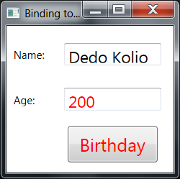
Binding to Other Controls
Live Demo

Slide 17
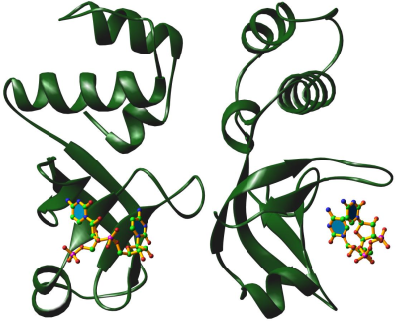


The Binding Class and Its Properties

Slide 18
Binding Class
A more full-featured binding example
This features are represent in Binding class
Converter – convert values back and forth from the data source
ConverterParameter – parameter passed to the IValueConverter methods during the conversion
<TextBox x:Name="TextBoxPerson"
Foreground="{Binding Path=Age, Mode=OneWay,
Source={StaticResource Tom},
Converter={StaticResource ageConverter}}" />

Slide 19
Binding Class (2)
More Binding class properties
ElementName – used when the source of the data is a UI element as well as the target
Mode – one of the BindingMode values TwoWay, OneWay, OneTime, OneWayToSource, or Default
Path – path to the data in the data source object
Source – a reference to the data source

Slide 20
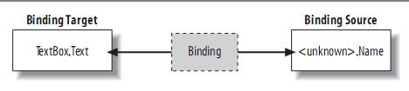
Binding Class (3)
The binding target can be any WPF element
Only allowed to bind to the element’s dependency properties
The TextBox control is the binding target
Object that provides the data is the binding source

Slide 21

Value Conversion

Slide 22
Value Conversion
In the previous example we might decide that anyone over age 25 is hot
Should be marked in the UI as red
Binding to a non-Text property
Bound the age text box’s Text property to the Person object’s Age property
<TextBox
Text="{Binding Path=Age}"
Foreground="{Binding Path=Age, …}" … />

Slide 23
Value Conversion (2)
How to bind the Foreground property of the text box to Age property on the Person object?
The Age is of type Int32 and Foreground is of type Brush
Mapping from Int32 to Brush needs to be applied to the data binding from Age to Foreground
That’s the job of a ValueConverter

Slide 24
Value Conversion (3)
A value converter is an implementation of the IValueConverter interface
Convert() – converting from the source data to the target UI data
ConvertBack() – convert back from the UI data to the source data

Slide 25
Value Conversion (4)
Converter Int32 → Brush
public class AgeToForegroundConverter : IValueConverter
{
public object Convert(object value,
Type targetType, …)
{
if (targetType != typeof(Brush))
{
return null;
}
int age = int.Parse(value.ToString());
return (age > 25 ? Brushes.Red : Brushes.Black);
}
…
}

Slide 26
Value Conversion (4)
Creating an instance of the converter class in the XAML:
<Window … xmlns:local="clr-namespace:WithBinding">
<Window.Resources>
<local:Person x:Key="Tom" … />
<local:AgeToForegroundConverter x:Key="ageConverter"/>
</Window.Resources>
<Grid DataContext="{StaticResource Tom}"> …
<TextBox
Text="{Binding Path=Age}"
Foreground="{Binding Path=Age,
Converter={StaticResource ageConverter}}" … /> …
<Button … Foreground="{Binding Path=Foreground,
ElementName=ageTextBox}">Birthday</Button>
</Grid>
</Window>

Slide 27
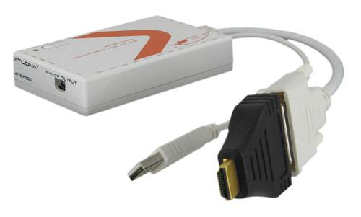
Value Conversion
Live Demo

Slide 28




Data Validation

Slide 29
Data Validation
A validation validates a piece of data in the target when the binding occurs
Derives from the base ValidationRule class
class EGNValidationRule : ValidationRule
{
public override ValidationResult Validate(
object value, CultureInfo cultureInfo)
{
if (Regex.IsMatch((string)value, "\A\d{10}\Z"))
return new ValidationResult(true, null);
else
return new ValidationResult(false, "Invalid EGN");
}
}

Slide 30
Data Validation (2)
When a validation result indicates invalid data, a ValidationError object is created
Checking for errors:
Getting the error messages:
You can also listen to the ValidationError attached event
Validation.GetHasError(UIElement)
var errors = Validation.GetErrors(UIElement);
string errorMsg = (string)errors[0].ErrorContent;

Slide 31
Data Validation (3)
Enabling validation rules in the XAML:
<Window x:Class="BindingValidation.MainWindow"
…
xmlns:local="clr-namespace:BindingValidation" />
…
<TextBox Name="TextBoxEGN">
<TextBox.Text>
<Binding Path="EGN">
<Binding.ValidationRules>
<local:EGNValidationRule />
</Binding.ValidationRules>
</Binding>
</TextBox.Text>
</TextBox>
…
</Window>

Slide 32
Data Validation (4)
Styling the UI controls containing an error:
<Window.Resources>
<Style TargetType="{x:Type TextBox}">
<Setter Property="Validation.ErrorTemplate">
<Setter.Value>
<ControlTemplate>
<WrapPanel>
<Border BorderBrush="Red">
<AdornedElementPlaceholder/>
</Border>
<TextBlock Foreground="Red">!</TextBlock>
</WrapPanel>
</ControlTemplate>
</Setter.Value>
</Setter>
</Style>
</Window.Resources>

Slide 33

Binding Path Syntax

Slide 34
Binding Path Syntax
When you use Path=Something in a Binding statement, the Something can be in a number of formats
Path=Property – bind to the property of the current object (Path=Age)
Path=(OwnerType.AttachedProperty) – bind to an attached dependency property (Path=(Validation.HasError))
Path=Property.SubProperty – bind to a subproperty (Path=Name.Length)

Slide 35
Binding Path Syntax (2)
Other formats
Path=Property[n] – bind to an indexer (Path=Names[0])
Path=Property/Property – master-detail binding (Path=Customers/Orders)
Path=(OwnerType.AttachedProperty)[n].SubProperty – bind to a mixture of properties, subproperties, and indexers
Path=(Validation.Errors)[0].ErrorContent)

Slide 36

Update Source Triggers

Slide 37
Update Source Triggers
In previous example validation doesn’t happen until the age text box loses focus
Validation can happen immediately when the control state changes
Using the UpdateSourceTrigger property on the Binding object
<TextBox …>
<TextBox.Text>
<Binding Path="Age"
UpdateSourceTrigger="PropertyChanged"> …
</Binding>
</TextBox.Text>
</TextBox>

Slide 38
Update Source Triggers
UpdateSourceTrigger values
Default – updates "naturally" based on the target control
PropertyChanged – updates the source immediately
LostFocus – updates the source when focus changes
Explicit – when BindingExpression. UpdateSource() is explicitly called

Slide 39
Data Binding
?
?
?
?
?
Questions?
?
?
?
?
?
http://academy.telerik.com

Slide 40
Exercises
Write a program that show a simple window, it contains two controls a Slider and a TextBlock with a single line of text. If you pull the thumb in the slider to the right, the font size of the text is increased immediately. Add a label that shows the current font size. Use data binding.
Add to the previous exercise few buttons each of which applies a preset value to the slider. When you click the "Set to Large" button the code in Click event sets the value of the slider, which in turn forces a change to the font size of the text through data binding.

Slide 41
Exercises (2)
Write a program that shows a simple window, which contains a TextBlock and setup the TextBlock to draw its text from a TextBox and its current foreground and background colors from separate lists of colors.
Create an application to enter person's name and age. Bind the person's age with a slider showing the range [1..100]. Add custom validation rules to make sure that person’s age is within a the range (derive from the ValidationRule class and override the Validate() method).

